Slide 1
NOMINAL // SPACECRAFT DEV & OPS
From TVAC to orbit.
One data platform across the spacecraft lifecycle — integration & test, software upgrades, commissioning, fleet operations, and anomaly response.
Live demo environment: 25-satellite GOCE constellation · app.gov.nominal.io

Slide 2
THE PITCH / BREADTH
Everything between the chamber and the constellation
01
02
03
04
05
Integration & test
Software & FSW
Commissioning
Fleet operations
Anomaly response
TVAC, EMI, bench DAQ — campaign data lands next to flight data, forever queryable
Upgrade campaigns — trend behavior before vs after, across every satellite
Checkout runs, automated data reviews, review-by-exception
Live limits, alerting to Slack/paging, durable events on the asset timeline
RCA workbooks, run comparison, procedures that command and verify
Same channels, same limits, same workflows at every stage — nothing gets rebuilt between phases.
NOMINAL / 02

Slide 3
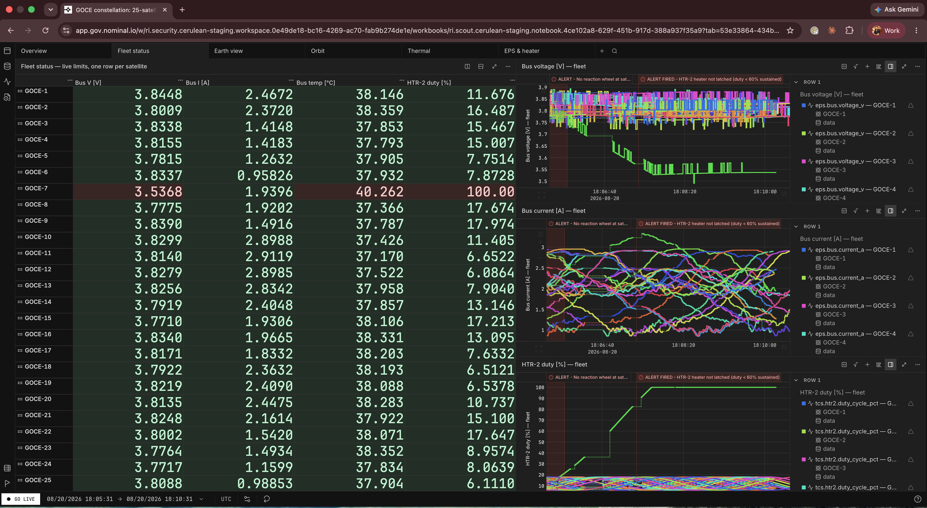
01 / FLEET MONITORING
A constellation on one screen
25 satellites, one live workbook — every asset filters a shared stream by tag. Satellite 26 is a config change, not a new dashboard.
Limits color the board, page Slack, and land as durable events on the asset — nobody has to be watching.
The heater latch-up on GOCE-7 was caught here: green to red in under two minutes.
NOMINAL / 03

Slide 4
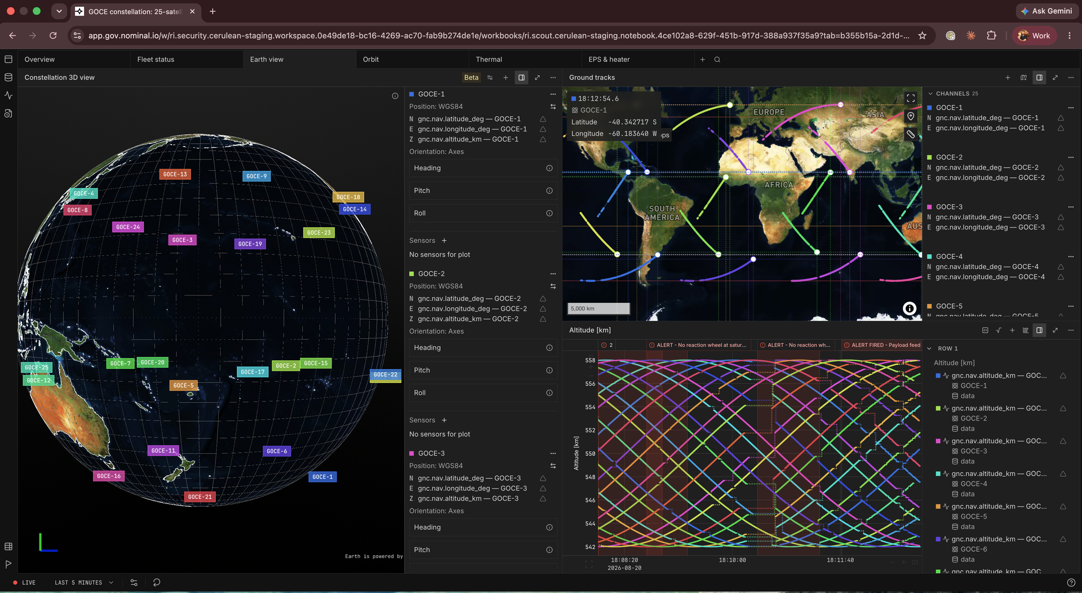
02 / SITUATIONAL AWARENESS
Ground tracks, globe, and stations — live
Live 2D ground tracks and 3D constellation view, driven by the same nav channels your MOC consumes.
Ground-station network drawn on every map — the same stations the commanding procedure uses later.
Nominal is the analysis and process layer on top of your existing stack — not a replacement for it.
NOMINAL / 04

Slide 5
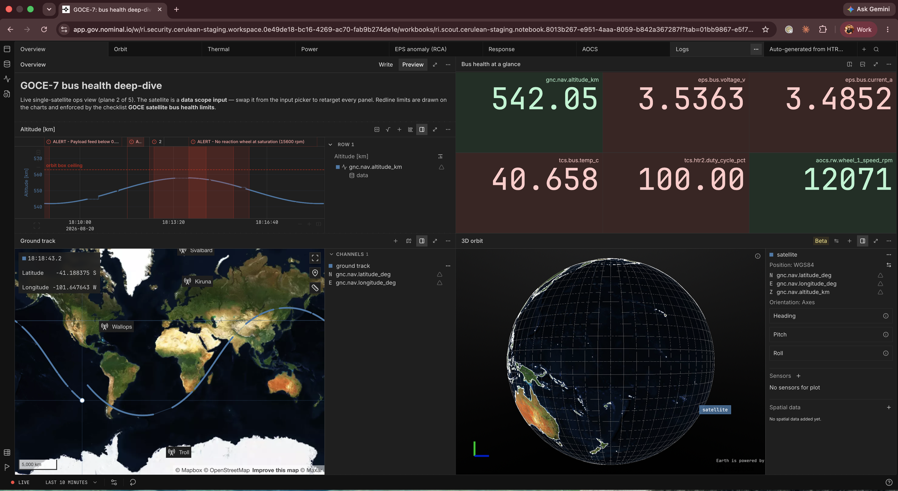
03 / ROOT-CAUSE ANALYSIS
From alert to physics in minutes
Logs and numeric telemetry side by side — no separate log-aggregator hop during triage.
Derive what isn't telemetered, live: bus power (V × I), then a Stefan–Boltzmann radiator-equilibrium check — proof the spacecraft physically cannot reject the extra heat.
Saved derivations are shared — the next engineer inherits the analysis, not a screenshot.
NOMINAL / 05

Slide 6
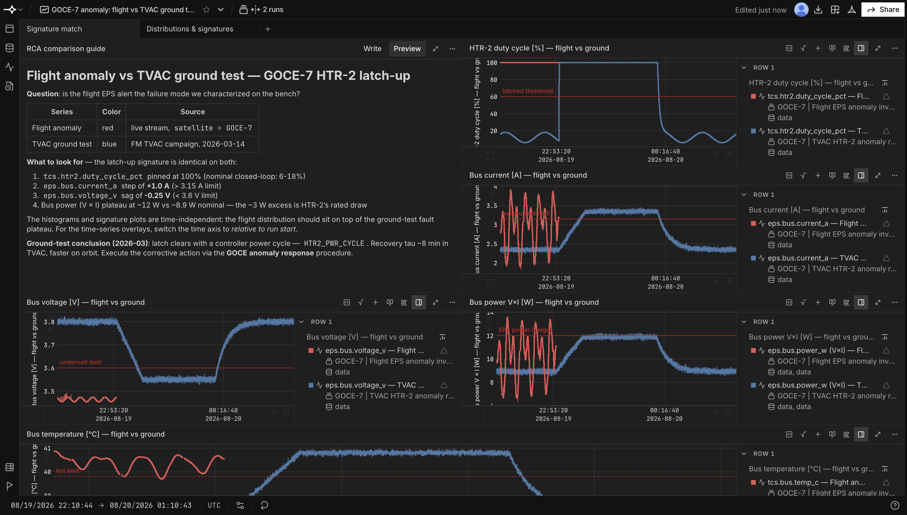
04 / TEST ↔ FLIGHT
Your test campaign never retires
A March TVAC bench replication overlaid on an August flight anomaly: identical signature — the answer was already in the archive.
Time-independent signature plots (V–I, duty–power) overlay bench and flight with zero timestamp gymnastics.
The same limit checklist executes against live streams and archived runs alike.
NOMINAL / 06

Slide 7
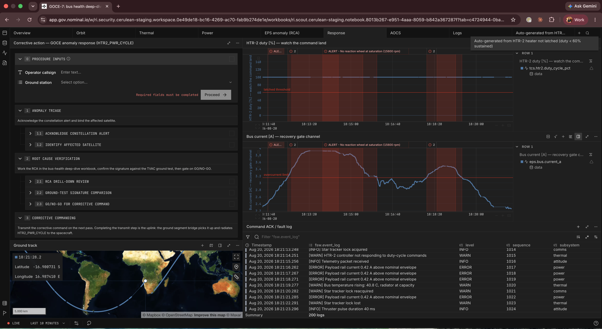
05 / PROCEDURES & COMMANDING
Command it — telemetry closes the loop
The anomaly-response procedure runs embedded beside live telemetry; every step lands as an event — GO/NO-GO accountability for free.
Completing the transmit step fires a webhook to the ground segment — Nominal drives your qualified commanding stack, it doesn't pretend to be one.
The recovery gate is channel-validated: the spacecraft, not the operator, closes the step.
NOMINAL / 07

Slide 8
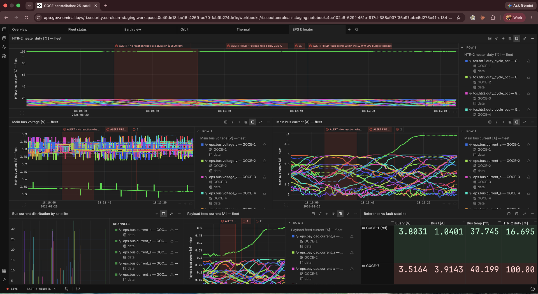
06 / FLEET ENGINEERING
Trend any subsystem across the fleet
Per-satellite overlays and distributions for every channel — spot the outlier bird at a glance.
Reference-vs-anomaly tables quantify exactly how far off-family a spacecraft is.
The backbone for software-upgrade campaigns: compare behavior before and after, across all birds at once.
NOMINAL / 08

Slide 9
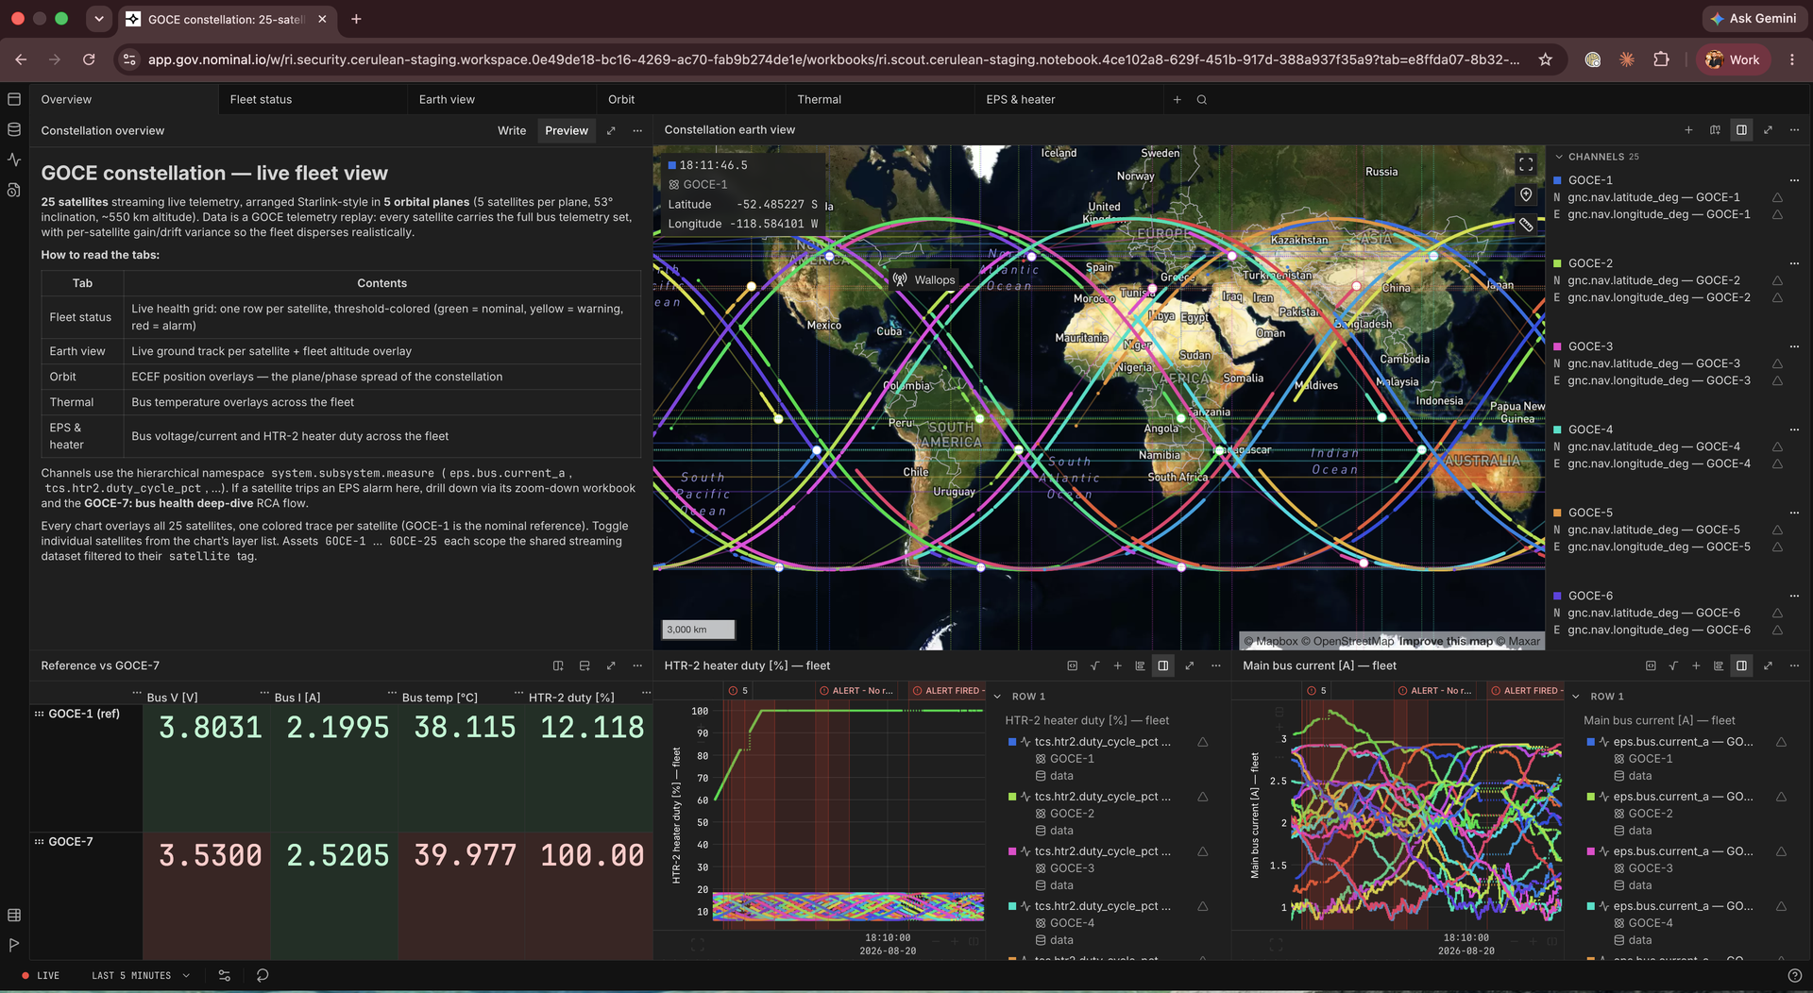
CLOSE
One platform.
Bench to orbit.
Everything shown was created through the public API — whatever we didn't build, you can.
Checklists and procedures are versioned like code — limit changes are deliberate, reviewed, published.
The asset timeline is the anomaly record: alert → GO → command → ACK → verified recovery.
nominal.io
NOMINAL / 09

