Slide 1
The ETL process: Introduction to Transforming Data
ACCTG 522
Data Analytics for Professional Accountants
MPAcc Class of 2027
Class 05 | Autumn | 2026

Slide 2
Agenda
Review
SQL check-in
Class Exercises on Joining, Cleaning, and Transforming Data
  PowerBI approaches
  Automated SQL approaches
Conclusion & Look Ahead

Slide 3
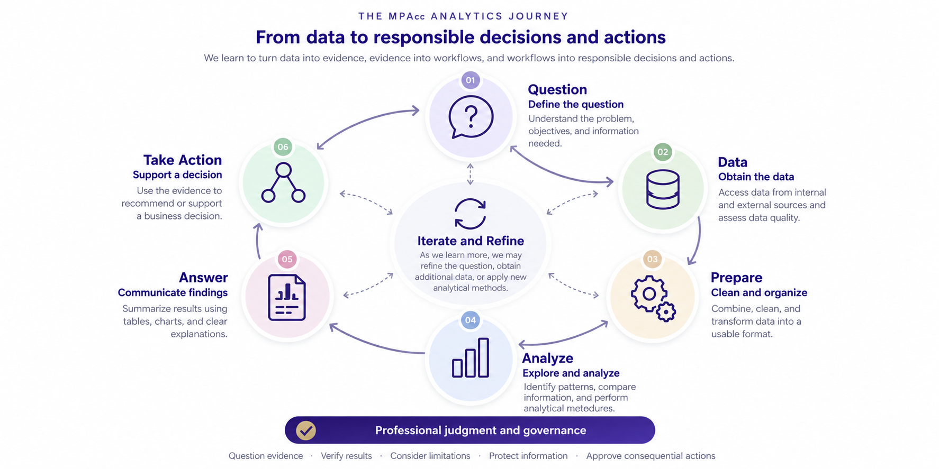

Slide 4
Review
Today's key takeaway: Understanding how data are connected is essential to producing reliable analytical evidence.
Tools like Power BI make relational data useful. Relationships, transformations, and visualizations allow us to explore data without always combining everything into one table.
SQL allows us to query relational data. We can select, filter, join, and aggregate records to answer accounting and business questions.

Slide 5
How do Power BI relationships work?
ChartOfAccounts
JELineItems
1
GLAccountNumber
JENumber
GLAccountName
*
GLAccountNumber
BusinessUnitID
*
Amount
BusinessUnits
1
BusinessUnitID
BusinessUnit
* = many 1 = one

Slide 6
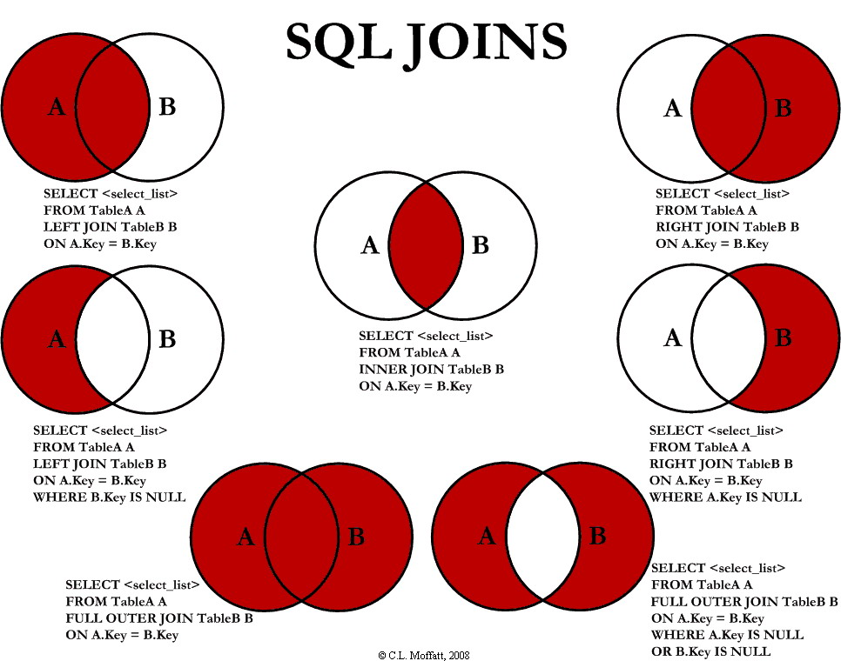

Slide 7
Agenda
Review
SQL check-in
Class Exercises on Joining, Cleaning, and Transforming Data
  PowerBI approaches
  Automated SQL approaches
Conclusion & Look Ahead

Slide 8
Agenda
Review
SQL check-in
Class Exercises on Joining, Cleaning, and Transforming Data
  PowerBI approaches
  Automated SQL approaches
Conclusion & Look Ahead

Slide 9
Remote labs
Use git pull to extract data from the class github.

Slide 10
Agenda
Review
SQL check-in
Class Exercises on Joining, Cleaning, and Transforming Data
  PowerBI approaches
  Automated SQL approaches
Conclusion & Look Ahead

Slide 12
Summary
Today's key takeaway: Understanding how raw data is delivered and how we transform it is essential to producing reliable analytical evidence and automating repetitive workflows.
Once a process is understood, automating that process reliably becomes possible.
Workflows that are repetitive are good candidates for automation, tools like sqlite and powerBI (among many others) provide automation possibilities.

Slide 13
Next steps
Next topic: The ETL Process: Advanced Data Transformations
A Core Data Analytic Skill, advanced approaches to transforming data using formulas and regular expressions to create the data we want
Develops data skills with Regular Expressions
We will use a combination of python and colabs / vscode, and online regex tools
Thank you!

