Slide 1
Individual RPA Workshop
Adv. Advisory | ACCTG 528 | Class 05
MPAcc Class of 2026

Slide 2

What will we do today?
Review of workflows
Submission overview:
Download your UiPath cloud file (.uip or .uis)
Submit to canvas and add commentary about the bot.
Workshop time

Slide 3
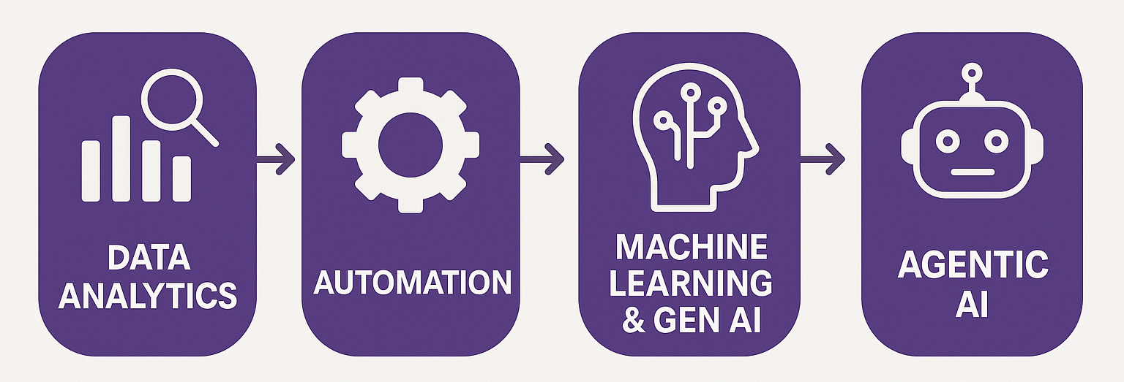
Course Diagram (high-level)

Slide 4




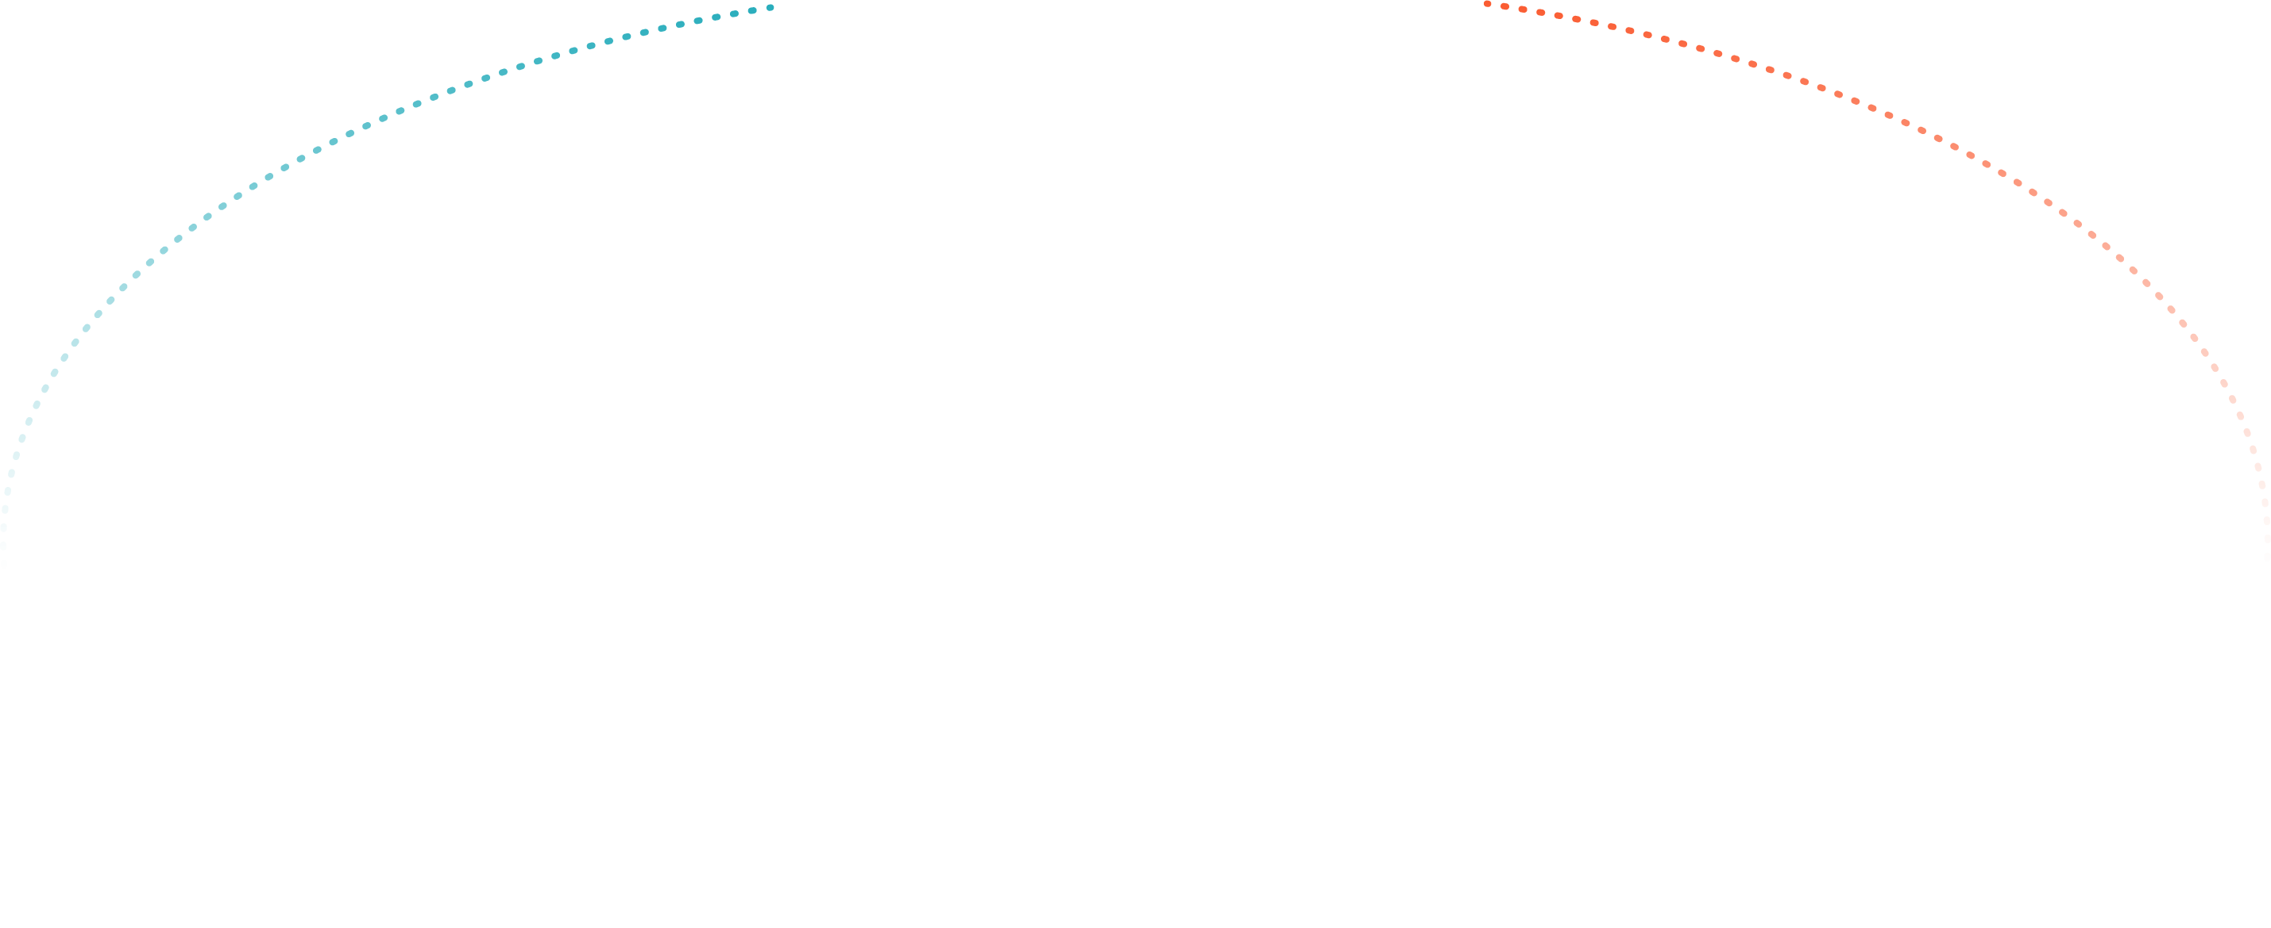




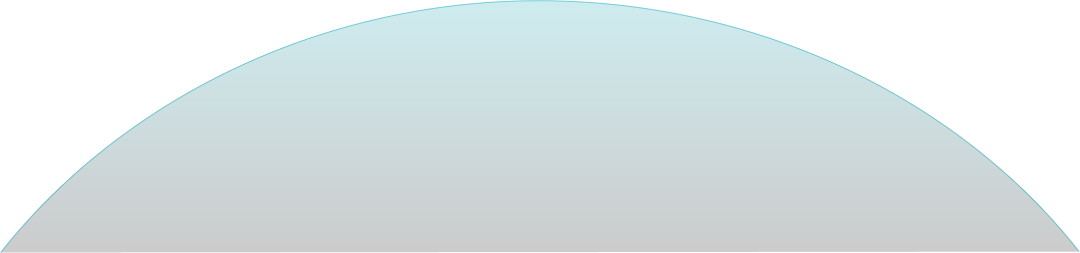

UiPath Agentic Automation
Notes:
Everything happens in one place: the UiPath Platform—where AI Agents aren’t just assistants, they’re true work partners, transforming complexity into a seamless, orchestrated operation.
We break it down into three powerful layers: Activities (the building blocks—reading, processing, integrating), Workflows (connecting the dots with human-in-the-loop and testing), and Processes (the big picture—managing, optimizing, and enhancing enterprise operations).
Agentic Orchestration / Maestro takes automation even further—coordinating UiPath Agents, third-party AI models, people, robots, and tools into a single, intelligent system.
Your existing systems don’t need to be reinvented—our platform integrates seamlessly with your data, applications, and workflows while maintaining enterprise-grade security, governance, and AI trust.
We’re not just compatible with your tech stack—we enhance it. From cloud providers like AWS, Google, and Azure to enterprise apps like Salesforce and SAP, we turn digital chaos into a symphony of efficiency.

Slide 5
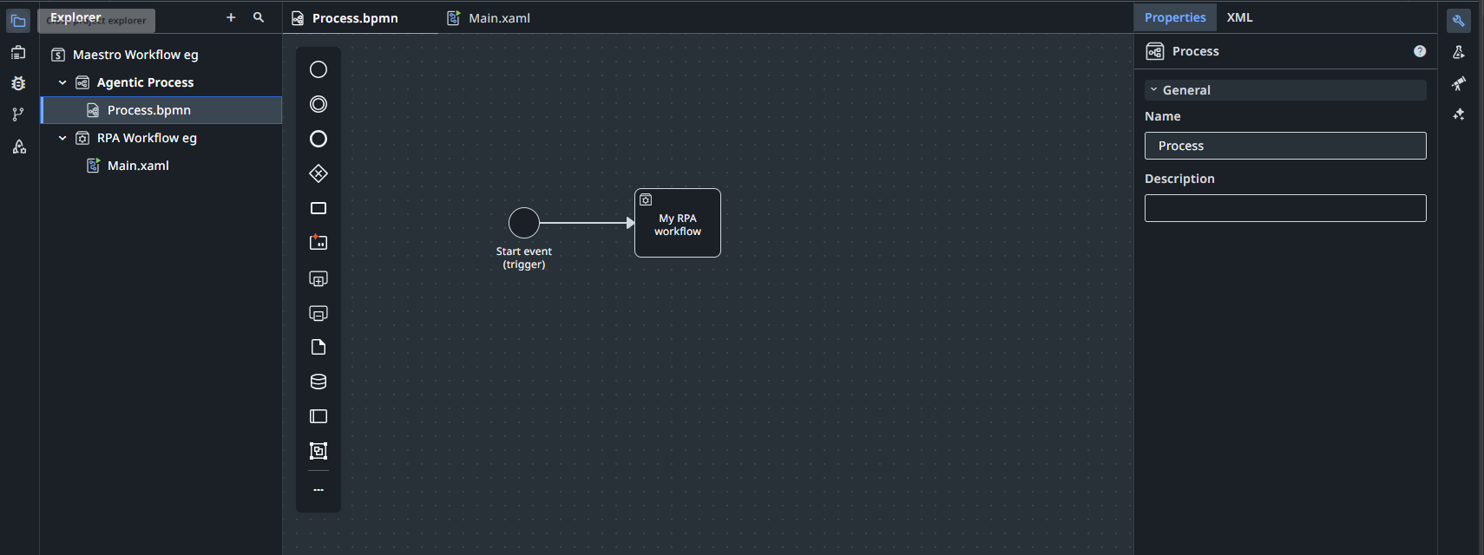
RPA Workflow (Studio)
Active overview
Triggers to start the workflow
Currently active view (Maestro)

Slide 6
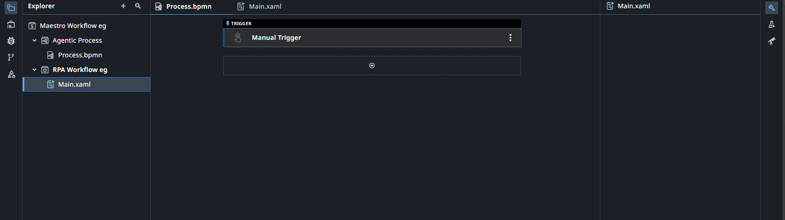
RPA Workflow (Studio)
Currently active view (Studio)

Slide 7
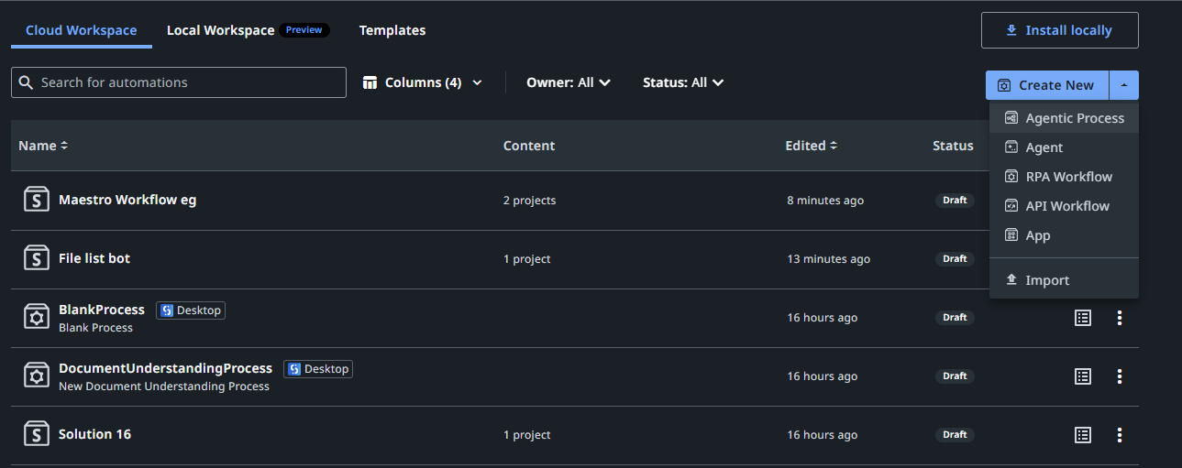

Slide 8
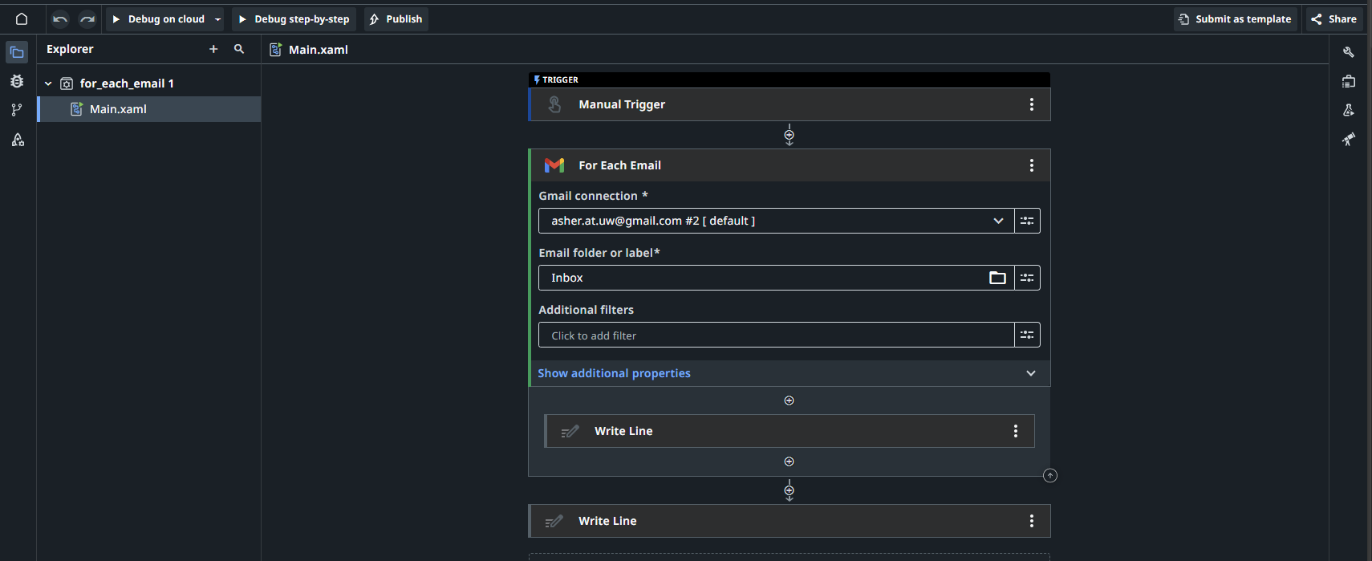
Outside the loop
The loop – all activities inside the boundary are in the loop

Slide 9
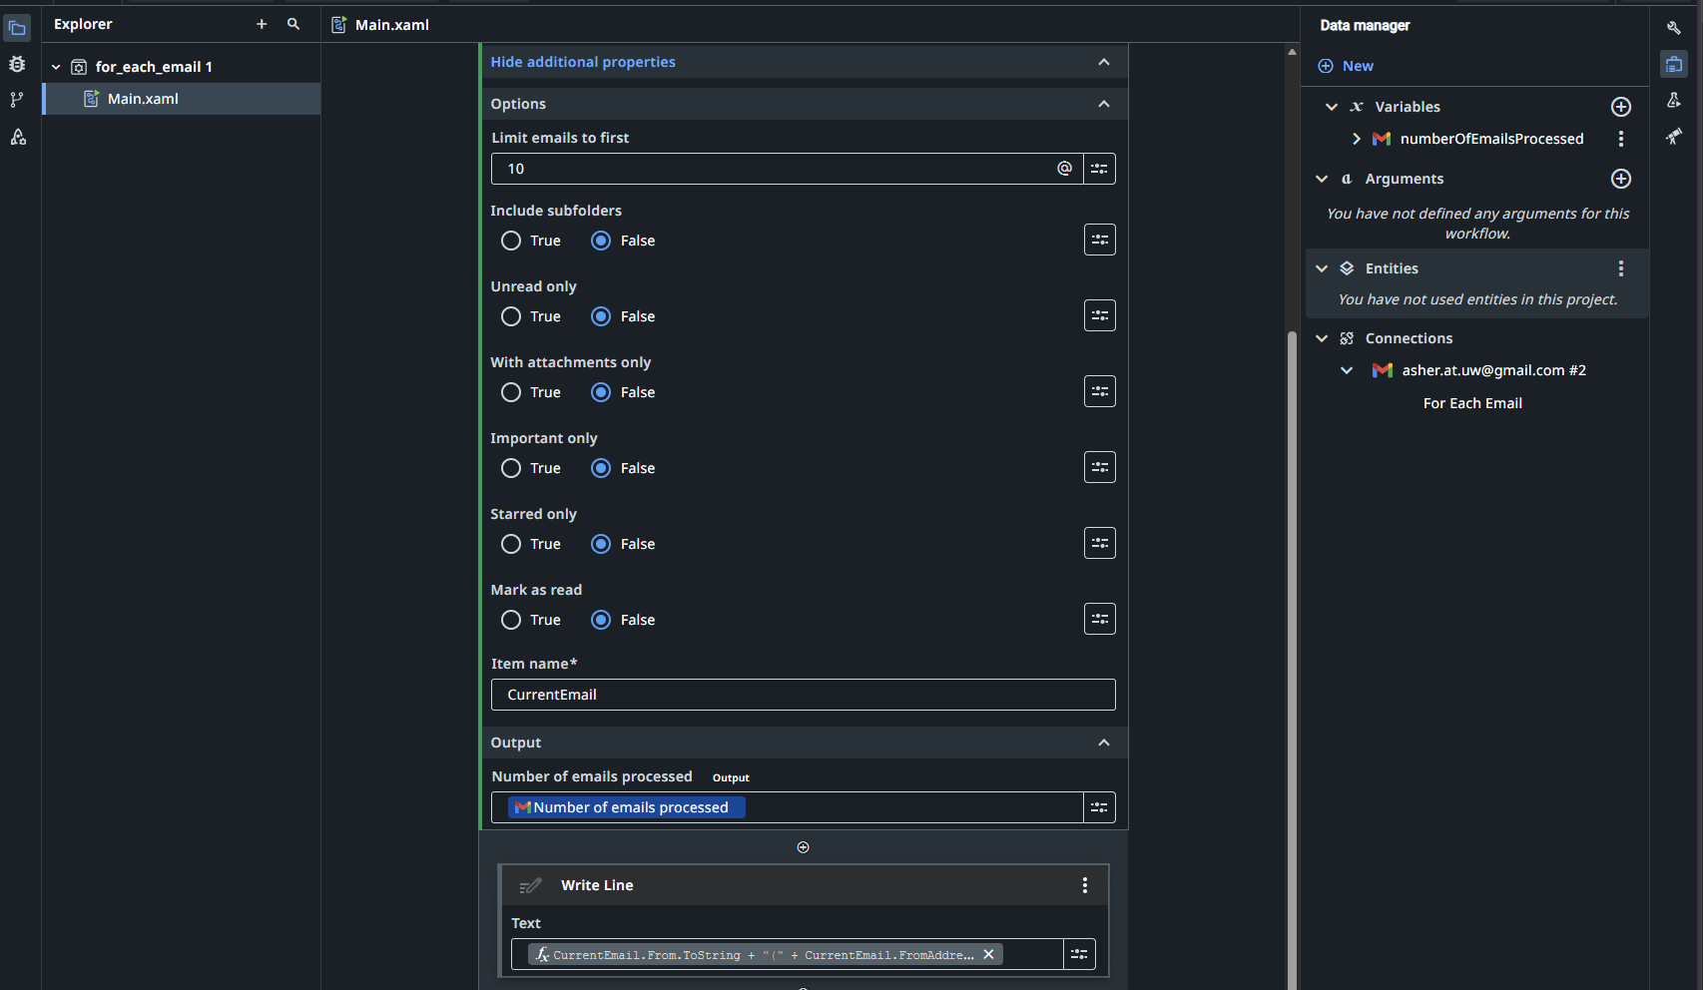
Inside the loop
Data manager (studio view)

Slide 10
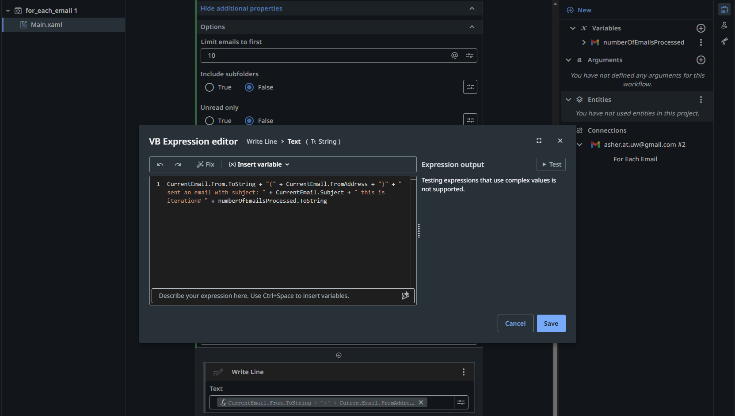
Expression editor

Slide 11
What will we do today?
Review of workflows
Submission overview:
Download your UiPath cloud file (.uip or .uis)
Submit to canvas and add commentary about the bot.
Workshop time

Slide 12
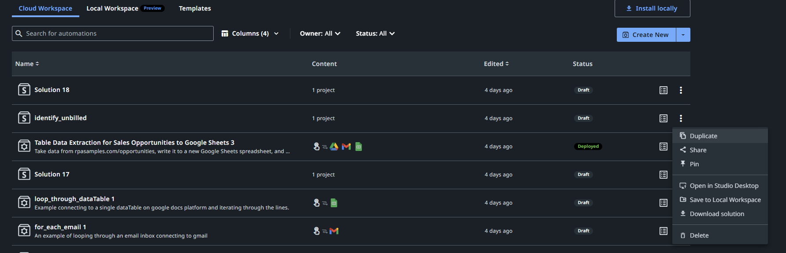
Saving the file for submission
1. Projects manager / Web Studio file menu
2. Download solution (look for a *.uip or *.uis file)

Slide 13
Submission overview: Canvas
Please submit a check-in copy of your RPA bot you have been working on in class (it is expected to be incomplete).
In the text field, please outline where you are hoping to get the bot to and what is working/not working at this point. If the bot is not working yet, that is fine. This is a check-in, not a final grade on this project. You are not required at this point to provide all the details on the RPA individual project, there is no need to discuss efficiency and effectiveness.
Feedback will include some comments on feasibility and where the bot will rank based on prior Individual RPA challenges and the work submitted by the class this year.
www.github.com/ashercurtis/robots.io

Slide 14
What will we do today?
Review of workflows
Submission overview:
Download your UiPath cloud file (.uip or .uis)
Submit to canvas and add commentary about the bot.
Workshop time

Slide 15
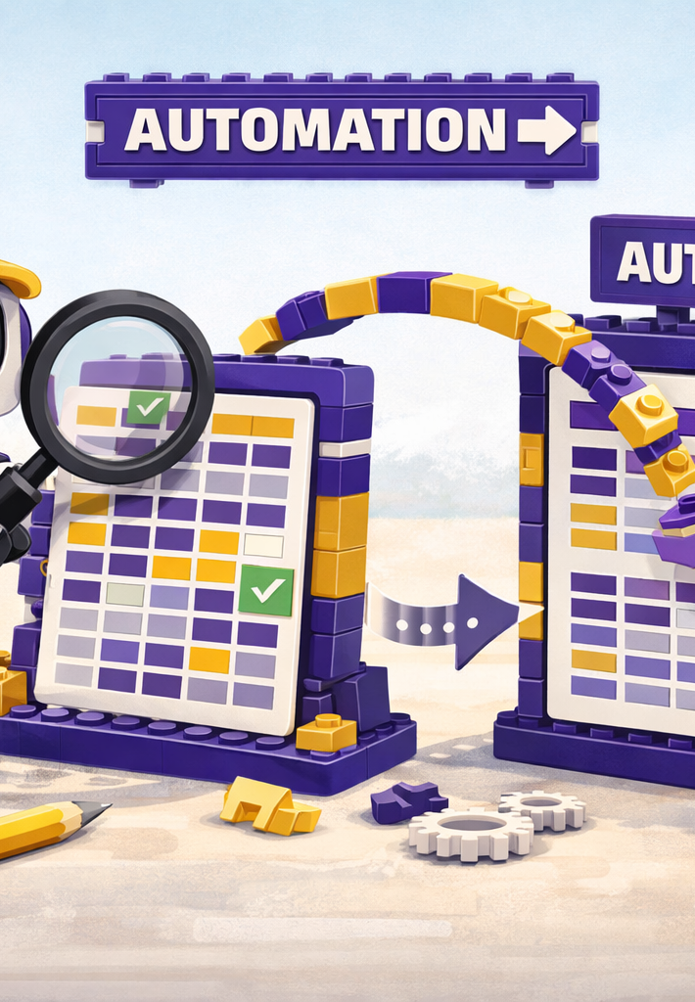
Where we will go next
Spreadsheets
BPMN revision and extension
Triggers
Controls
Costs and benefits of RPA
Selection of Tasks for RPA versus Agent
Manipulation of files

Slide 16
Thank you

