Slide 1
Individual RPA Workshop
Adv. Advisory | ACCTG 528 | Class 06
MPAcc Class of 2026

Slide 2

What will we do today?
Review of workflows
Submission overview:
Download your UiPath cloud file (.uip or .uis)
Submit to canvas and add commentary about the bot.
Workshop time

Slide 3
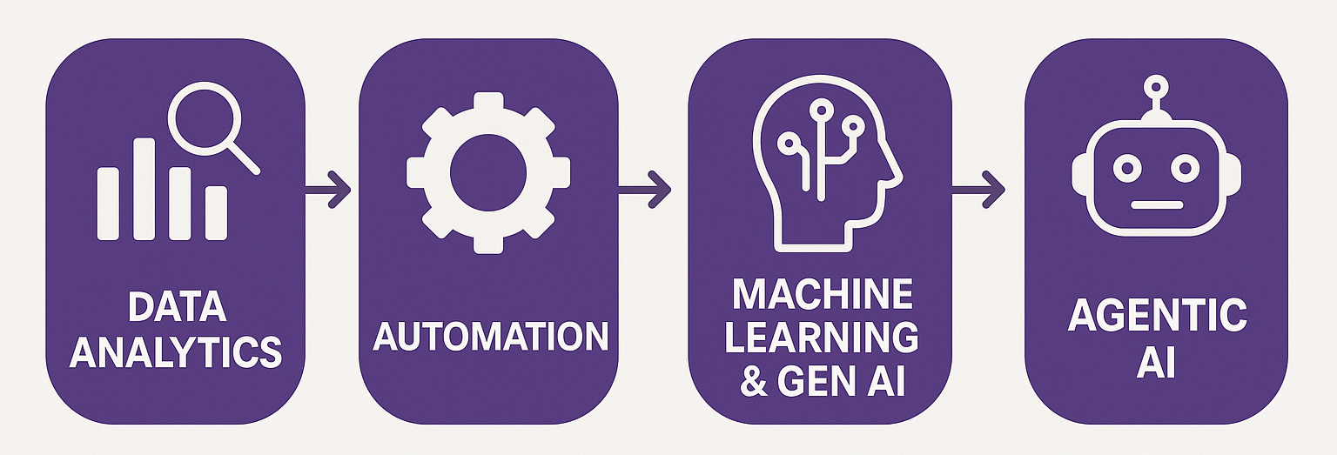
Course Diagram (high-level)

Slide 4











UiPath Agentic Automation
Notes:
Everything happens in one place: the UiPath Platform—where AI Agents aren’t just assistants, they’re true work partners, transforming complexity into a seamless, orchestrated operation.
We break it down into three powerful layers: Activities (the building blocks—reading, processing, integrating), Workflows (connecting the dots with human-in-the-loop and testing), and Processes (the big picture—managing, optimizing, and enhancing enterprise operations).
Agentic Orchestration / Maestro takes automation even further—coordinating UiPath Agents, third-party AI models, people, robots, and tools into a single, intelligent system.
Your existing systems don’t need to be reinvented—our platform integrates seamlessly with your data, applications, and workflows while maintaining enterprise-grade security, governance, and AI trust.
We’re not just compatible with your tech stack—we enhance it. From cloud providers like AWS, Google, and Azure to enterprise apps like Salesforce and SAP, we turn digital chaos into a symphony of efficiency.

Slide 5
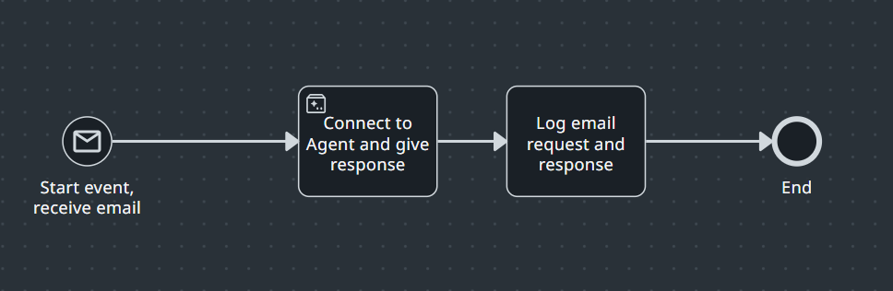
What is BPMN?
Business Process Model and Notation is a standardized graphical notation for modeling, documenting, and visualizing business processes clearly and consistently
Notes:
Business Process Model and Notation (BPMN) is a standardized graphical notation used for modeling, visualizing, and communicating business processes. It provides a clear, structured way of representing the sequence, flow, and logic of tasks within an organization or between different organizations. The primary objective of BPMN is to simplify process communication among stakeholders (such as business analysts, managers, and IT professionals) by providing a universally understood visual language.
BPMN consists of various symbols and notations, which fall into several core categories:
Events - show when things happen.
Activities - represent the work performed.
Gateways - manage the process flow and logic.
BPMN helps stakeholders visualize and understand the detailed flow of business processes clearly, facilitating analysis, improvement, and automation.
Let’s take them one by one.

Slide 6
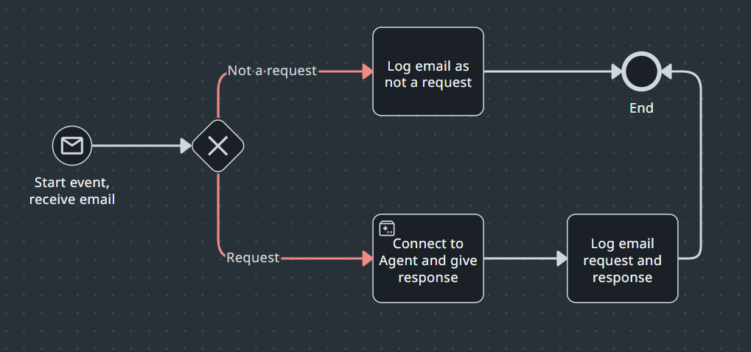
BPMN Example with Gateways

Slide 7
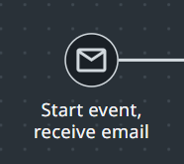
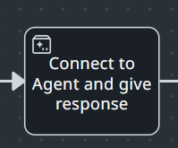
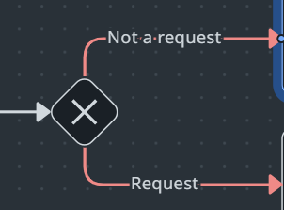
BPMN main set-up
BPMN consists of various symbols and notations, which fall into several core categories:
Events - show when things happen.
Activities - represent the work performed.
Gateways - manage the process flow and logic.

Slide 8














Events Things that happen during the process
 | Start |  |  | Intermediate |  |  |  | End
 | Standard | Subprocess interrupting | Subprocess non-interrupting | Catching | Boundary interrupting | Boundary non-interrupting | Throwing | Standard
Plain: Generic event with no visual indicators; used for start, end, or milestones.
Message: Represents external communication
Timer: Indicates a specific time or duration delay.
Use an event to show something that happens in the process.
Start with a start event, like when a customer submits an online order.
Add an intermediate event if something needs to wait or respond, like pausing for 3 days before sending a reminder email.
End with an end event, like sending an order confirmation to the customer.
Events help you mark the beginning, waiting points, and end of a process.
Notes:
Events represent things that happen during a process. They indicate the start, intermediate points, and end of a process.
Start Event (circle with thin outline):
Indicates the initiation or starting point of a process.
Example: "Order received“
Intermediate Event (circle with double outline):
Marks an occurrence during the process flow, often used for triggers, timers, messages, or conditions. An Intermediate Throwing Event indicates that something is happening between the start and end of a process. Intermediate Events affect the flow of a process, but do not start or directly terminate the process.
Example: "Wait for payment confirmation“
End Event (circle with thick outline):
Indicates the completion or final outcome of a process, and every process has at least one end event.
Example: "Order delivered successfully“
Events may have specific symbols inside them to further describe the type, such as:
Timer events ⏲️ (e.g., waiting until a certain date or period passes).
Message events 📩 (e.g., receiving or sending information).
Start & End Events best practices
Always include Start and End Events.
Represent alternative process initiations with separate Start Events.
Use distinct End Events for different outcomes.
Merge flows that lead to the same end state.

Slide 9
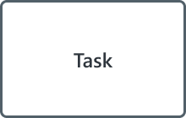
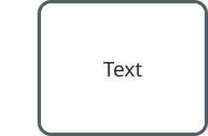

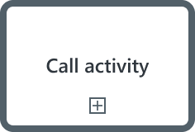
Activities Work that is performed in the process
Task: An action performed by a person or software within a process.
Subprocess: A group of related tasks bundled together into a single activity to make the main process easier to read.
Call activity: A wrapper that invokes another BPMN process (or global task) stored outside the current diagram.
Use activities when something (whether it’s an AI Agent, Robot, or Person) performs work. For example, packing items into a box is considered a task
Or when an agent handles the entire payment process, which includes multiple steps like validating the card and processing the payment. This is called a Subprocess. Use Subprocesses when your process model starts to feel crowded
Subprocess

Slide 10
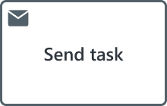
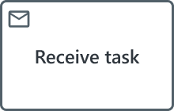
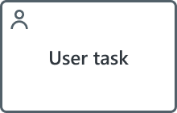
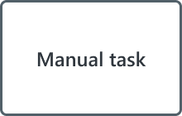
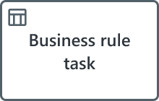
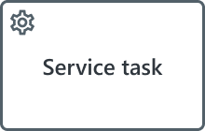
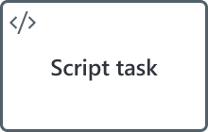
Task types Keep processes clear and executable
Send task Sends a message to an external entity.
Receive task Waits for a message from an external entity.
User task Performed by a person with software interaction.
Manual task Performed by a person without software.
Business rule task Executes logic via a business rules engine (DMN).
Service task Fully automated activity.
Script task Runs a script automatically when triggered.
Use task types to clearly show what kind of work is being done. This helps everyone quickly understand who or what is responsible. For example:
use a User Task when a person needs to do something (like review an application).
use a Service Task when a system performs an automated action (like running an Agent or a Robot)
use a Script Task when the system runs a script without human input
Notes:
Activities describe tasks or actions performed within the process. They represent the actual work done.
Task (rounded rectangle):
Represents an atomic activity or action performed by someone or a system.
Example: "Approve loan application“
Tasks are further classified based on how they are executed:
User Task – Performed by a human (e.g., manual approval).
Service Task – Performed by a system or external service.
Script Task – Executed automatically via a script.
Manual Task – A task performed without automation, such as signing a document
Sub-process (rounded rectangle with plus sign "+"):
Represents a collection of tasks or subprocesses grouped together, usually depicted in greater detail separately.
Example: "Process customer refund" (a subprocess consisting of multiple tasks)
Activities can also indicate task types:
User task (human-performed action)
Service task (system-performed action)

Slide 11





Gateways
Decision points that govern and control the process flow
Exclusive gateway (XOR): The classic ‘fork in the road’. Choose one path based on a decision.
Parallel gateway (AND): Do all paths at the same time.
Inclusive gateway (OR): Do one or more paths, depending on conditions.
Event-based gateway: Wait for one event to happen, then follow the path linked to that event.
Complex gateway: When the standard gateways above can’t be used, you can use custom logic to decide what happens next.
You can use a gateway when the process needs to make a decision or split into multiple paths.
For example, you might check whether payment was successful to decide what happens next. This is an exclusive gateway.
You might also need to do two things at the same time, like preparing an invoice and updating inventory. This is a parallel gateway.
Or you might check which delivery options the customer selected and follow one or more paths based on their choices. This would be an inclusive gateway.
Notes:
Gateways control the flow of the process, managing how sequences branch, merge, or parallelize. They handle decision-making logic.
Exclusive Gateway (XOR) (diamond with an "X"):
Represents a decision point where only one path can be chosen.
Example: "Is the order approved? Yes or No.“
Inclusive Gateway (OR) (diamond with circle):
Allows multiple possible paths simultaneously based on conditions (one or more).
Example: "Choose multiple optional insurance products.“
Parallel Gateway (AND) (diamond with “plus"):
Indicates parallel paths; multiple flows happen simultaneously.
Example: "Send invoice and ship goods at the same time."
Event Based Gateway (diamond with “star"):
Represents a branching point in a process where the path taken depends on events that occur rather than evaluations of process data (as with an Exclusive or Inclusive Gateway).
Example: "Wait for customer response—proceed based on message received.“ Gateways best practices
Use Gateways for splitting or merging flows.
Avoid mixed-mode Gateways (both diverging and converging).
Place an Activity before diverging Gateways (Exclusive, Inclusive, Complex) to allow process interruption if needed.
Abstract multiple diverging Gateways into a Business Rule Task for simplified diagrams.

Slide 12
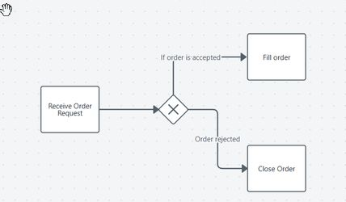
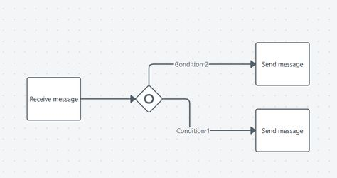
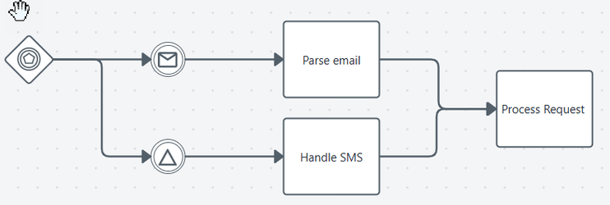
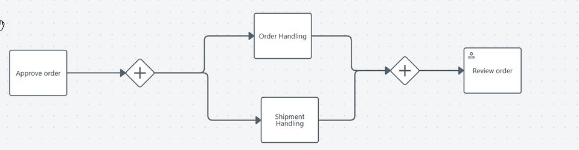
Gateways
Inclusive Gateway
Exclusive Gateway
Parallel Gateway
Event Based Gateway
Notes:
Gateways control the flow of the process, managing how sequences branch, merge, or parallelize. They handle decision-making logic.
Exclusive Gateway (XOR) (diamond with an "X"):
Represents a decision point where only one path can be chosen.
Example: "Is the order approved? Yes or No.“
Inclusive Gateway (OR) (diamond with circle):
Allows multiple possible paths simultaneously based on conditions (one or more).
Example: "Choose multiple optional insurance products.“
Parallel Gateway (AND) (diamond with “plus"):
Indicates parallel paths; multiple flows happen simultaneously.
Example: "Send invoice and ship goods at the same time."
Event Based Gateway (diamond with “star"):
Represents a branching point in a process where the path taken depends on events that occur rather than evaluations of process data (as with an Exclusive or Inclusive Gateway).
Example: "Wait for customer response—proceed based on message received.“ Gateways best practices
Use Gateways for splitting or merging flows.
Avoid mixed-mode Gateways (both diverging and converging).
Place an Activity before diverging Gateways (Exclusive, Inclusive, Complex) to allow process interruption if needed.
Abstract multiple diverging Gateways into a Business Rule Task for simplified diagrams.

Slide 13
BPMN Example with Gateways

Slide 14
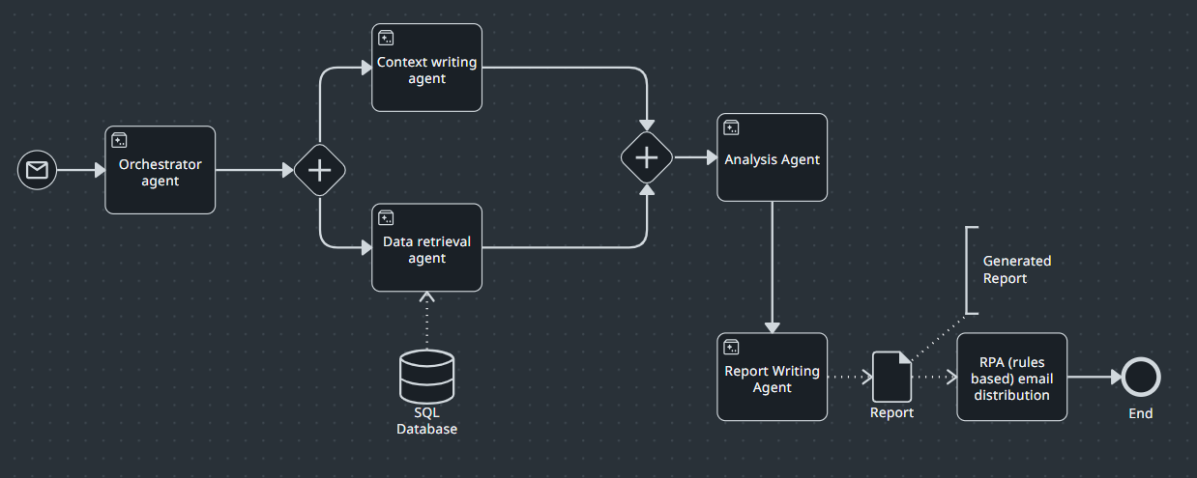
Parallel Gateways

Slide 15
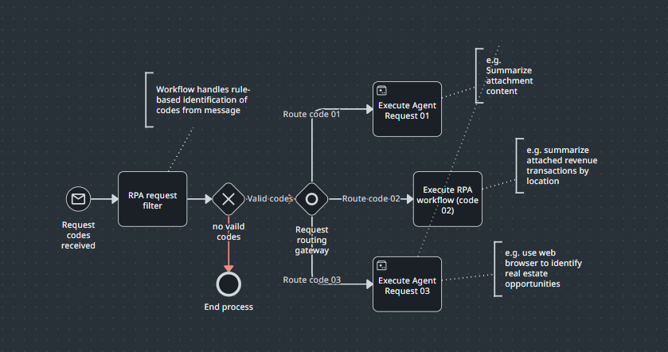

Slide 16
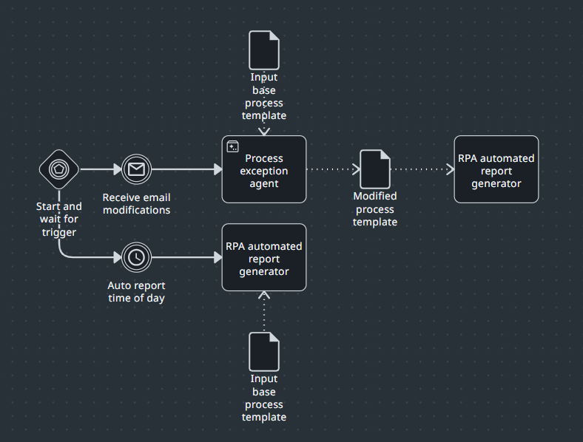

Slide 17


Markers
Used to specify behavior of objects
Multi instance parallel marker: Runs the task multiple times in parallel.
Multi-instance sequential marker: Runs the task multiple times in sequence.
You can use markers when you want to show how an activity behaves.
For example, if a robot needs to send the same email to 100 customers, you can use a multi-instance sequential marker to show that the task repeats for each customer.
Markers help clarify how the work happens, not just what the work is.

Slide 18


Flows Keep processes connected
Sequence flows: Shows the order of steps in a process.
Message flows: Shows communication between different people, systems, or roles.
Association: Links extra information, like data or notes, to a task or event.
Use flows to show how different parts of your process connect and move forward.
For example, if a customer places an order, and then the system checks inventory, you would use a sequence flow to connect those two steps.
If the system sends a confirmation message to the customer, you would use a message flow to show that communication between the system and the customer.
And if you want to link a note or a document to a task, like attaching shipping instructions to “Pack the order,” you’d use an association.

Slide 19


Data
Shows the information used or produced during a process.
Data object: A piece of information used or created during a process
Data store: A place where data is saved and can be accessed across processes
In a hiring process, when a candidate applies, the system creates a “Job Application” data object. This application is then reviewed in the next step.
All past job applications are saved in a “Candidate Database” data store. This lets the HR team search and reuse data across different hiring processes.

Slide 20
Best Practices
Process Scope
Define Who, What, When, Where, and Why of the process (the How is the process itself).
Determine Start Events (ways to trigger the process).
Define End Events (possible outcomes of process instances).
Diagram Layouts
Fit BPMN diagrams on one page with a clear primary (“Happy”) path.
Use horizontal Sequence Flows and vertical Data Associations to enhance readability.
Avoid zigzag layouts and excessive flow crossing.
Process Partitioning & Structure
Use a hierarchical multi-layer approach.
Split processes into phases using Sub-Processes.
Reuse other processes with Call Activities.

Slide 21
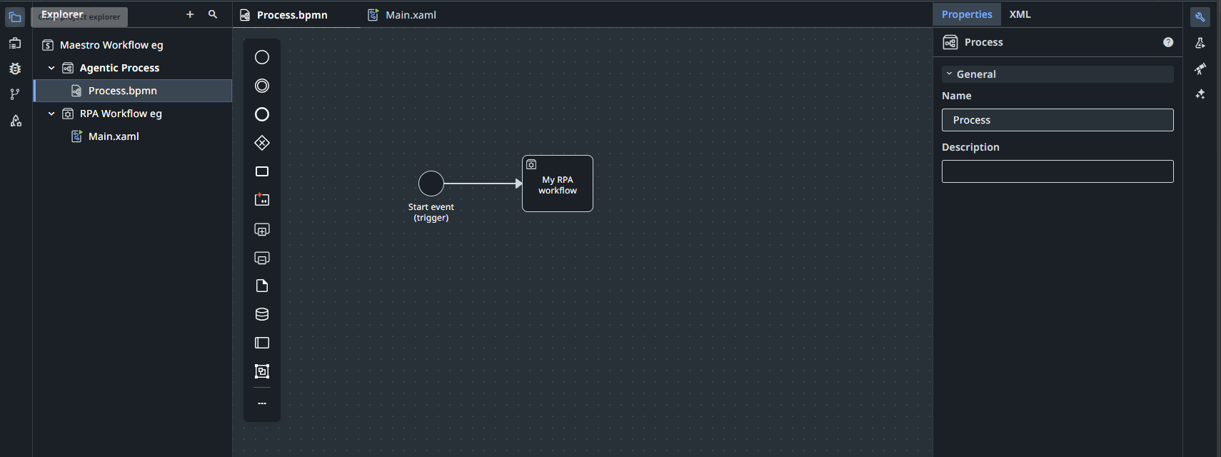
RPA Workflow (Studio)
Active overview
Triggers to start the workflow
Currently active view (Maestro)

Slide 22
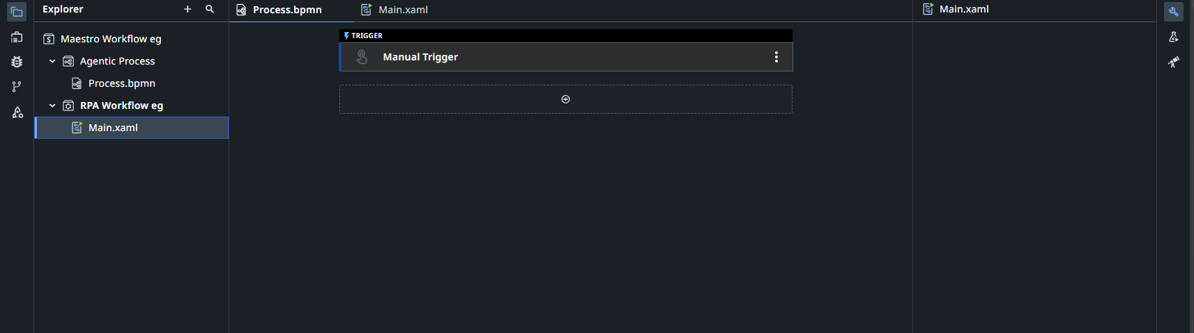
RPA Workflow (Studio)
Currently active view (Studio)

Slide 23
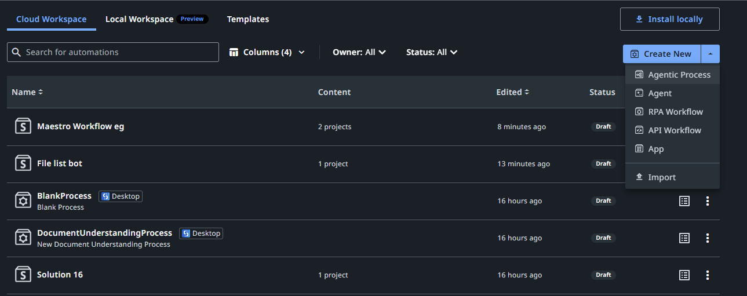

Slide 24
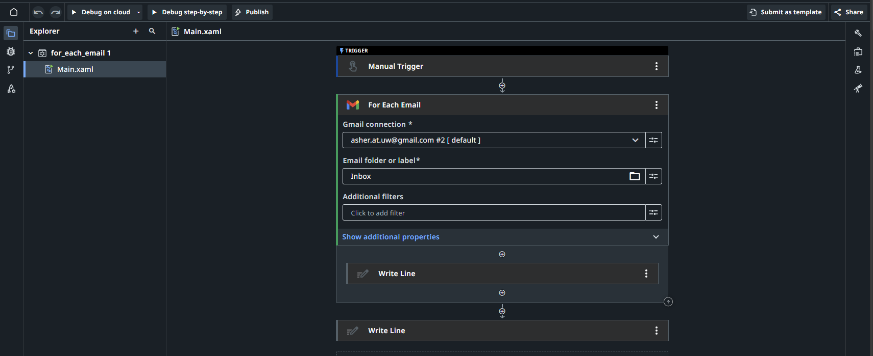
Outside the loop
The loop – all activities inside the boundary are in the loop

Slide 25
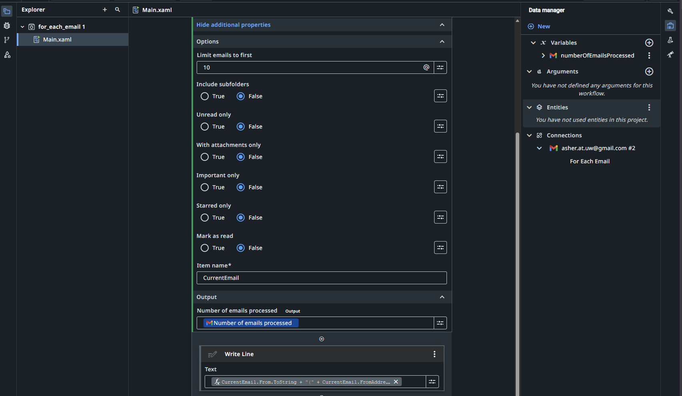
Inside the loop
Data manager (studio view)

Slide 26
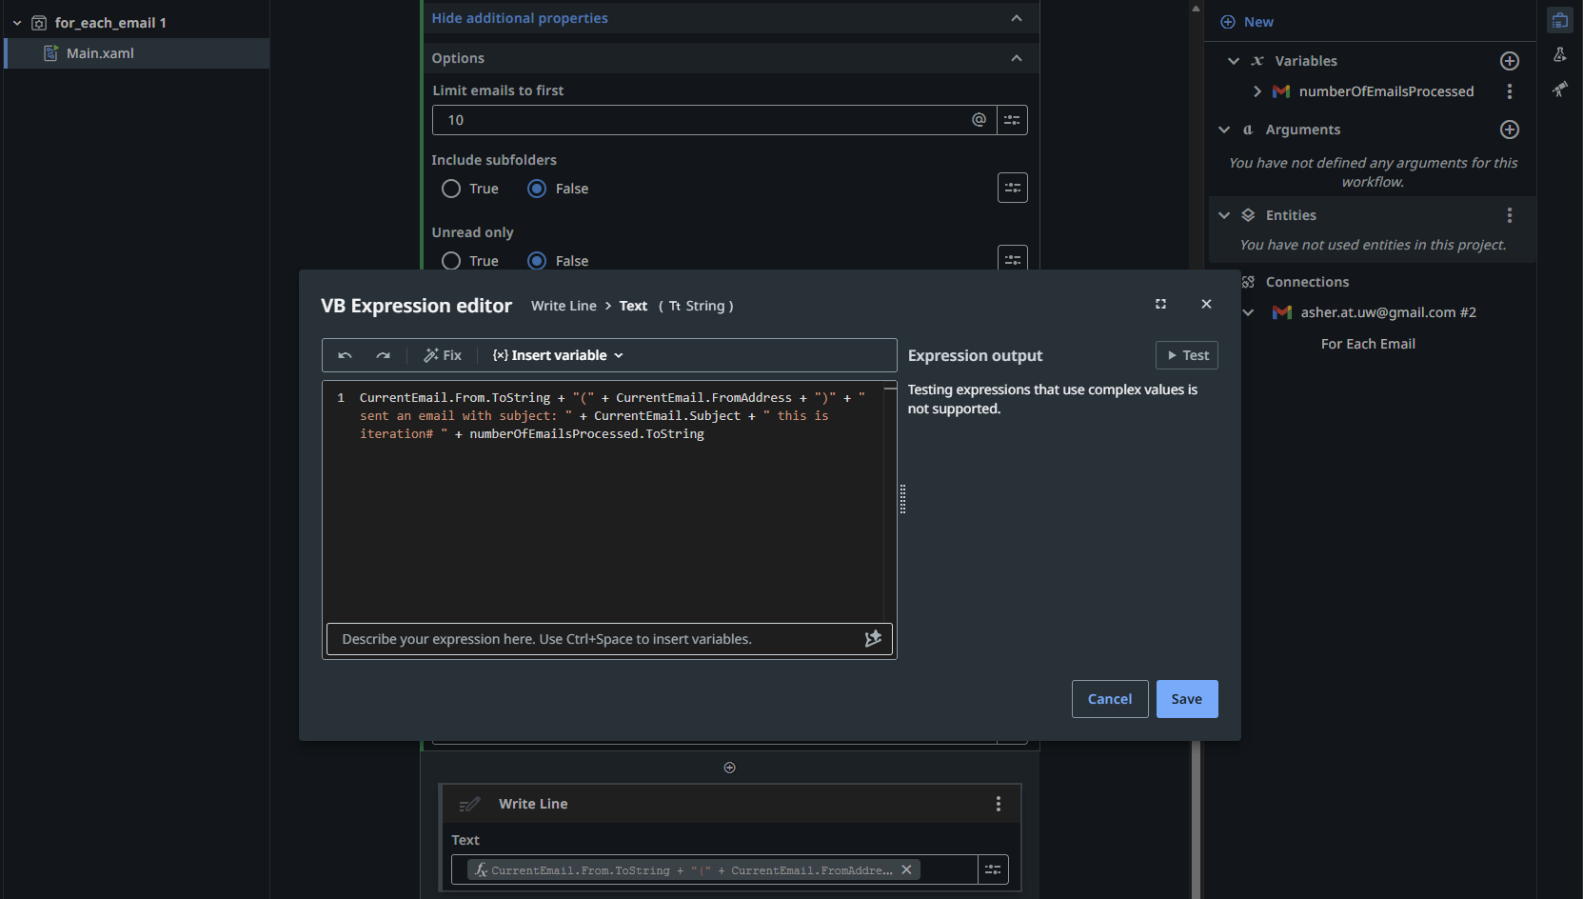
Expression editor

Slide 27
What will we do today?
Review of workflows
Submission overview:
Download your UiPath cloud file (.uip or .uis)
Submit to canvas and add commentary about the bot.
Workshop time

Slide 28
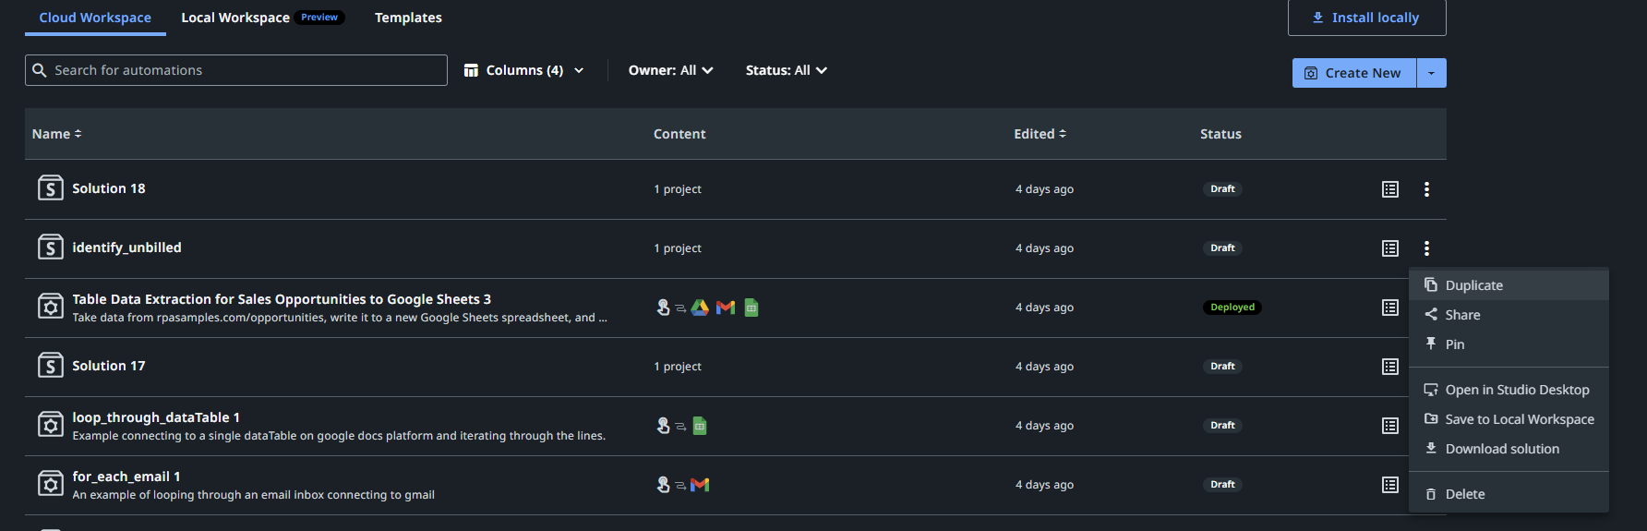
Saving the file for submission
1. Projects manager / Web Studio file menu
2. Download solution (look for a *.uip or *.uis file)

Slide 29
Submission overview: Canvas
Please submit a check-in copy of your RPA bot you have been working on in class (it is expected to be incomplete).
In the text field, please outline where you are hoping to get the bot to and what is working/not working at this point. If the bot is not working yet, that is fine. This is a check-in, not a final grade on this project. You are not required at this point to provide all the details on the RPA individual project, there is no need to discuss efficiency and effectiveness.
Feedback will include some comments on feasibility and where the bot will rank based on prior Individual RPA challenges and the work submitted by the class this year.
www.github.com/ashercurtis/robots.io

Slide 30
What will we do today?
Review of workflows
Submission overview:
Download your UiPath cloud file (.uip or .uis)
Submit to canvas and add commentary about the bot.
Workshop time

Slide 31
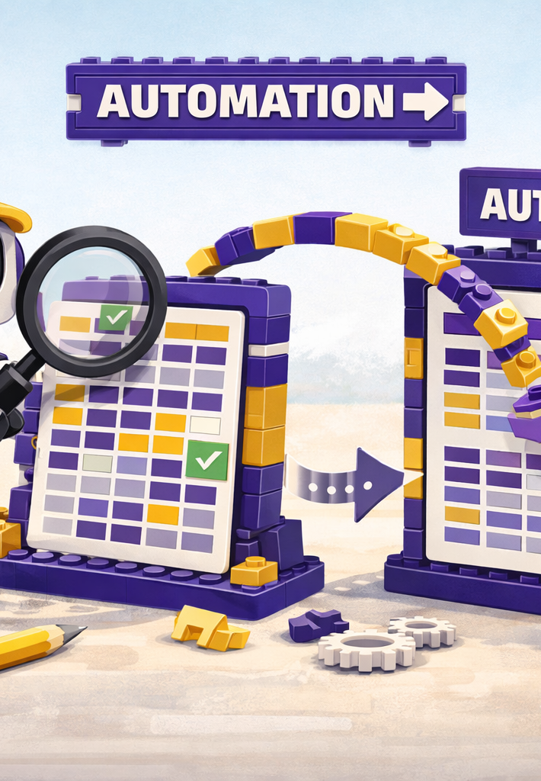
Where we will go next
Spreadsheets
BPMN revision and extension
Triggers
Controls
Costs and benefits of RPA
Selection of Tasks for RPA versus Agent
Manipulation of files

Slide 32
Thank you

