Slide 1
Introduction to the Extract, Transform and Load (ETL) Process
ACCTG 522
Data Analytics for Professional Accountants
MPAcc Class of 2027
Class 02 | Autumn | 2026

Slide 2
Agenda
Review
ETL Overview
Class Exercises
  Scavenger Hunt
  Data Limitations (PPP dataset)
  Introduction to Data Profiling and Data Quality
Conclusion & Look Ahead

Slide 3
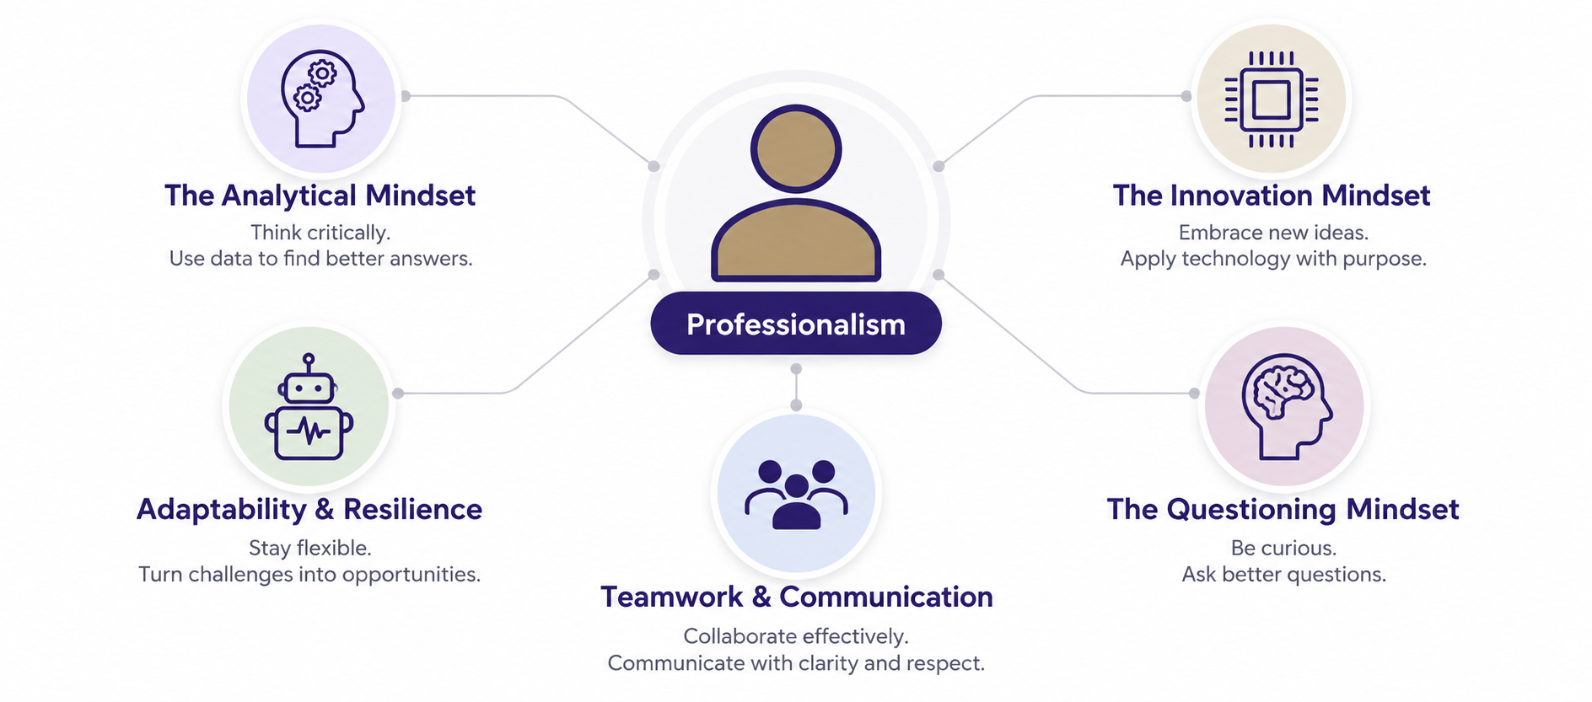
MPAcc mindsets

Slide 4
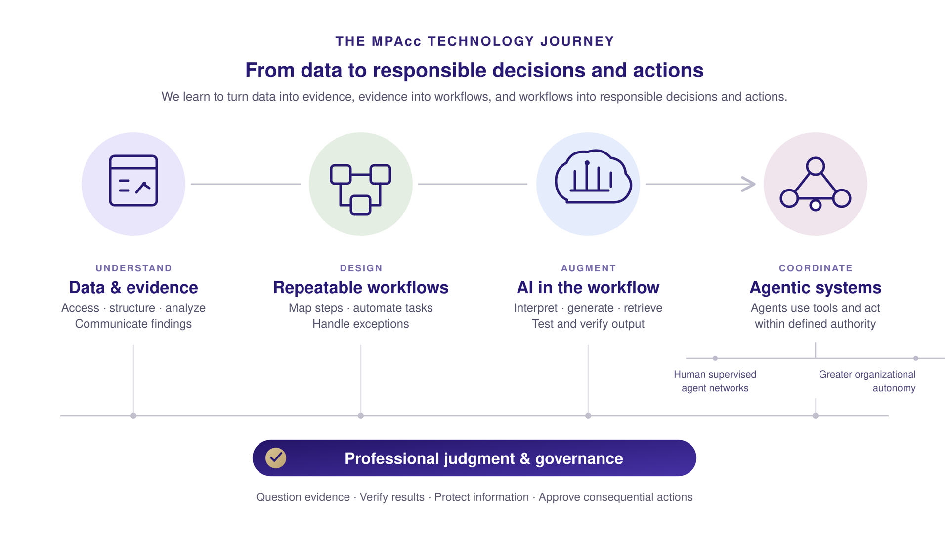

Slide 5
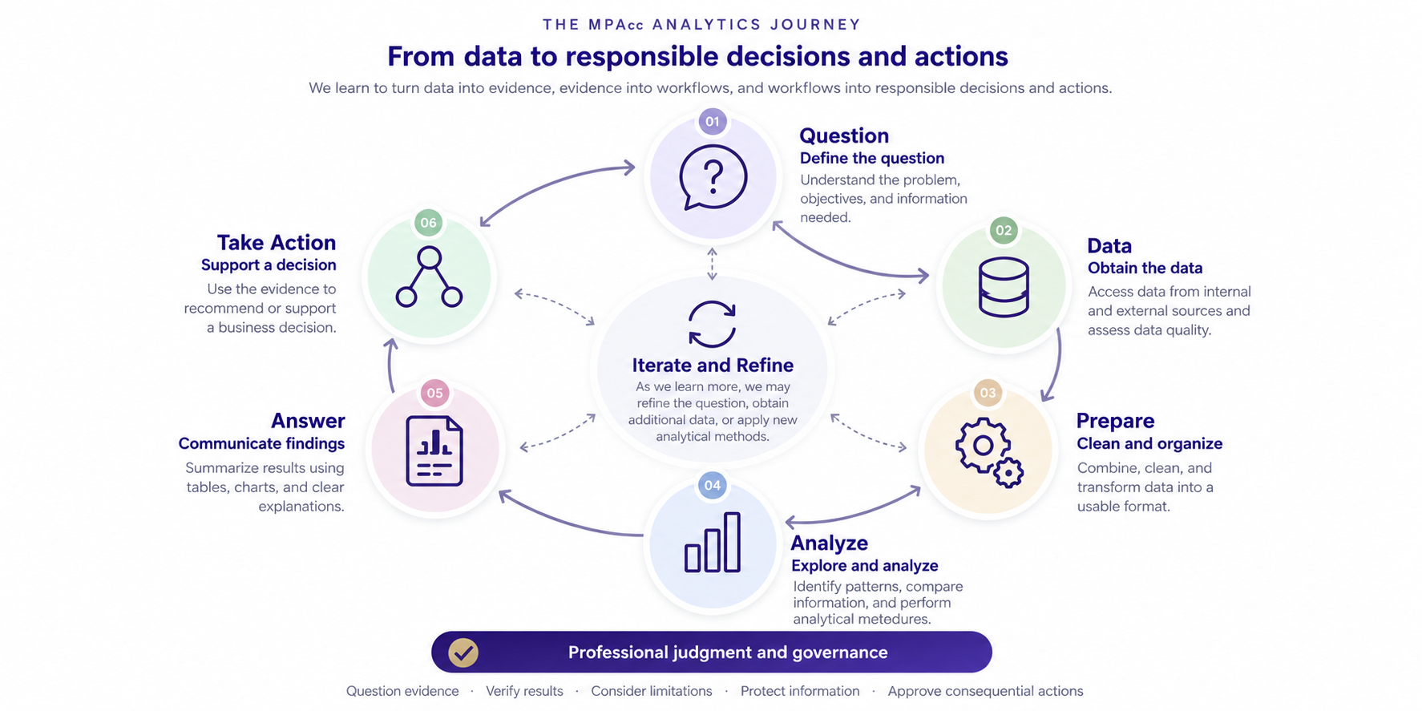

Slide 6
Agenda
Review
ETL Overview
Class Exercises
  Scavenger Hunt
  Data Limitations (PPP dataset)
  Introduction to Data Profiling and Data Quality
Conclusion & Look Ahead

Slide 7
The data we want is not always the data we have
The data we would ideally collect
The data that actually exist
The data that we can access
The data that we can correctly interpret
The data that are suitable for our analytical question
These may all be different.

Slide 8
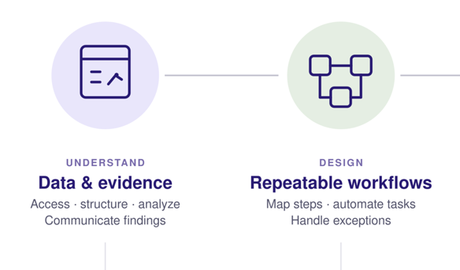
ETL: from available data to usable evidence
Extract — obtain data from its source.
Transform — clean, combine, standardize, validate, and restructure data.
Load — place the resulting data where it can be used for analysis or storage.
ETL is a process, not a particular software product.
The process should be understandable, reproducible, and validated.

Slide 9
Extract is an interface problem
Different sources require different ways of obtaining and interpreting data:
  Files → file readers and format rules
  Databases → connections and queries
  APIs → requests and structured responses
  Websites → web interfaces / extraction
  Documents → parsing or extraction
The analytical question can remain the same while the extraction method changes.

Slide 10
ETL and ELT
ETL: Extract → Transform → Load
Transform before loading into the analytical destination.
ELT: Extract → Load → Transform
Retain raw data in a destination platform and perform transformations there.
The important idea today is not the acronym: preserve provenance and make transformations reproducible.

Slide 11
Before we analyze data, we have to interpret it
What type of file is it?
How is information represented inside it?
What software or library can interpret it?
What additional rules are required?
  Delimiter
  Encoding
  Version
  Schema

Slide 12
File extension ≠ file format ≠ application
File extension — a label commonly used to identify a format.
File format — rules governing how information is represented.
Encoding — rules mapping stored bytes to characters or values.
Schema — structure and meaning of fields/elements.
Application — software that knows how to interpret one or more formats.

Slide 13
Open and application-specific representations
Text / broadly documented representations
  CSV — delimited text
  JSON — objects and arrays
  XML — tagged hierarchical data
Application-specific formats
  Excel — .xlsx / .xls
  Alteryx — .yxdb
  Tableau — .hyper
A format can be open even when we usually interact with it through a particular application.

Slide 14
Agenda
Review
ETL Overview
Class Exercises
  Scavenger Hunt
  Data Limitations (PPP dataset)
  Introduction to Data Profiling and Data Quality
Conclusion & Look Ahead

Slide 15
Exercise 1: Scavenger Hunt
Go to remote labs:
Navigate to your U: Drive
In the windows path, type cmd then enter
A command window will open up inside the U-Drive
Write the following commands (enter after each one):
  git clone --filter=blob:none --sparse https://github.com/ashercurtis/datasets.io.git
  cd datasets.io
  git sparse-checkout set acctg522

Slide 16
Scavenger Hunt
Can you decode the message?
6 files contain hidden keywords
Open the files to find the keywords
Write the words in order to decode the message

Slide 17
Scavenger Hunt: Clues
Can the file be inspected in a text editor?
Is the content human-readable?
Does the beginning of the file contain recognizable structure or a signature?
Does a particular application recognize the contents?
What happens if the extension is changed?
What did the extension contribute, and what remained unchanged?

Slide 18
Scavenger Hunt: MPAcc debrief
Data are encoded according to rules.
Software must know enough about those rules to interpret the data correctly.
A successful 'open' does not guarantee a correct interpretation.
Extraction therefore includes understanding what was extracted and how it was represented.
This becomes increasingly important when retrieval is automated.

Slide 19
Agenda
Review
ETL Overview
Class Exercises
  Scavenger Hunt
  Data Limitations (PPP dataset)
  Introduction to Data Profiling and Data Quality
Conclusion & Look Ahead

Slide 20
Exercise 2: PPP data
Navigate to your datasets.io/ACCTG522 folder and look for:
02_PPP_extract/ in this folder is a file “PPP Data – Washington sample.csv”
In teams read the data using different programs, try:
PowerBI
Tableau
Notepad
Excel
VSCode

Slide 21
Start with the analytical question
What would we like to know?
  Who received PPP loans?
  Where did the money go?
  Which industries received the most support?
  Did PPP preserve jobs?
  Did recipients comply with program requirements?
  Was there fraud?
Different questions require different evidence.

Slide 22
Data provenance: where did this row come from?
Business activity / underlying economic reality ↓
Applicant supplies information ↓
Lender records and validates information ↓
Government systems receive and process information ↓
Public PPP dataset ↓
Our ETL process ↓
Analytical dataset and conclusion

Slide 23
Where can error or uncertainty enter?
Applicant — error, misunderstanding, omission, or intentional misstatement
Lender — procedures, interpretation, validation, and data entry
Program administration — changing rules, system design, aggregation, publication
Our extraction — wrong file, incomplete pull, parsing problem
Our transformation — incorrect filtering, joining, recoding, or aggregation
Our interpretation — assuming a field measures something it does not

Slide 24
What does a field actually measure?
Suppose JobsReported = 25.
Does that mean:
  25 people worked at the business?
  25 jobs were supported by the loan?
  25 jobs would have disappeared without PPP?
  25 is the value reported through the program process?
A field name is not a complete measurement definition.

Slide 25
Unusual value or data error?
Suppose JobsReported = 0.
Possible explanations:
  A true zero
  Missing information encoded as zero
  Applicant misunderstanding
  A transformation performed upstream
  A valid but unusual observation
An unusual value is a reason to investigate — not automatically a reason to delete.

Slide 26
Validity rules versus investigation rules
Some conditions can provide strong evidence of invalid data.
  Example: a field violates a documented allowable value or logical constraint.
Other conditions identify observations that deserve investigation.
  Example: an unusually large loan or JobsReported = 0.
Profiling should distinguish 'impossible under our rules' from 'unusual.'

Slide 27
Measurement versus the question
Question: Did PPP save jobs?
Available field: JobsReported
Even if JobsReported is recorded perfectly, it may not identify the counterfactual:
'How many jobs would have existed without PPP?'
Data quality and identification / suitability are different problems.

Slide 28
The recursive framework in practice
Initial question: Did PPP save jobs?
Inspect available data: JobsReported exists, but the counterfactual does not.
Possible responses:
  Refine the question to something the data can support.
  Obtain additional data.
  Use a stronger analytical/research design.
The data have changed what question we can responsibly answer.

Slide 29
Before transforming: profile the data
Rows × columns
Field names and definitions
Data types
Missingness by field
Unique values and category frequencies
Numeric ranges and distributions
Potential duplicates
Unexpected values or relationships

Slide 30
PPP activity — profile the Washington sample
Before trying to answer a PPP question, build a profile of the dataset.
Identify:
  What is one row?
  Which fields appear complete or sparse?
  Which categorical fields need interpretation?
  Which numeric fields have surprising ranges?
  What might constitute a duplicate?
  Which observations should be investigated?

Slide 31
What is a duplicate?
Two identical rows?
Two records with the same borrower name?
Same borrower + address?
Same borrower + loan amount?
Could the same business legitimately receive more than one record?
Duplicate detection requires a definition of the entity and transaction represented by each row.

Slide 32
Three different problems
1. Data quality
  A recorded value may be wrong, incomplete, duplicated, or inconsistent.
2. Measurement / definition
  A field may not mean what we initially assume it means.
3. Data suitability / identification
  Even perfectly recorded data may not support the inference we want.
Cleaning cannot solve all three.

Slide 33
Data quality dimensions
Accuracy — does the value reflect the underlying reality?
Completeness — are required observations or fields present?
Consistency — are comparable items represented consistently?
Validity — do values conform to expected rules?
Uniqueness — are records duplicated?
Timeliness — are the data appropriate for the relevant period?

Slide 34
Authoritative source ≠ verified underlying value
Government publication provides provenance and credibility about the dataset's source.
But individual values may originate with applicants, lenders, or upstream systems.
Ask:
  Who generated this value?
  What incentive and process produced it?
  What validation occurred?
  What transformations occurred before we received it?

Slide 35
Transformation is an assertion
When we change data, we implicitly assert that the transformation is appropriate.
Examples:
  Treat blank and zero as equivalent
  Combine two borrower names into one entity
  Remove a suspected duplicate
  Convert a text value into a date
Each assertion should be defensible and, where consequential, reviewable.

Slide 36
Manual cleaning versus reproducible workflows
A manual edit and a scripted transformation can produce the same output.
A reproducible process provides additional benefits:
  Repeatability
  Documentation
  Scalability
  Reviewability
  Ability to rerun when source data change
The objective is not 'avoid Excel'; it is to make consequential transformations traceable.

Slide 37
ETL controls: validate the process
Before ETL — establish expectations about the source.
During ETL — record transformations and exceptions.
After ETL — reconcile the output to expectations.
A workflow that runs without an error message has not necessarily produced correct data.

Slide 38
What could we reconcile?
Record counts before and after filters
Control totals for important numeric fields
Missing-value counts
Duplicate counts
Unmatched records after joins
Rejected or exception records
Expected categories and numeric ranges
Changes should have an explanation.

Slide 39
Agenda
Review
ETL Overview
Class Exercises
  Scavenger Hunt
  Data Limitations (PPP dataset)
  Introduction to Data Profiling and Data Quality
Conclusion & Look Ahead

Slide 42
Summary
Today's key takeaway: Data and Prepare/ETL are not mechanical steps.
Profiling, provenance, validation, and professional judgment can cause us to iterate backward.
Responsible action depends on understanding both the evidence and its limitations.

Slide 43
Next steps
Next topic: The ETL process: Extraction from APIs
Supports the Common Final Project (sourcing high-quality financial data)
Develops data skills with APIs, JSON files and schema understanding
Thank you!

