Slide 1
Introduction to Agentic Workflows
Adv. Advisory | ACCTG 528 | Class 11
MPAcc Class of 2026

Slide 2

What will we do today?
Review
Workflows and Logic
The Data Validator Challenge
Intro to Agentic Workflows
Key terms
Labs
System prompt
Maestro BPMN revision and extension
Team Exercise

Slide 3
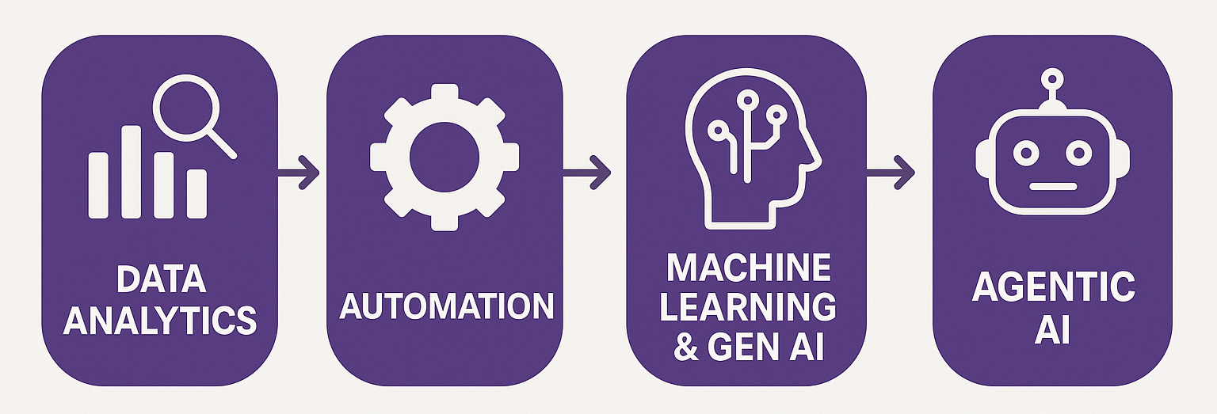
Course Diagram (high-level)

Slide 4











UiPath Agentic Automation
Notes:
Everything happens in one place: the UiPath Platform—where AI Agents aren’t just assistants, they’re true work partners, transforming complexity into a seamless, orchestrated operation.
We break it down into three powerful layers: Activities (the building blocks—reading, processing, integrating), Workflows (connecting the dots with human-in-the-loop and testing), and Processes (the big picture—managing, optimizing, and enhancing enterprise operations).
Agentic Orchestration / Maestro takes automation even further—coordinating UiPath Agents, third-party AI models, people, robots, and tools into a single, intelligent system.
Your existing systems don’t need to be reinvented—our platform integrates seamlessly with your data, applications, and workflows while maintaining enterprise-grade security, governance, and AI trust.
We’re not just compatible with your tech stack—we enhance it. From cloud providers like AWS, Google, and Azure to enterprise apps like Salesforce and SAP, we turn digital chaos into a symphony of efficiency.

Slide 5
Looking ahead
Where do your individual and team projects go next?
Individual:
Appropriate identification rules-based automation
Selection of appropriate automation spectrum model
Team:
Appropriate mix of RPA, Agent, and human in the loop
Selection of best cases for agent decision enhancement

Slide 6
Workflows and Logic
Inputs: Web-scraped data, spreadsheet data
Loops: For each row; CurrentRow(“Header”)
Outputs: Spreadsheet, email
Cleaning steps appear logical
Workflows logical
Need to continue to ID the activities/tools in workflows
Data cleaning in VB (using assign)

Slide 7
Data validator challenge
Old approach:
Learn code from books / internet → Modify examples → Apply code
New Approach:
LLM generates modified code → Apply code

Slide 8
What will we do today?
Review
Workflows and Logic
The Data Validator Challenge
Intro to Agentic Workflows
Key terms
Labs
System prompt
Team Exercise
Maestro BPMN revision and extension

Slide 9
Key Terms
Generative AI: A subset of artificial intelligence that focuses on systems capable of generating new content such as text, images, audio, or code by learning patterns from training data and producing original outputs.
Large Language Models (LLMs): A class of generative artificial intelligence systems trained on vast corpora of text data to model linguistic patterns and relationships, enabling them to generate, interpret, and transform natural language. LLMs operate by predicting sequences of tokens based on contextual probabilities learned during training, allowing them to perform a wide range of tasks including text generation, summarization, translation, question answering, and code synthesis.

Slide 10
Ket terms: Agentic
Agentic AI:
AI systems designed to operate with a degree of autonomy, persistence, and goal-orientation, often executing sequences of actions independently and adapting to changes in their environment or instructions.

Slide 11
What will we do today?
Review
Workflows and Logic
The Data Validator Challenge
Intro to Agentic Workflows
Key terms
Labs
System prompt
Maestro BPMN revision and extension
Team Exercise

Slide 12
System prompt lab
Objective:
Work on the system prompt with a free tier LLM obtained from openrouter.ai
Sign up at openrouter.ai (link on class 11 page)
Upload openrouter_ai_starter.uis to UiPath cloud
Modify the workflow (add key, run, work on system prompt)

Slide 13
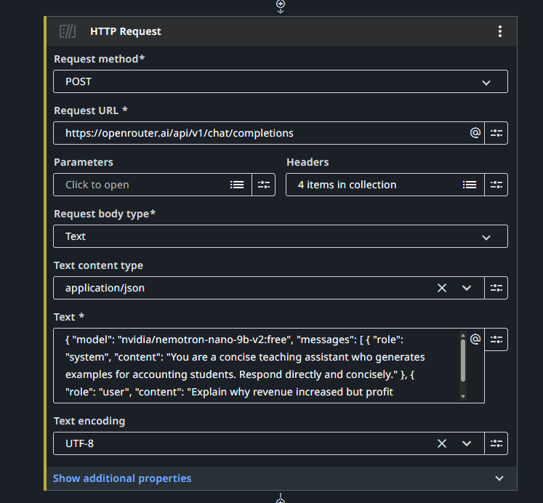
1. Update the Authorization field with your API key (leave Bearer ) in both API calls
2. Compare the system prompts between API call 1 and 2

Slide 14
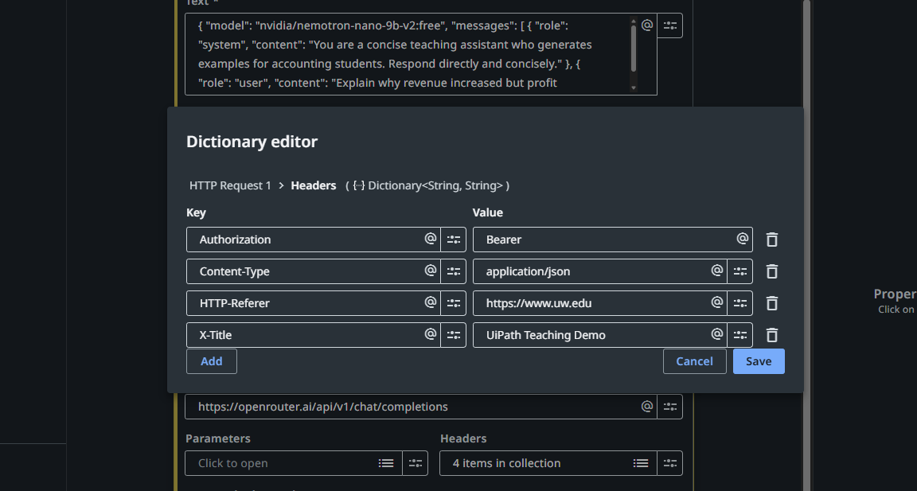

Slide 15
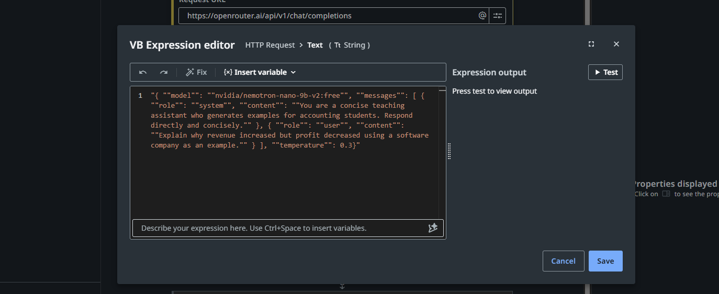

Slide 16
{"id":"gen-1777910675-Ft9jv9q1kWGM9SUXmxK3","object":"chat.completion","created":1777910675,"model":"nvidia/nemotron-nano-9b-v2:free","provider":"Nvidia","system_fingerprint":null,"choices":[{"index":0,"logprobs":null,"finish_reason":"stop","native_finish_reason":"stop","message":{"role":"assistant","content":"\n\n**Example:** A softwarecompany launches a popular new app, boosting sales (revenue ↑). However, it also spends heavily on marketing, R&D, and hiring to scale, causing expenses to rise faster than revenue. Profit ↓ due to higher costs outweighing revenue growth.\n","refusal":null,"reasoning":"Okay, the user wants an example of a software company where revenue goes up but profit goes down. Let me think about the possible reasons.\n\nFirst, revenue increase could be from selling more software licenses or subscriptions. But profit decrease might be due to higher costs. Maybe they expanded rapidly, hiring more staff or investing in R&D. That would increase expenses.\n\nAnother angle: maybe they started offering more services or discounts. If they lower prices to attract more customers, revenue might still go up if volume increases enough, but the lower prices could reduce profit margins. Or maybe they have higher marketing costs to acquire new customers.\n\nAlso, one-time expenses could be a factor. Like a big acquisition or a lawsuit settlement. Even if revenue is up, a large unexpected cost could eat into profits.\n\nOr maybe they invested heavily in infrastructure or technology upgrades. Capital expenditures don't directly affect revenue but increase expenses.\n\nLet me structure this. Example: A software company launches a new product, increasing sales (revenue up). But they also spend a lot on marketing, R&D, and hiring. These costs rise more than the revenue increase, leading to lower profit.\n\nAlternatively, if they offer a subscription model with lower prices but higher volume. Suppose they reduce the price per subscription but get many more subscribers. Revenue might still go up if the volume compensates, but the lower per-unit profit could lead to overall lower profit if costs don't decrease proportionally.\n\nAnother point: maybe they have higher operating costs due to scaling. Like more servers, customer support, etc., as they grow. Fixed costs might not scale linearly with revenue.\n\nI should pick the most common scenario. Rapid expansion with high investment costs is a typical reason. So the example would be a software company increasing sales through new products or markets but facing higher costs from expansion, leading to lower profit despite higher revenue.\n","reasoning_details":[{"type":"reasoning.text","text":"Okay, the user wants an example of a software company where revenue goes up but profit goes down. Let me think about the possible reasons.\n\nFirst, revenue increase could be from selling more software licenses or subscriptions. But profit decrease might be due to higher costs. Maybe they expanded rapidly, hiring more staff or investing in R&D. That would increase expenses.\n\nAnother angle: maybe they started offering more services or discounts. If they lower prices to attract more customers, revenue might still go up if volume increases enough, but the lower prices could reduce profit margins. Or maybe they have higher marketing costs to acquire new customers.\n\nAlso, one-time expenses could be a factor. Like a big acquisition or a lawsuit settlement. Even if revenue is up, a large unexpected cost could eat into profits.\n\nOr maybe they invested heavily in infrastructure or technology upgrades. Capital expenditures don't directly affect revenue but increase expenses.\n\nLet me structure this. Example: A software company launches a new product, increasing sales (revenue up). But they also spend a lot on marketing, R&D, and hiring. These costs rise more than the revenue increase, leading to lower profit.\n\nAlternatively, if they offer a subscription model with lower prices but higher volume. Suppose they reduce the price per subscription but get many more subscribers. Revenue might still go up if the volume compensates, but the lower per-unit profit could lead to overall lower profit if costs don't decrease proportionally.\n\nAnother point: maybe they have higher operating costs due to scaling. Like more servers, customer support, etc., as they grow. Fixed costs might not scale linearly with revenue.\n\nI should pick the most common scenario. Rapid expansion with high investment costs is a typical reason. So the example would be a software company increasing sales through new products or markets but facing higher costs from expansion, leading to lower profit despite higher revenue.\n","format":"unknown","index":0}]}}],"usage":{"prompt_tokens":48,"completion_tokens":435,"total_tokens":483,"cost":0,"is_byok":false,"prompt_tokens_details":{"cached_tokens":0,"cache_write_tokens":0,"audio_tokens":0,"video_tokens":0},"cost_details":{"upstream_inference_cost":0,"upstream_inference_prompt_cost":0,"upstream_inference_completions_cost":0},"completion_tokens_details":{"reasoning_tokens":514,"image_tokens":0,"audio_tokens":0}}}

Slide 17
{"id":"gen-1777910699-NYdjHWJoipF7hDXnPJa7","object":"chat.completion","created":1777910699,"model":"nvidia/nemotron-nano-9b-v2:free","provider":"Nvidia","system_fingerprint":null,"choices":[{"index":0,"logprobs":null,"finish_reason":"stop","native_finish_reason":"stop","message":{"role":"assistant","content":"TechSoft Inc. sees rising revenue from a popular new app, but profit falls due to heavy R&D spending and marketing costs to sustain growth.\n","refusal":null}}],"usage":{"prompt_tokens":59,"completion_tokens":241,"total_tokens":300,"cost":0,"is_byok":false,"prompt_tokens_details":{"cached_tokens":0,"cache_write_tokens":0,"audio_tokens":0,"video_tokens":0},"cost_details":{"upstream_inference_cost":0,"upstream_inference_prompt_cost":0,"upstream_inference_completions_cost":0},"completion_tokens_details":{"reasoning_tokens":262,"image_tokens":0,"audio_tokens":0}}}

Slide 18
Maestro lab
Objective:
Work on a combined RPA and single agent workflow using UiPath’s Maestro product.
Upload the revenue_analyzer.uis example maestro workflow.
Change the send to email in RPA: Send Email workflow.
Modify the system prompt / user prompt → broaden, deliver from external source, etc.
Modify the input mechanism(s) for the tools (can you change this to another company for example, triggered by email?

Slide 19
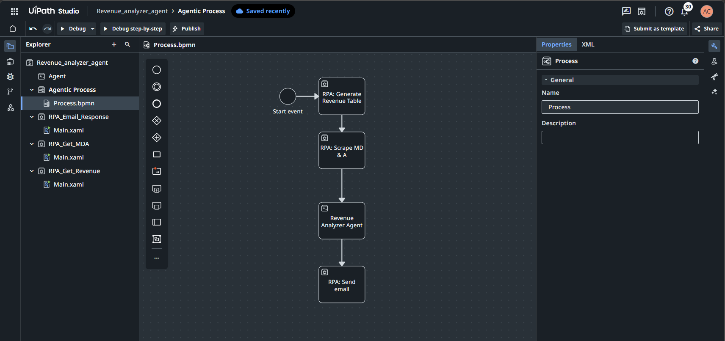

Slide 20
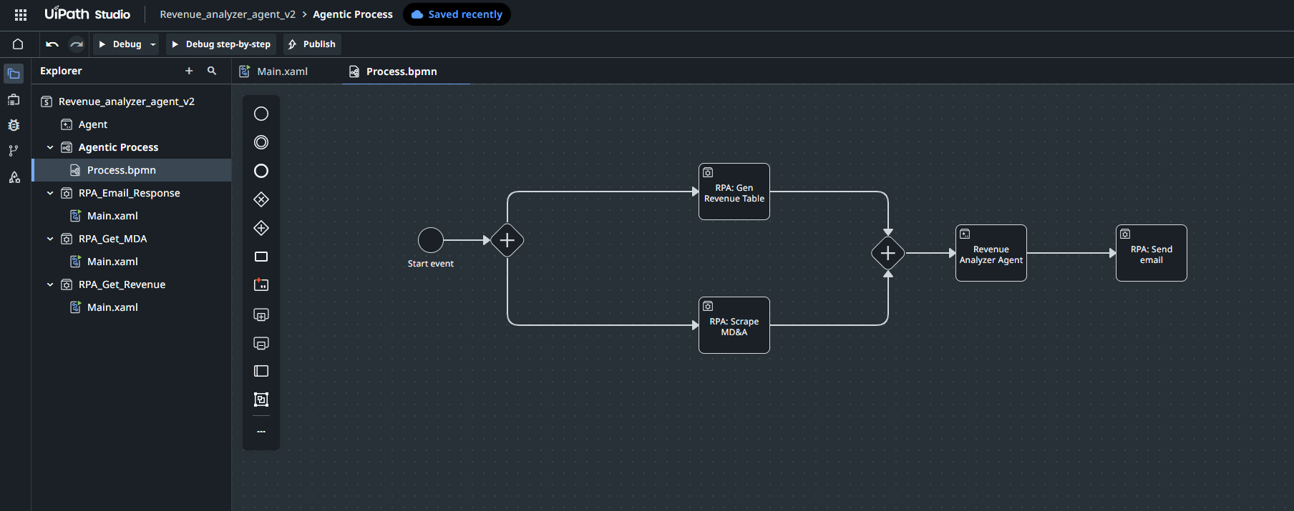

Slide 21
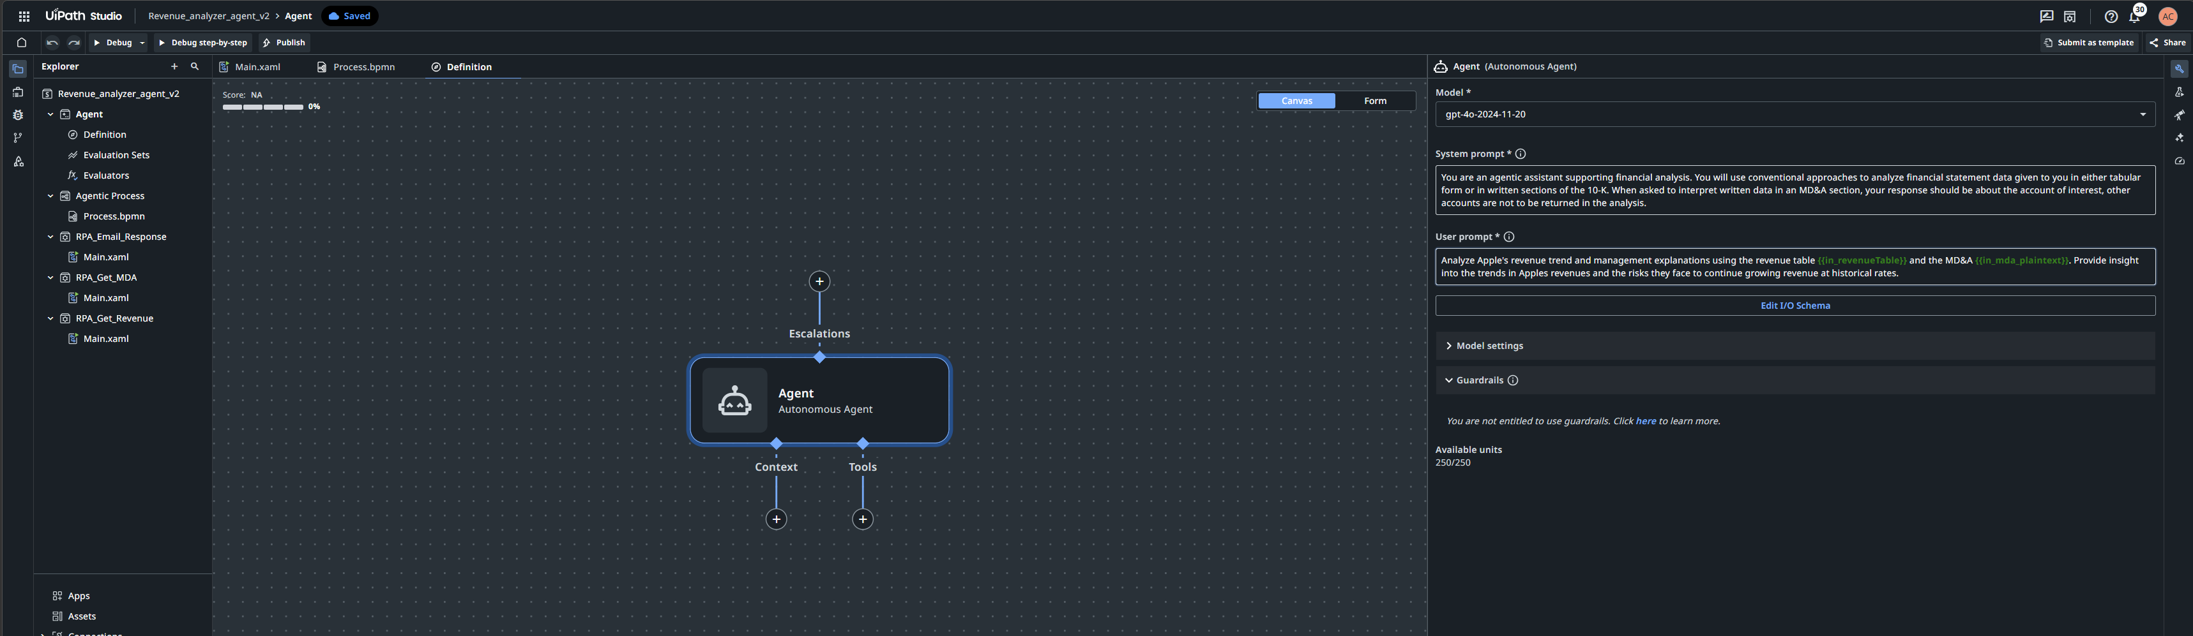

Slide 23
Teams
Objective:
Finalize topic selection (teams are in Canvas) fill out our table.

Slide 24
Final topic Selections
Team | Topic
Automata Imperium
Data Dominus
Fluxus Digitalis
Intellectus Agens
Machina Cognita
Ordo Mechanicus
Praxis Automata
Processus Nexus
Ratio Automata

Slide 25
Thank you

