Slide 1
The ETL Process: Text Analytics
ACCTG 522
Data Analytics for Professional Accountants (sit in Assessment teams)
MPAcc Class of 2027
Class 08 | Autumn | 2026

Slide 2
Agenda
Review
Overview and Discussion
CAVA Case Example
Final Project Scoping Task
Conclusion & Look Ahead

Slide 3
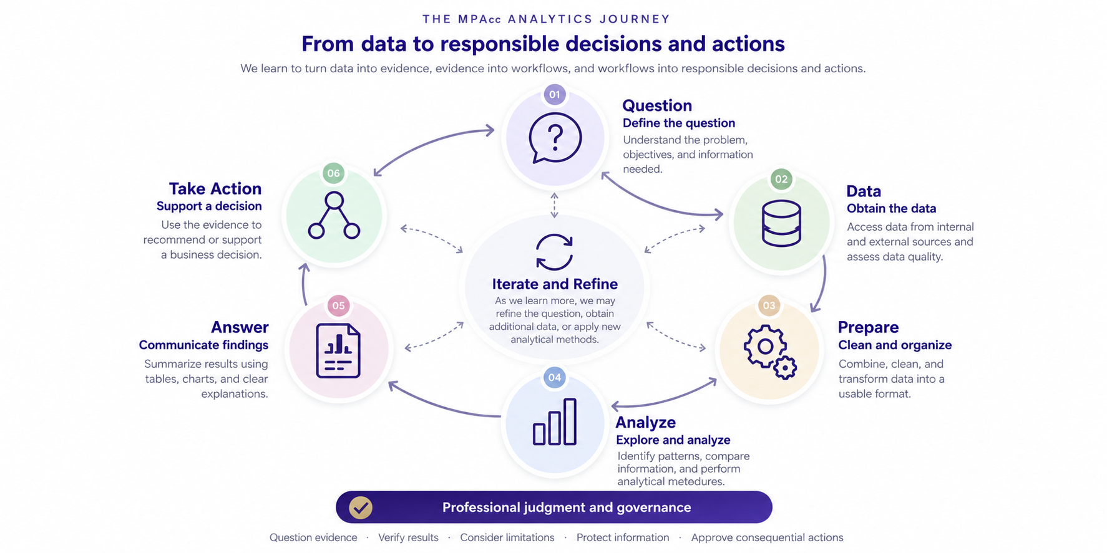

Slide 4
Review
Message-ID: <25828831.1075855376669.JavaMail.evans@thyme> Date: Mon, 26 Nov 2001 07:25:16 -0800 (PST) From: k..allen@enron.com To: jsmith@austintx.com Subject: RE: Additional properties in San Antonio Jeff, Can you resend the info on the three properties you mailed and the one you faxed on Tuesday. I was out of the office last week. Phillip -----Original Message----- From: "JEFF SMITH" <jsmith@austintx.com>@ENRON Sent: Tuesday, November 20, 2001 3:43 PM To: Allen, Phillip K. Subject: Additional properties in San Antonio Phillip, I am waiting to get info. on two more properties in San Antonio. The broker will be faxing info. on Monday. One is 74 units for $1,900,000, and the other is 24 units for $550,000. Also, I have mailed you info. on three other properties in addition to the 100 unit property that I faxed this AM. Let me know if you have any questions. Jeff Smith The Smith Company 9400 Circle Drive Austin, TX 78736 512-394-0908 office 512-394-0913 fax 512-751-9728 mobile jsmith@austintx.com

Slide 5
Review
Key takeaway: Transforming unstructured email data into structured analytical evidence requires effective data preparation, pattern recognition, and careful interpretation of results.
Email data contains valuable information, but its unstructured nature makes systematic analysis challenging. Regular expressions (Regex) provide a flexible and powerful way to identify, extract, and transform patterns within text.
Analyzing the Enron emails illustrates how we can convert large volumes of communications into structured data to investigate potential risks.

Slide 6
Agenda
Review
Overview and Discussion
CAVA Case Example
Final Project Scoping Task
Conclusion & Look Ahead

Slide 7
The Enron workflow connects to textual analytics
In the Enron case, Python and regex helped us prepare email text and find specified keywords or patterns.
The same workflow applies to filings: load the source, prepare the text, apply a method, and inspect the output.
Readability measures writing complexity. Dictionary sentiment and FinBERT estimate tone. Semantic search retrieves related meaning.
The analytical question remains: What does the output support, and what context or evidence is missing?
Notes:
Bridge to the prior class: students used the Enron email case and a Python workflow for regex cleaning, preparation, and keyword/pattern searches. Ask them to name one search pattern and one result they had to inspect. Then explain that the preparation and verification habits transfer to MD&A, while the analytical methods now address complexity, tone, and meaning. The new methods complement regex. Preserve source text and inspect passages before interpreting scores. No new Enron findings or model outputs are asserted.

Slide 8
Financial narrative adds context to the numbers
Financial statements report outcomes. Narrative describes management’s explanations and expectations (typically in the MD&A but also in conference calls).
Textual analytics helps analysts examine many passages consistently.
The analytical task is to connect a measure to a business question and supporting evidence.
Management’s stated explanation still requires corroboration.
Notes:
Ask students what additional evidence would support an explanation that revenue rose because demand strengthened.

Slide 9
Tools for textual analytics
Readability measures writing complexity.
Dictionary sentiment and FinBERT estimate tone.
Semantic search retrieves related meaning.
The analytical question remains: What does the output support, and what context or evidence is missing?
Notes:
Bridge to the prior class: students used the Enron email case and a Python workflow for regex cleaning, preparation, and keyword/pattern searches. Ask them to name one search pattern and one result they had to inspect. Then explain that the preparation and verification habits transfer to MD&A, while the analytical methods now address complexity, tone, and meaning. The new methods complement regex. Preserve source text and inspect passages before interpreting scores. No new Enron findings or model outputs are asserted.

Slide 10
Agenda
Review
Overview and Discussion
CAVA Case Example
Final Project Scoping Task
Conclusion & Look Ahead

Slide 11
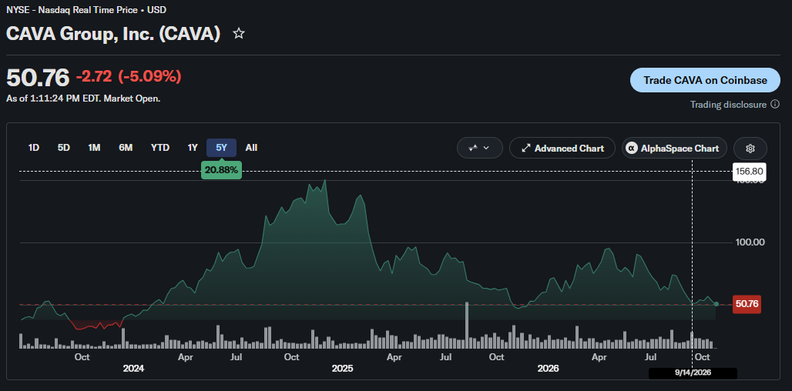

Slide 12
CAVA Case Example
https://www.sec.gov/edgar/browse/?CIK=0001639438
Central question: Does positive language distinguish expansion from stronger demand at existing restaurants?

Slide 13
Hints
Can you find the MD&A automatically?
How is the MD&A structured?
What information would you want to extract?
What challenges do you see?

Slide 14
Final Project Scoping
Where should we use textual analytics?
What are some ETL challenges we will likely face?
What are some language issues we would need to feel comfortable with?
For both questions have your response include worked examples from the 10-Ks your reviewed (screenshots).
Submit your scoping analysis, one per team, relating to MD&A key data items to be extracted. These should be noted as both Tables and Text narrative (can be paragraph-, sentence-, word-level). Include screen shots of similarities or differences between companies in your industry. Highlight key metrics (key performance indicators, non-GAAP, Alternative Performance Measures, and any other important performance breakdowns).

Slide 15
Next steps
Next topic: Screening stock
Develop a strategy for using public data (from Factset) to screen stocks
Need to consider how many layers of screening are appropriate and what metrics we can use (reminder target one long & one short stock)
Let me know about any access issues with Factset/S&P if you have not already.
Thank you!

