Slide 1

The ETL Process: Advanced Data Transformations
ACCTG 522
Data Analytics for Professional Accountants
MPAcc Class of 2027
Class 06 | Autumn | 2026

Slide 2
Agenda
Review
Labs SQL cases
  Oh Canada 2
  Oh Canada 3 & 4 (includes individual submission)
Conclusion & Look Ahead

Slide 3
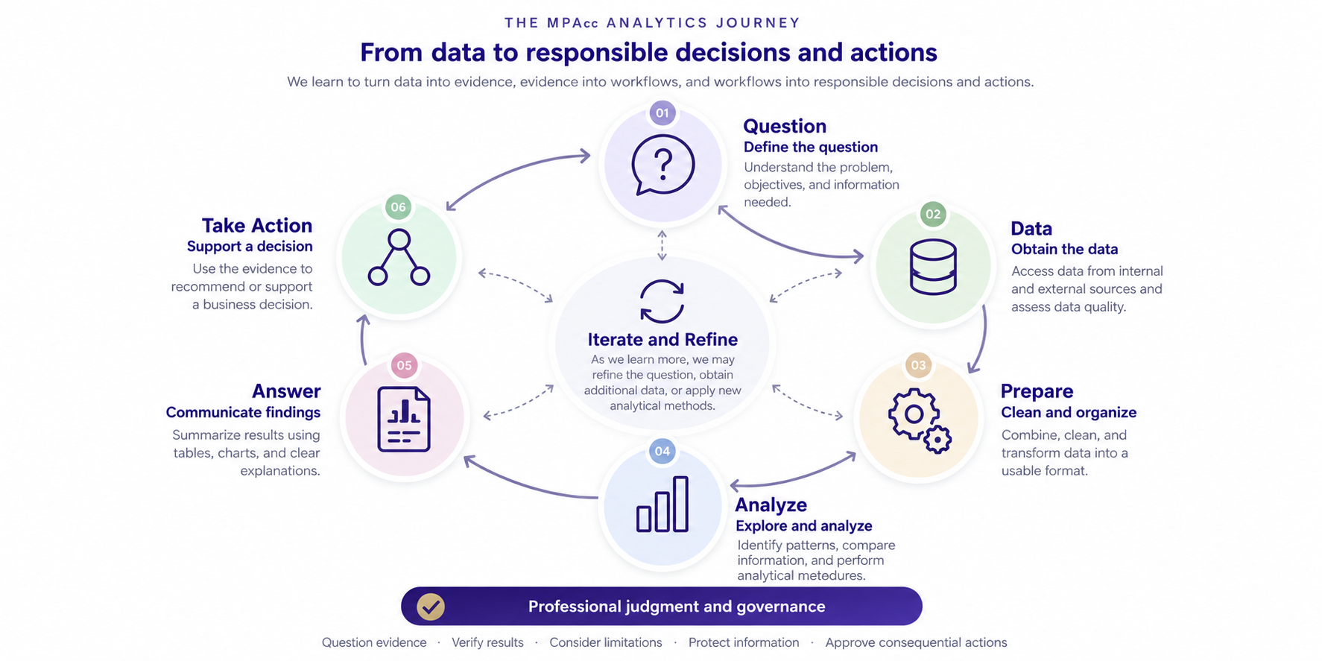

Slide 4
Review
Key takeaway: Understanding how raw data is delivered and how we transform it is essential to producing reliable analytical evidence and automating repetitive workflows.
Once a process is understood, automating that process reliably becomes possible.
Workflows that are repetitive are good candidates for automation, tools like SQLite and powerBI (among many others) provide automation possibilities.

Slide 5
Agenda
Review
Labs SQL cases
  Oh Canada 2
  Oh Canada 3 & 4 (includes individual submission)
Conclusion & Look Ahead

Slide 6
Remote labs
Use git pull to extract data from the class github.
Labs SQL cases
  Oh Canada 2: Warm up & refresher from EYARC Live SQL material.
  Oh Canada 3 & 4:
    More challenging queries plus open-ended questions (Q10 in both cases).
    Report to me in conversation what you would report to the client in Case 3 (Q9).
    Write down a response to Q10 in either or both case 3 & 4 as your submission.

Slide 7
Agenda
Review
Labs SQL cases
  Oh Canada 2
  Oh Canada 3 & 4 (includes individual submission)
Conclusion & Look Ahead

Slide 9
Summary
Today's key takeaway: Understanding how relational data is structured and how we query it to transform that data to answer questions is essential to producing reliable analytical evidence.
Relational data can be queried with Structured Query Language (SQL) to directly answer questions.
SQL provides a very rich and flexible way to query relational databases.

Slide 10
Next steps
Next topic: The ETL Process: Regular Expressions
A Core Data Analytic Skill, RegEx, allow us to transform raw text data using formulas (called regular expressions) to capture patterns in data
Develops data skills with Regular Expressions
We will use a combination of python and colabs / vscode, and online regex tools
Thank you!

