Slide 1
The ETL Process: Regular Expressions
ACCTG 522
Data Analytics for Professional Accountants
MPAcc Class of 2027
Class 07 | Autumn | 2026

Slide 2
Agenda
Review
Labs Enron Email Regex Exercises
  Regex101.com practice
  Google CoLab Exercise
Conclusion & Look Ahead

Slide 3
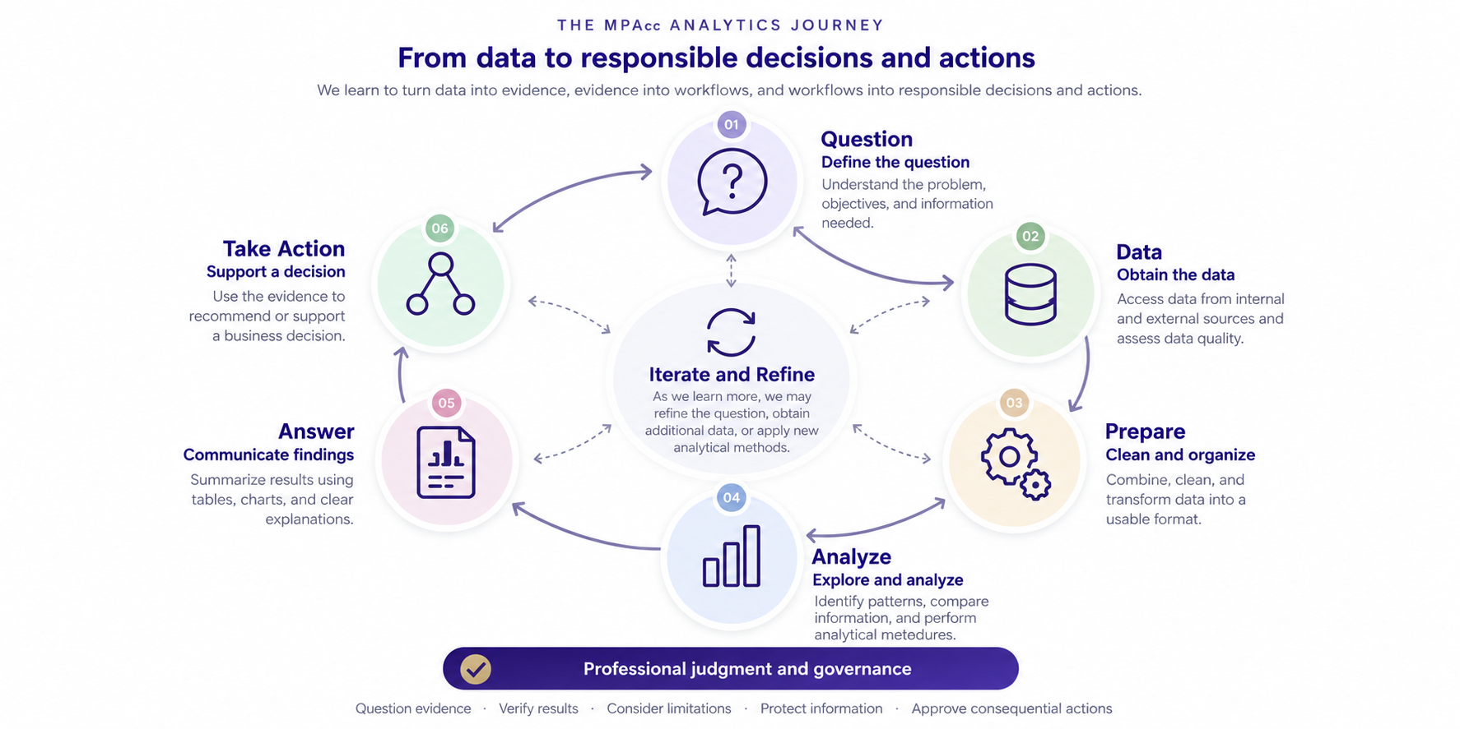

Slide 4
Review
Today's key takeaway: Understanding how relational data is structured and how we query it to transform that data to answer questions is essential to producing reliable analytical evidence.
Relational data can be queried with Structured Query Language (SQL) to directly answer questions.
SQL provides a very rich and flexible way to query relational databases.

Slide 5
Agenda
Review
Labs Enron Email Regex Exercises
  Regex101.com practice
  Google CoLab Exercise
Conclusion & Look Ahead

Slide 6
Regex101
A free online regex tool that we can use to cover some of the basics.
https://regex101.com/
Message-ID: <25828831.1075855376669.JavaMail.evans@thyme> Date: Mon, 26 Nov 2001 07:25:16 -0800 (PST) From: k..allen@enron.com To: jsmith@austintx.com Subject: RE: Additional properties in San Antonio Jeff, Can you resend the info on the three properties you mailed and the one you faxed on Tuesday. I was out of the office last week. Phillip -----Original Message----- From: "JEFF SMITH" <jsmith@austintx.com>@ENRON Sent: Tuesday, November 20, 2001 3:43 PM To: Allen, Phillip K. Subject: Additional properties in San Antonio Phillip, I am waiting to get info. on two more properties in San Antonio. The broker will be faxing info. on Monday. One is 74 units for $1,900,000, and the other is 24 units for $550,000. Also, I have mailed you info. on three other properties in addition to the 100 unit property that I faxed this AM. Let me know if you have any questions. Jeff Smith The Smith Company 9400 Circle Drive Austin, TX 78736 512-394-0908 office 512-394-0913 fax 512-751-9728 mobile jsmith@austintx.com

Slide 7
Agenda
Review
Labs Enron Email Regex Exercises
  Regex101.com practice
  Google CoLab Exercise
Conclusion & Look Ahead

Slide 8
Google Colab
We can upload the entire email dataset to colab and process it online:
https://colab.research.google.com/
Notebook (open>github): ashercurtis
  Select enron_email_new
  Select Enron_Email_Audit_Student.ipnyb
Download data first: https://github.com/ashercurtis/enron_email_new/blob/main/Cybersecurity_case_studies_Enron.csv
  Upload it to google colab by running first command.

Slide 9
Agenda
Review
Labs Enron Email Regex Exercises
  Regex101.com practice
  Google CoLab Exercise
Conclusion & Look Ahead

Slide 11
Summary
Today's key takeaway: Transforming unstructured email data into structured analytical evidence requires effective data preparation, pattern recognition, and careful interpretation of results.
Email data contains valuable information, but its unstructured nature makes systematic analysis challenging. Regular expressions (Regex) provide a flexible and powerful way to identify, extract, and transform patterns within text.
Analyzing the Enron emails illustrates how we can convert large volumes of communications into structured data to investigate potential risks.

Slide 12
Next steps
Next topic: The ETL Process: Text Analytics
Continue to develop data skills with Regular Expressions, to code text for analysis
We will use a combination of regex with other text analytics tools to undertake sentiment analysis
Thank you!

