Slide 1
Cases in Cybersecurity 1
Advanced Cases in Assurance Services (ACCTG 521)
Class 16 | MPAcc class of 2026

Slide 2
Agenda
Review
Deliverable
Lab:
Liberty Systems Cybersecurity Case

Slide 3
Review

Slide 4
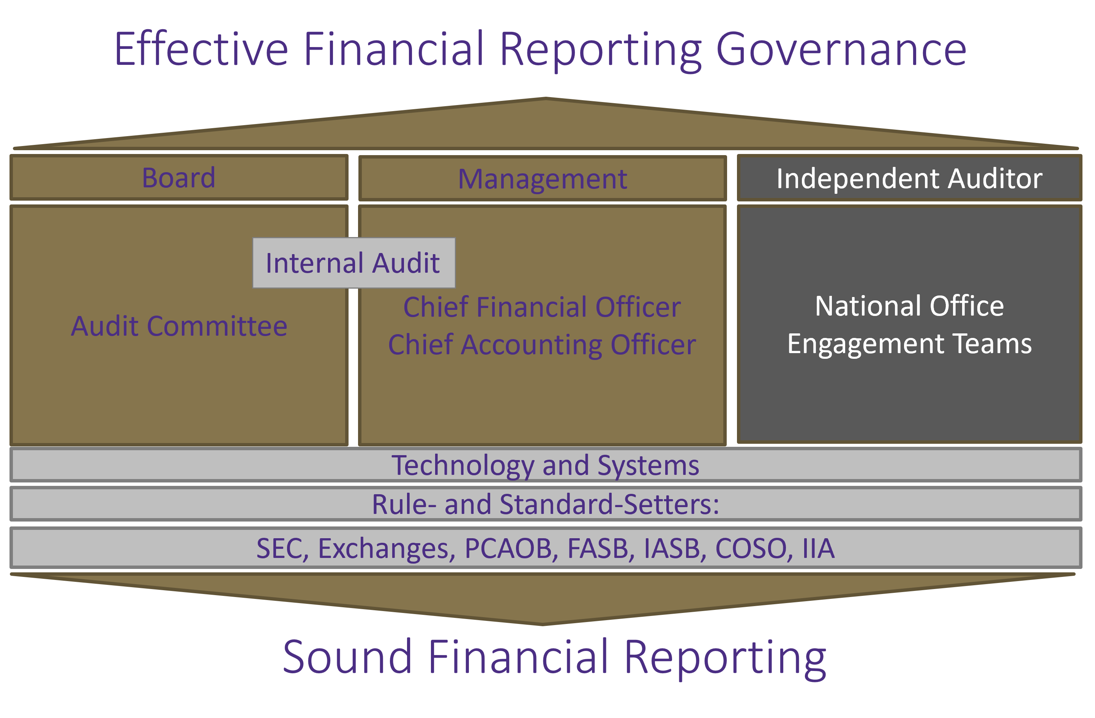
Helix Analyzer
Simulation
Blockchain Audit
Systems/controls: Pcard;
Alteryx suspicious transactions.
Early Classes on Economics of Audit, Systems: Transaction Analyses (incl: 522)
Notes:
Bob – Course Overview (3 legged stool)
Christina – Refer to Syllabus and go into depth on professionalism piece
See if class has any questions on syllabus

Slide 5
Cybersecurity
Notes:
Bob – Course Overview (3 legged stool)
Christina – Refer to Syllabus and go into depth on professionalism piece
See if class has any questions on syllabus

Slide 6
Management
Audit
First Line of Defense
Second Line of Defense
Third Line of Defense
Management Control
Enterprise Risk Management
Internal Audit/External Audit & Consulting
Legal & Privacy
Physical Security
The Business / Operations
Third Party Risk Management
Cybersecurity
Business Continuity Management
Compliance
Information Technology General Controls
ITGC : Testing and Compliance issues

Slide 7
Agenda
Review
Deliverable
Lab:
Liberty Systems Cybersecurity Case

Slide 8
Deliverable
A 1-page memo with a screenshot of your final Alteryx workflow.
The memo should answer the following (based on Q7 and Q8 of the case):
Based on your analysis, what do you believe should be the next steps for the external audit?
What other concerns do you have from reviewing the data? List at least three concerns you have and explain why you are concerned.

Slide 9
Agenda
Review
Deliverable
Lab:
Liberty Systems Cybersecurity Case

Slide 10
Today’s Challenge
Fewer steps makes a workflow easier to follow and debug, making it easier to share.
The Challenge: Do better than the following screenshot by using fewer tools.

Slide 11
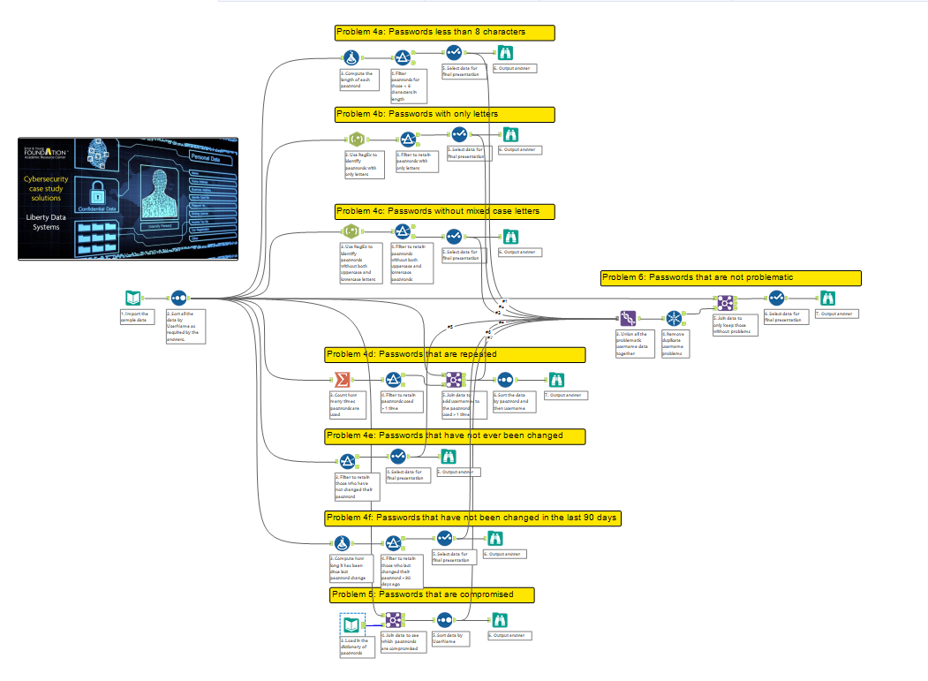
The goal to beat:
35 steps

Slide 12


Tool Suggestions
Formula tool can accommodate many expressions, including RegEx, and output data in many formats (e.g., Boolean).
Filter tool can accommodate many custom conditions using AND, with Boolean = 1 = True.

Slide 13
RegEx Help
RegEx that matches the following plain English:
Only lowercase letters:
“[a-z]*”
Upper and lowercase letters:
“.*[a-z].*[A-Z].*|.*[A-Z].*[a-z].*”
The “|” pipe delimiter is an “OR” operator.

Slide 14
Final Hints
Combine steps into Formula and filter tools, use boolen (or False=0/True=1) to simplify the filter conditions.
Final output is Passwords that are NOT problematic, you will find (only) 6 meet the criteria.

Slide 15

Thank you!

