Slide 1
Accounting & Finance Function 1
Data Analytics for Professional Accountants (ACCTG 522)
Class 13 | MPAcc Class of 2026

Slide 2
Welcome!
Class Agenda
Accounting & Finance Function Overview
Lab:
Case 1. General Ledger Case
Conclusion and look ahead

Slide 3
Accounting & Finance Function
Alteryx SparkEd Cases:
Five cases
Three Classes
One Challenge

Slide 4
Welcome!
Class Agenda
Accounting & Finance Function Overview
Lab:
Case 1. General Ledger Case
Conclusion and look ahead

Slide 5
Cleaning up the GL Case
Involved ETL case in three steps:
Read in the GL file: We will then examine the data to identify problems.
Extract/fill missing data: some new tools, some old tools.
Clean and output the file: including correcting field types.

Slide 6
Case 1 Challenge Levels
Completed Workflow
Hints and Tools
No Hints
Dynamic header solution

Slide 7
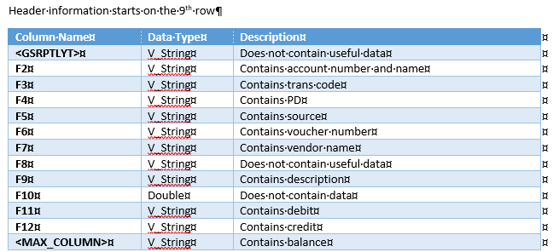
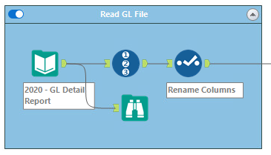
Start cleaning this up
Examine data for problems

Slide 8
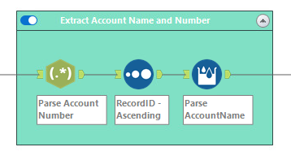
Sort data and use a *new* tool: multi-row formula
Regex

Slide 9
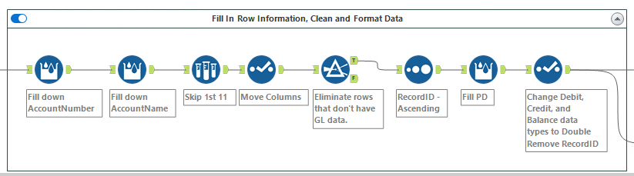
Complete the ETL process:

Slide 10
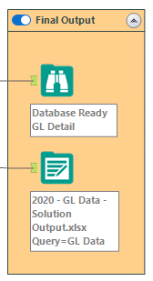
Output the data to excel:

Slide 11
Conclusion and look-ahead
Accounting and Finance Function:
Some data analytics tasks are good candidates for automated workflows:
Repeatable using the same workflow.
Tasks that are encountered frequently (e.g., monthly).
This approach is a modern alternative to a manual skill!
Saves time and reduces errors relative to a manual approach.

Slide 12
Conclusion and look-ahead
Next 3 classes:
Accounting and finance function analytics parts 2 and 3 using Alteryx (2 classes / 4 cases).
Alteryx Escape Room Challenge.

Slide 13

Thank you!

