Slide 1
Integrating Analytical Skills 1
ACCTG 320
Accounting Systems and Analytics
Class 09 | Autumn | 2026

Slide 2
Agenda
Review/Overview of workflows
Labs:
  Introduction to Alteryx
  Data quality revisions in Alteryx
  Time permitting additional Alteryx exercise
Conclusion and look ahead

Slide 3
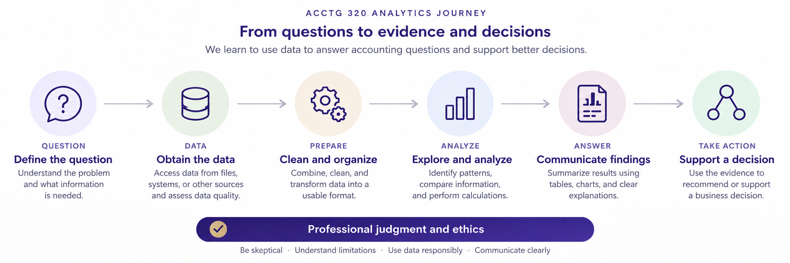

Slide 4
The course’s analytical journey
Define the business question and the decision it supports.
Obtain data and establish what each record and field represents.
Prepare and connect the data using appropriate rules.
Analyze and communicate evidence, including limitations.
Recommend an action justified by that evidence.
4

Slide 5
Data Analytic Workflows
Data Analytics, is a sequence of task, or a workflow:
Examples of workflows:
Combine monthly transaction files
Bank reconciliation
Duplicate invoice screening
Accounts receivable aging
Budget-to-actual analysis
Sales and gross-margin analysis
Employee expense compliance

Slide 6
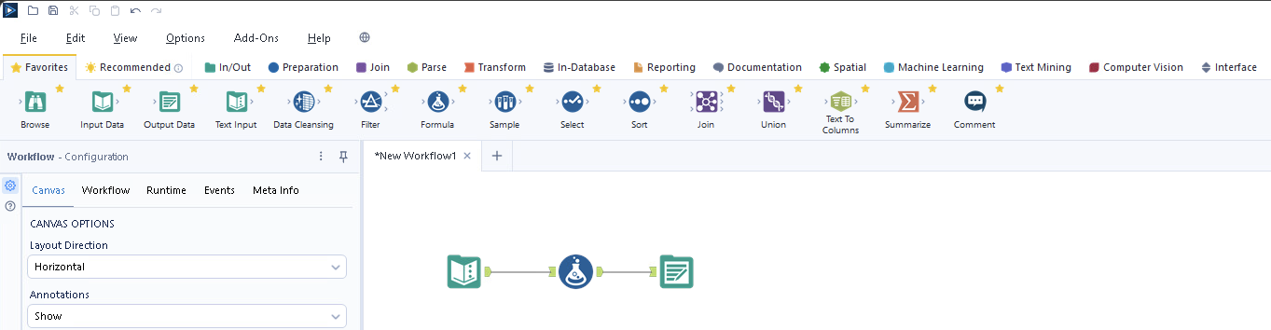
Why Alteryx?
Alteryx brings data preparation and analysis into a visual workflow, allowing us to connect analytical steps in a logical sequence that is easy to follow, check, and repeat.

Slide 7
How Can Gen AI tools assist with Alteryx?
Suggest tools: Describe your task and ask which Alteryx tool could help.
Guide setup: Ask how to configure a tool or write a formula.
Help debug: Share an error message or unexpected result to identify possible causes and checks.

Slide 8
Agenda
Review/Overview of workflows
Labs:
  Introduction to Alteryx
  Data quality revisions in Alteryx
  Time permitting additional Alteryx exercise
Conclusion and look ahead

Slide 9
Labs
https://fprod-hcs.foster.uw.edu/

Slide 10
Next steps
Next topic: Integrating Analytical Skills 2
We will continue to use Alteryx workflows to better understand business problems/decisions
Consider how financial and other data can be analyzed to understand various business problems
Thank you!

