Slide 1
Financial Screening and Signal Construction
ACCTG 522
Data Analytics for Professional Accountants (sit in Assessment teams)
MPAcc Class of 2027
Class 09 | Autumn | 2026

Slide 2
Agenda
Review
Overview and Discussion
Final Project Screening Task & Template
Conclusion & Look Ahead

Slide 3
Text Analytics
Text analytics provides opportunities to calculate quantitative data from text:
Regex can help find patterns and quickly return matches that can be used to:
  Count word searches, look up dictionaries of words.
Text Analytics is a developing field, with many new ways to quantify text being developed. Some reasonably established approaches can:
  Use readability analytics to measure writing complexity.
  Use various approaches to assess the sentiment/tone of text (e.g., Bag-of-words/Dictionary; FinBERT; and many more including Generative Pre-trained Transformers).
  Semantic search retrieves related meaning and can be used with other analytics (e.g., sentiment around specific paragraphs in the MD&A).

Slide 4
Financial narrative adds context to the numbers
Financial statements report outcomes. Narrative describes management’s explanations and expectations (typically in the MD&A but also in conference calls, other parts of the 10-K/Q, and 8-Ks).
Textual analytics helps analysts examine many passages consistently following a rule.
To use modern text analytics, we will typically require an approach using code (e.g., Python is likely a good choice as it has modern open-source packages).
  Other tools like Alteryx, PowerBI, Excel have shortcomings in this area.
  SQL is not appropriate here; it is not designed for this task.
The key is understanding what data we want to extract (each team is different here).
Is there a role for Gen-AI?

Slide 5
Agenda
Review
Overview and Discussion
Final Project Screening Task & Template
Conclusion & Look Ahead

Slide 6
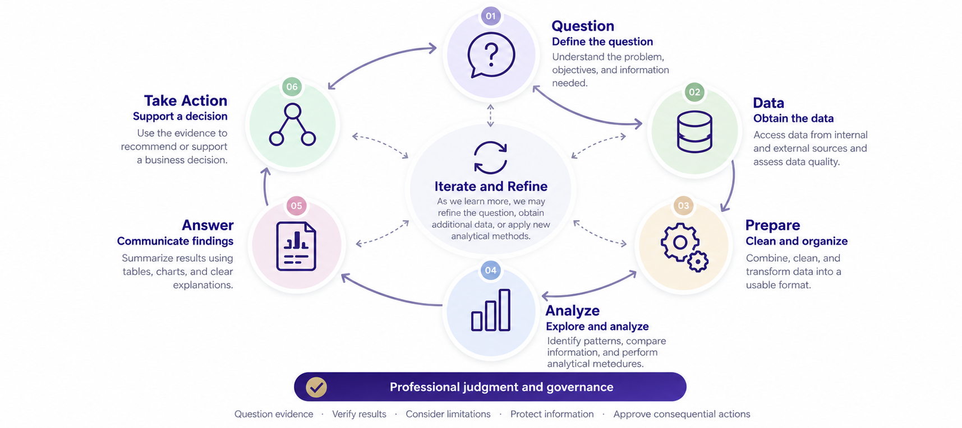
How does screening fit?
01: has been given in the case brief
05 and 06: Identify the long and the short. Proceed to the rest of the project.
04: Undertake the screen against selected data
02 and 03: Topic for today, lots of choices to make/plan

Slide 7
Stock screening and the extremes
Stock screening applies defined criteria to a universe of stocks to identify candidates for further investigation.
Why examine the extremes?
The highest and lowest values reveal the strongest contrasts in the characteristic we want to study, such as valuation or accounting quality.
How does backtesting help?
Form historical groups using information available at the time, then compare their subsequent returns. This tests whether the extremes distinguished outcomes after costs and risk considerations.
**Historical evidence supports evaluation of a screen. It does not guarantee future returns.
2

Slide 8
How to Screen Stocks
Data needed: Stock ID’s, Data to Test Eligibility, Data to measure economic indicators.
Where does the data come from?
Financial data can be found on EDGAR and through data providers.
FactSet as an example, has a screening tool, but it is limited.
Anything outside of FactSet will require a calculation and join to be useful.

Slide 9
Data and technology choices
FactSet: supplied fields and an integrated screen
Compustat: historical accounting inputs and custom measures
CRSP: returns, market inputs, and event windows
EDGAR and text: additional documents and derived evidence
Implementation choices: EDGAR APIs, FactSet, Excel, Alteryx, SQL, Python, Power BI, Tableau
EVAL supports forecasting and valuation for shortlisted firms.

Slide 10
The process that transfers between tools
Stage | Decision and evidence to retain
1 Establish eligibility | Identify the permitted universe. Record filters, observation dates, and requirements needing separate verification.
2 Define the screen | Explain the economic rationale, factor definitions, ranking direction, and treatment of missing or invalid values.
3 Obtain and prepare data | Select sources, standardize units and periods, and check company and security identifiers.
4 Calculate and compare | Apply the same rules across peers. Retain inputs, calculations, exclusions, and ranked output.
5 Investigate candidates | Check surprising results and explain why the proposed long and short fit the intended traits.
6 Analyze and value firms | Load historical information into one EVAL workbook per firm. Develop forecasts and valuations for shortlisted companies.

Slide 11
Potential screening variables
FactSet
Adding Compustat
Adding CRSP
EDGAR and text
Industry and eligibility
Market value of equity
P/E and P/B
Other valuation ratios
Margins and turnover
Accruals / cash conversion
Working-capital trends
Asset growth
Earnings momentum
Piotroski F-score
Mohanram G-score
Dechow F-score
Beneish M-score
Altman Z-score
Financing / dilution
QMJ quality components
Share-price momentum
Beta / return volatility
Custom valuation
Earnings surprise / PEAD
Quality / distress extensions
Short interest / days to cover*
MD&A / call sentiment
Disclosure changes
Critical audit matters
SEC correspondence
Non-GAAP / GAAP gap
Insider transactions
Categories can overlap. Full QMJ and some distress measures need market inputs.
*Short-interest positions require an additional dataset. CRSP supplies some denominator inputs.
17

Slide 12
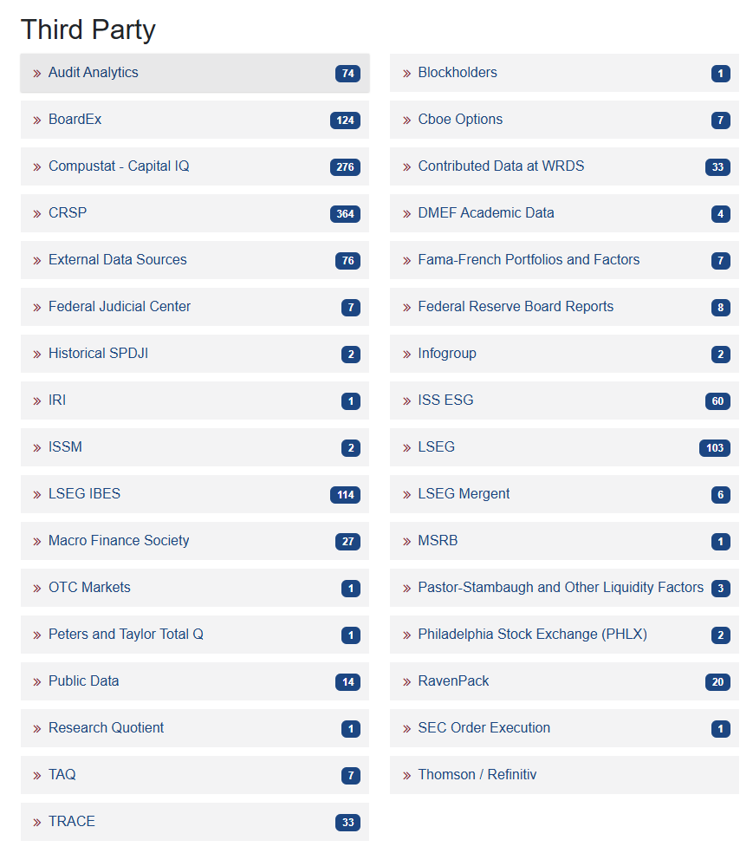
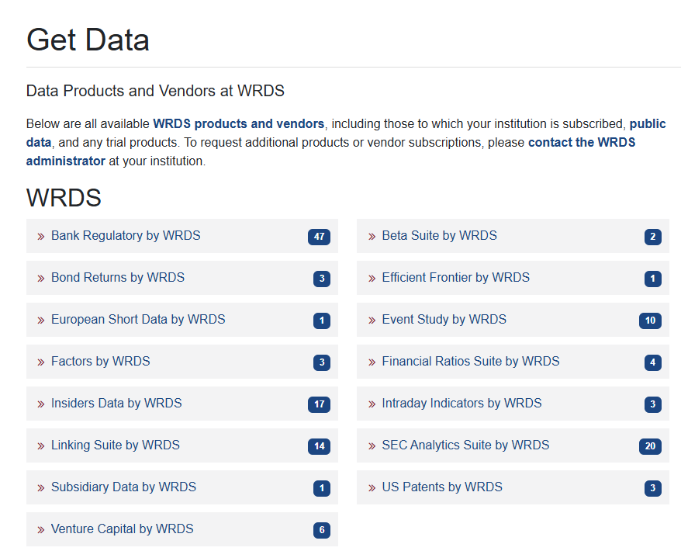
WRDS: Data Available

Slide 13
Agenda
Review
Overview and Discussion
Final Project Screening Task & Template
Conclusion & Look Ahead

Slide 14
Team data access requirements: Today’s task
FactSet
WRDS / Compustat
WRDS / CRSP and CCM
EDGAR
Additional datasets
EVAL
Other source
Required history and latest available date
Identifiers needed to combine sources
Source for November 6 eligibility checks
Data to request from the instructor
Access issue most likely to delay the team
For each source: data needed, access status, owner, and next action
Calculation environment, access test date, next check, and due date
22

Slide 15
Eligibility, screening, and pair selection
Eligibility establishes which securities the project permits.
Screening compares eligible firms using economically justified measures.
Pair selection requires investigation and an explanation of the chosen firms.
DISCUSSION
Can a firm pass every eligibility filter and still be a poor long candidate?
3

Slide 16
AI use and completed business work
MIT (2025) and McKinsey (2026) reports describe a gap between AI use and business outcomes.
Individual time savings can coexist with limited enterprise financial impact. For enterprises, AI coding assistants can help make processes more complete and accurate.
For this project, assess the complete screening process, including verification. If AI is used in the workflow, it needs to be part of the submitted workflow.
DISCUSSION
What would demonstrate that AI improved your analysis?
4

Slide 17
AI as an assistant and as a measurement method
AI helps build the analysis
AI supplies a measured value
Drafts a formula, translates SAS, or writes a workflow.
Students inspect the logic and reproduce the calculations.
Assigns sentiment or classifies an accounting concern.
Students validate the labels against source passages.
DISCUSSION
Which role would AI play in your proposed screen?
5

Slide 18
FactSet
Examples: industry filters, P/E, P/B, and market value of equity
AI contribution
Student verification
Translate an investment idea into candidate filters.
Explain ratios and suggest comparisons.
Confirm actual fields and dates.
Check that the executed screen matches the economic question.
DISCUSSION
Would the lowest P/E firm necessarily be your best long candidate?
6

Slide 19
Adding Compustat
Examples: accruals, asset growth, Piotroski, Dechow, and Mohanram scores
AI contribution
Student verification
Translate published definitions into calculations.
Generate intermediate outputs and checks.
Check model versions, base fields, units, lags, and missing values.
Recalculate selected firms independently.
DISCUSSION
If the code runs successfully, what have we established?
7

Slide 20
Adding CRSP
Examples: momentum, beta, custom valuation, and earnings-announcement analysis
AI contribution
Student verification
Help implement company–security links.
Construct return windows and combine accounting with market data.
Check link validity, dates, corporate actions, and duplicates.
Exclude information unavailable at the screening date.
DISCUSSION
How could a correct-looking merge produce an incorrect ranking?
8

Slide 21
Adding EDGAR and textual analytics
Examples: MD&A sentiment, disclosure changes, CAMs, and SEC correspondence
AI contribution
Student verification
Extract passages and compare documents.
Help classify topics or implement a defined text measure.
Check retrieval coverage and extraction.
Retain supporting passages and review ambiguous classifications.
DISCUSSION
How would you check whether the model applied the same rule to every firm?
9

Slide 22
Example 1: an Apple quality decile
“Can you calculate the AQR quality decile for AAPL?”
The prompt omits the date, comparison universe, and available inputs.
A plausible decile could reflect calculation, retrieval, or unsupported inference.
DISCUSSION
What evidence distinguishes calculation, retrieval, and unsupported inference for an Apple quality decile?
10

Slide 23
Example 2: a long and short recommendation
“Pick one long and one short in consumer discretionary.”
A persuasive narrative may precede any systematic comparison.
Sector membership alone does not establish industry comparability or project eligibility.
DISCUSSION
What would establish that a long and short screening process actually occurred?
11

Slide 24
Example 3: a supplied ticker list
AAPL, MSFT, NVI, JGO, KJH, LMNT, FOOD, DATA
“From this list, pick one short and one long.”
Company identity, listing status, and eligibility still require verification.
DISCUSSION
What should the model do before choosing from a supplied ticker list?
12

Slide 25
Total effort and tool choice
Generating an answer is one part of the work.
Data preparation, review, correction, and rerunning also require effort.
Tool choice should reflect the team’s question and ability to verify results.
DISCUSSION
If generation takes two minutes and checking takes two hours, what would you compare?
13

Slide 26
Evidence that supports an AI contribution
What work did AI perform?
Identify its contribution to design, implementation, or measurement.
What evidence supports its output?
Retain sources, calculations, settings, and supporting passages.
How would we detect an incorrect result?
Use independent checks and inspect exceptions.
14

Slide 27
Team screening plan
Which economic characteristic will your team’s screen identify?
Which data category and technology will your team use?
Where could AI help, and how will your team check its contribution?
What is the next missing input or implementation step?
Before submission: retain the process, investigate the pair, and refresh required eligibility checks.
15

Slide 28
FactSet screening discussion
Which characteristic is your team trying to identify?
Is a supplied field an adequate measure?
What additional evidence would distinguish an inexpensive company from a company that deserves a low price?
18

Slide 29
Compustat screening discussion
If two firms receive the same composite score, do their underlying strengths and weaknesses have to be the same?
Which score fits your economic question?
19

Slide 30
CRSP data requirements
Market observations add return histories and event windows to accounting measures.
The handout identifies the inputs needed for momentum, valuation, PEAD, and quality extensions.
Short-interest positions require an additional dataset.
20

Slide 31
EDGAR and additional sources
Which added source would change your ranking enough to justify its retrieval and validation effort?
21

Slide 32
Next steps
Next topic: Data Veracity and Validation
Understand verification/validation and data veracity in a world with Generative AI.
Thank you!

