Slide 1
Processing Data and Data Objects using Loops and Variables
Adv. Advisory | ACCTG 528 | Class 04
MPAcc Class of 2026

Slide 2

What will we do today?
Review of workflows
Loops:
Three example starter templates
Work on loops in your RPA workflows
Submit check-in (Canvas)

Slide 3
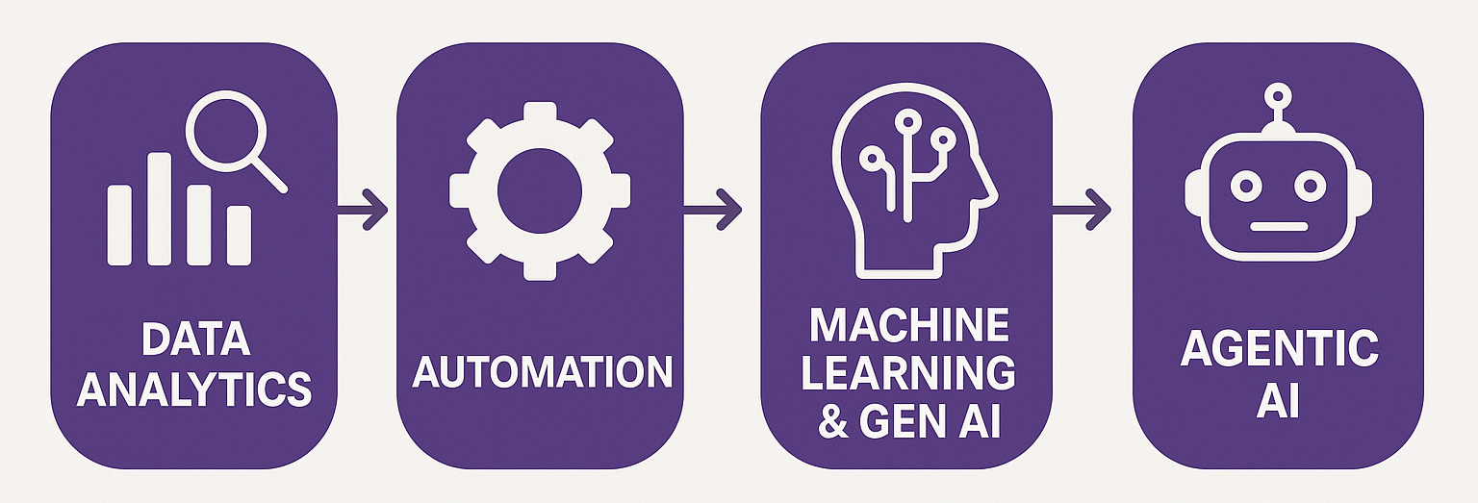
Course Diagram (high-level)

Slide 4




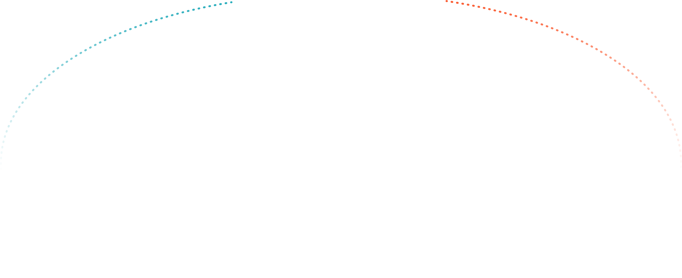


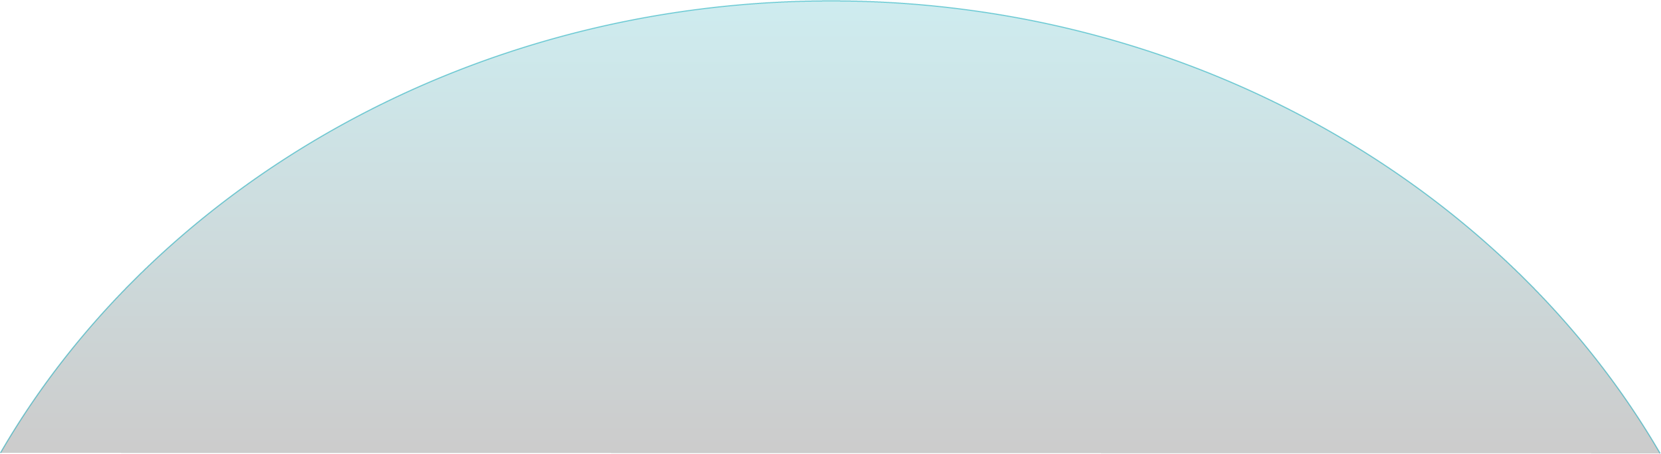

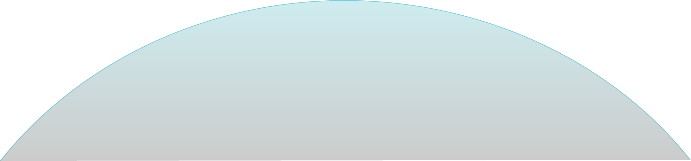

UiPath Agentic Automation
Notes:
Everything happens in one place: the UiPath Platform—where AI Agents aren’t just assistants, they’re true work partners, transforming complexity into a seamless, orchestrated operation.
We break it down into three powerful layers: Activities (the building blocks—reading, processing, integrating), Workflows (connecting the dots with human-in-the-loop and testing), and Processes (the big picture—managing, optimizing, and enhancing enterprise operations).
Agentic Orchestration / Maestro takes automation even further—coordinating UiPath Agents, third-party AI models, people, robots, and tools into a single, intelligent system.
Your existing systems don’t need to be reinvented—our platform integrates seamlessly with your data, applications, and workflows while maintaining enterprise-grade security, governance, and AI trust.
We’re not just compatible with your tech stack—we enhance it. From cloud providers like AWS, Google, and Azure to enterprise apps like Salesforce and SAP, we turn digital chaos into a symphony of efficiency.

Slide 5
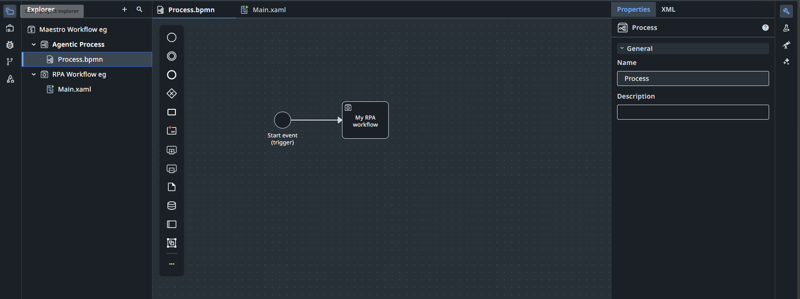
RPA Workflow (Studio)
Active overview
Triggers (Monday)
Currently active view (Maestro)

Slide 6
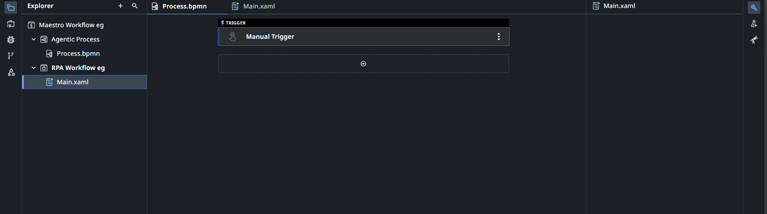
RPA Workflow (Studio)
Currently active view (Studio)

Slide 7
What will we do today?
Review of workflows
Loops:
Three example starter templates
Work on loops in your RPA workflows
Submit check-in (Canvas)

Slide 8
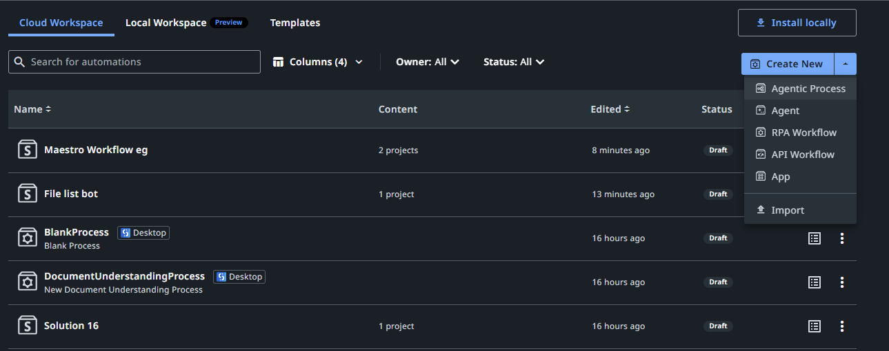

Slide 9
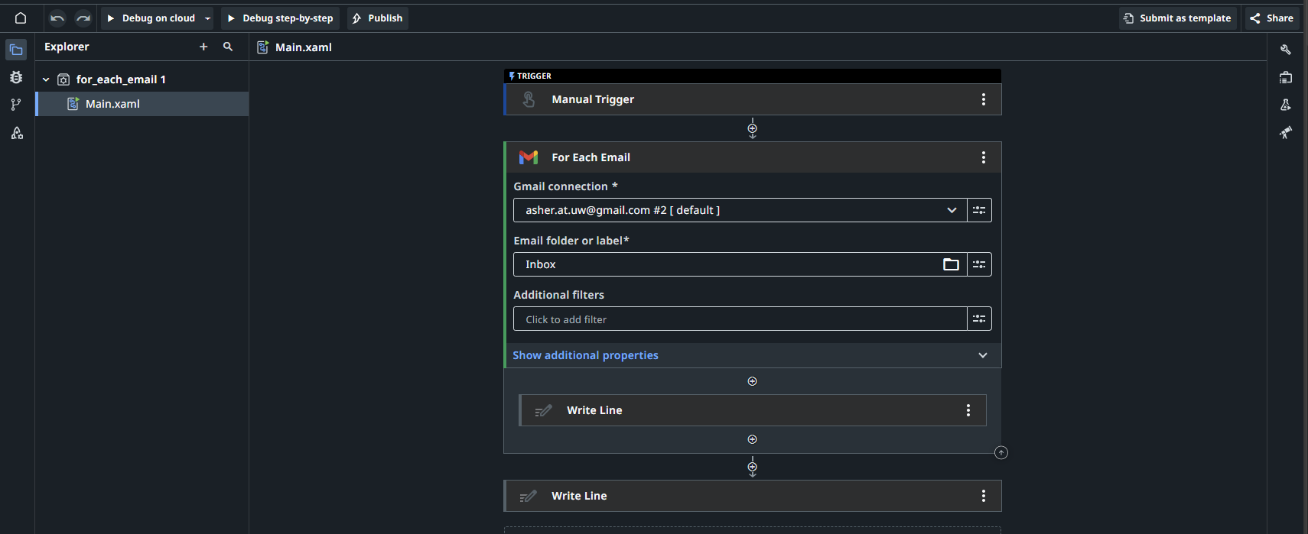
Outside the loop
The loop – all activities inside the boundary are in the loop

Slide 10
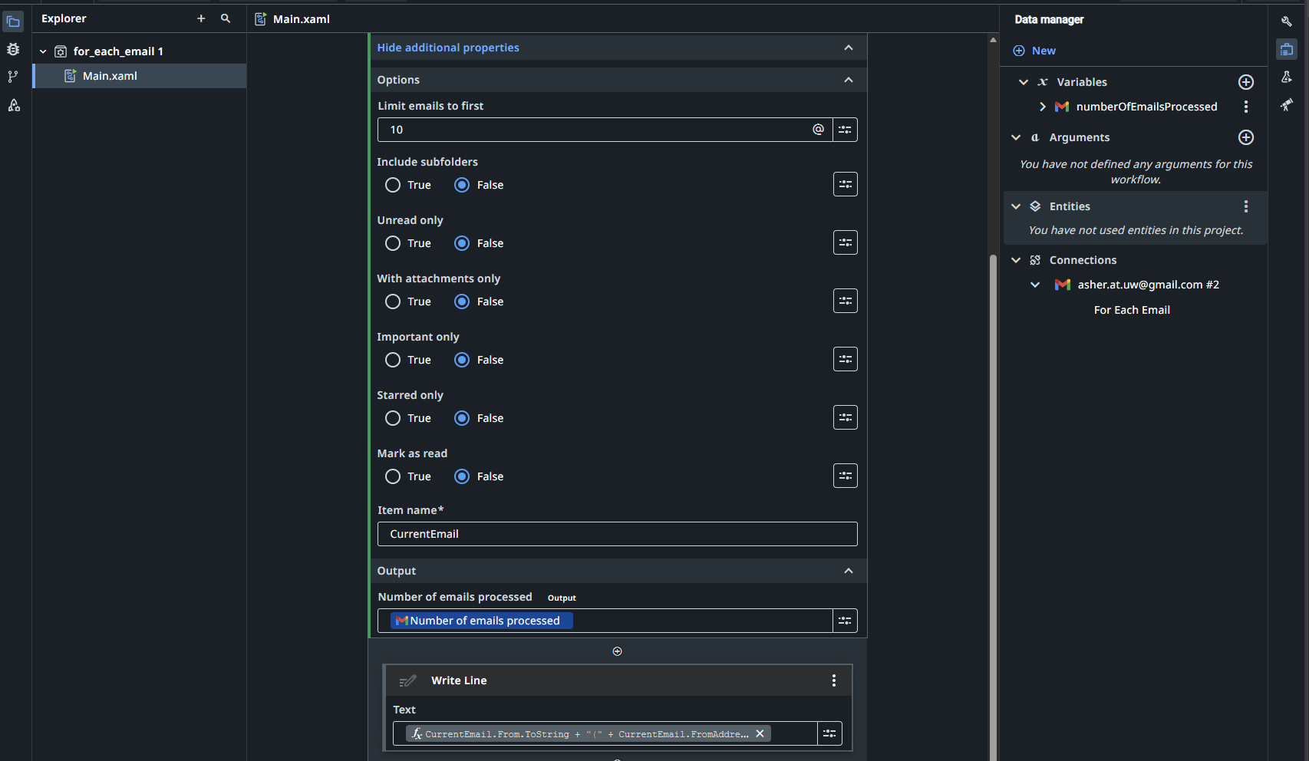
Inside the loop
Data manager (studio view)

Slide 11
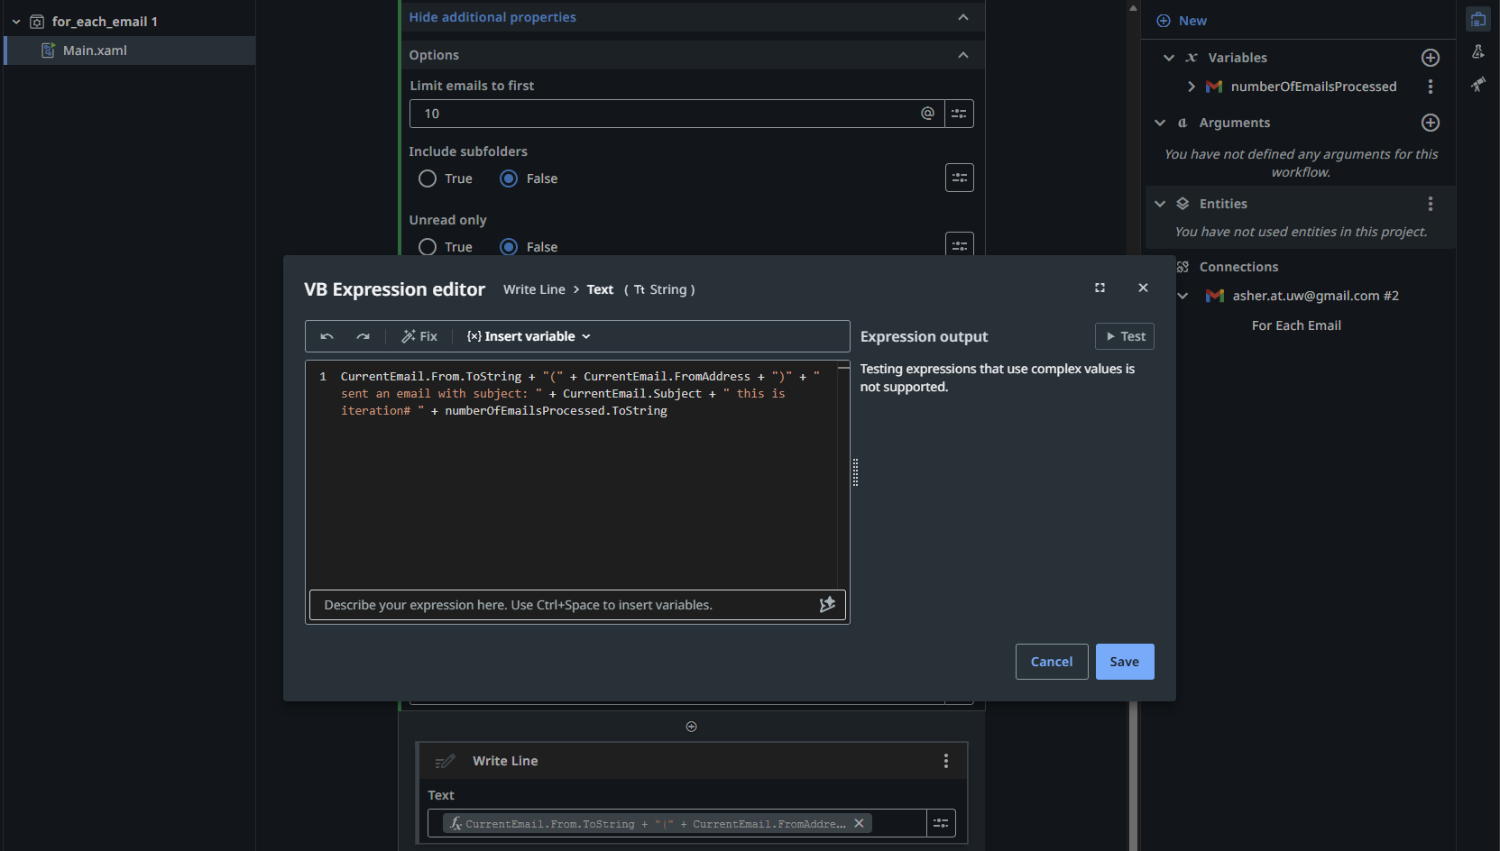
Expression editor

Slide 12
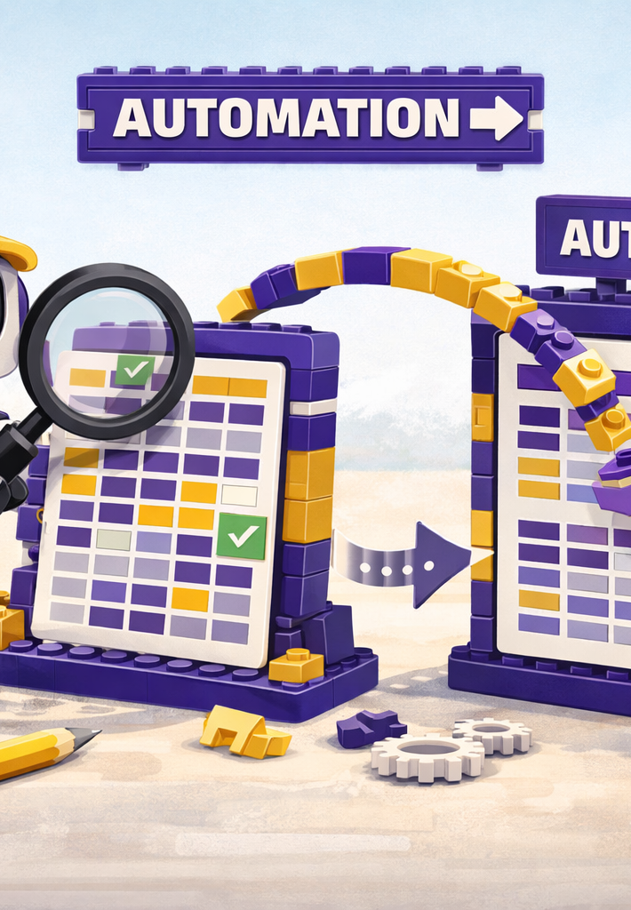
Where we will go next
Spreadsheets
Triggers
Controls
Costs and benefits of RPA
Selection of Tasks for RPA versus Agent
Manipulation of files

Slide 13
Thank you

