Slide 1
Data Veracity: Generative AI 2
Advanced Cases in Assurance Services (ACCTG 521)
Class 14 | MPAcc class of 2026

Slide 2
Agenda
Review: Individual Deliverable (Due Nov 13th)
Labs:
ETL for Multiple Input Files
Preliminary Assessments of Gen AI Sophistiation
Time for Memo Writeup

Slide 3

Swindler Case Part 2

Slide 4
Part Two Requirements
Perform at least seven tests that will help determine if the data set is real or fake. Your tests can use the data included in the file Skylar sent you or you can add external data. If you add external data, include the link in the test explanation showing where you acquired the data.

Slide 5
Memo Requirements
Documentation of Preliminary Testing Environment (last class)
Outline of Expectations (more sophisticated Generative AI, last or this class)
Analysis of Increasing Gen AI sophistication and implications (this class)

Slide 6
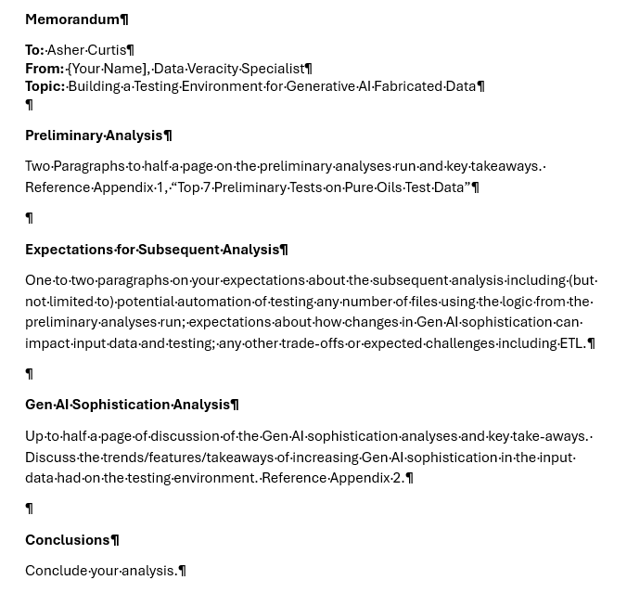

Slide 7
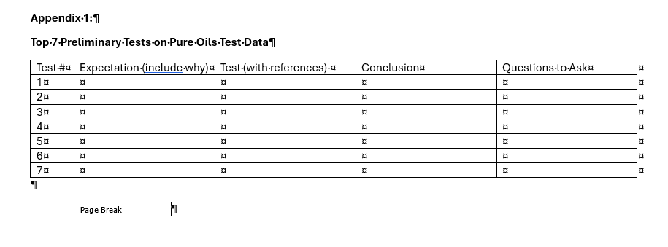
Directly from Case
+ Ask the Right Questions
Based on the conclusion from the test, what question would you ask the hypothetical manager / borrower?

Slide 8
If you didn’t complete this, change from expectations to actual ETL challenges,
if you did: footnote actual ETL challenges

Slide 9
Appendix 2
Depending on how you have set up your analysis:
Tabulate the results for submission types 1, 2, & 3
OR
Take screenshots of the test outcomes you want to discuss.
E.g., The more sophisticated prompt 2, did not fail test X as often as prompt 1, see Appendix 2 Table/Figure X
Write up as many of the tests as you feel support your conclusion, but don’t ignore contrary evidence.

Slide 10
In the Memo Text for Gen AI section
Link your discussion to the Appendix:
E.g., The more sophisticated prompt 2, did not fail test X as often as prompt 1, see Appendix 2 Table/Figure X
Write up as many of the tests as you feel support your conclusion, but don’t ignore contrary evidence.

Slide 11
Finally
Please upload your workflow(s) used in these two classes to the same portal as the memo
https://canvas.uw.edu/courses/1826714/assignments/10826325

Slide 12
Agenda
Review: Individual Deliverable (Due Nov 13th)
Labs:
ETL for Multiple Input Files
Preliminary Assessments of Gen AI Sophistiation
Time for Memo Writeup

Slide 13
ETL for multiple files
ETL Steps:
ETL selected data
Update your file to accommodate multiple files (or run them one-by-one)
Run your analysis for each level of sophistication.
**Note: In addition to your own file(s) you can git pull the class submissions to ACCTG 522.

Slide 14
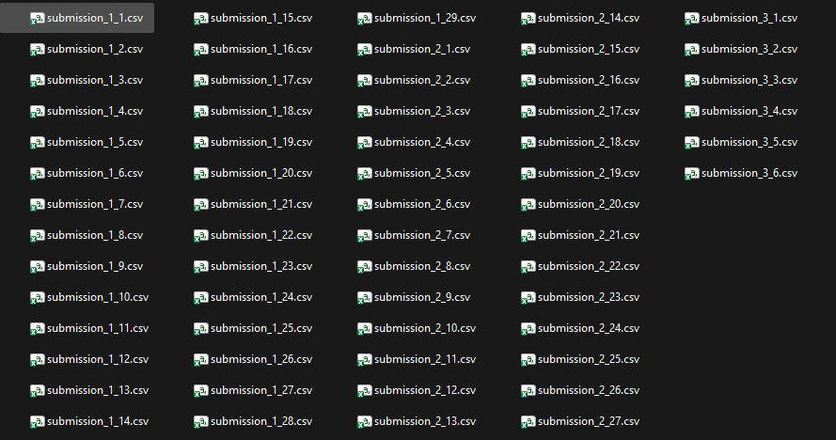
64 potential
input files

Slide 15
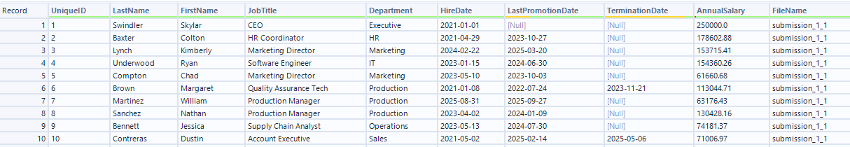
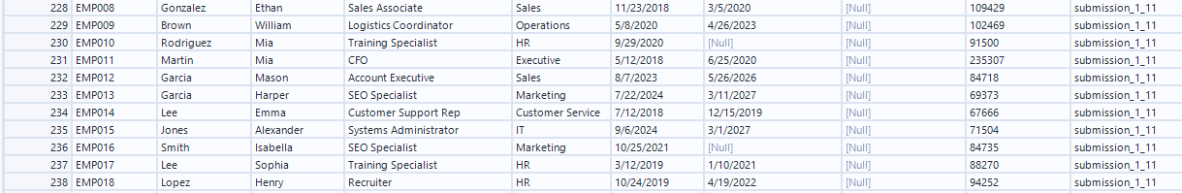
Date formats in the files:
yyyy-mm-dd
mm/dd/yyyy
dd-mm-yyyy etc.
ETL
Convert dates to Alteryx format

Slide 16
ETL Challenge levels
Use single files, class_prompt (1), followup (2) and python (3)
Use a post ETL File (only if you get stuck)
Create a new file for the ETL workflow (se hints on logic).
Do the ETL in as few steps as possible.

Slide 17
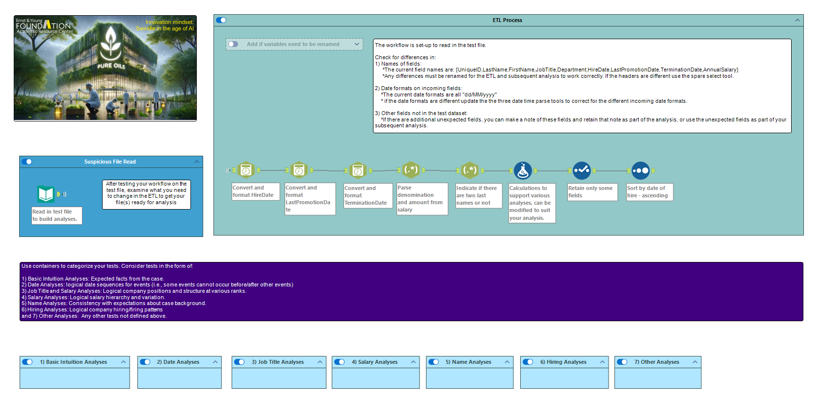
Remove these steps
if dates are formatted in the Alteryx file
Replace with
Alteryx file or individual files
Check that these steps are working for the new file(s)
Your Analysis from last Thursday is here

Slide 18
ETL Logic
Use wildcard * read of csv files in folder, keep filename
Create source w/ regex “submission_(\d)_\d+” (e.g., 1, 2, or 3)
Sort out the dates
Save file in Alteryx format

Slide 19
ETL Logic
Sort out the dates:
Replace / with – in all dates (replace() in formula tool)
Split to columns using –
Find max date part for each file (summarize tool)
Use logic to identify incoming date format mm<=12, dd<=31, yyyy>31 (formula tool, **one expression)
Use logic to parse Alteryx Dates using dateparse() in formula
**Use multi-field formula to parse all three dates where possible

Slide 20

Thank you!

