Slide 1
Advanced ETL and Textual Analysis
Data Analytics for Professional Accountants (ACCTG 522)
Class 4 | MPAcc Class of 2026

Slide 2
Welcome!
Class Agenda
(Extended) Review: Joins Case
Mini-Lab Alteryx Joins
Case Overview: Enron Emails Case
Lab: RegEx parsing of email header & subject/body
Tools (RegEx, DateTime)

Slide 3
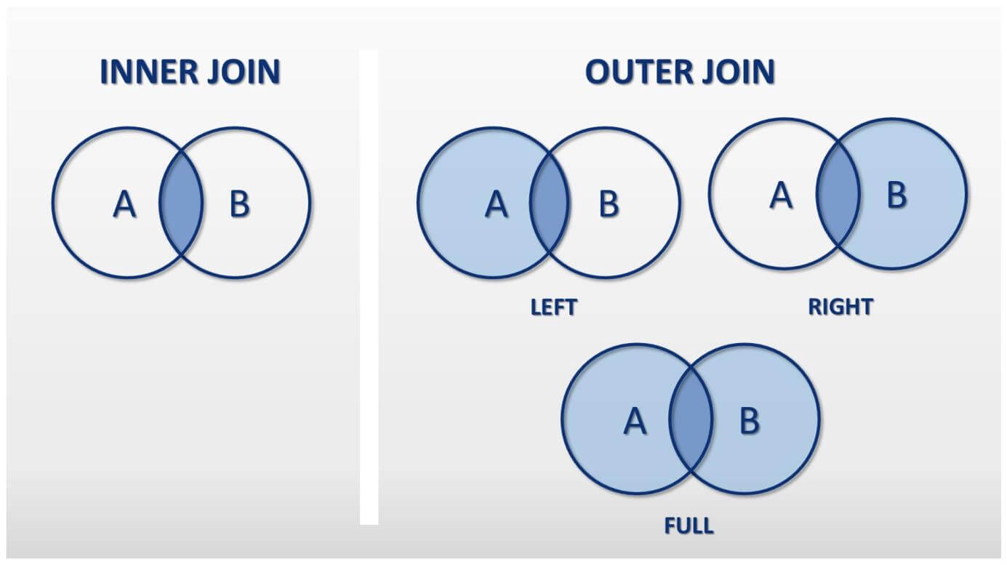

Slide 4
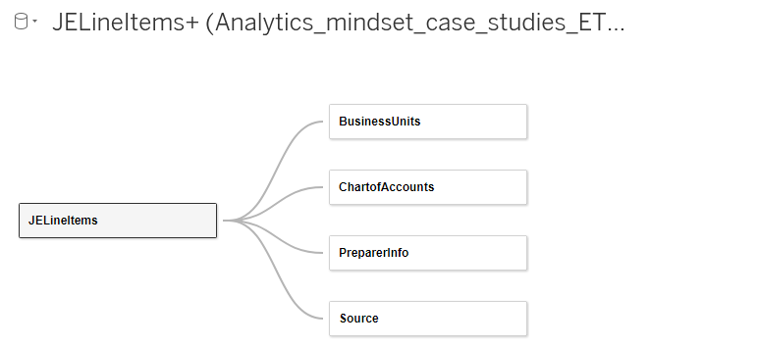
Tableau Relationships

Slide 5
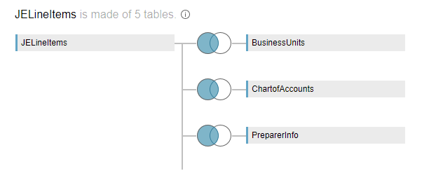
Tableau Joins

Slide 6
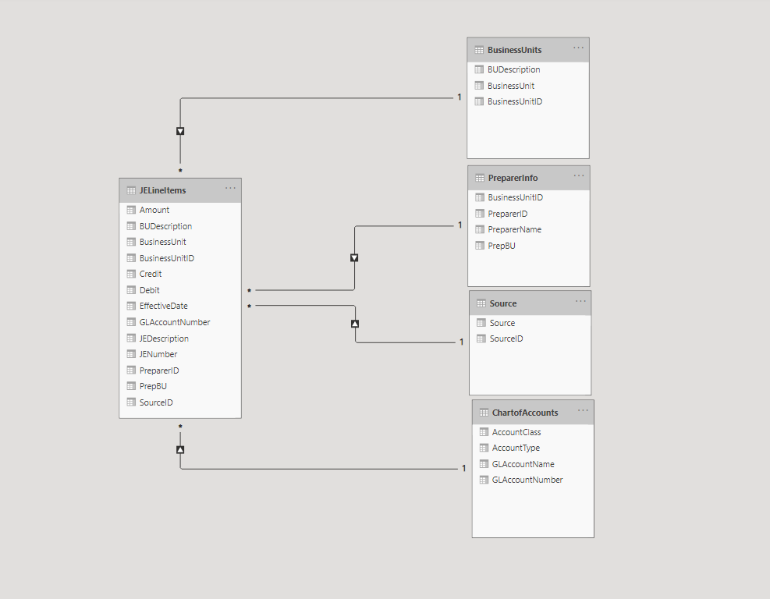
Power BI Data Relationships

Slide 8
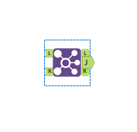
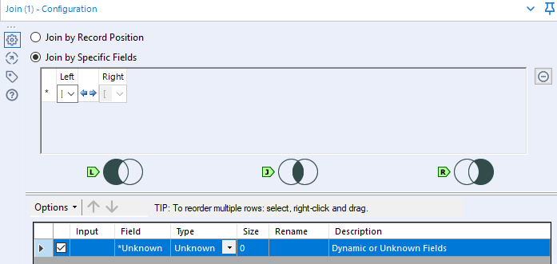
Alteryx Join Tool:
“L” input node
“L” output node
Alteryx explains what is kept for each node, e.g. “L” output

Slide 9
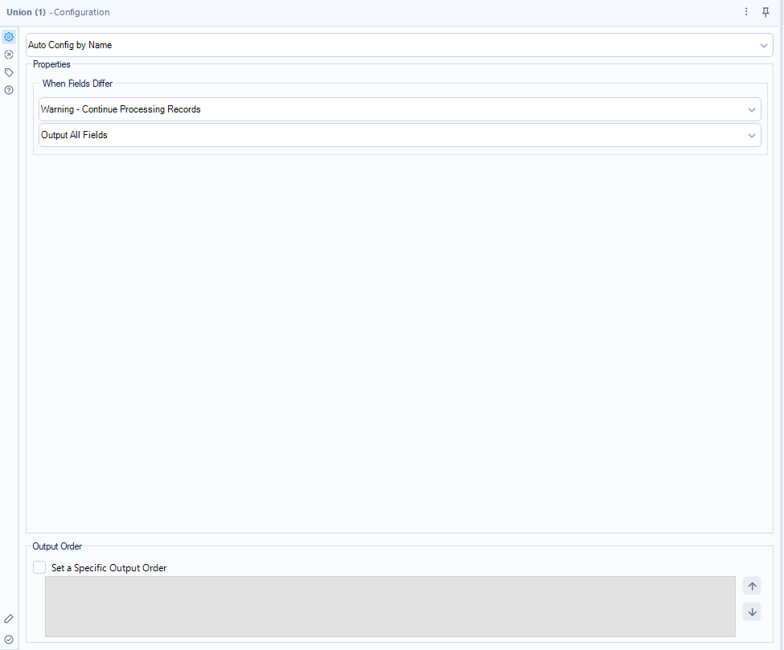

Alteryx Union Tool:
A
B
C
Multiple input node
Single output node
A
B
C

Slide 10
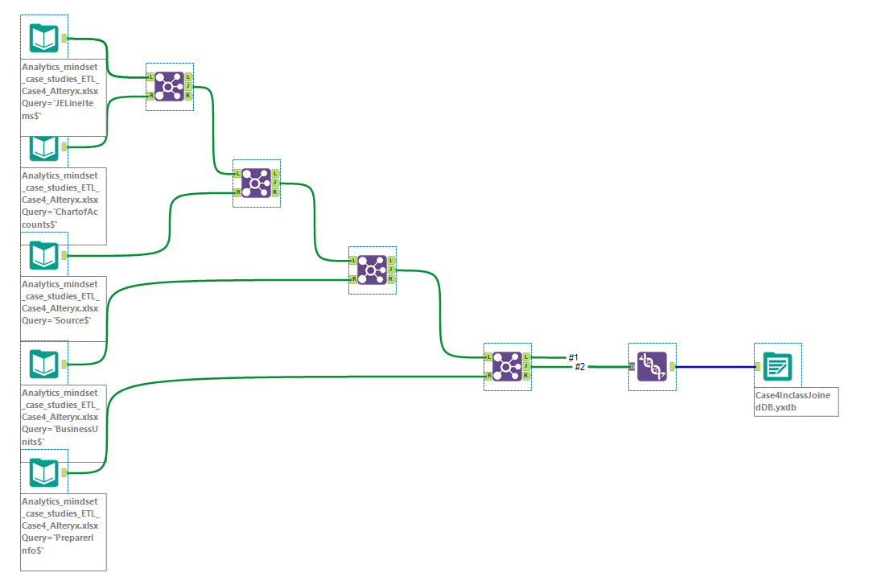

Slide 11
Agenda
Class Agenda
(Extended) Review: Joins Case
Mini-Lab Alteryx Joins
Case Overview: Enron Emails Case
Lab: RegEx parsing of email header & subject/body
Tools (RegEx, DateTime)

Slide 12
Case Overview:
Enron Emails Case

Slide 13
Regex101
Paste the example email below into https://regex101.com/:
Message-ID: <25828831.1075855376669.JavaMail.evans@thyme> Date: Mon, 26 Nov 2001 07:25:16 -0800 (PST) From: k..allen@enron.com To: jsmith@austintx.com Subject: RE: Additional properties in San Antonio Jeff, Can you resend the info on the three properties you mailed and the one you faxed on Tuesday. I was out of the office last week. Phillip -----Original Message----- From: "JEFF SMITH" <jsmith@austintx.com>@ENRON Sent: Tuesday, November 20, 2001 3:43 PM To: Allen, Phillip K. Subject: Additional properties in San Antonio Phillip, I am waiting to get info. on two more properties in San Antonio. The broker will be faxing info. on Monday. One is 74 units for $1,900,000, and the other is 24 units for $550,000. Also, I have mailed you info. on three other properties in addition to the 100 unit property that I faxed this AM. Let me know if you have any questions. Jeff Smith The Smith Company 9400 Circle Drive Austin, TX 78736 512-394-0908 office 512-394-0913 fax 512-751-9728 mobile jsmith@austintx.com

Slide 14
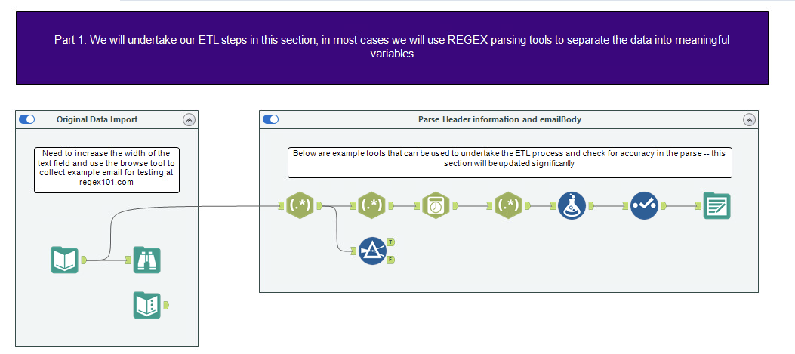
Enron Emails ETL Overview
We will use “Custom” Date-Time Parsing
Additional Formulas
Input data and browse to look at it
Retain and output data we want to keep
We will use Regular Expressions to break apart the text fields
One example email for practice

Slide 15
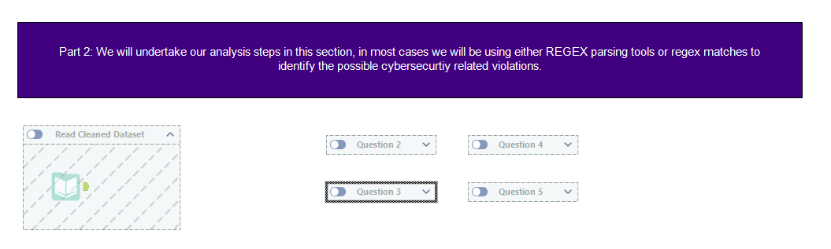
Enron Emails Analysis Overview
Teams will work on each question together
Start on:
Q2 (teams 1,2,3) -> Q3
Q3 (teams 4,5) -> Q2
Q4 (teams 6,7) -> Q5
Q5 (teams 8,9,10) -> Q4
Save dataset from part 1 and read it into Alteryx

Slide 16
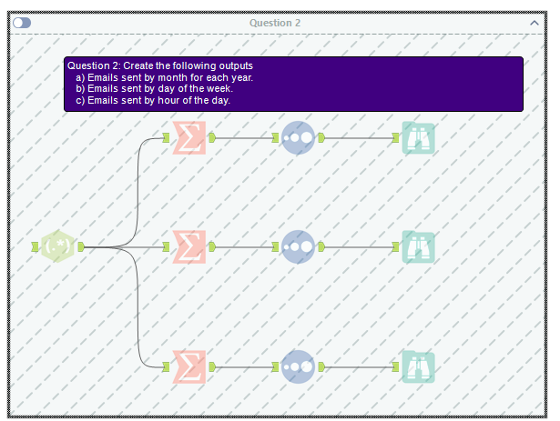
Enron Emails Analysis Hints

Slide 17
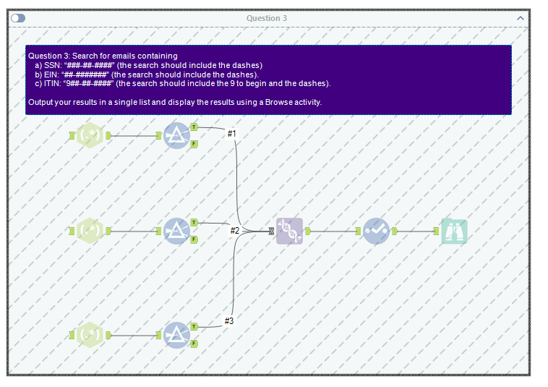
Enron Emails Analysis Hints

Slide 18
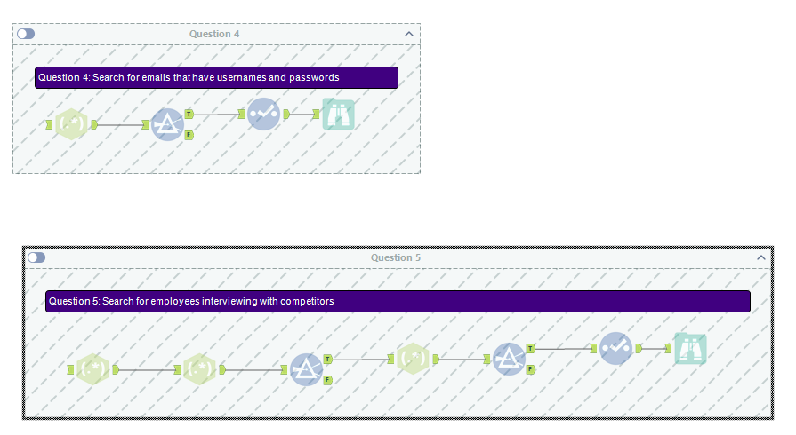
Enron Emails Analysis Hints

Slide 19
Extension: Enron Email Case
Extracting data from unstructured text, like emails, requires more advanced ETL tools. We can use regular expressions to:
Undertake open-ended exploration for suspicious email and negative sentiment/tone over time.

Slide 20
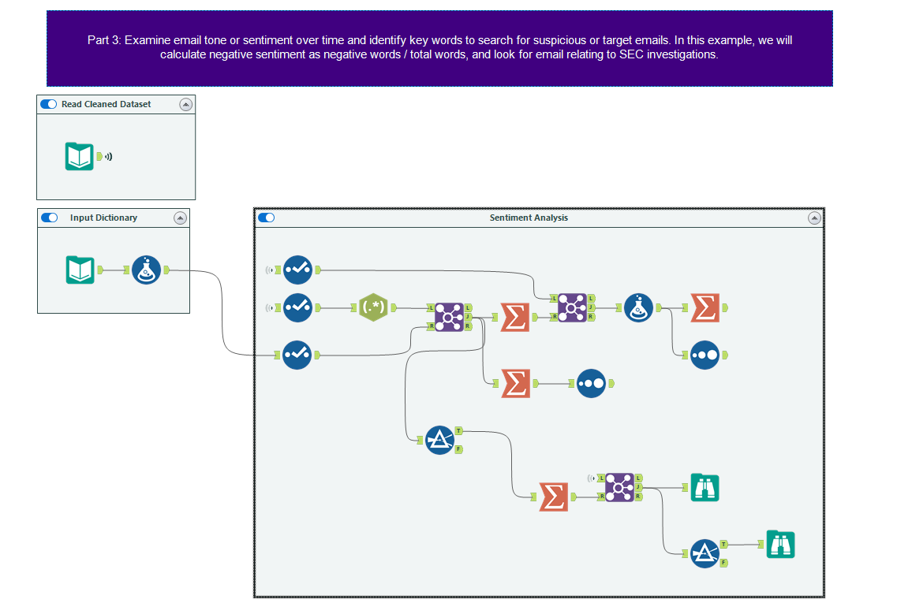
The parsed dataset
Formula tool to transform data for analysis
Extracts individual “words” \<\w+\> with Tokenize
2
Summarize tool used four different ways
1
Dictionary of positive/negative words
Sorting tool
3
Three different joins for different purposes

Slide 21
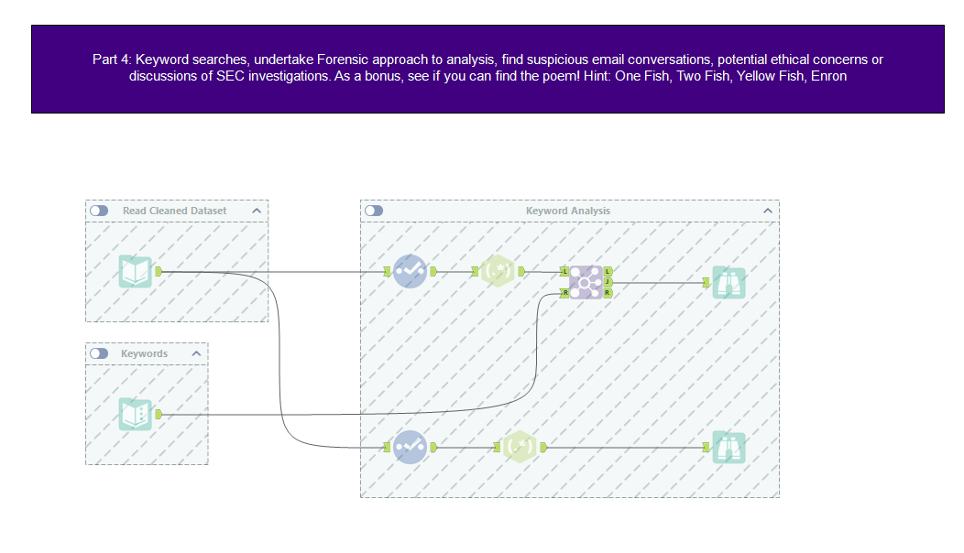

Slide 22
Conclusion and look-ahead
We have started using advanced tools to perform analyses on unstructured (email) data.
We will continue this on Wednesday with keyord and sentiment analyses.

Slide 23

Thank you!

