Slide 1
Accounting & Finance Function 2
Data Analytics for Professional Accountants (ACCTG 522)
Class 14 | MPAcc Class of 2026

Slide 2
Welcome!
Class Agenda
Review: Multi-Row Formula tool
Lab:
Case 2. Vendor Analysis / Suspect Vendors
Case 3. PO Splitting
Conclusion and look ahead

Slide 3
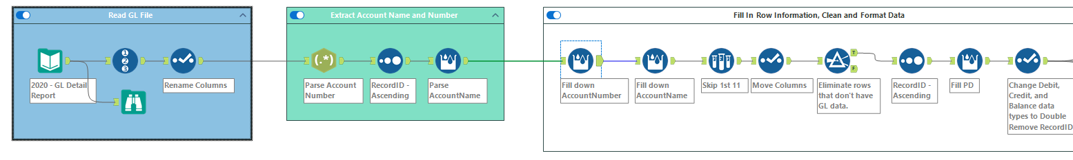
Multi-Row Formula Tool
Parse related field like row1:number, row2:name
Fill in missing values within a field (i.e., column)

Slide 4
Welcome!
Class Agenda
Review: Multi-Row Formula tool
Lab:
Case 2. Vendor Analysis / Suspect Vendors
Case 3. PO Splitting
Conclusion and look ahead

Slide 5
Overview
The U.S. Department of the Treasury's Office of Foreign Assets Control (OFAC) oversees U.S. economic and trade sanctions. These sanctions target certain foreign countries, known terrorists, narcotics traffickers, and other threats. OFAC strongly encourages companies to have a sanction compliance program that includes internal controls and auditing.
To ensure compliance with OFAC policies, invoices authorized for payment are checked against the OFAC Consolidated Screening List (CSL), which is a list of sanctioned individuals or entities maintained by the Office of Foreign Assets Control. Identify whether any of the provided vendors are on the OFAC CSL.

Slide 6
Objective
Determine whether any of the vendors are on the OFAC CSL. Create a single output file with all of the vendors that are on the list separated into three tabs based on the vendor’s status.
Additional note: In a real-world process we would want to check for names that are similar but slightly different (think Fred vs. Freddy). In this example, exact matches are all we are looking for, but in some instances companies might want to utilize fuzzy matching to identify pairs that are close but not exact.

Slide 7
Processes
Pull in the Vendors.yxdb file, clean the names by removing punctuation and standardizing the case, and ensure there is only one record for each Vendor ID.
Pull in the Consolidated Screening List – Modified.yxdb, clean the names by removing punctuation and standardizing case, and add a unique identifier to each record.
Identify the vendors that are present on the OFAC list, and organize those vendors by date with the newest vendors first. Remove any fields that are entirely blank.
Output an Excel file of those vendors with a separate tab for each status.

Slide 8
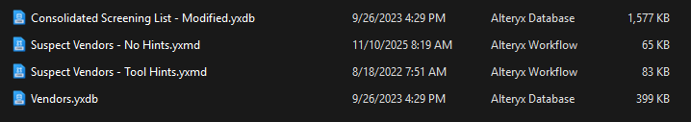
Starter files

Slide 9
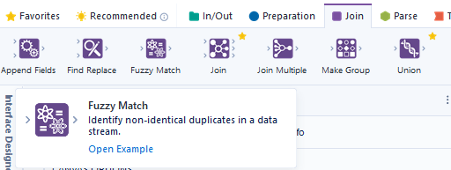
Extension
Determine whether any of the vendors are on the OFAC CSL. Create a single output file with all of the vendors that are on the list separated into three tabs based on the vendor’s status.
Also attempt: In a real-world process we would want to check for names that are similar but slightly different (think Fred vs. Freddy). In this example, exact matches are all we are looking for, but in some instances companies might want to utilize fuzzy matching to identify pairs that are close but not exact.

Slide 10
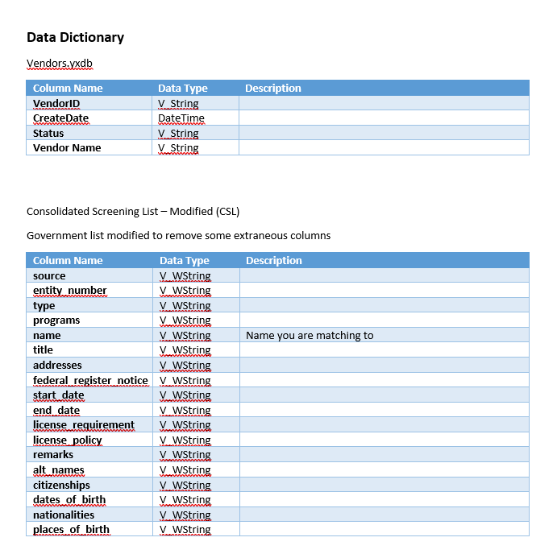
Are any of these names
On this list?

Slide 11
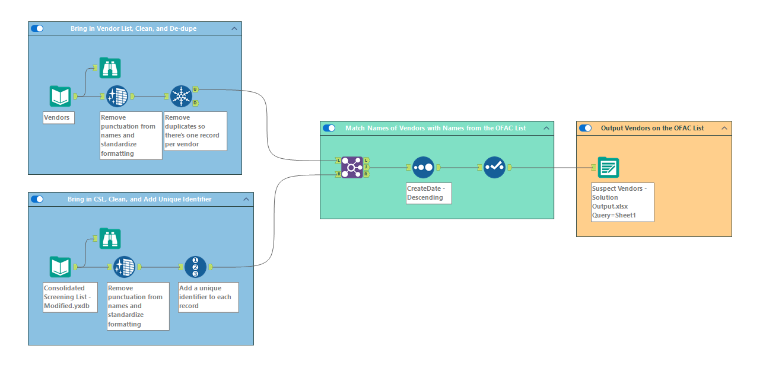

Slide 12
Welcome!
Class Agenda
Review: Multi-Row Formula tool
Lab:
Case 2. Vendor Analysis / Suspect Vendors
Case 3. PO Splitting
Conclusion and look ahead

Slide 13
Overview
In most companies, employees with purchasing authority have a monetary limit on how much they can purchase without management authorization. For example, an IT manager may be able to purchase up to $50,000 in software and equipment. Any amount over that would require director approval. In practice, this means that the IT manager requires director approval for any Purchase Order (PO) with a purchase amount over $50,000. If a manager wants to purchase $75,000, they could try to get around this by issuing two POs to the same vendor totaling $75,000 but each being less than $50,000. This is a violation of corporate compliance rules known as “PO Splitting.”

Slide 14
Objective
Create a simple workflow to detect PO splitting. In this case we are looking for multiple POs to the same vendor within a three-day period. At this point we are not checking to see if the same buyer is issuing the POs. (It is possible that there is collusion between employees to hide the splitting so there would need to be further examination of the POs found by our analysis).

Slide 15
Process
The input file has PO line-item detail. The first step is to remove inactive PO’s, eliminate fields specific to the PO line, and retain only one record for each PO.
Then identify the vendors to whom multiple POs have been issued.
Determine if there are any vendors where the interval between their consecutive transaction dates is 3 days or less.
Output this list for further investigation.

Slide 16
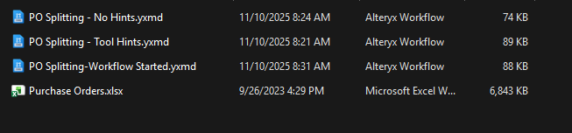
Starter Files

Slide 17
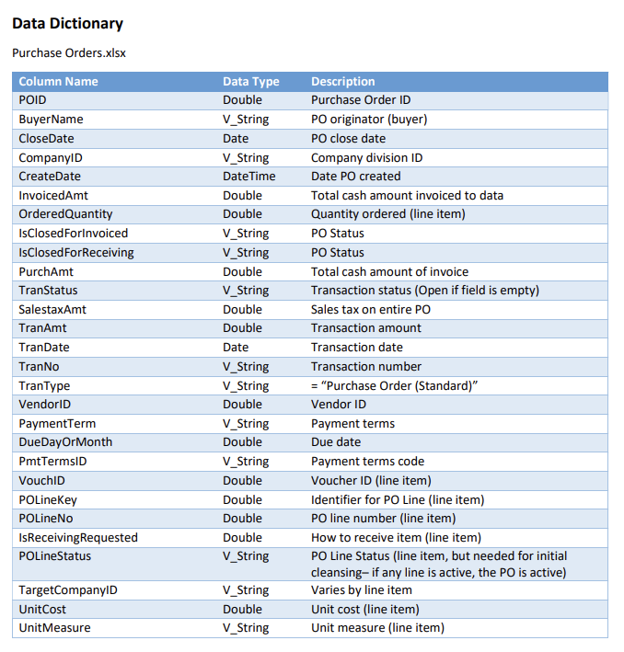

Slide 18
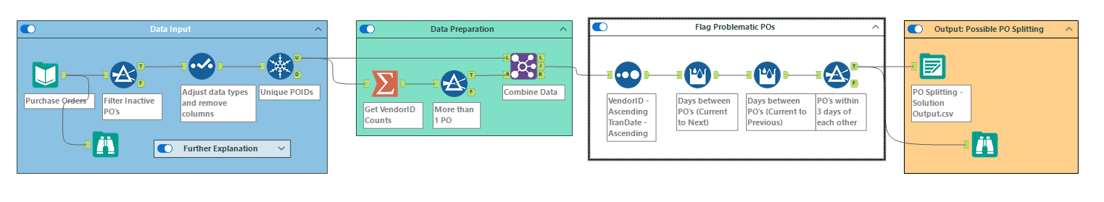

Slide 19
Conclusion and look-ahead
Next 2 classes:
Accounting and finance function analytics part 3 using Alteryx (1 class / 1-2 longer cases).
Alteryx Escape Room Challenge.

Slide 20

Thank you!

