Slide 1
Introduction to Automation Essentials
Adv. Advisory | ACCTG 528 | Class 02
MPAcc Class of 2026

Slide 2
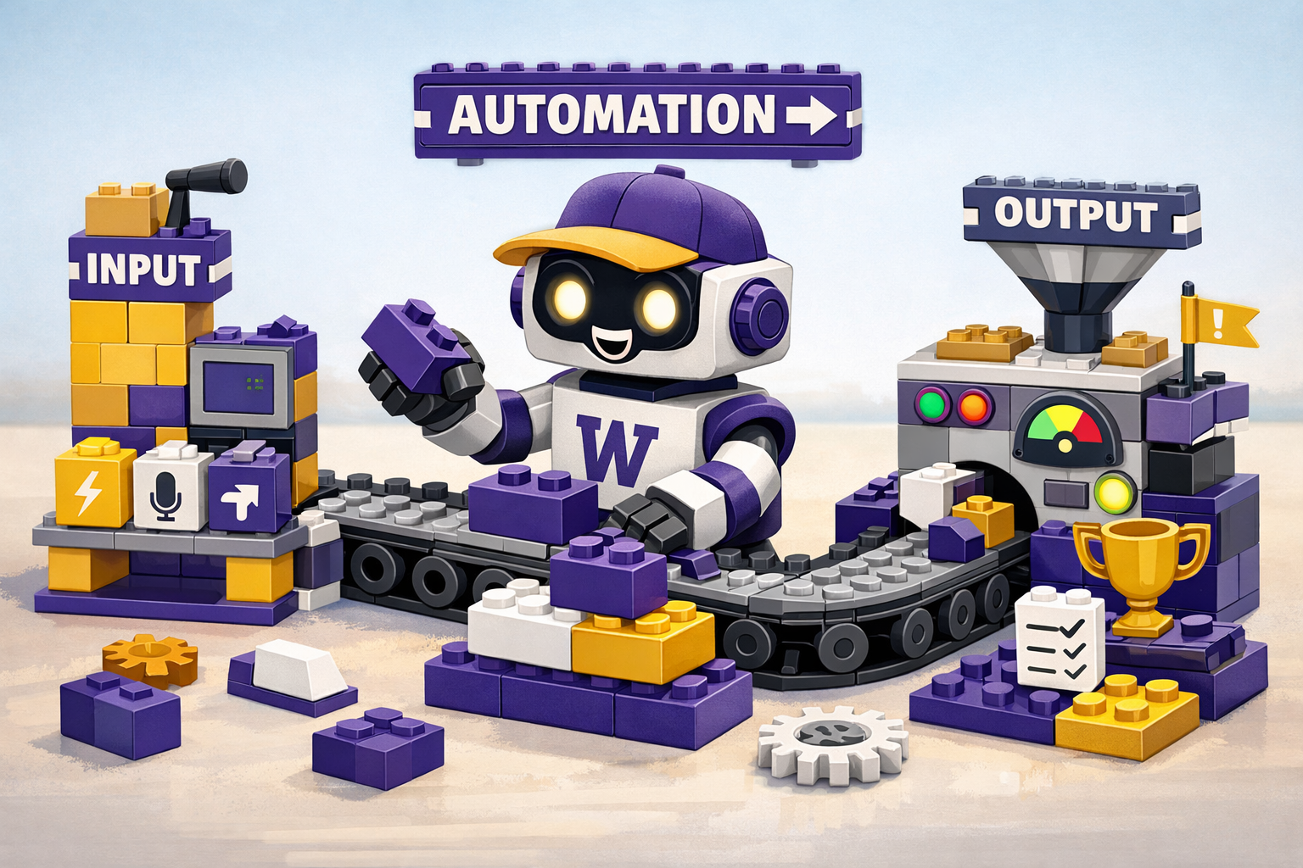
What will we do today?
Review of Class 01 (UiPath Cloud set-up)
Essential tools and concepts
Connectors and triggers (email, file-sharing platforms, APIs)
Folders, files, variables (and objects)
Activities and Loops
LLMs and LLMs as Agents (API connectors)

Slide 3
Automation Essentials | Review of Class 01

Slide 4
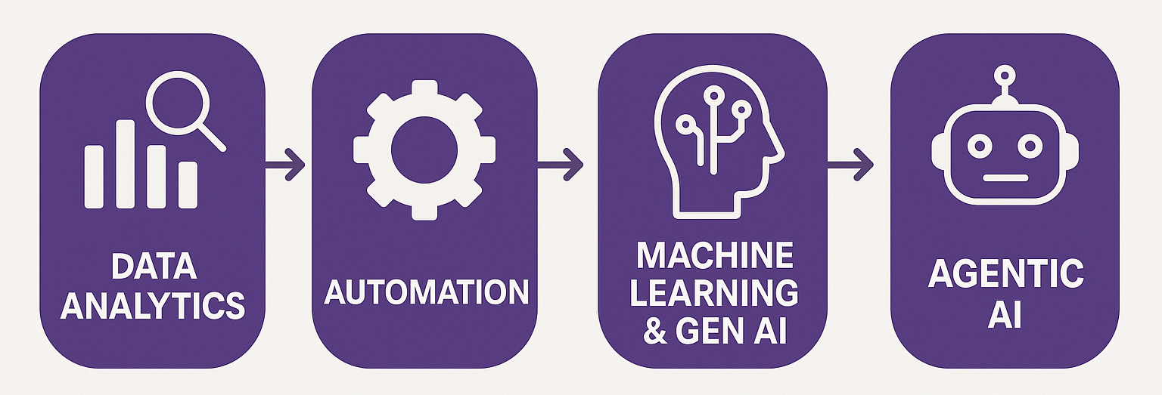
Course Diagram (high-level)

Slide 5











UiPath Agentic Automation
Notes:
Everything happens in one place: the UiPath Platform—where AI Agents aren’t just assistants, they’re true work partners, transforming complexity into a seamless, orchestrated operation.
We break it down into three powerful layers: Activities (the building blocks—reading, processing, integrating), Workflows (connecting the dots with human-in-the-loop and testing), and Processes (the big picture—managing, optimizing, and enhancing enterprise operations).
Agentic Orchestration / Maestro takes automation even further—coordinating UiPath Agents, third-party AI models, people, robots, and tools into a single, intelligent system.
Your existing systems don’t need to be reinvented—our platform integrates seamlessly with your data, applications, and workflows while maintaining enterprise-grade security, governance, and AI trust.
We’re not just compatible with your tech stack—we enhance it. From cloud providers like AWS, Google, and Azure to enterprise apps like Salesforce and SAP, we turn digital chaos into a symphony of efficiency.

Slide 6
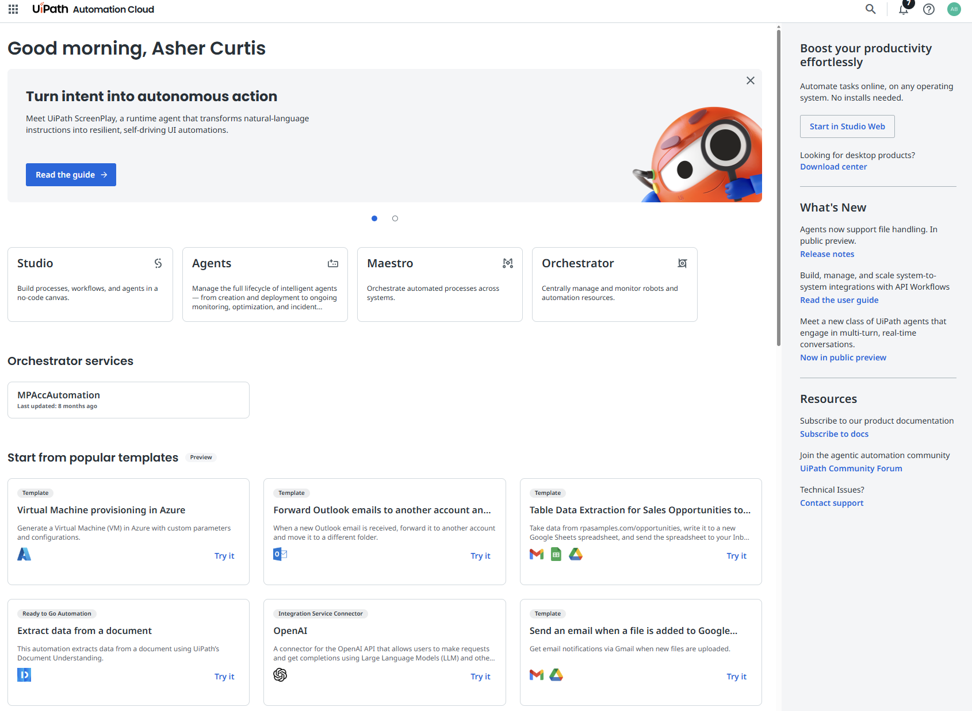
1. Where we start for RPA
A screenshot of the UiPath Cloud Home page

Slide 7
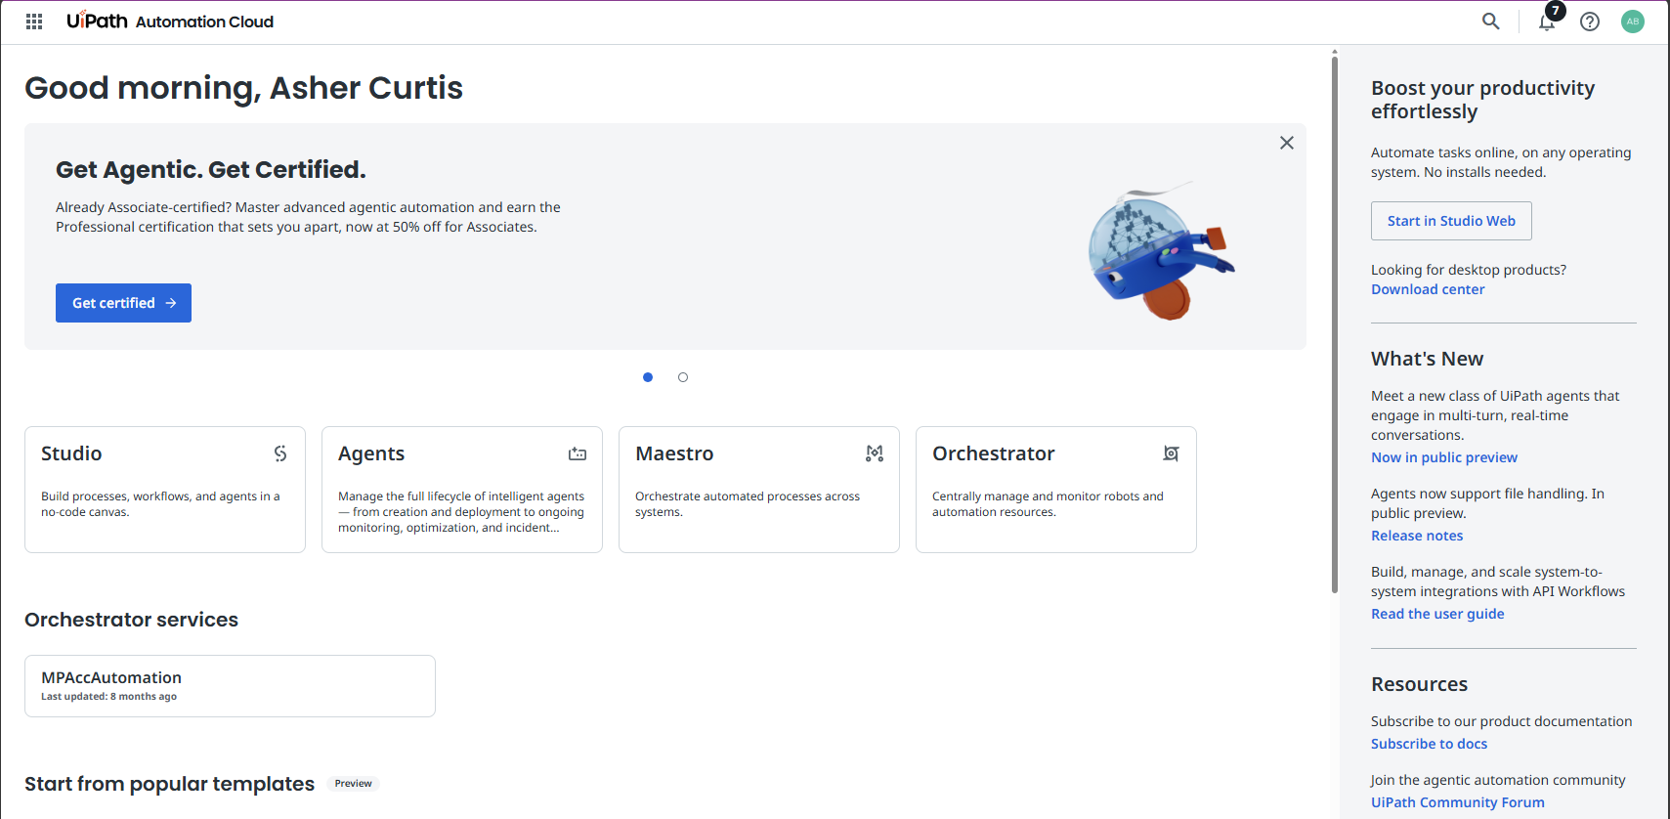
UiPath Cloud Home
2. Useful site-wide menu
1. Where we start for RPA
3. Might not be here – no need to worry.
4. Useful helpers/starters

Slide 8
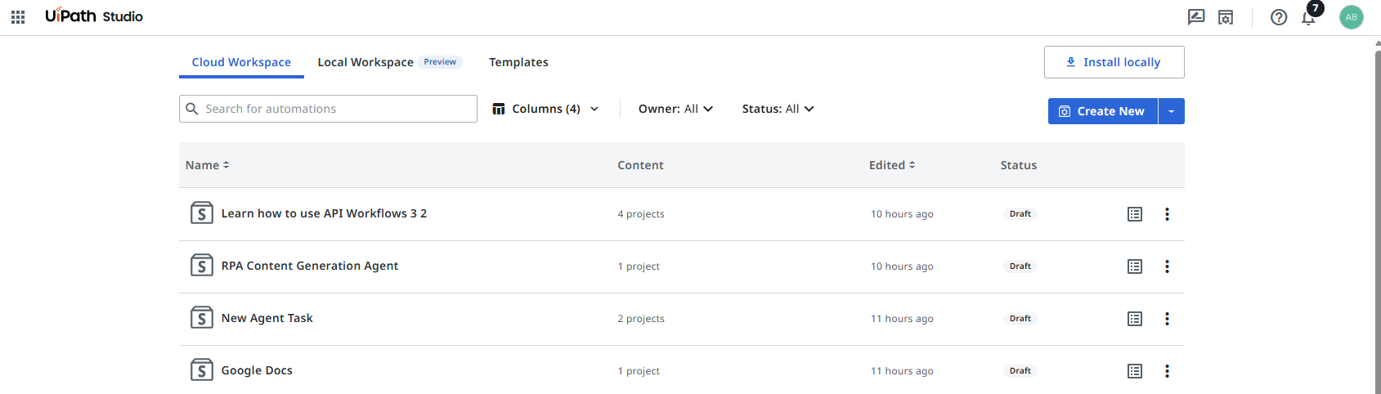
UiPath Projects
2. Consider later for certain processes
1. Create new and select from the choices
Your projects (probably a template RPA and a Maestro Process, “Solution 1” and “Solution 2”?)

Slide 9
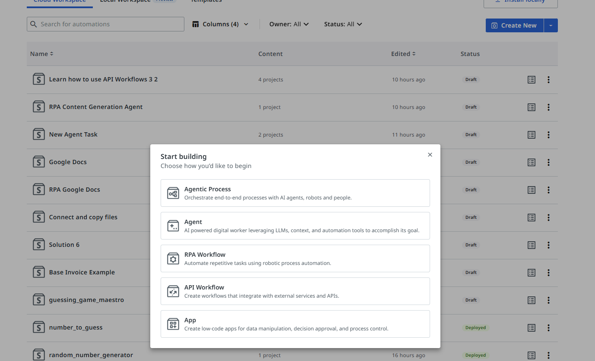
Create a new RPA Workflow (launches Studio)
2. Where we start new Agents and processes with agents
1. Where we start for RPA workflows
3. Additional Data Options and human-in-the-loop “Apps”

Slide 10
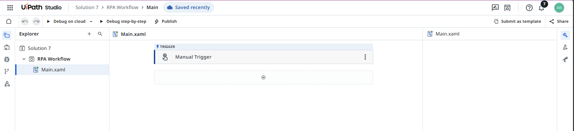
Studio Web Interface
1. Name of solution (can contain multiple files)
3. Solutions menu (for variables and arguments moving across the solution)
2. Name of individual RPA file “.xaml”

Slide 11
Studio Web Interface
1. Menu to add new building block (UiPath “Activities”)
2. Name of individual RPA file “.xaml”
3. RPA Menu (configuration is the wrench, debug is the beaker)

Slide 12
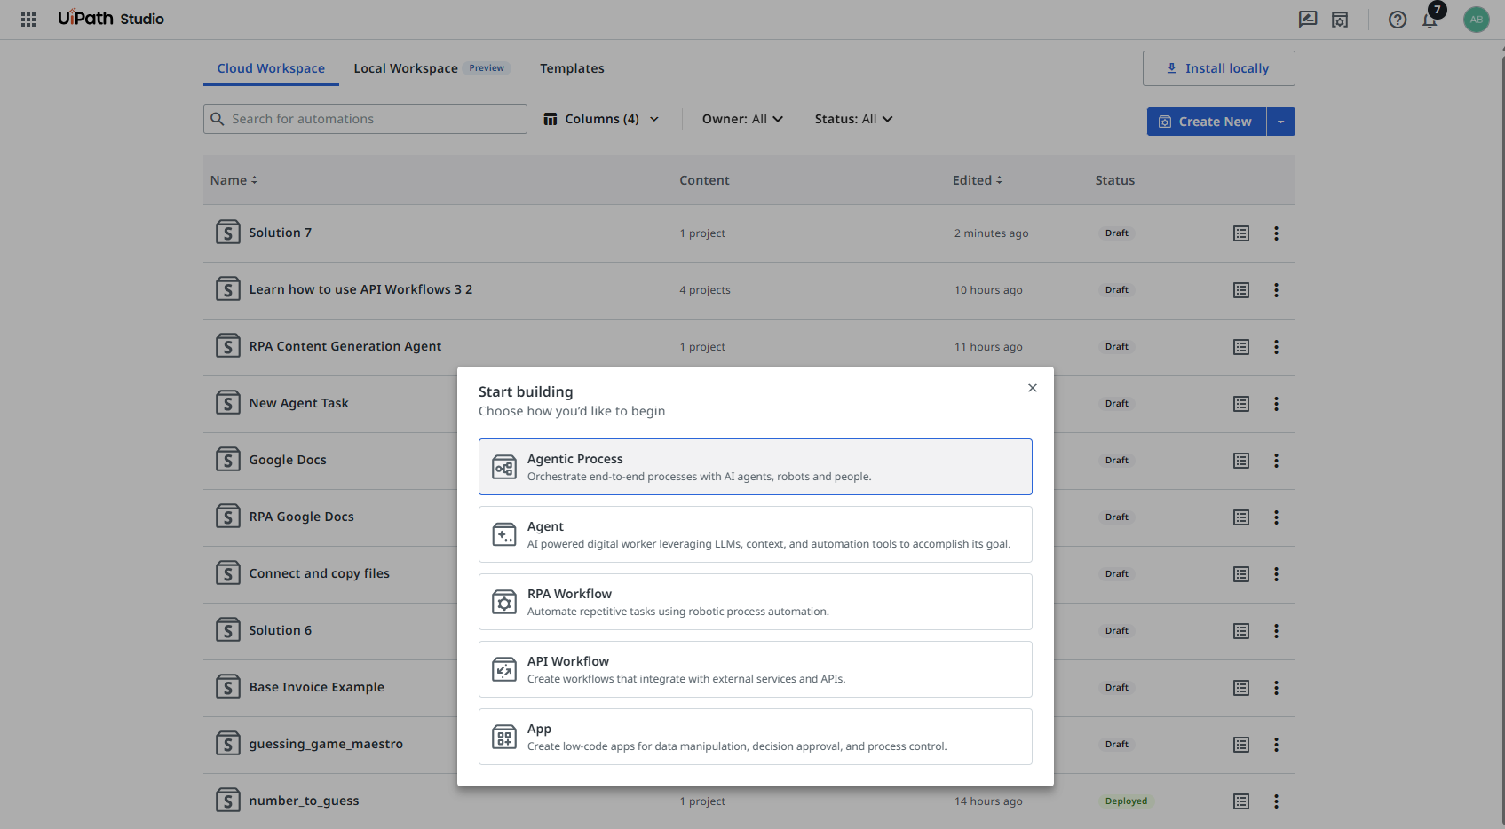
Create a new Agentic Process (launches Maestro)
1. Where we start for Maestro Processes and add an agent
2. In contrast here we start with just an agent

Slide 13
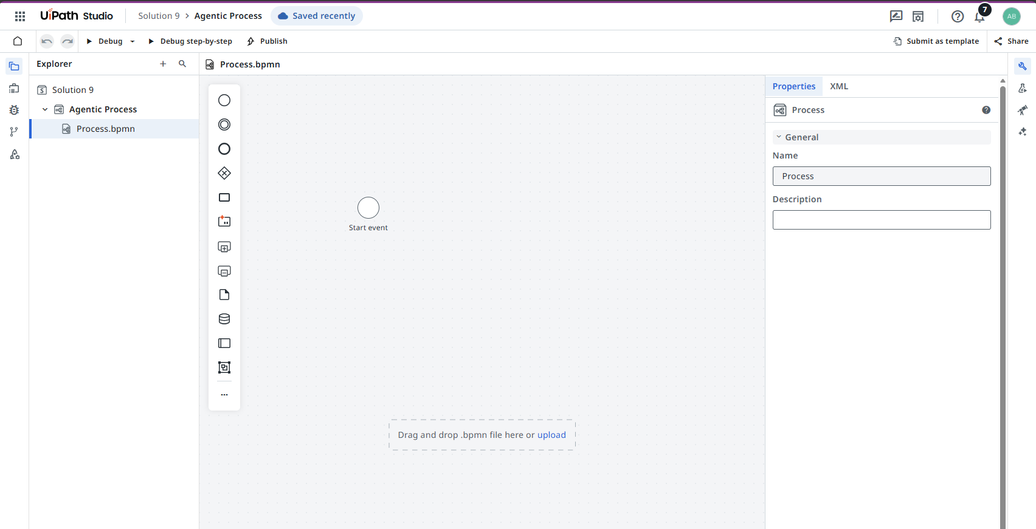
Maestro Interface
1. Drag and drop BPMN canvas
2. UiPath BPMN elements menu (unconfigured by default)
3. Configuration window (changes to selected element)

Slide 14
Automation Essentials | Essential Tools and Concepts

Slide 15
What will we do today?
Review of Class 01 01 (UiPath Cloud set-up)
Essential tools and concepts
Connectors and triggers (email, file-sharing platforms, APIs)
Folders, files, variables (and objects)
Activities and Loops
LLMs and LLMs as Agents (API connectors)

Slide 16
Lab
UiPath Cloud:
RPA Workflows
Maestro Processes
Connecting them together

Slide 17
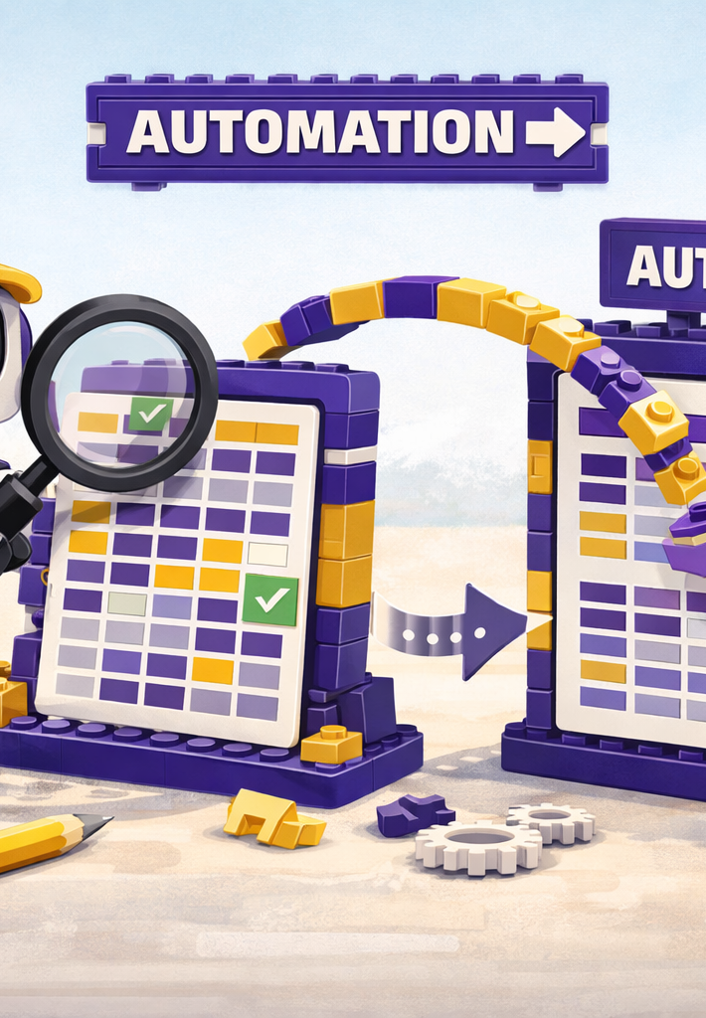
Where we will go next
Spreadsheets
Controls
Costs and benefits of RPA
Selection of Tasks for RPA versus Agent
Manipulation of files

Slide 18
Thank you

