Slide 1
EDGAR Explorer: XBRL and APIs 2
Data Analytics for Professional Accountants (ACCTG 522)
Class 9 | MPAcc Class of 2026

Slide 2
Welcome!
Class Agenda
Review
XBRL Filings and SEC API data
Catch-up Lab:
Examine a company XBRL filing & reconcile to API data.
Project Pathways Overviews:
Possible avenues to consider
Alteryx (and other software) practicalities
Time for team work to prep for Mon Oct 27 preliminary proposal meetings.
Conclusion and look ahead.

Slide 3
Review
XBRL Filings and SEC API data
Clarifications and documentation

Slide 4
Clarifications
Documentation
https://www.sec.gov/search-filings/edgar-application-programming-interfaces

Slide 5
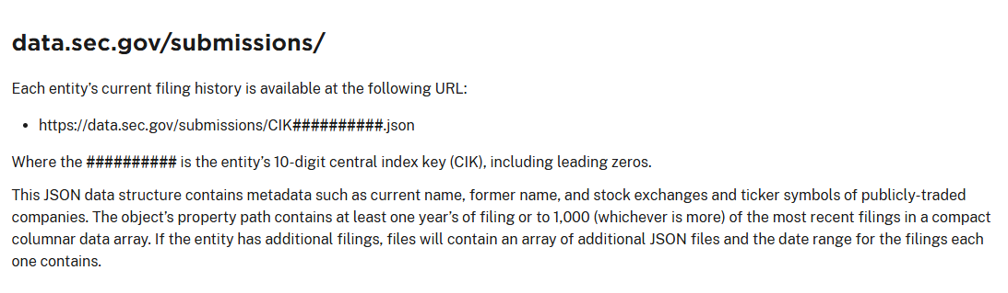
Submissions API
All the submissions for a specific company:

Slide 6
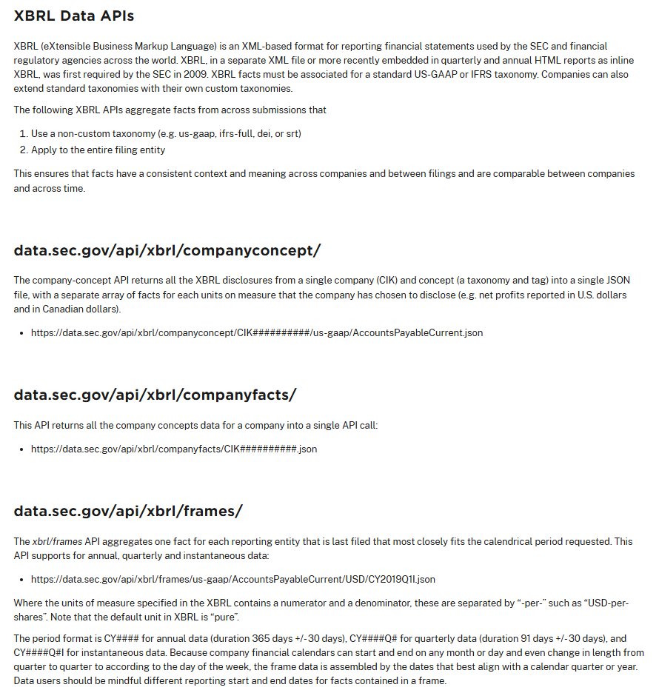
XBRL Data APIs
Company Facts is most useful for our purposes, the others are typically account specific.
One company, one account, all timeframes
One company, all accounts, all timeframes
All companies, one account, one timeframe
Potentially confusing “Frames” Syntax (also in CompanyFacts). CY{YYYY} for annual, and two quarterly formats Q{Qtr=1,2,3,4} and with I or no I for “Instantaneous”

Slide 7
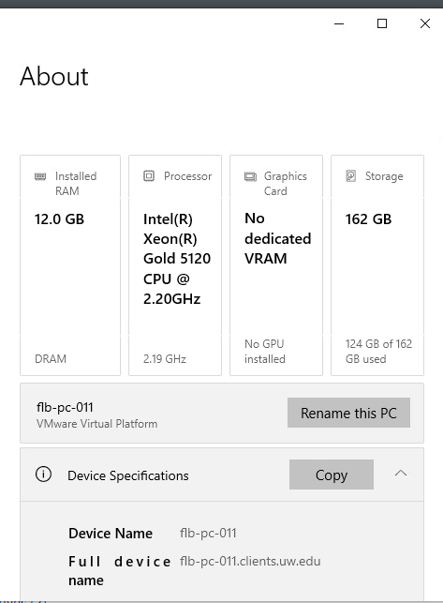
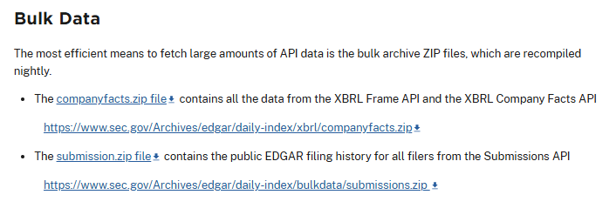
Bulk Data
Alteryx’s AMP uses 25%-50% before hitting performance issues, remote labs RAM
CompanyFacts.zip = 1.2GB → 18,950 files, 16+GB
Submissions.zip = 1.4GB → too many files to unzip in windows easily…

Slide 8
Welcome!
Class Agenda
Review
XBRL Filings and SEC API data
Catch-up Lab:
Examine a company XBRL filing & reconcile to API data.
Project Pathways Overviews:
Possible avenues to consider
Alteryx (and other software) practicalities
Time for team work to prep for Mon Oct 27 preliminary proposal meetings.
Conclusion and look ahead.

Slide 9
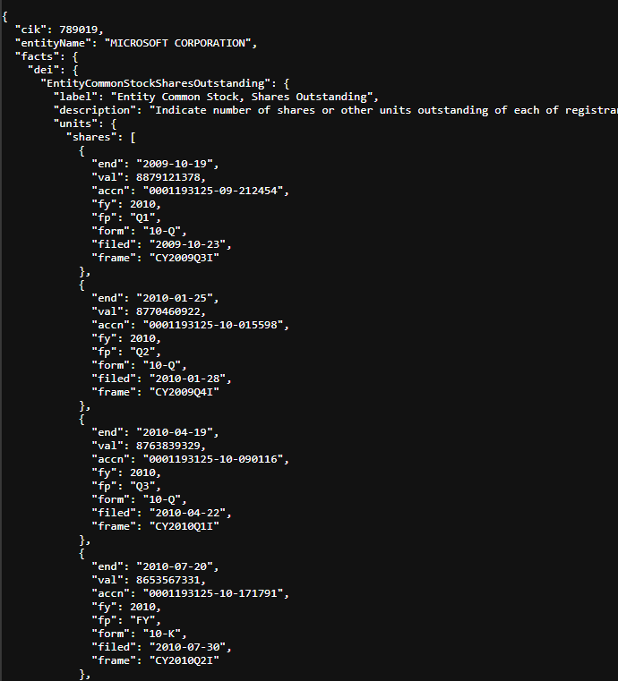
API Returned Data
https://data.sec.gov/api/xbrl/companyfacts/CIK0000789460.json
A JSON Record for “shares” which is a list, nested within the “units” dictionary, nested within the EntityCommonSharesOutstanding dictionary, nested within the “dei” dictionary, nested within the “facts” dictionary in the JSON file returned by the API “CIK0000789460.json”

Slide 10
XBRL Filings
Use the EDGAR Search Tool
SEC.gov | Search Filings (www.sec.gov/search-filings).
Obtain the most recent 10-K of your target company.
Access the XBRL instance of the 10-K.

Slide 11
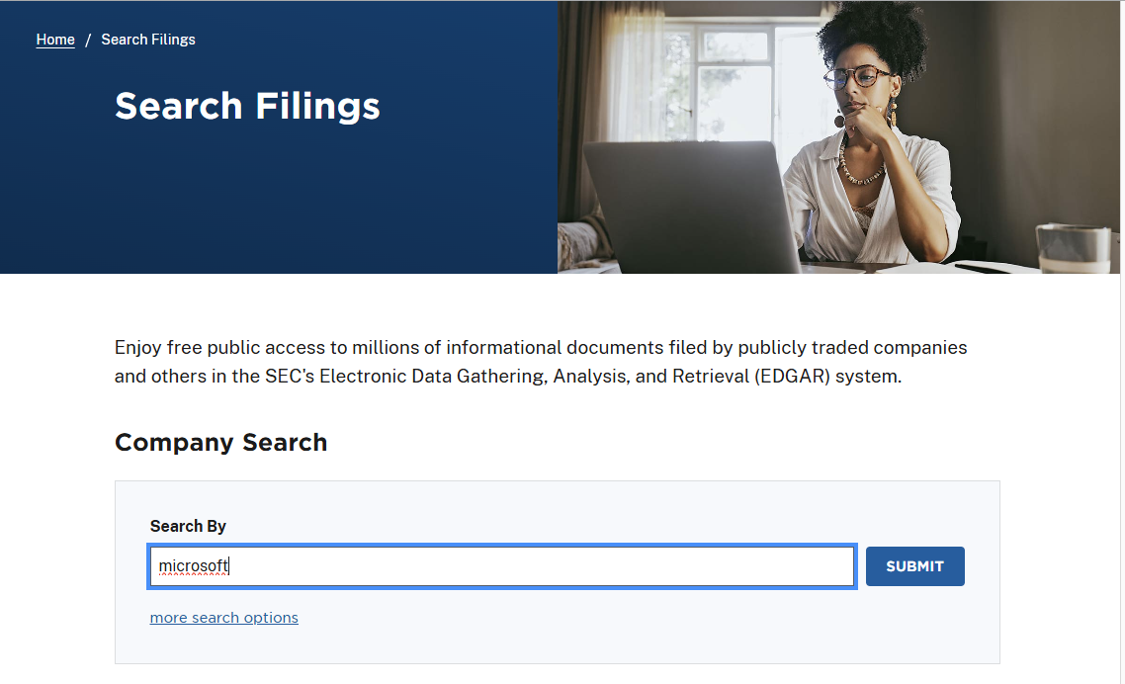

Slide 12
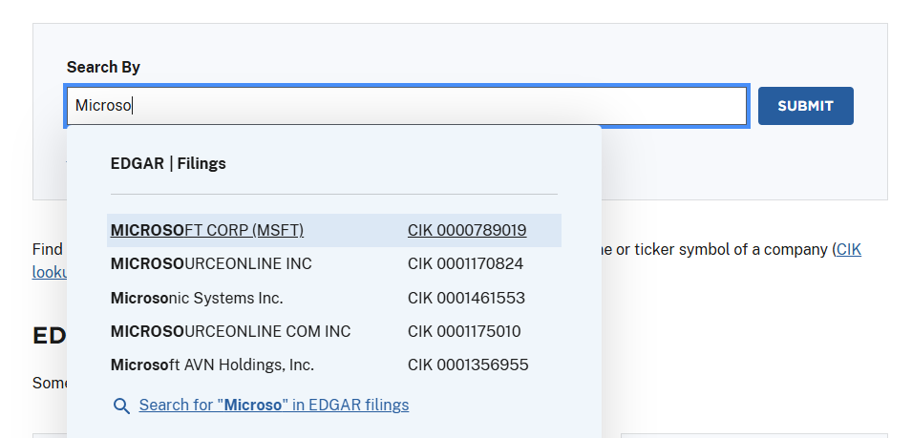

Slide 13
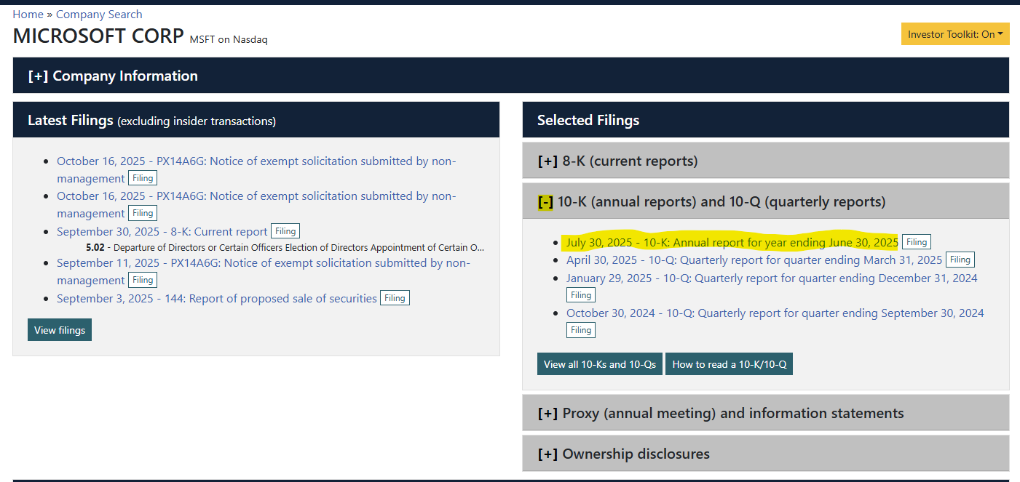

Slide 14
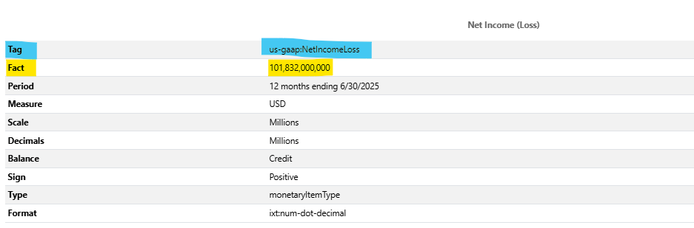
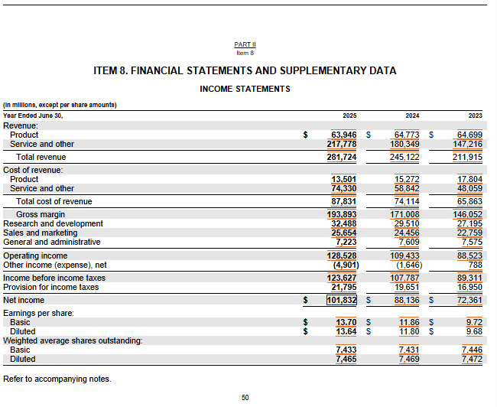

Slide 15
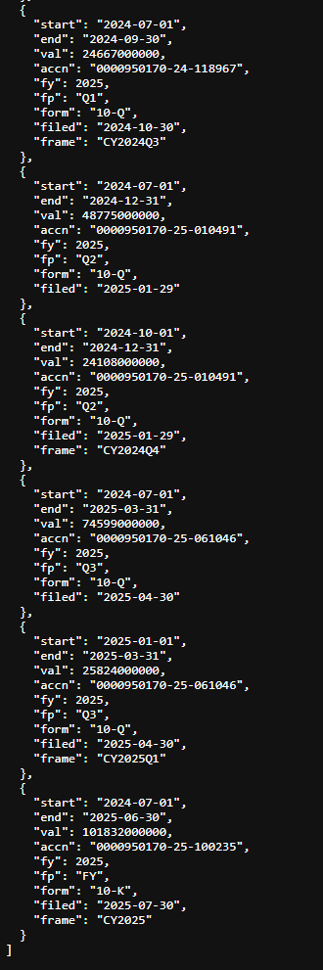
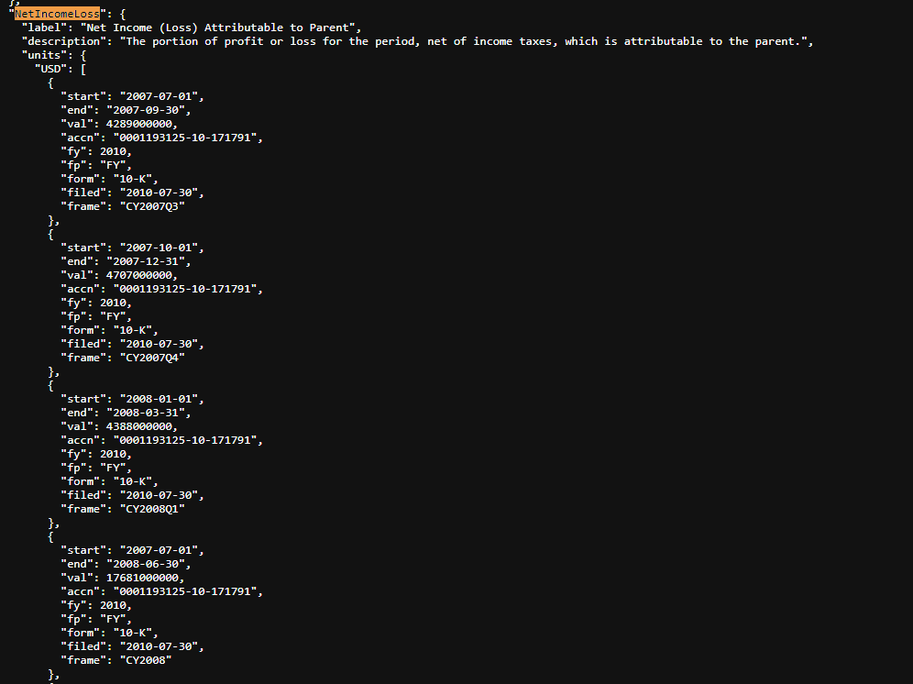
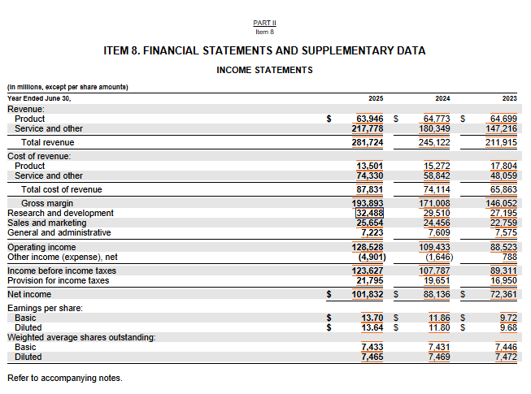

Slide 16
Data linked via “accn” note start and end, 9m and 3m periods. Why? Because 10-Qs report cumulative results from beginning of fiscal year.
Only the 3 month amount is in the “frame”: “CY2025Q1” and the annual “CY2025”.

Slide 17
Welcome!
Class Agenda
Review
XBRL Filings and SEC API data
Catch-up Lab:
Examine a company XBRL filing & reconcile to API data.
Project Pathways Overviews:
Possible avenues to consider
Alteryx (and other software) practicalities
Time for team work to prep for Mon Oct 27 preliminary proposal meetings.
Conclusion and look ahead.

Slide 18
1. Information collection and processing
2. Forecasting
3. Fundamental Valuation
4. Decisions
improves
necessary
for
informs
Information collection and processing:
Screening enhancements: What are the limitations of the current screening tools? Do you want to screen on custom metrics? (e.g., accruals quality, sentiment)
Account-level refinements: What are the limitations of the current data aggregators groupings? Do you want more disaggregated data for risk assessments and forecasts? (e.g., multiple revenue streams and COS aggregated into single line items)
XBRL tagging often includes company specific tags referenced by the company’s ticker.
Footnote analysis can also be possible with XBRL tags
10-K Text Analytics:
Sentiment analysis (usually MD&A)
Risk section analysis
Keyword searches
LLM interpretations/summaries.

Slide 19
1. Information collection and processing
2. Forecasting
3. Fundamental Valuation
4. Decisions
improves
necessary
for
informs
Forecasting
More advanced analytics such as time-series estimates / forecasts (regression-based, ARIMA, ML models), cointegration or comovement analysis.
Formal forecasting models (e.g., revenue driver models: Same store sales, revenue per sq ft etc).

Slide 20
1. Information collection and processing
2. Forecasting
3. Fundamental Valuation
4. Decisions
improves
necessary
for
informs
Fundamental Valuation
Advanced scenario analysis supported by macros / automation, allowing for changes in multiple forecasting dimensions used in the valuation model to estimate scenarios and sensitivity.
Advanced analytics aimed at estimated risks and growth parameters.

Slide 21
1. Information collection and processing
2. Forecasting
3. Fundamental Valuation
4. Decisions
improves
necessary
for
informs
Decisions / Recommendations
Support recommendations with additional analytics supported risk analysis.
Support decisions with beta / market comovement analysis and potential for slippage.
Support decisions with other red-flag and future-looking issues that could affect short and long differently (i.e., not just the overall market changes).

Slide 22
Alteryx (and other software) practicalities
Advanced Alteryx functionality includes:
Macros
Python integration
Both are complex and have Alteryx specific “features” that don’t extend as well as their typical tools to other software. Don’t overspend your time – ask me for help once you have an analysis in mind.

Slide 23
Preliminary proposal meetings
Next Monday:
Meet with me one-on-one at a specific time for up to 15 mins.
Make sure you have an idea in mind as to what you want to achieve for the final project, and any other questions you have for your team’s approach/understanding.

Slide 24

Thank you!

