Slide 1
The ETL process: Extraction from APIs
ACCTG 522
Data Analytics for Professional Accountants
MPAcc Class of 2027
Class 03 | Autumn | 2026

Slide 2
Agenda
Review
EDGAR Overview
Class Exercises
  InLine XBRL (the human version)
  APIs (the computer version)
  XBRL tags and common line items (discussion)
Conclusion & Look Ahead

Slide 3
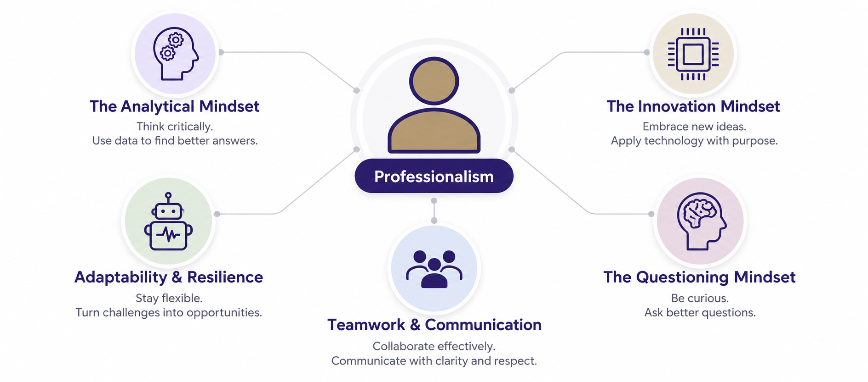
MPAcc mindsets

Slide 4
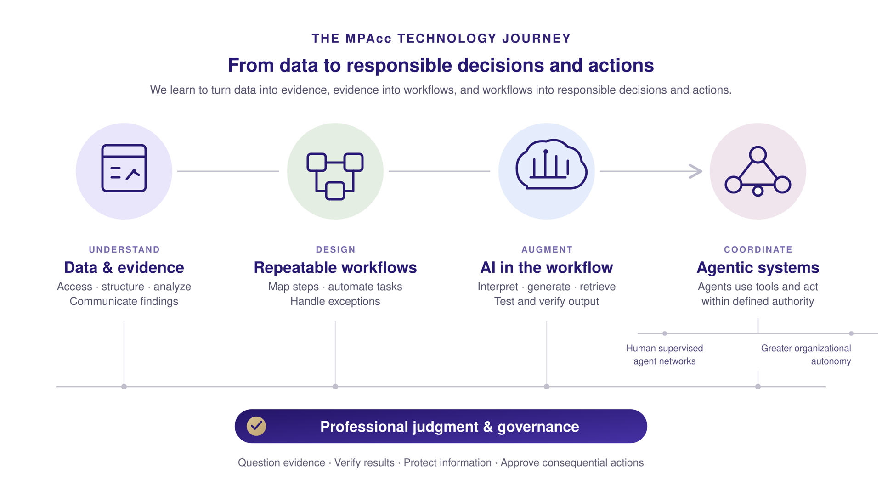

Slide 5
Review
Today's key takeaway: Data and Prepare/ETL are not mechanical steps.
Profiling, provenance, validation, and professional judgment can cause us to iterate backward.
Responsible action depends on understanding both the evidence and its limitations.

Slide 6
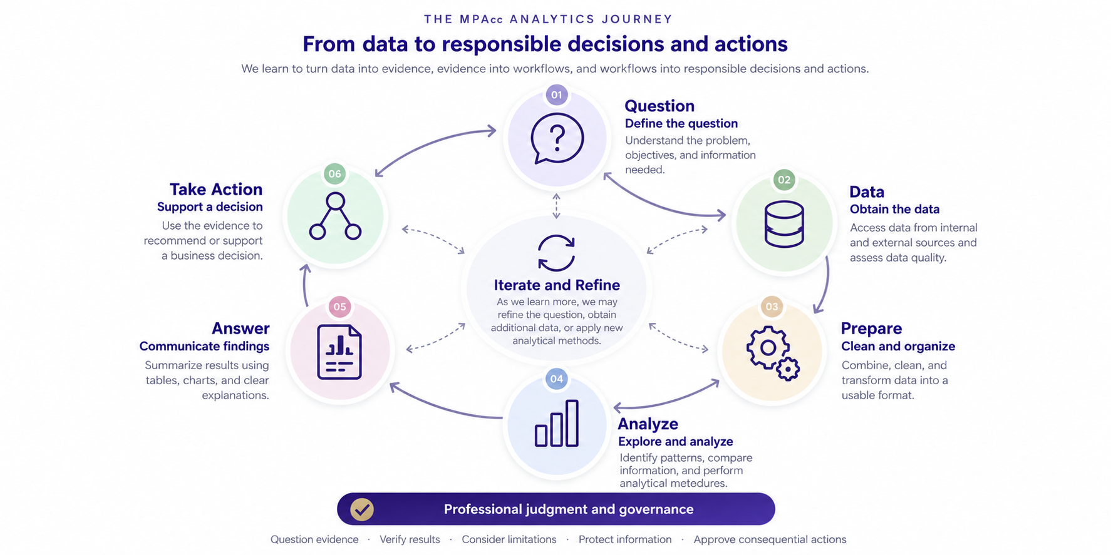

Slide 7
Agenda
Review
EDGAR Overview
Class Exercises
  InLine XBRL (the human version)
  APIs (the computer version)
  XBRL tags and common line items (discussion)
Conclusion & Look Ahead

Slide 8
SEC’s EDGAR
Definition: The Electronic Data Gathering, Analysis, and Retrieval (EDGAR) system.
Maintained by the Securities and Exchange Commission (SEC)
The primary system for companies and others submitting documents under the Securities Act of 1933, the Securities Exchange Act of 1934, the Trust Indenture Act of 1939, and the Investment Company Act of 1940.
Access to EDGAR’s public database is free.
SEC.gov | About EDGAR

Slide 9
EDGAR Filings
EDGAR processes about 4,700 filings per day, serves up 3,000 terabytes of data to the public annually, and accommodates 40,000 new filers per year on average.
SEC.gov | Search Filings
Is a tool that allows for a look-up of a public company filings, including financial statement filings that use (inline) XBRL to access financial data.

Slide 10
What is Inline XBRL?
Inline XBRL is a structured data language that allows filers to prepare a single document that is both human-readable and machine-readable, so that filers need only prepare one Inline XBRL document rather than generate an HTML document of their financial statement information or risk/return summary information and then tag a copy of the data to create a separate XBRL exhibit.
For data users, Inline XBRL provides an easier way to view, access, and explore the contextual information of the underlying data. For example, users can click on individual tagged data points in the filing to find more information about the data, such as citations and hyperlinks to the relevant accounting guidance, narrative definitions for the values, and reporting period information associated with each value.
https://www.sec.gov/structureddata/osd-inline-xbrl.html

Slide 11
Agenda
Review
EDGAR Overview
Class Exercises
  InLine XBRL (the human version)
  APIs (the computer version)
  XBRL tags and common line items (discussion)
Conclusion & Look Ahead

Slide 12
Understanding inline XBRL
Let’s use inline XBRL to better understand Apple, Inc.’s most recent 10-K filing. Start at the entity landing page below:
https://www.sec.gov/edgar/browse/?CIK=320193

Slide 13
Inline XBRL in action
The search on the inline XBRL form allows us to navigate the 10-K filing using XBRL tags, which contain companyfacts.
Let’s explore:
Revenue tags
Balance Sheet Tags
Footnote tags
Custom tags

Slide 14
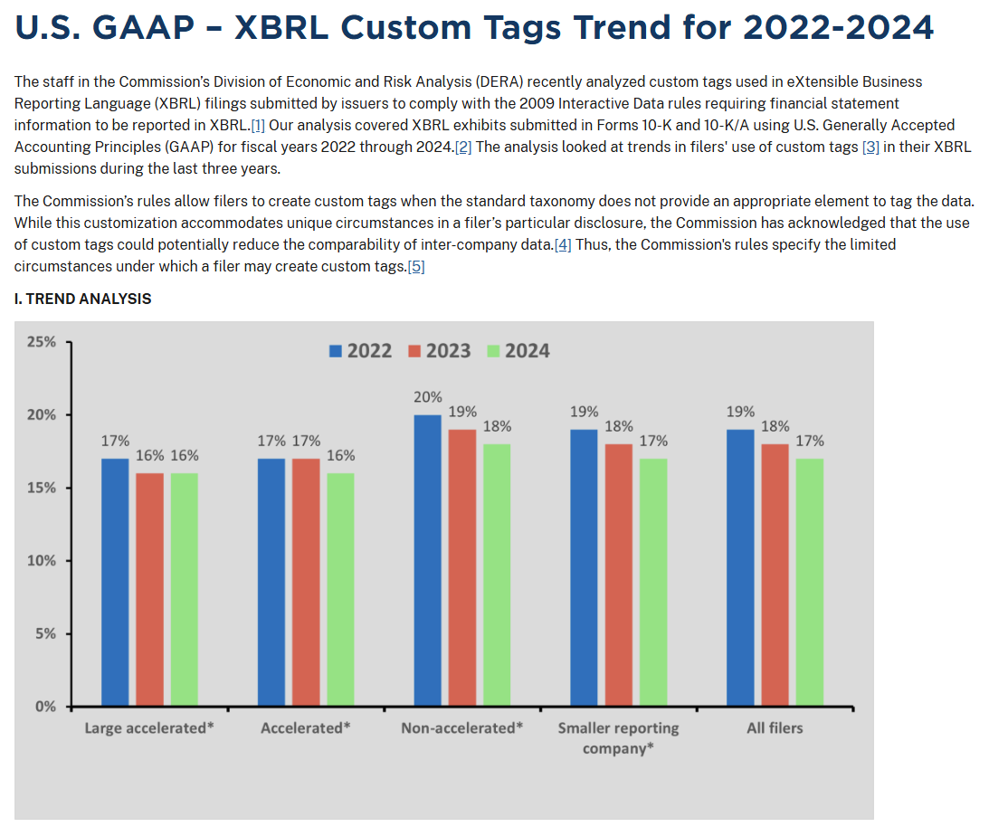
Custom Tags

Slide 15
Agenda
Review
EDGAR Overview
Class Exercises
  InLine XBRL (the human version)
  APIs (the computer version)
  XBRL tags and common line items (discussion)
Conclusion & Look Ahead

Slide 16
Application Programming Interface (API)
The SEC maintains several APIs to allow for the automated extraction of public company data. We will focus on two:
Company Submissions: data.sec.gov/submissions/
Company Facts: data.sec.gov/api/xbrl/companyfacts/

Slide 17
Lab environment: Google CoLab
Use the links on the website for this class.

Slide 18
Agenda
Review
EDGAR Overview
Class Exercises
  InLine XBRL (the human version)
  APIs (the computer version)
  XBRL tags and common line items (discussion)
Conclusion & Look Ahead

Slide 19
XBRL: Extract to Transform
XBRL gives us extraordinarily rich accounting data.
But does having a tag mean we have a comparable accounting variable we can use in financial statement analysis?

Slide 20
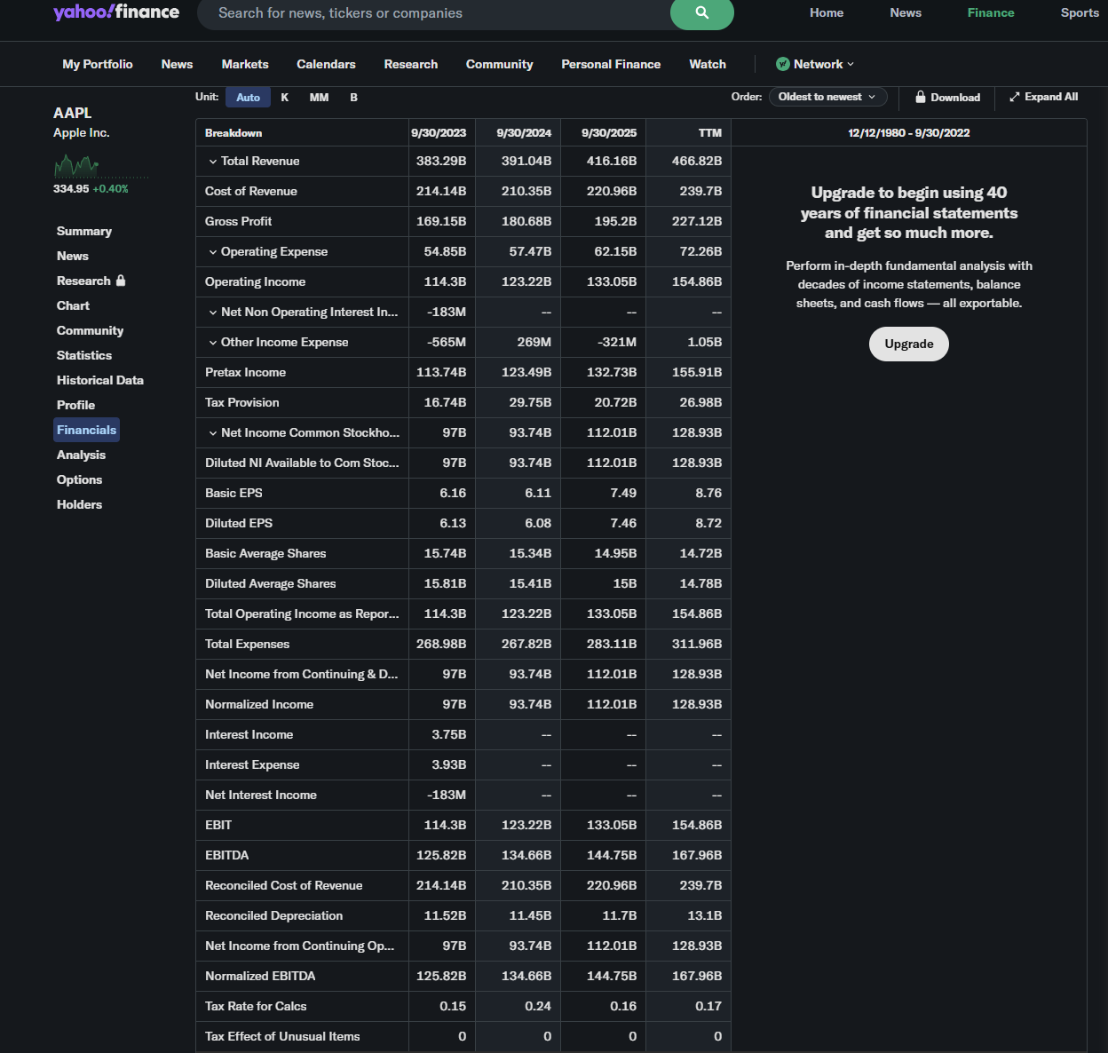
Compare with:
Yahoo finance
Operating
Non-operating
Other disaggregated information
https://finance.yahoo.com/quote/AAPL/financials/

Slide 21
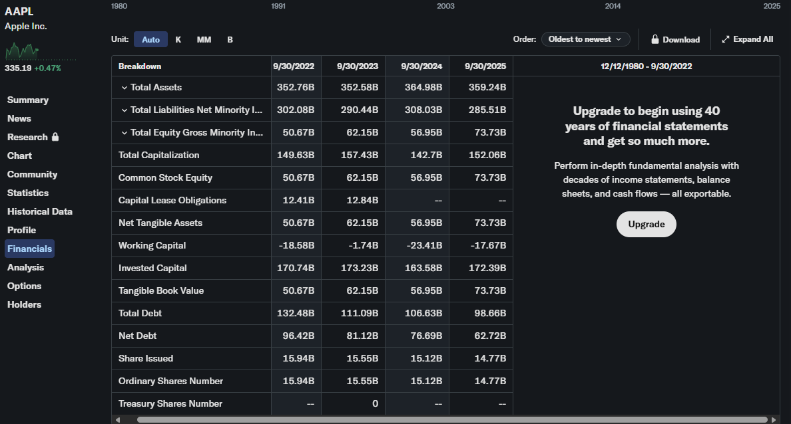

Slide 22
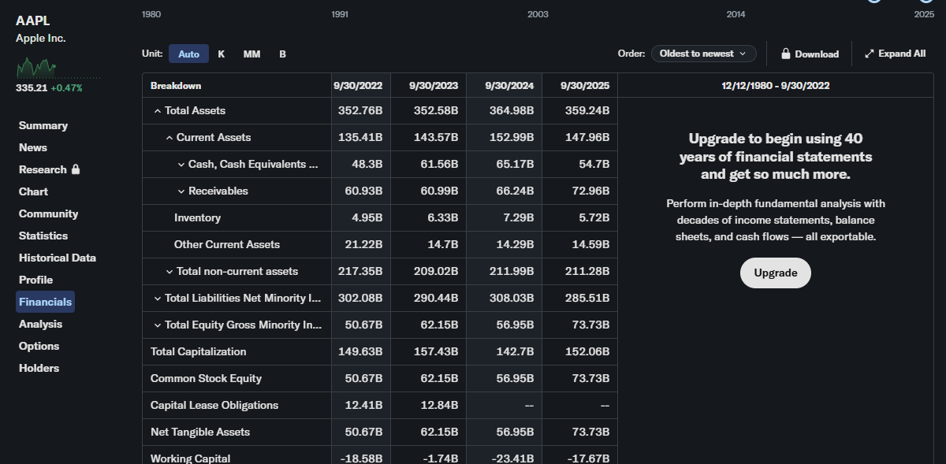

Slide 23
Extract to Transform Question
Which accounting concepts should be relatively easy to standardize across companies, and which should be difficult?

Slide 24
Agenda
Review
EDGAR Overview
Class Exercises
  InLine XBRL (the human version)
  APIs (the computer version)
  XBRL tags and common line items (discussion)
Conclusion & Look Ahead

Slide 27
Summary
Today's key takeaway: We need to get comfortable with complex data extraction and transformations.
APIs automate a data extraction process (compare to copy and pasting info from the 10-K).
Understanding how to transform automated extraction mechanisms gives us a powerful set of data analytic ETL tools.

Slide 28
Next steps
Next topic: The ETL process: Relational Databases
A Core Data Analytic Skill, for joining, querying and summarizing data
Develops data skills with SQL and SQL queries
Introduce VSCode as a utility software tool, and PowerBI as an alternative join approach
Thank you!

