Slide 1
Generative AI Workshop
Data Analytics for Professional Accountants (ACCTG 522)
Class 12 | MPAcc Class of 2026

Slide 2
Welcome!
Class Agenda
Review: Generative AI
Labs:
Overview: GenAI for accounting innovators
Hints and Tips
Discussion Group Teamwork
Discussion Team Brief Presentations and Peer Feedback
Conclusion and look ahead

Slide 3
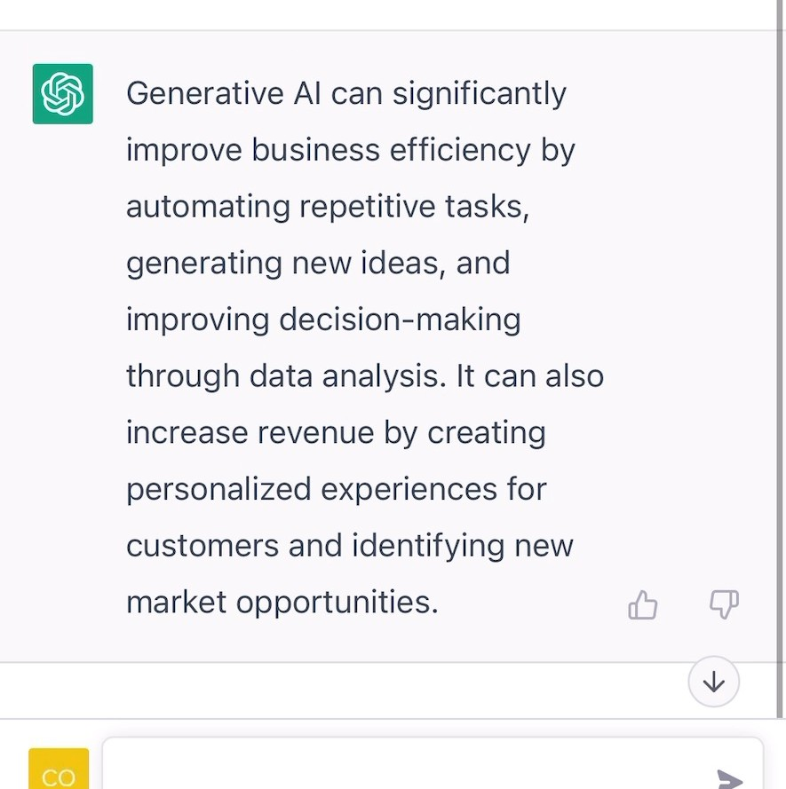
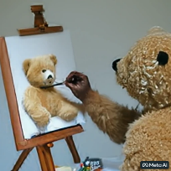
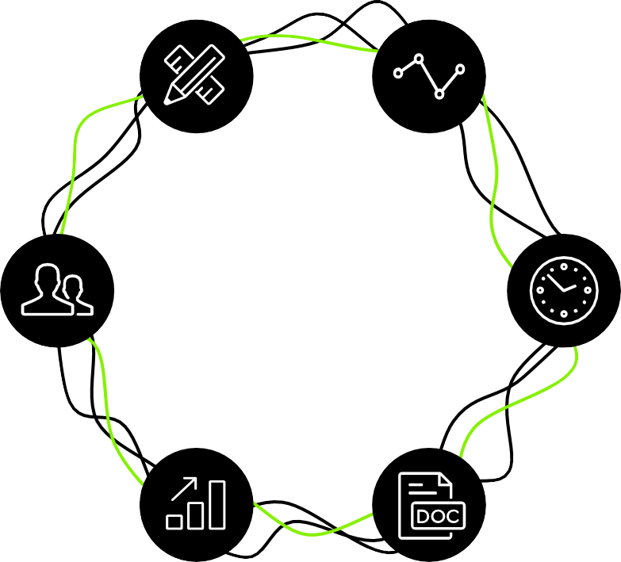

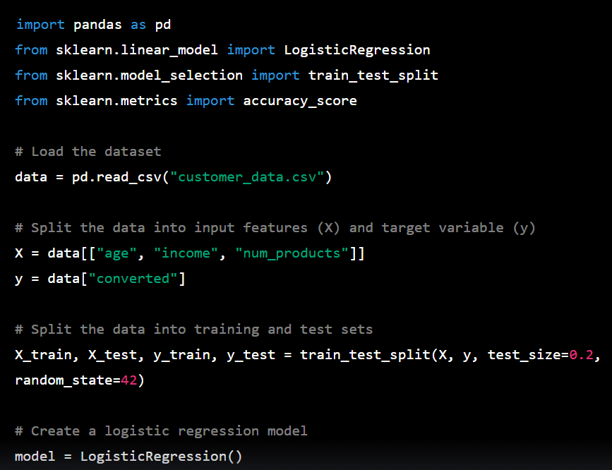

Generative AI capabilities
Generative AI can produce a wide range of outputs depending on the specific application and type of data that is needed. Here are some common output types that are applicable to business
Text
Video
Prompt: Explain the business impact of Generative AI in 50 words
Prompt: Create a video of a teddy bear painting a portrait
Image
Code
Prompt: A bowl of soup that is a portal to another dimension as digital art
Prompt: In python, code a program that predicts the likelihood of customer conversion
Phone / Voice
Multi-Lingual
Multiple Tasks
Empathy / Humor
Ensures Resolution
Systems Integration
Audio
3D
Generative AI-powered customer service agents
Prompt: A beautiful dress made out of garbage bags, on a mannequin. Studio lighting, high quality, high resolution.

Slide 4
System (or meta) prompt
Prompt
OR
Prompt plus input data:
Data,
Speadsheets,
Documents,
Code,
Images,
Audio,
Video,
Software etc
(i.e., any digital data)
LLM
Desired Outputs
Text
Code
Audio/Visual
Images
Integration with other software

Slide 5

System (or meta) prompt
“You are an AI accounting analyst. Your task is to read, interpret, and summarize spreadsheets according to the following criteria: completeness, reasonableness, and anomalies. Always provide a concise explanation supported by numbers.”
Prompt
OR
Prompt plus input data:
Data,
Speadsheets,
Documents,
Code,
Images,
Audio,
Video,
Software etc
(i.e., any digital data)
LLM
Desired Outputs
Text
Code
Audio/Visual
Images
Integration with other software
“Analyze this spreadsheet for me and identify any unusual revenue spikes.”

Slide 6
Core Capabilities: Doc & Data Intelligence
Doc Intelligence
Automated understanding and summarization of documents
Quick extraction of important points and data from any text
Comparison of document contents to identify key differences
Accurate language translation for diverse document types
Trend and pattern detection within large volumes of text
Data Intelligence
Connect to any data source, integrating seamlessly with AI.
Utilize AI to uncover deep insights from complex datasets.
Empower finance to do real-time decision-making with dynamic, AI-driven data analysis.
Leverage predictive analytics to forecast trends and guide strategic planning.

Slide 7
Welcome!
Class Agenda
Review: Generative AI
Labs:
Overview: GenAI for accounting innovators
Hints and Tips
Discussion Group Teamwork
Discussion Team Brief Presentations and Peer Feedback
Conclusion and look ahead

Slide 8
Overview: Task
This is an open-end case to encourage creativity and self -directed learning (and comfort with Gen AI tools).
Teams will conceive, design and prototype an accounting-related solution that leverages GenAI.

Slide 9
Overview: Presentation
A brief 2-3 minute presentation on findings covering:
The problem or opportunity you addressed.
How GenAI was used to develop or power the solution and/or a demonstration of the working features (focusing on the Gen AI role)

Slide 10
Hints and Tips
Teams need to define the scope of the project by identifying a specific tool, process improvement, workflow enhancement, simple application or any other solution that supports the work of accounting professionals or accounting students.

Slide 11
Hints: Potential scope
The scope is wide, but to help narrow the scope consider:
Gen AI as an assistant for a task in any case, exercise or project (including the final) from any MPAcc course.
Any other task that could benefit from Gen AI in an accounting/accounting related area.

Slide 12
Hints and Tips
Teams need to attempt to test how the Gen AI tool can be integrated practically. This means that in many use cases, you will need to use data as part of the input.
Tips: e.g., input data: 10-Ks, transaction data, etc., either use material from prior classes or generate data like in the Skylar / Pure Oils case.

Slide 13

Thank you!

