Slide 1
Cases in Cybersecurity 2
Advanced Cases in Assurance Services (ACCTG 521)
Class 17 | MPAcc class of 2026

Slide 2
Agenda
Review and look ahead (workshop classes)
Deliverable
Lab:
Escape the Digital Dungeon Case

Slide 3
Review

Slide 4
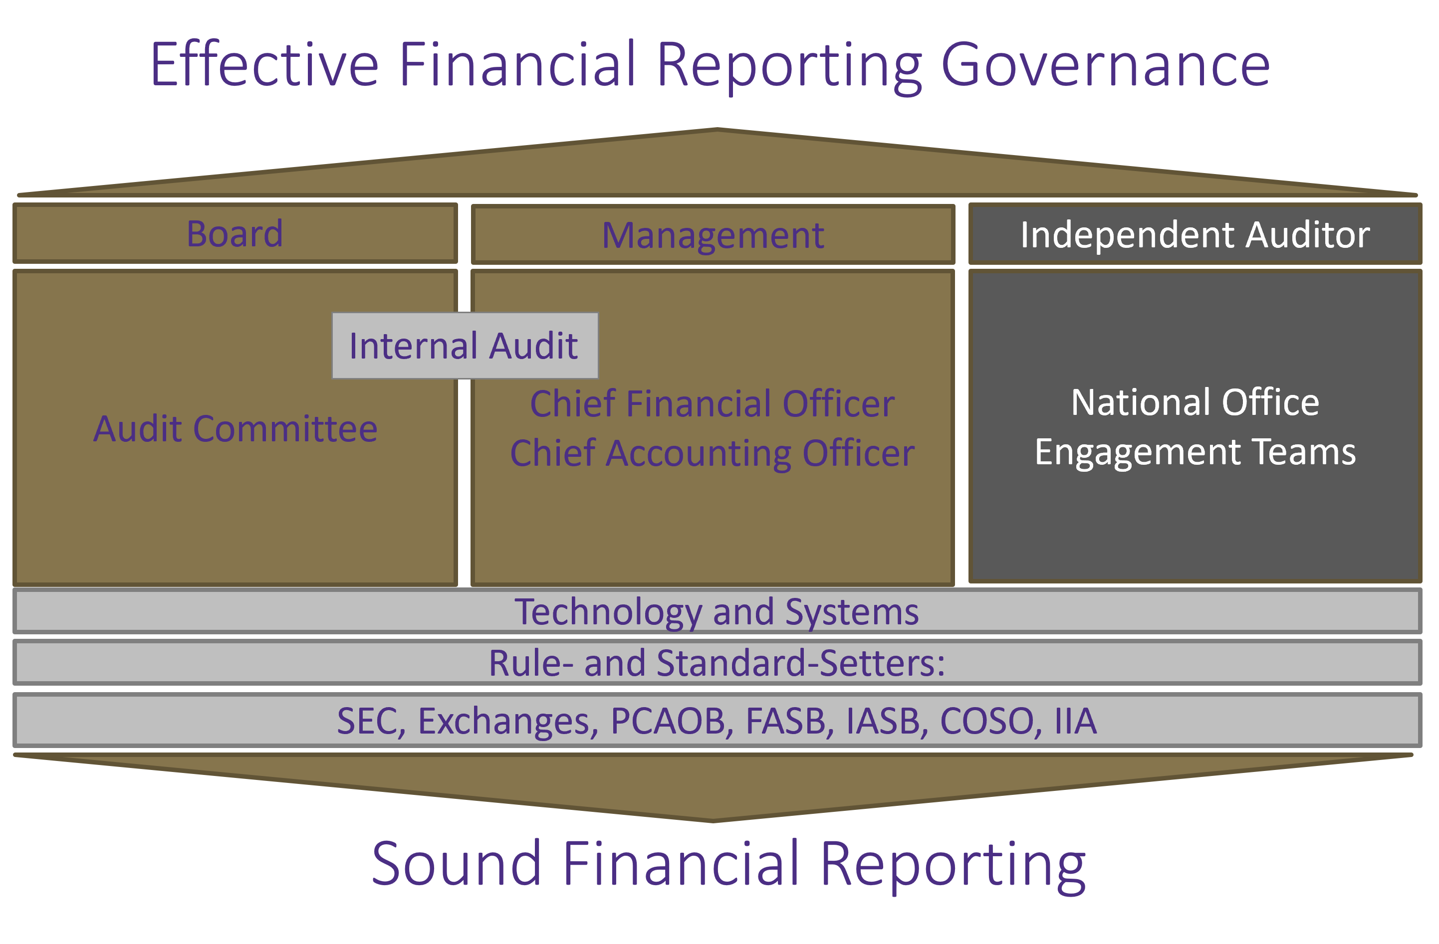
Helix Analyzer
Simulation
Blockchain Audit
Systems/controls: Pcard;
Alteryx suspicious transactions.
Early Classes on Economics of Audit, Systems: Transaction Analyses (incl: 522)
Notes:
Bob – Course Overview (3 legged stool)
Christina – Refer to Syllabus and go into depth on professionalism piece
See if class has any questions on syllabus

Slide 5
Management
Audit
First Line of Defense
Second Line of Defense
Third Line of Defense
Management Control
Enterprise Risk Management
Internal Audit/External Audit & Consulting
Legal & Privacy
Physical Security
The Business / Operations
Third Party Risk Management
Cybersecurity
Business Continuity Management
Compliance
Information Technology General Controls
ITGC : Testing and Compliance issues

Slide 6
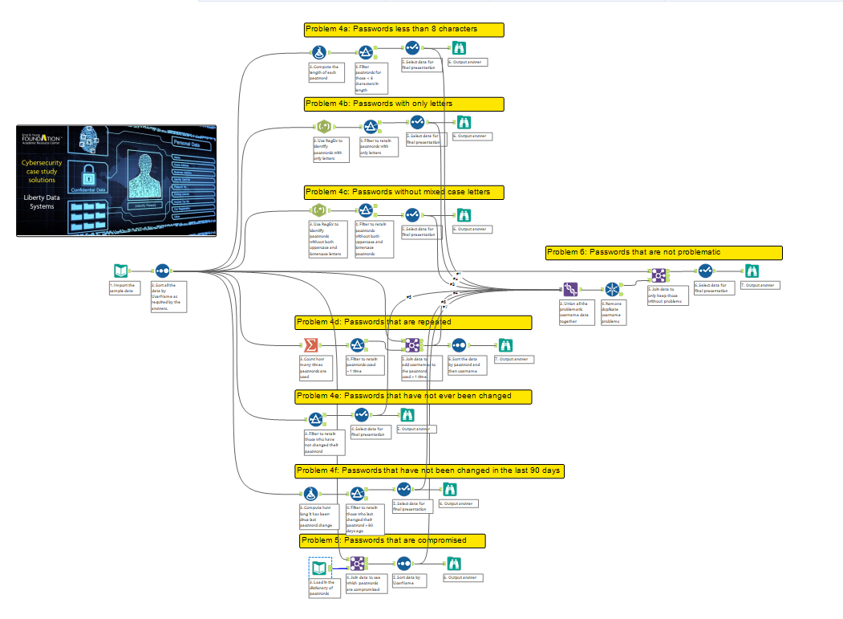
The goal to beat:
35 steps

Slide 7
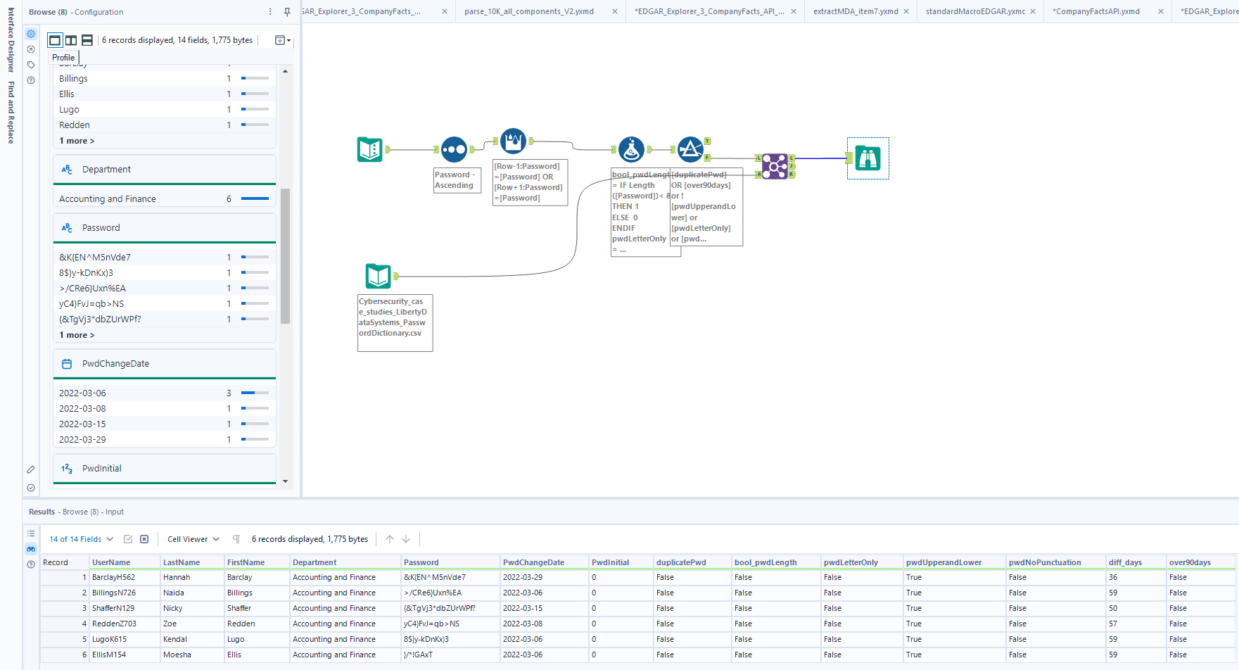

Slide 8
Key Cybersecurity Take-Aways
Many passwords are not secure, IT Controls need to work on password policy.
Today: Software patching can prevent malware injections.

Slide 9
Look ahead (workshop classes)

Slide 10
Workshop classes
Goal facilitate completion of the final project.
Class # | ACCTG 522 | ACCTG521
18 | 11/24 Workshop | 11/25 Blockchain (individual)
19 | 11/26 Thanksgiving break | 11/27 Thanksgiving break
20 | 12/2 Workshop | 12/2 Workshop *Audit Plan Deadline
21 | 12/3 Workshop *Final Project Due by 11:59PM | 12/4 Final Presentations
Workshops do not require classroom presence, if teams want to meet remotely or in break out rooms, let me know.

Slide 11
Workshop focus
https://forms.office.com/r/mTpgsZX5hu

Slide 12
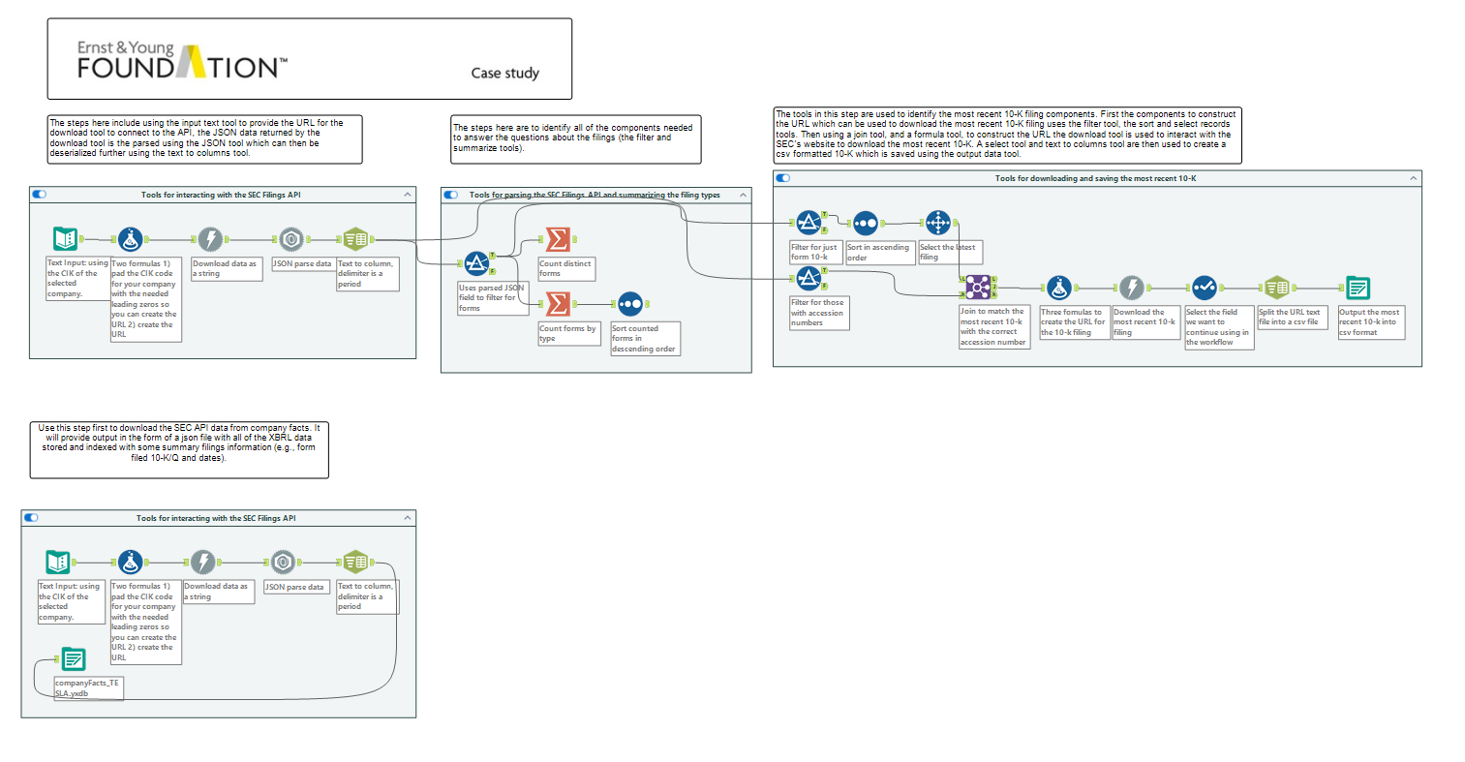
Full text filing
(text, tables, XBRL schema and more)
JSON file of XBRL (largely numeric)

Slide 13
Final Project Templates
Data Source Appendix
Goal: Have a summary Table documenting the sources of data used and where the data was used.

Slide 14
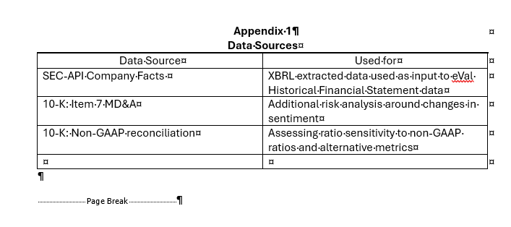

Slide 15
Final Project Templates
Analytics Enhancement Appendix
Goal: Have a summary Table documenting the sources analytical methods used and where in the Financial Statement Analysis they were incorporated.

Slide 16
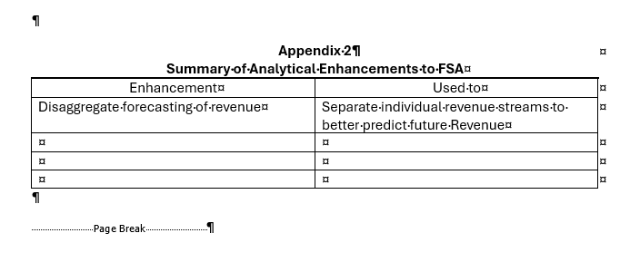

Slide 17
Final Project Templates
XBRL Mapping to eVal
Goal: Have a summary Table documenting the mapping of disaggregated tags to eVal line items.

Slide 18
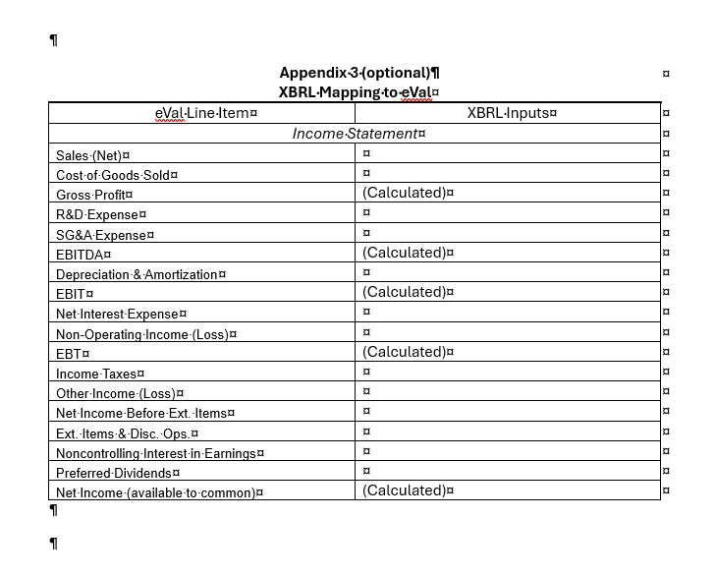

Slide 19
Alteryx Challenge 11/24
Two required submission portals with multiple files:
Individual Case Submissions: Alteryx Workflows -> all completed SparkEd (up to 6 files) and complete/incomplete Challenge (3 files)
Individual Case Submissions: Alteryx Challenge Memo -> memo about the three Alteryx challenges in 11/16 class (with Nicole as guest).

Slide 20
Agenda
Review
Deliverable
Lab:
Escape the Digital Dungeon Case

Slide 21
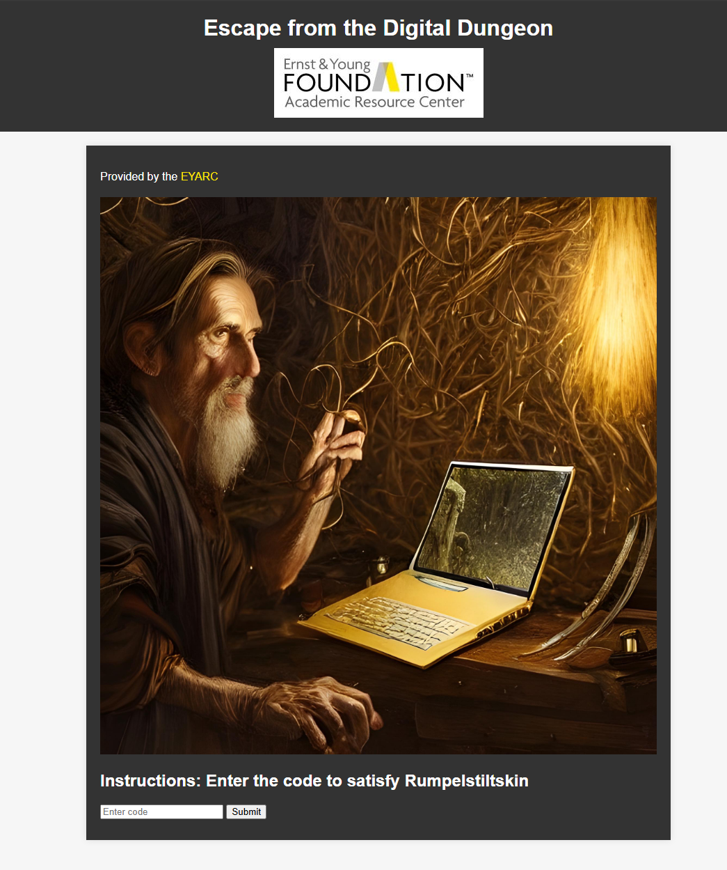
Enter your Alteryx generated code
A response will appear, and if you are correct the “unlock code” copy it and paste it into a comment on your workflow along with your name.
https://eyarc.site/cyber/index.html

Slide 22
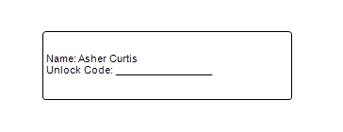
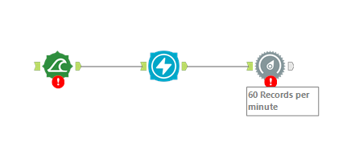
Deliverable
Comment tool with name and code
Rest of your workflow
**Save workflow as a packaged workflow

Slide 23
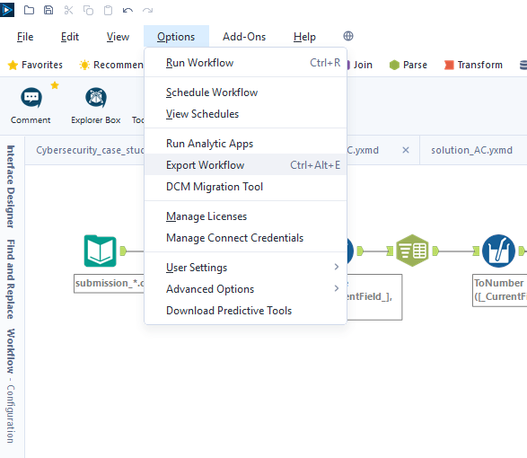
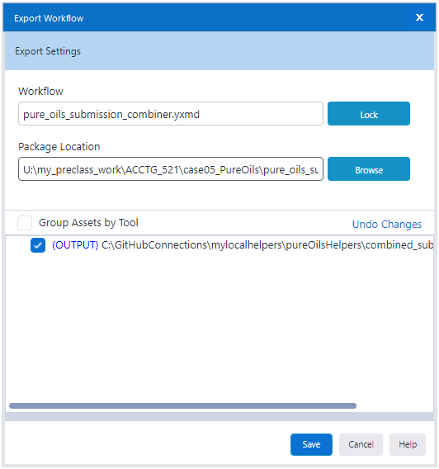
Deliverable
Your final Alteryx workflow, as a packaged workbook.
1
2
3 (note file ext
is “.yxzp”)

Slide 24
Agenda
Review
Deliverable
Lab:
Escape the Digital Dungeon Case

Slide 25
Today’s Challenge
Add a macro component as part of the workflow solution.
Must be a part of the workflow done more than once.

Slide 26
Case Cryptic Clue:
Search every person’s files, Search high and low! I used just one person’s two peoples' files For my password bold. Password? You say. What is it? You ask. Find all the digits Sum them up! It’s the only way To avoid bad luck. Time is ticking … Rumpelstiltskin

Slide 27
Remainder of case gives hints about the workflow
Read through including data description
Think about starting point of analysis, use Required section to help set-up workflow order.
Hints includes reminders of prior cases.

Slide 28
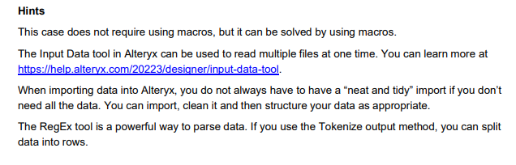
Hints

Slide 29

Thank you!

