Slide 1
Integrating Analytical Skills, continued
ACCTG 320
Accounting Systems and Analytics
Class 11 | Autumn | 2026

Slide 2
Agenda
Review/Overview of workflows
Labs:
  SparkEd Case 1: Suspect Vendors (as a class)
  SparkEd Case 2: Purchase Order Splitting (in small teams)
Conclusion and look ahead

Slide 3


Slide 4

Why Alteryx?
Alteryx brings data preparation and analysis into a visual workflow, allowing us to connect analytical steps in a logical sequence that is easy to follow, check, and repeat.

Slide 5
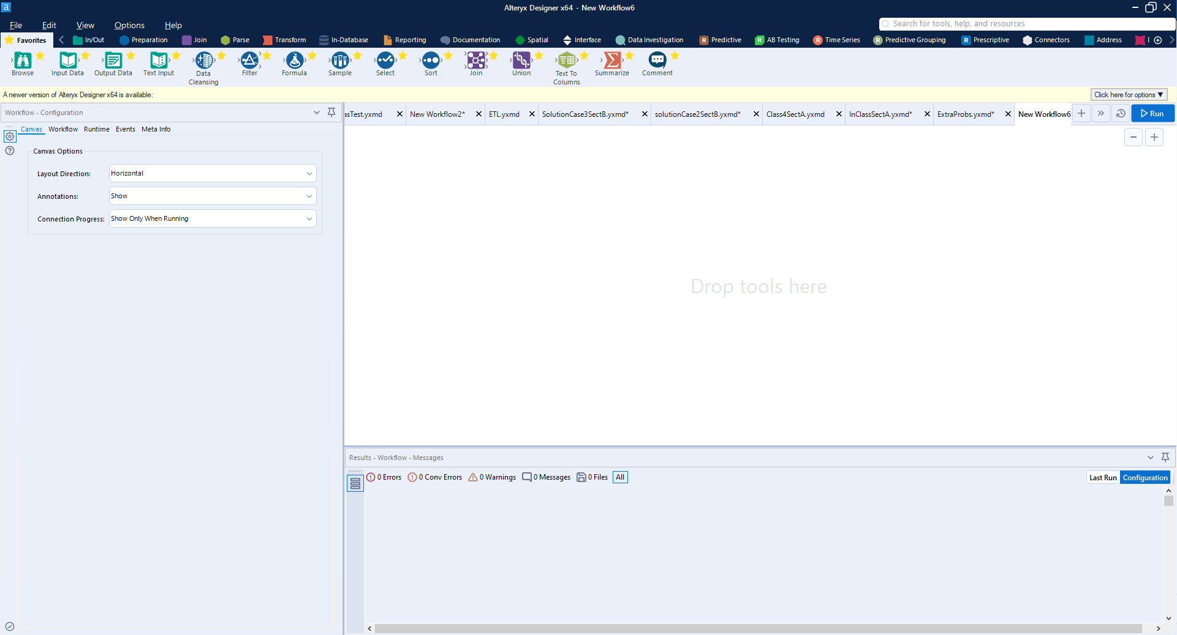
Tool Bar
Workflow
Configuration Window
Workflow Log & Preview Window

Slide 6
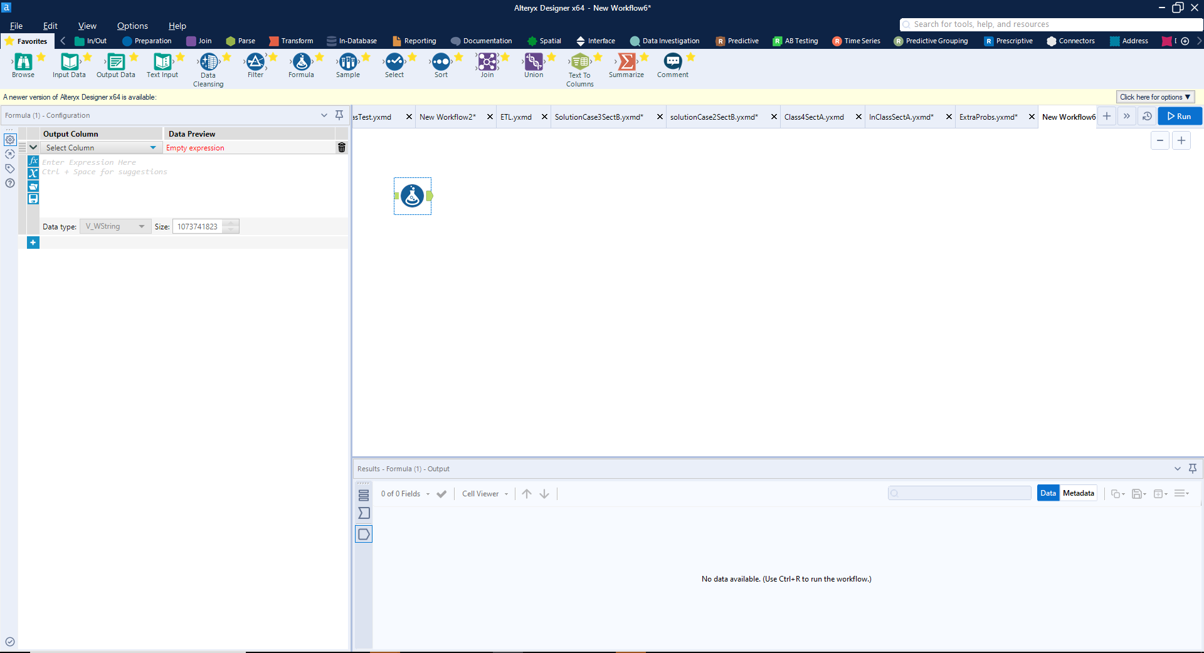
Drag a Tool onto/into the Workflow
Configuration Window
Updates to the tool
selected

Slide 7
How Can Gen AI tools assist with Alteryx?
Suggest tools: Describe your task and ask which Alteryx tool could help.
Guide setup: Ask how to configure a tool or write a formula.
Help debug: Share an error message or unexpected result to identify possible causes and checks.

Slide 8
Agenda
Review/Overview of workflows
Labs:
  SparkEd Case 1: Suspect Vendors (as a class)
  SparkEd Case 2: Purchase Order Splitting (in small teams)
Conclusion and look ahead

Slide 9
Labs
https://fprod-hcs.foster.uw.edu/
Case: Suspect Vendors Overview

Slide 10
Suspect Vendors: Question
Background: The U.S. Department of the Treasury's Office of Foreign Assets Control (OFAC) provides a list of companies and individuals that US firms are prohibited from doing business with.
Question: Has the company undertaken any transactions with companies/individuals on that list? If so, how many?

Slide 11
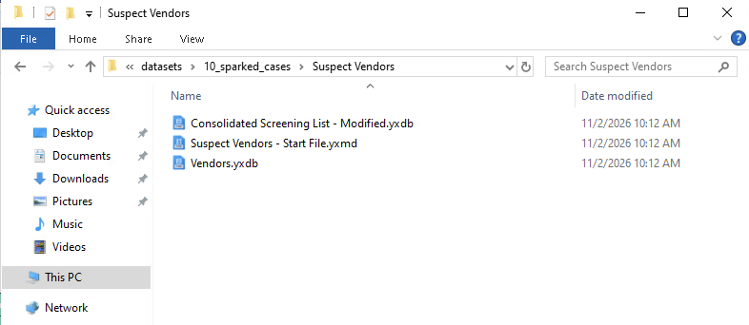
Suspect Vendors: Question
Data: git pull to create 10_sparked_cases; copy entire folder to mywork.
First case is in folder “Suspect Vendors”
Two datasets (.yxdb files)

Slide 12
Suspect Vendors: Question
Data: git pull to create 10_sparked_cases; copy entire folder to mywork.
First case is in folder “Suspect Vendors”
One starter workflow (.yxmd file)
Double click to open in Alteryx

Slide 13
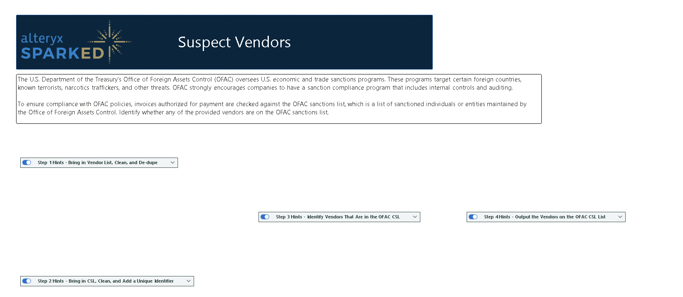
Starter file has hints

Slide 14
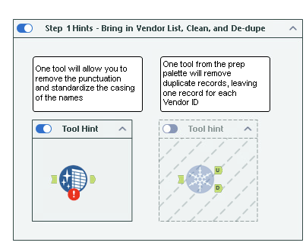

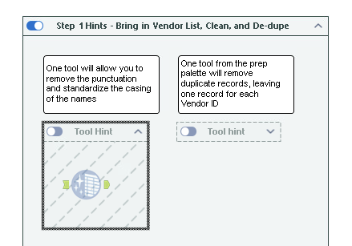
Access the hints
Not enabled
Greyed out

Slide 15
Two ways to use the hints
Enable the tools and connect them in the starter workflow:
  Tools are already in the workflow, just need to configure them.
  Canvas can get a bit crowded.
Start a new workflow and use the hints as a guide
  Need to locate the tools.
  Canvas will be clearer.

Slide 16
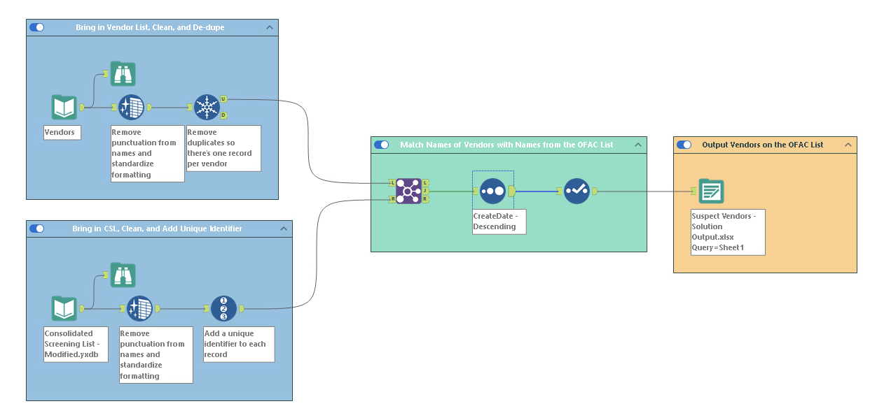
Solution preview/guide
10 Records match

Slide 17
Labs
https://fprod-hcs.foster.uw.edu/
Case: PO Splitting Overview

Slide 18
Alteryx challenge
Cases have increasing difficulty/complexity:
PO Splitting
GL Clean up
Organizing Financial Data
International Group Taxes
Sales & Use Tax
If you finish PO Splitting!
-- let me know and start GL Clean up

Slide 19
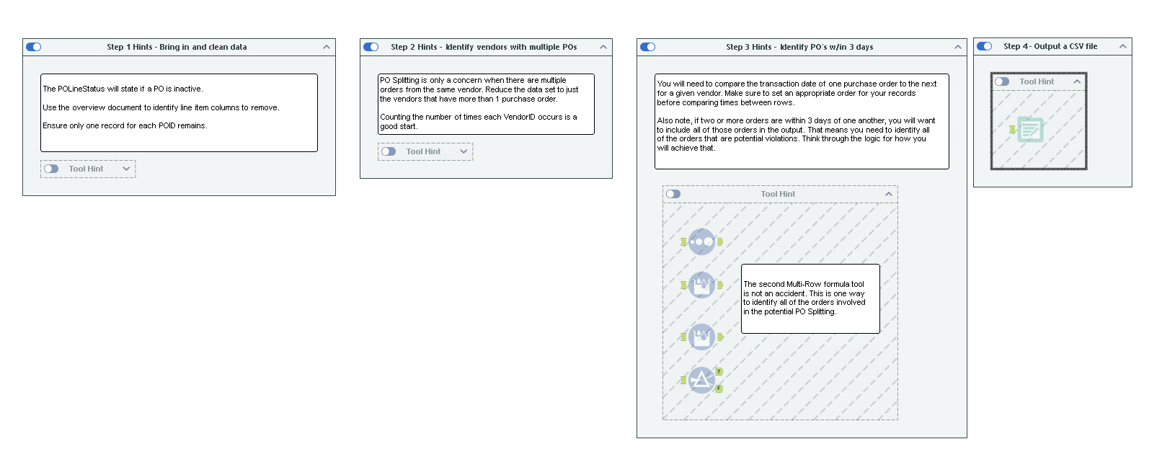
Purchase order splitting hints

Slide 20
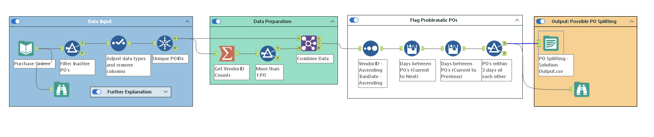
Purchase order splitting:
186 records
10 records

Slide 21
Next steps
Next topic: Integrating Analytical Skills, continued
We will continue to use Alteryx workflows to better understand business problems/decisions
Consider how financial and other data can be analyzed to understand various business problems
Thank you!

