Slide 1
Innovative Data Sources and Tools: Generative AI
Data Analytics for Professional Accountants (ACCTG 522)
Class 7 | MPAcc Class of 2026

Slide 2
Welcome!
Class Agenda
Review
Brief Overview on Generative AI
Labs:
Pure Oils Part 1 (Chat GPT and Python)
Conclusion and look ahead
Pure Oils Part 2 (Alteryx)

Slide 3
The Analytical Mindset
The Analytical Mindset is defined as the ability to work with data to apply appropriate analytics and interpret and share insight with stakeholders.

Slide 4
Why do we care about Extract, Transform & Load (ETL)?
The Extract, Transform & Load or ETL Process is the first task required to complete the analytical process.
In most cases, data required for the analytical process is stored in a database and must be extracted from that database and loaded into analytics software.
More challenging extraction (typically unstructured) require more advanced tools.

Slide 5
Regular Expressions
More advanced ETL Processes include using Regular Expressions (RegEx) to extract patterns from any set of characters (numbers, string, punctuation).
Regular Expressions allowed us to split the email header text into useable fields
And allowed us to undertake analysis of unstructured text (i.e., the subject & email body).

Slide 6
Welcome!
Class Agenda
Review
Brief Overview on Generative AI
Labs:
Pure Oils Part 1 (Chat GPT and Python)
Conclusion and look ahead
Pure Oils Part 2 (Alteryx)

Slide 7
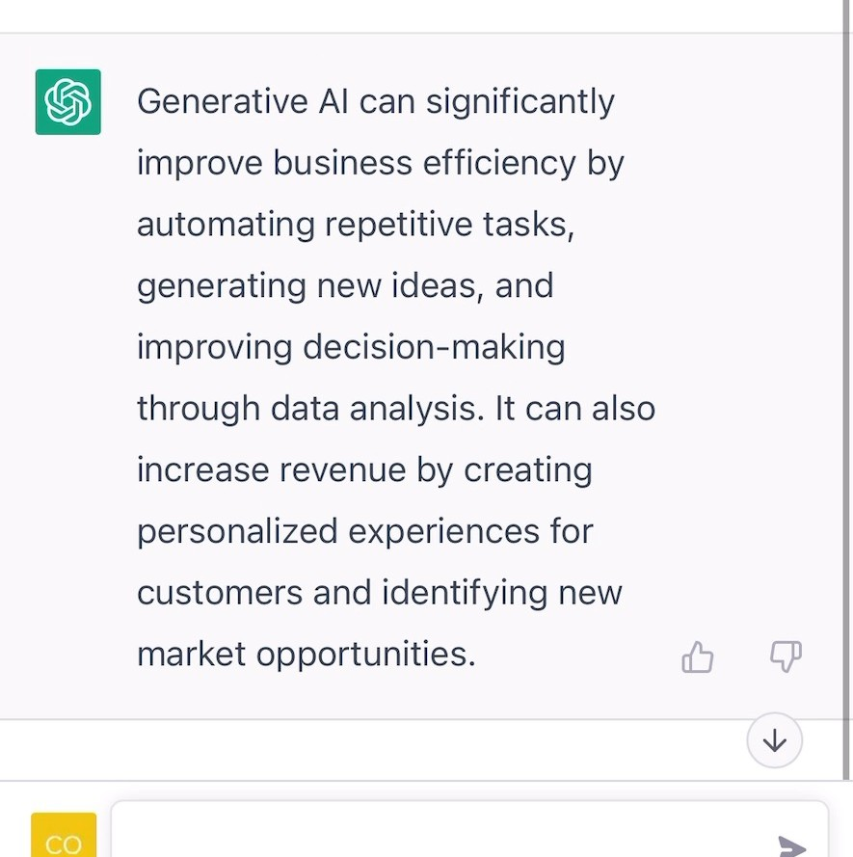
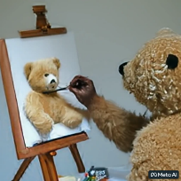
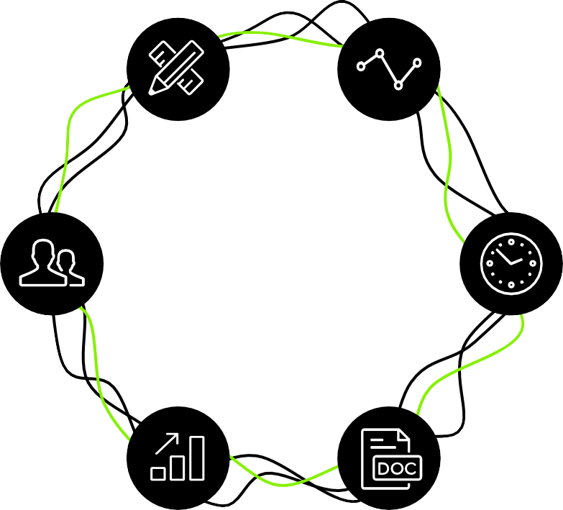

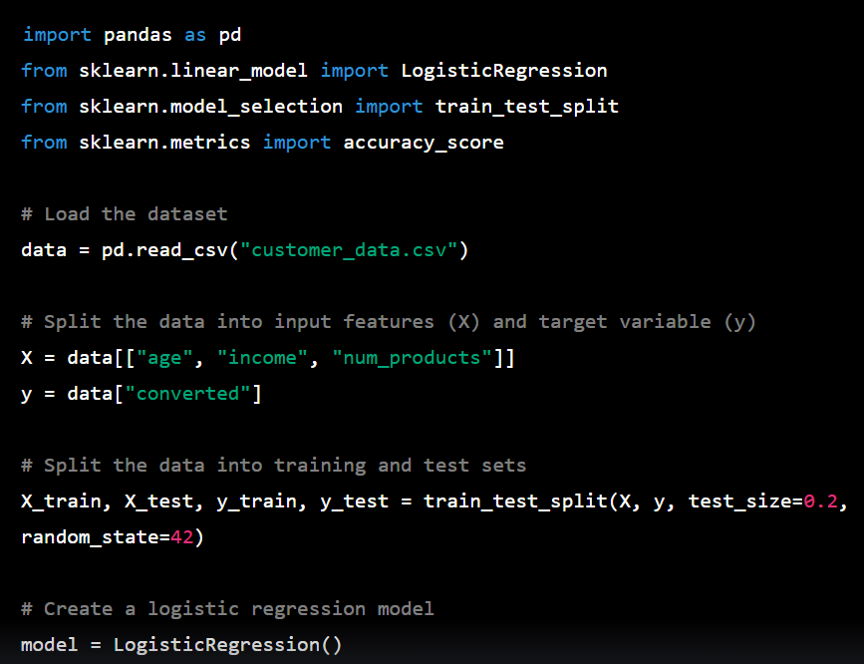

Generative AI capabilities
Generative AI can produce a wide range of outputs depending on the specific application and type of data that is needed. Here are some common output types that are applicable to business
Text
Video
Prompt: Explain the business impact of Generative AI in 50 words
Prompt: Create a video of a teddy bear painting a portrait
Image
Code
Prompt: A bowl of soup that is a portal to another dimension as digital art
Prompt: In python, code a program that predicts the likelihood of customer conversion
Phone / Voice
Multi-Lingual
Multiple Tasks
Empathy / Humor
Ensures Resolution
Systems Integration
Audio
3D
Generative AI-powered customer service agents
Prompt: A beautiful dress made out of garbage bags, on a mannequin. Studio lighting, high quality, high resolution.

Slide 8
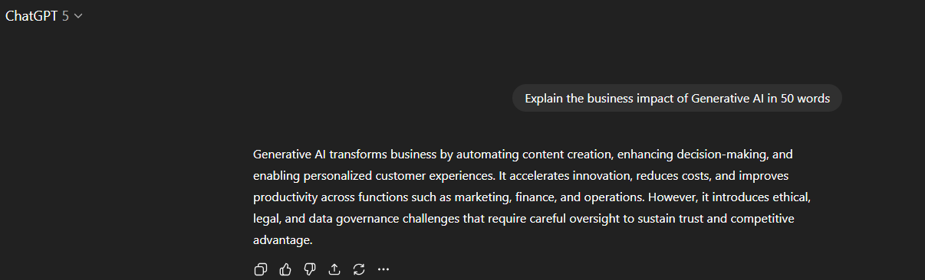

Slide 9
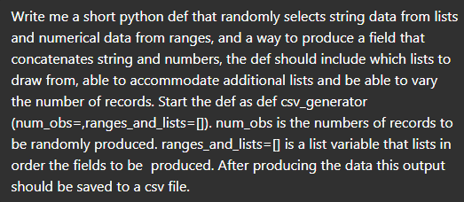
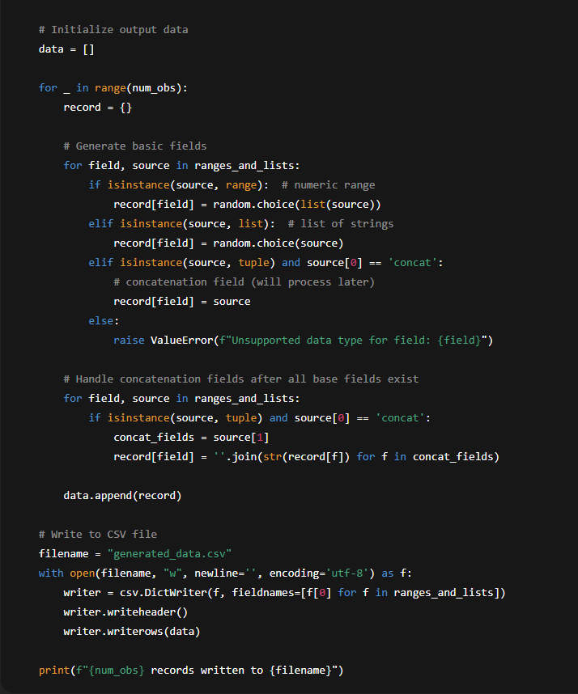
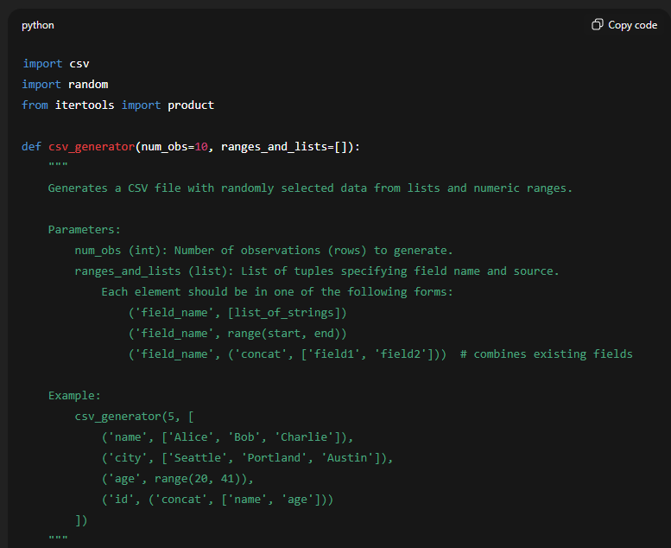

Slide 10
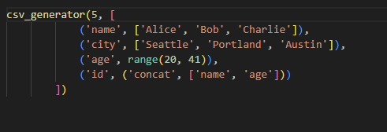
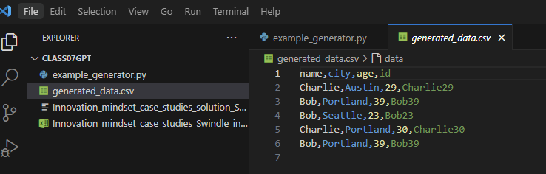
On the remote labs we can use visual studio code, import a few libraries and make an update at the end of the file to call the def
And our data is generated:

Slide 11
Core Capabilities: Doc & Data Intelligence
Doc Intelligence
Automated understanding and summarization of documents
Quick extraction of important points and data from any text
Comparison of document contents to identify key differences
Accurate language translation for diverse document types
Trend and pattern detection within large volumes of text
Data Intelligence
Connect to any data source, integrating seamlessly with AI.
Utilize AI to uncover deep insights from complex datasets.
Empower finance to do real-time decision-making with dynamic, AI-driven data analysis.
Leverage predictive analytics to forecast trends and guide strategic planning.

Slide 12
AI Engagement Models: Prompt vs. Pre-Prompt
Prompt-Response
Use an AI assistant for direct, real-time interaction to receive immediate feedback and assistance.
Adaptive AI responses evolve from each user interaction, enhancing accuracy and relevance.
Enable swift problem-solving and decision support, improving overall efficiency and user experience.
Pre-Prompt
AI operates in the background based on predefined prompts and conditions.
Conducts continuous background processing for data analysis, info generation, and monitoring.
Automates tasks to streamline operations and prepare actionable insights without user intervention.

Slide 13
Welcome!
Class Agenda
Review
Brief Overview on Generative AI
Labs:
Pure Oils Part 1 (Chat GPT and Python)
Conclusion and look ahead
Pure Oils Part 2 (Alteryx)

Slide 14
Pure Oils Case Overview
Founder: Skylar Swindler Founded: 2021 Headquarters: Recife, Brazil Business Claim: Produces 100% natural essential oils from fallen rainforest leaves — marketed as eco-friendly and possessing “near magical” properties. Reality: Entire operation is fraudulent — bottles filled with water and other liquids.
Employees: 110 total
Majority hired in the past year
Promoted as native Brazilians “lifted out of poverty”
Example employee story: Fernanda Silva Pazos featured in marketing
Skylar claims large-scale employment of local workers

Slide 15
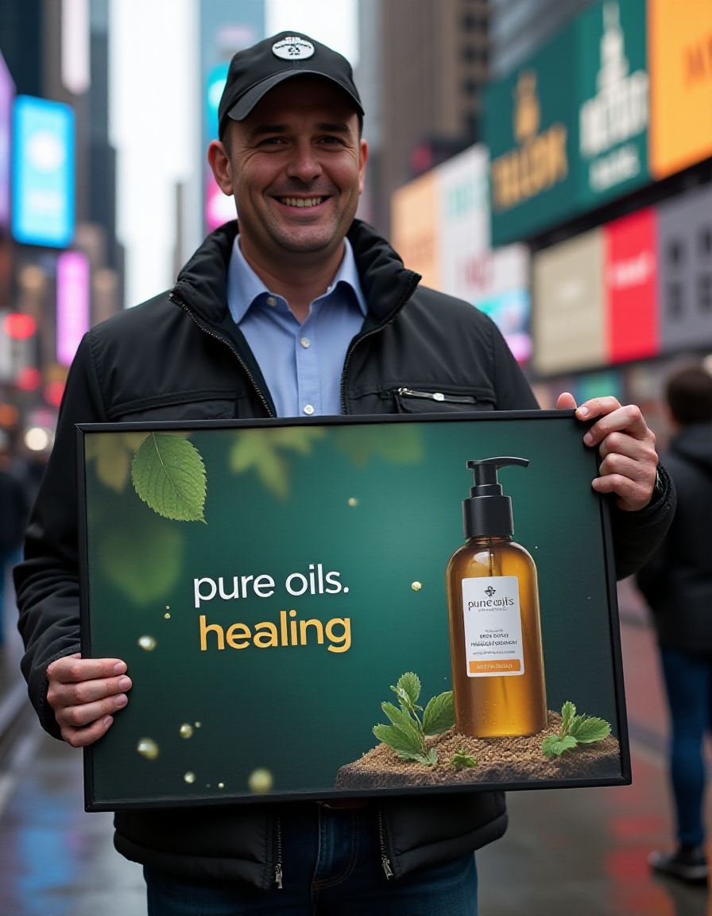
Lab Part 1
Help Skylar Swindler at Pure Oils provide evidence of his company’s legitimate existence:
Single Prompt (“One Shot” approach)
Assessment of Red-flags
Secondary prompt for refinement
Use as a Coding Assistant
Generate data for 110 current employees in csv format

Slide 16
The Class Prompt
Generate me a dataset of 110 employees for a fictitious company called Pure Oils and return it as a csv. The fields are [UniqueID,LastName,FirstName,JobTitle,Department,HireDate,LastPromotionDate,TerminationDate,AnnualSalary]. The first employee is Called Skylar Swindler, his job title is CEO. He was hired on 1/1/2021.

Slide 17
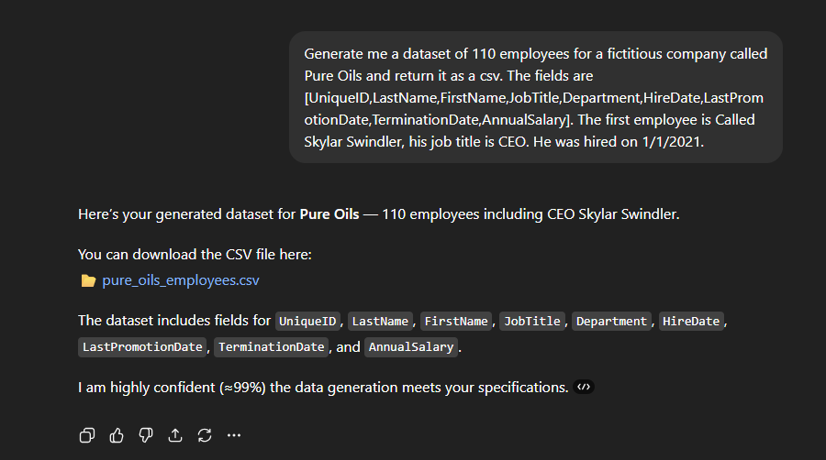
Single prompt / Class Prompt

Slide 18
Example output
UniqueID | LastName | FirstName | JobTitle | Department | HireDate | LastPromotionDate | TerminationDate | AnnualSalary
PO-100001 | Swindler | Skylar | CEO | Executive | 1/1/2021 |  |  | 250000
PO-100002 | Patel | Peyton | Assistant | Marketing | 12/8/2024 | 7/23/2025 |  | 147817
PO-100003 | Young | Alex | Technician | IT | 8/21/2023 |  |  | 76073
PO-100004 | Baker | Sky | Specialist | Sales | 2/25/2023 |  |  | 86402
PO-100005 | Allen | Jordan | Technician | Operations | 5/22/2024 | 1/31/2025 |  | 70100
PO-100006 | Garcia | Jesse | Engineer | Sales | 6/28/2022 | 7/21/2025 |  | 62712
PO-100007 | Baker | Drew | Technician | IT | 10/23/2022 | 2/13/2024 |  | 98189
PO-100008 | Wright | Dakota | Supervisor | Finance | 8/26/2024 | 9/9/2024 |  | 145092
PO-100009 | Rivera | Avery | Specialist | Quality | 2/6/2022 | 2/13/2025 | 8/23/2023 | 113581
PO-100010 | Baker | Morgan | Engineer | Logistics | 6/13/2021 | 12/30/2021 |  | 79331

Slide 19

Follow-up Prompt
Keep your prompt open and prompt fixes of the data.
Look to see how much improvement you achieve.

Slide 20
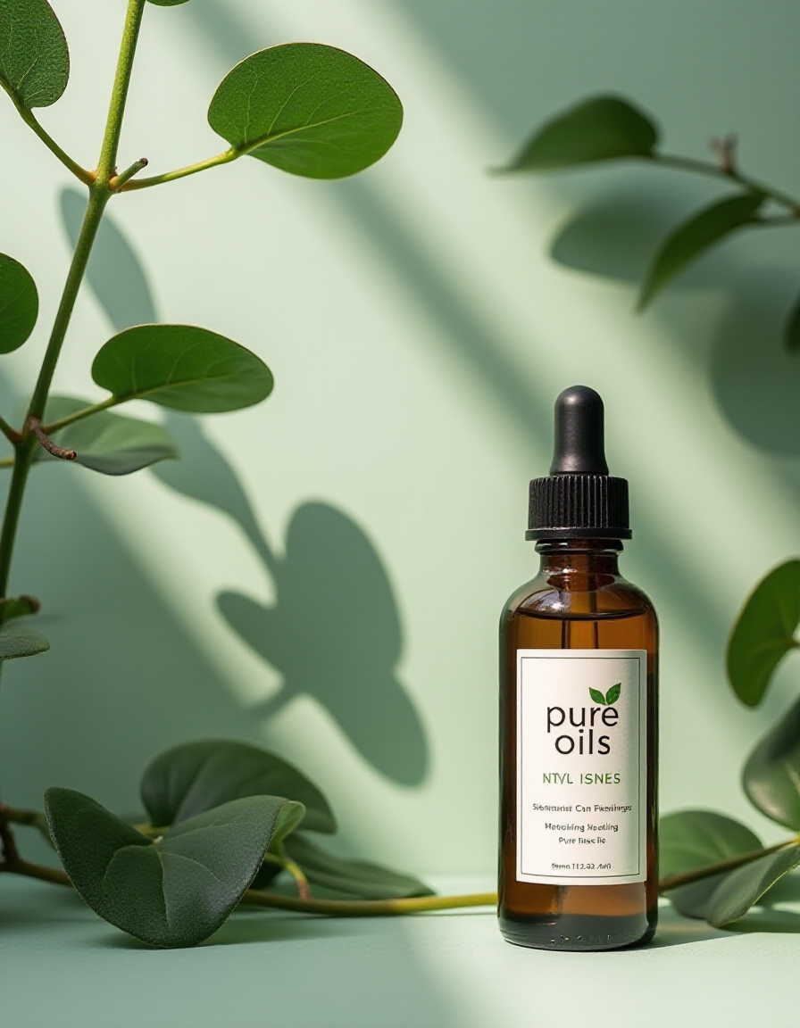
Coding assistant
Have Chat GPT help build you customizable python code to generate the fake dataset.
Tips: use it’s knowledge of various features of the demographics you may not be aware of.

Slide 21
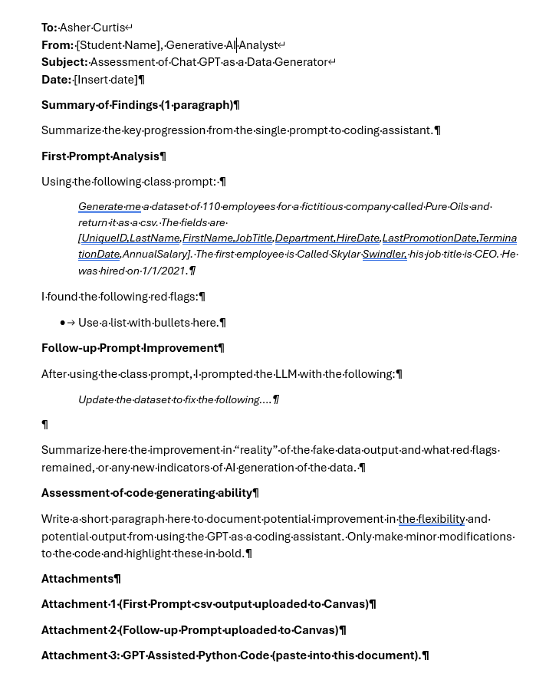

Slide 22
Welcome!
Class Agenda
Review
Brief Overview on Generative AI
Labs:
Pure Oils Part 1 (Chat GPT and Python)
Conclusion and look ahead
Pure Oils Part 2 (Alteryx)

Slide 23

Lab Part 2 – In future ACCTG521
Assess the output files from classmates:
Alteryx workflows:
Generate a diagnostic for a fake/AI generated csv file
Look for red flags, set up tests, use Alteryx to help find and document the red flags

Slide 24

Thank you!

