Slide 1
Misstatement Risk
Advanced Cases in Assurance Services (ACCTG 521)
Class 4 | MPAcc class of 2026

Slide 2
Agenda
Review
Overview
Misstatement Risk
Mini-Lab
Explaining Common 2024/2025 Accounting Restatements
Labs
Using F-Scores a restatement risk tool

Slide 3
Economics of Audit
Conflicting incentives for (i) firms to disclose and withhold information and (ii) for firms to undertake audits (or information verification).
Factors that influence demand for audit and therefore audit fee include:
Agency conflicts
Information asymmetry
Risk of intentional manipulation
Risk of unintentional errors
For example, firm size (i.e., total assets)

Slide 4
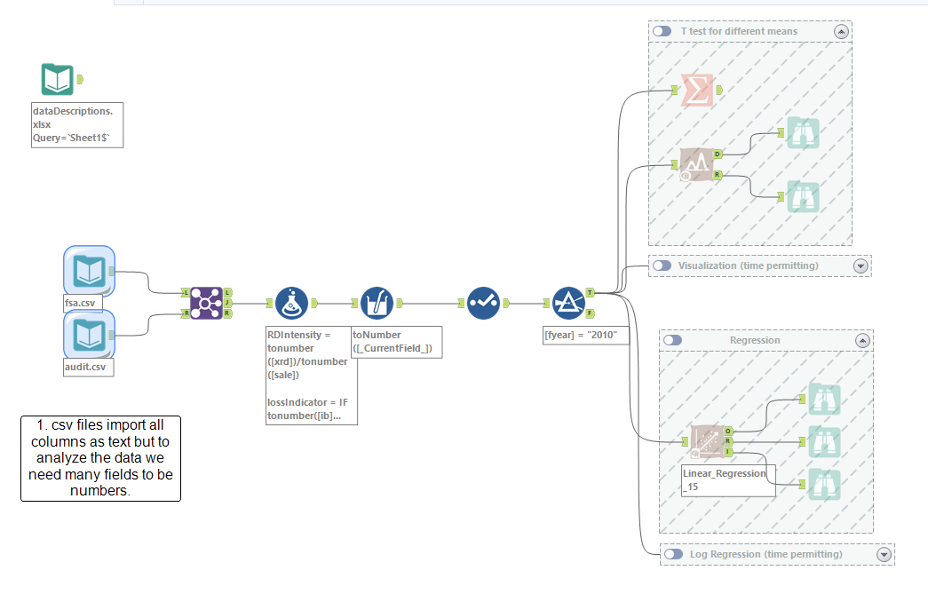

Slide 5
Audit Risk Model
Audit Risk: risk that the auditor expresses an inappropriate audit opinion when the financial statements are materially misstated
AR = IR x CR x DR
RMM
Inherent Risk: risk that a management assertion is materially misstated (before considering internal controls)
Control Risk: risk that internal controls fail to detect a misstatement
Detection Risk: risk that auditors fail to detect a misstatement

Slide 6
Audit Planning
Assessment of business risks is fundamental to thoughtful planning and execution of the audit.
Business risks provide helpful starting point for assessing financial statement risks.
Firm disclosures are helpful but can also contain boilerplate information or inconsistencies. Consider broad sources.
Materiality is judged by whether the information would change the decision of a reasonable investor
Materiality is based on qualitative and quantitative factors. It is subjective and requires judgment, but it is a critical starting point for understanding where to focus audit planning attention.

Slide 7
Agenda
Review
Overview
Misstatement Risk
Mini-Lab
Explaining Common 2024/2025 Accounting Restatements
Labs
Using F-Scores a restatement risk tool

Slide 8
What is a Misstatement? (AS2810.A2)
"A misstatement, if material individually or in combination with other misstatements, causes the financial statements not to be presented fairly in conformity with the applicable financial reporting framework. A misstatement may relate to a difference between the amount, classification, presentation, or disclosure of a reported financial statement item and the amount, classification, presentation, or disclosure that should be reported in conformity with the applicable financial reporting framework. Misstatements can arise from error (i.e., unintentional misstatement) or fraud.”

Slide 9
Material Misstatements
Material misstatements will cause a firm to restate their financial statements.
Many restatements are publicly announced in an 8-K.

Slide 10
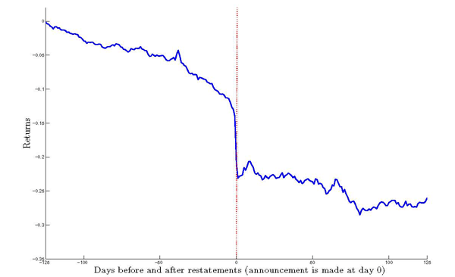
Market response to restating firm
Average abnormal returns below negative 9%
Why might investors perceive a restatement as bad news?

Slide 11
Impact on auditor of a client restatement
Auditors face a higher likelihood of litigation when a client restates
increasing for common frauds
and those including fictional transactions
Who do you expect brings legal action against the auditor? And why?

Slide 12
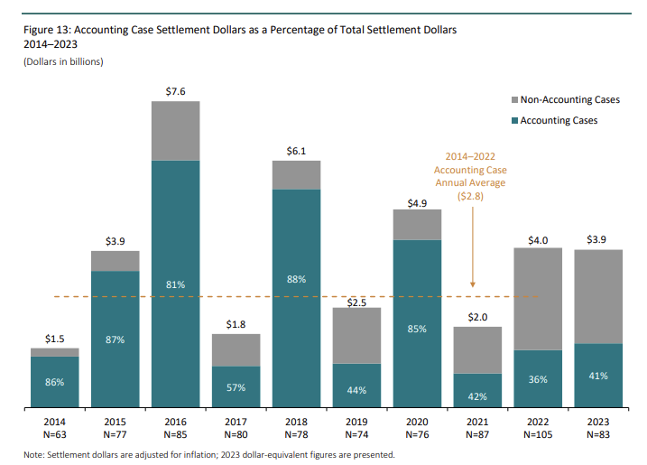
Source: Cornerstone Research “Accounting-Class-Action-Filings-and-Settlements-2023”

Slide 13
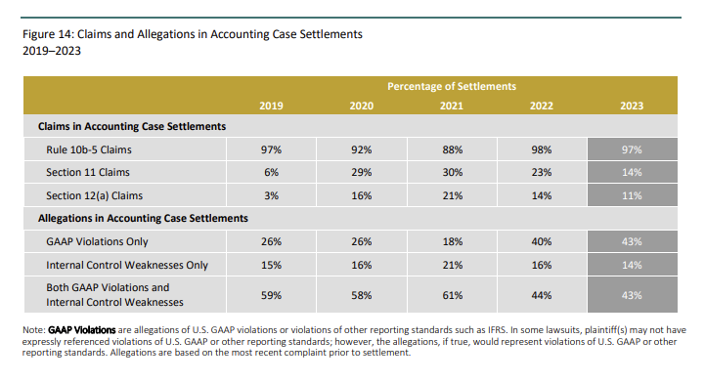
Source: Cornerstone Research “Accounting-Class-Action-Filings-and-Settlements-2023”

Slide 14
Impact on management of a misbehavior-related restatement
Firms with a misbehavior-related restatement had higher turnover in 13 months around restatement
49% of CEOs vs only 8% for error-related restatement
64% of CFOs vs only 12% for error-related restatement
91% of misbehavior restatements had either CEO or CFO leave
(Hennes, Leone, and Miller 2008)
More on misbehavior vs error related restatement:
Market reaction is -14% for misbehavior restatement, -2% for error-related restatement
80% of misbehavior has a class action lawsuit, while only 1% of error did

Slide 15
Agenda
Review
Overview
Misstatement Risk
Mini-Lab
Explaining Common 2024/2025 Accounting Restatements
Labs
Using F-Scores a restatement risk tool

Slide 16
Mini-Lab
Goal: Explain, using an example firm, one of the top-10 reasons for restatements in 2024/2025.

Slide 17
Mini-Lab Assignments
Discussion Team | Count of Restatements | Accounting Issue
1 | 103 | Debt, quasi-debt, warrants & equity ( BCF) security issues
2 | 62 | Liabilities, payables, reserves and accrual estimate failures
3 | 59 | Revenue recognition issues
4 | 57 | EPS, ratio and classification of income statement issues
5 | 51 | Cash flow statement (SFAS 95) classification errors
6 | 43 | Expense (payroll, SGA, other) recording issues
7 | 42 | Acquisitions, mergers, disposals, re-org acct issues
8 | 39 | PPE intangible or fixed asset (value/diminution) issues
9 | 38 | Accounts/loans receivable, investments & cash issues
10 | 36 | Debt and/or equity classification issues

Slide 18
Alteryx Workflow Hints
Read in “Accounting_restatements.yxdb”
Save workflow to your /my_work/ folder
Filter [RES_ACCOUNTING_RES_CAT_TIT_LIS]
ID one firm to research as your example, and start with reading the information in the variable [DISCLOSURE_TEXT]
Note larger impacts on restated net income are more negative in [CHANGE_CUM_NET_INCOME_USD]
Note [HTTP_FILE_NAME_HTML_OF_8K_402] is a partial link to the filing @ www.sec.gov (var is /Archives/…)

Slide 19
Agenda
Review
Overview
Misstatement Risk
Mini-Lab
Explaining Common 2024/2025 Accounting Restatements
Labs
Using F-Scores a restatement risk tool

Slide 20
What firm characteristics might predict restatement risk?
Discussion Teams | Firm Characteristic | Measures | + / - ? | Why?
1,2,3 | Accruals | ChgRec, ChgInv, RSST accruals, % soft assets
4,5 | Firm Performance | ChgROA, ChgCashSales
6 | Abn chg in # employees | AbnChgEmp
7 | Off-balance sheet information | OperLeases
8 | Stock / Debt market incentives | IssueDebtEquity
9,10 | Growth expectations | StockReturns, BooktoMarket

Slide 21
F-Score
The F-Score combines the information in these different firm characteristics to predict the likelihood or risk of restatements.
F-Scores above one indicate increased risk, with the higher the number the higher the risk (capped at 5)
Numbers less than or equal to one imply no heightened risk.

Slide 22
F-Score Lab Assignments
Discussion Team | Audit Firm Focus
1 | BDO International (BDO USA in North America)(Seidman and Seidman prior to September 1, 1988)
2 | Crowe Horwath
3 | Deloitte & Touche (Deloitte, Haskins and Sells prior to December 4, 1989; Haskins & Sells prior to May 1, 1978)
4 | EisnerAmper LLP (Richard A. Eisner prior to August 16, 2010)
5 | Ernst & Young (Ernst & Whinney from July 1, 1989 to September 29, 1989; Ernst & Ernst prior to July 1, 1989)
6 | Grant Thornton
7 | KPMG (Peat, Marwick, Mitchell prior to April 1, 1987)
8 | Moss Adams
9 | PricewaterhouseCoopers (Price Waterhouse prior to July 1, 1998 merger with Coopers and Lybrand)
10 | RSM (McGladrey LLP prior to October 26, 2015; McGladrey and Pullen prior to May 1, 2012; McGladrey, Hendrickson and Pullen prior to May 1988)

Slide 23
Lab Exercise
File for analysis is either fscore_data_with_auditor .yxdb (Alteryx) or .hyper (Tableau)
Identify your Assigned Audit Firm Companies and their F-Scores.
Research one high risk company and one low risk company using F-Score.
Identify if a company characteristic in the F-Score model could help identify accounts with heightened misstatement risk.

Slide 24

Thank you!

