Slide 1
Enhanced FSA with Data Analytics
Data Analytics for Professional Accountants (ACCTG 522)
Class 11 | MPAcc Class of 2026

Slide 2
Welcome!
Class Agenda
Review
Valuation-based screening
Portfolio Approaches
Additional considerations for Short Positions
Lab:
Simplified RIV-to-Price screen (Factset Inputs, Alteryx workflow)
Team Selection and Justification Time
Team Memo with initial write-up of long-short justification.
Conclusion and look ahead.

Slide 3
Review
Final Project Consists of an Initiation Report for
Two stocks
One long and one short position
Often called a “Pairs strategy” and attempts to hedge market-wide (or common) stock movements
With supporting documentation and justification.

Slide 4
Review
The first step is to use screening to identify:
An undervalued stock, with relatively higher expected returns over the next year as a long target.
An overvalued stock, with relatively poor expected returns over the next year as a short target.

Slide 5
Review
Data Analytics can enhance FSA by:
Providing more targeted metrics for screening stocks into over and undervalued.
Providing more disaggregated or theoretically driven data to support forecasting.

Slide 6
Welcome!
Class Agenda
Review
Valuation-based screening
Portfolio Approaches
Additional considerations for Short Positions
Lab:
Simplified RIV-to-Price screen (Factset Inputs, Alteryx workflow)
Team Selection and Justification Time
Team Memo with initial write-up of long-short justification.
Conclusion and look ahead.

Slide 7
Valuation-based screening
Goal
Use an estimate of the fundamental value (Vf), or intrinsic value, of a stock and compare it to price (p), so that the ratio Vf/p can be used to identify:
Stocks that are potentially undervalued because Vf/p is relatively high (Vf>p)
Stocks that are potentially overvalued because Vf/p is relatively low (Vf<p)

Slide 8
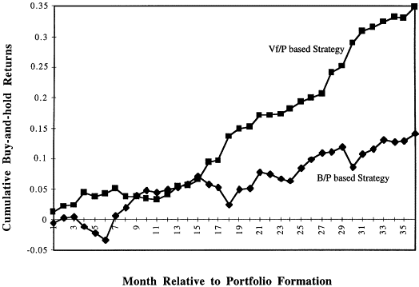
Portfolio Approaches
What does the data tell us about the fv/p’s ability to pick over v under valued stocks?

Slide 9
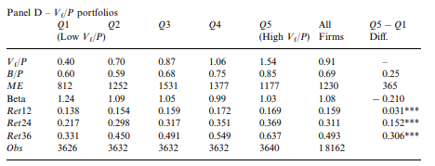
Portfolio Approaches
“Hedge returns”
Average over performance of the overvalued “Q1” relative to the undervalued “Q5”
What does this mean? In each of the five portfolios/quintile groupings, we see the average return for the portfolio above, but not the individual return.
Key interpretation: Vf/P gets it right on average (especially in the extremes Q1,5), but it isn’t guaranteed or perfect.
Source: Accounting valuation, market expectation, and cross-sectional stock returns

Slide 10


Portfolio Approaches: Lab Simplification
Using Factset historical data and prices, we will simplify the Frankel and Lee (1998) version of Vf below:
To a simplified model used in Curtis (2012)
Key differences:
Don’t require analysts forecasts, or estimates of future book value, use current data on income and book value and add growth in the denominator.

Slide 11
Welcome!
Class Agenda
Review
Valuation-based screening
Portfolio Approaches
Additional considerations for Short Positions
Lab:
Simplified RIV-to-Price screen (Factset Inputs, Alteryx workflow)
Team Selection and Justification Time
Team Memo with initial write-up of long-short justification.
Conclusion and look ahead.

Slide 12
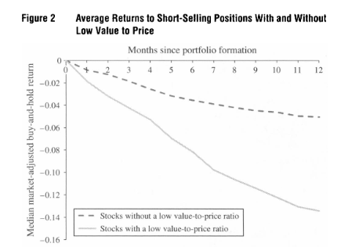
Additional Considerations for Short Positions
Source: https://www.jstor.org/stable/24550588

Slide 13
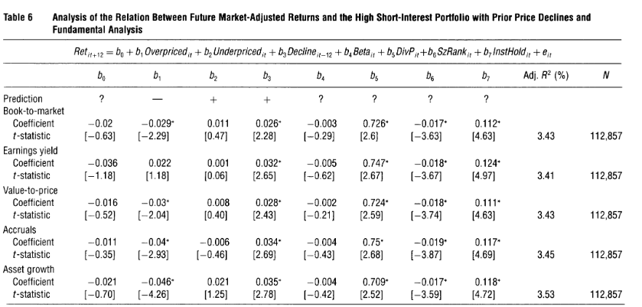
Additional Considerations for Short Positions
Other metrics to consider
Prior declines (already correcting some overvaluation), larger stock market values
Dividend paying stocks, stocks with large institutional holdings.
Source: https://www.jstor.org/stable/24550588

Slide 14
Welcome!
Class Agenda
Review
Valuation-based screening
Portfolio Approaches
Additional considerations for Short Positions
Lab:
Simplified RIV-to-Price screen (Factset Inputs, Alteryx workflow)
Team Selection and Justification Time
Team Memo with initial write-up of long-short justification.
Conclusion and look ahead.

Slide 15
Future Potential Analyses to improve with data
Forecasting
Risk analyses, sentiment (10-K data / words), Fog index
Ratios, forecasts (xbrl data)
Other forms 8-K (events), Form 4 (insider selling).

Slide 16

Thank you!

