Slide 1
Audit Analytics 2
Advanced Cases in Assurance Services (ACCTG 521)
Class 9 | MPAcc class of 2026

Slide 2
Agenda
Review & Overview
Internal Controls and Fraud
Labs (in assessment teams)
Required deliverables (pre-, post-, meeting memos, meeting)
Helix Audit and assessment of potential control weakness/deficiency, or even fraud.
With time to draft your pre-meeting memo

Slide 3
Auditors’ responsibility
Plan and perform the audit to obtain reasonable assurance about whether the financial statements are free of material misstatement, whether caused by fraud or error
Absolute assurance is not attainable and, thus, even a properly planned and performed audit may not detect material misstatement resulting from fraud
Exercise Professional Skepticism: a questioning mind and a critical assessment of audit evidence
Mindset that recognizes the possibility that a material misstatement due to fraud could be present, regardless of any past experience with the entity and regardless of the auditor’s belief about management’s honesty and integrity
Ongoing questioning of whether the information and evidence obtained suggest a material misstatement due to fraud occurred

Slide 4
Fraud triangle
Incentive or pressure providing a reason to commit fraud
Ability to rationalize committing fraud, e.g., an attitude, character or set of unethical values allow person to intentionally commit dishonest act; but even otherwise honest individuals commit fraud in an environment imposing sufficient pressure
Circumstances exist, e.g., absence of controls, ineffective controls or ability of management to override controls, providing an opportunity for fraud
Notes:
Incentive / pressure
Opportuntiy / circumstances exists
rationalization

Slide 5
Fraud may be concealed by
Withholding evidence or misrepresenting information.
Collusion among management, employees or third parties, e.g., consistent misleading explanations by more than one individual.
Hiding through multiple steps or entries.
Each entry on its own may not appear unusual, but when you look at them collectively or “follow the cash,” you find an illogical set of transactions.

Slide 6
Multiple steps
1. PP&E $100
Sales $100
This entry on its own would look suspicious.
Notes:
Usually concealed through multiple steps or entries
Individually not interesting or unique, but together don’t make sense
> THIS entry would look weird, right?

Slide 7
Multiple steps
1. PP&E $100
Sales $100
1. PP&E $100
Accounts payable $100
2. Accounts receivable $100
Sales $100
3. Accounts payable $100
Accounts receivable $100
To “better” conceal this, multiple journal entries could be recorded that appear more “normal,” but result in the same financial impact.
Additionally, you can see that neither the accounts payable nor accounts receivable transactions close to cash.
Notes:
You can get to the same point through a couple of additional entries
>AR will close to cash and when you close out all the entries, you’re left with PPE, sales, and cash

Slide 8
Audit procedures to detect fraud
Test the effectiveness of controls over journal entries.
Perform substantive analytical procedures in response to assessed fraud risks.
Examples might include:
Comparing revenue reported by month and by product line or business segment during the current reporting period with comparable prior periods
Comparing gross profit or operating margins by location, line of business or month to auditor-developed expectations
Notes:
Controls
Substantive procedures
Trending of activity
Profit margins
Gross margins
Relationship analyses between accounts (e.g., depreciation v. asset costs, etc.)

Slide 9
Journal entry testing considerations to detect fraud
Nature and complexity of the accounts and transactions
Complex or unusual transactions
Significant estimates and period-end adjustments
Prone to errors in the past
Have not been reconciled on a timely basis
Contain intercompany transactions
Associated with an identified fraud risk: revenue is always a fraud risk
Notes:
ASK what kind of characteristics of a JE might be susceptible to fraud ?

Slide 10
Journal entry testing considerations to detect fraud
Characteristics of fraudulent entries
Manual journal entries
Made to unrelated, unusual or seldom-used accounts
Made by individuals who are not approved to make journal entries
Made by individuals who do not typically make journal entries
Recorded at the end of the period or as post-closing entries that have little or no explanation or description
Made either before or during the preparation of the financial statements and do not have account numbers
Contain round numbers or a consistent ending number
Have a description that might be unique or absent
Recorded outside the normal course of business
Nonrecurring transactions (e.g., a business combination)
Nonrecurring estimates (e.g., an asset impairment)
Notes:
REVENUE is always a fraud risk

Slide 11
Agenda
Review & Overview
Internal Controls and Fraud
Labs (in assessment teams)
Required deliverables (pre-, post-, meeting memos, meeting)
Helix Audit and assessment of potential control weakness/deficiency, or even fraud.
With time to draft your pre-meeting memo

Slide 12
Peach State University Hotel
Three parts:
Introduction and Revenue (Done - Tuesday)
Extended Audit Investigation (Today)
Client Interview (Next Tuesday)

Slide 13
Deliverables
Pre-meeting memo: Based on evidence your team finds in this class using
“Analytics_mindset_case_studies_PSU_Hotels_fraud” tableau workbook.
Memo is internal to the audit firm, addressed to the partner.
A very brief introduction of the purpose of the memo (hint: to highlight any concerns arising from the audit of PSU Hotel).
A succinct description of the main concerns arising from the audit.
A discussion of the controls that the team is going to assess in the Client Interview.

Slide 14
Meeting (Simulation)
Each group will meet with the instructor individually to simulate a meeting with the client to follow-up on issues raised during the audit. Students will play the audit team assigned to undertake an initial control walkthrough meeting with the client. Consider the following key elements of the meeting:
The key learning objective is to be able to effectively communicate in a professional setting, including asking the right questions, obtaining necessary information with time constraints, incorporating evidence to focus the conversation, and avoiding or resolving conflict respectfully.
I will be playing the role of James Brown.

Slide 15
Post-Meeting
Internal memo to audit partner:
A discussion of your findings regarding the internal controls of PSU Hotel.
What additional documentation, if any, is needed for the completion of the testing of controls over financial reporting.
If you have an estimate of the potential effect on revenue or net income of the control weaknesses (i.e., extent of potential misstatement), include that amount. (If not, don't stress about this requirement.)
A conclusion stating clearly whether your team's assessment of PSU Hotels points to either a material weakness or significant deficiency in any controls over financial reporting, and if so, which specific control (or controls) has the weakness or deficiency.

Slide 16
Agenda
Review & Overview
Internal Controls and Fraud
Labs (in assessment teams)
Required deliverables (pre-, post-, meeting memos, meeting)
Helix Audit and assessment of potential control weakness/deficiency, or even fraud.
With time to draft your pre-meeting memo

Slide 17
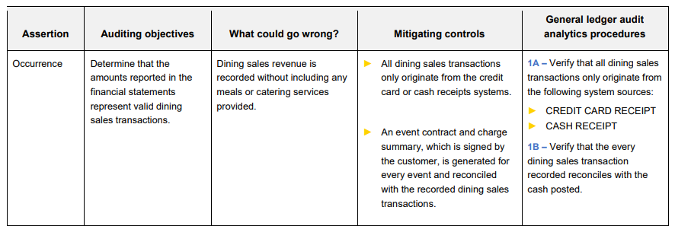
Audit assertions and tests
E.g., from the handout:

Slide 18

Thank you!

