Slide 1
Data Tables and Spreadsheet Automation
Adv. Advisory | ACCTG 528 | Class 03
MPAcc Class of 2026

Slide 2

What will we do today?
Review of Class 02 (Automation Essentials)
Data Tables and Spreadsheets
Four Case Paths Overview
RPA Workflows/Sequences (Lucidchart)
Workflow set-ups (Maestro)
Start on the RPA Sequence

Slide 3
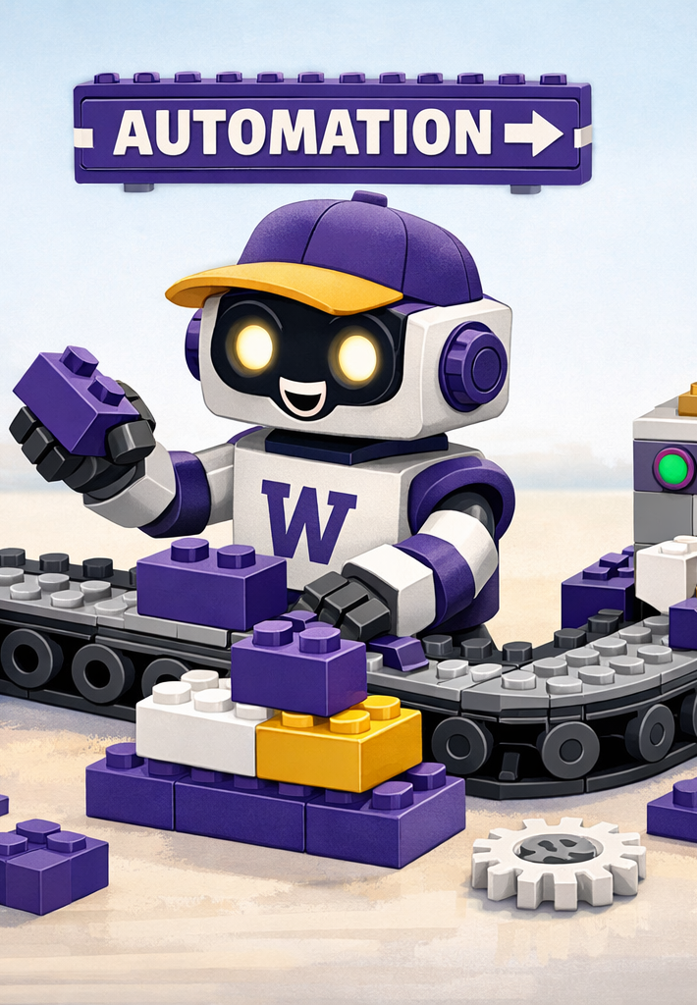
Review
UiPath Cloud:
RPA Workflows Examples
Maestro Processes
Connecting them together

Slide 4
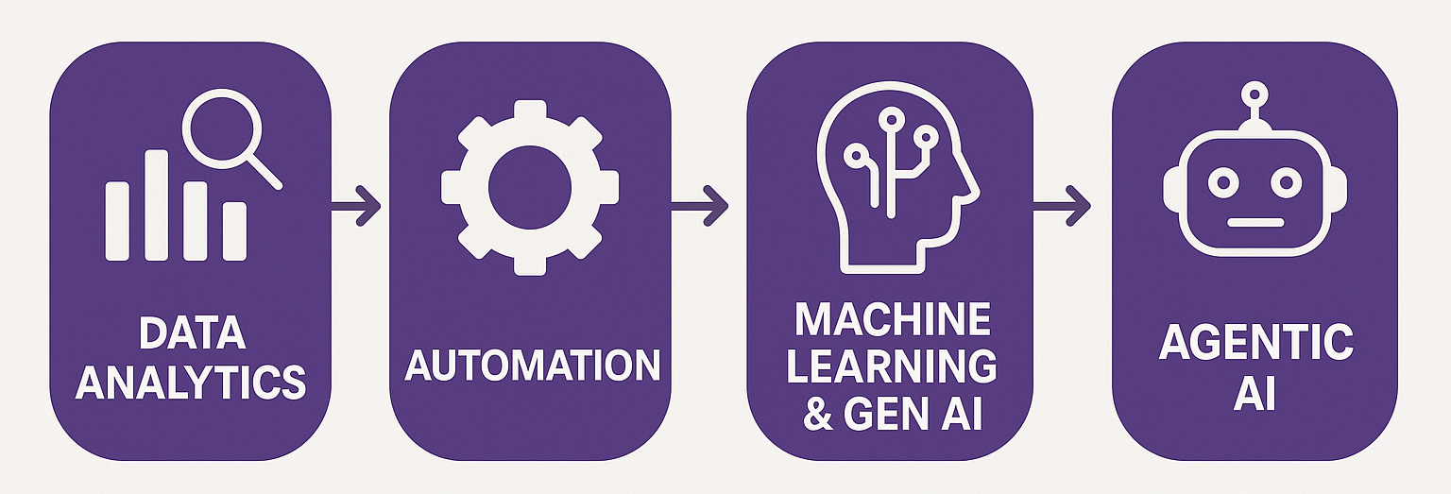
Course Diagram (high-level)

Slide 5









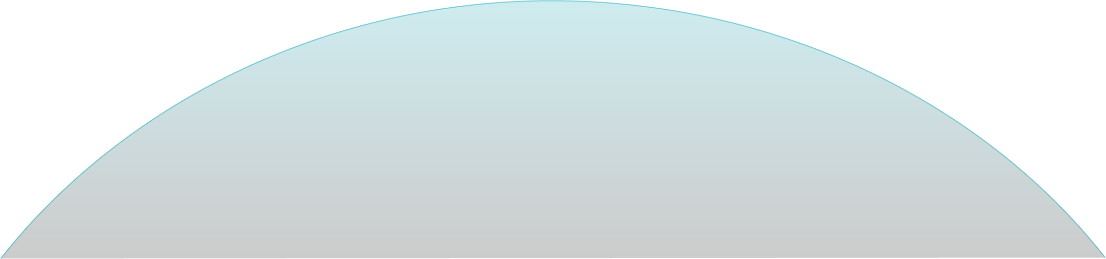

UiPath Agentic Automation
Notes:
Everything happens in one place: the UiPath Platform—where AI Agents aren’t just assistants, they’re true work partners, transforming complexity into a seamless, orchestrated operation.
We break it down into three powerful layers: Activities (the building blocks—reading, processing, integrating), Workflows (connecting the dots with human-in-the-loop and testing), and Processes (the big picture—managing, optimizing, and enhancing enterprise operations).
Agentic Orchestration / Maestro takes automation even further—coordinating UiPath Agents, third-party AI models, people, robots, and tools into a single, intelligent system.
Your existing systems don’t need to be reinvented—our platform integrates seamlessly with your data, applications, and workflows while maintaining enterprise-grade security, governance, and AI trust.
We’re not just compatible with your tech stack—we enhance it. From cloud providers like AWS, Google, and Azure to enterprise apps like Salesforce and SAP, we turn digital chaos into a symphony of efficiency.

Slide 6
What will we do today?
Review of Class 02 (Automation Essentials)
Data Tables and Spreadsheets
Four Case Paths Overview
RPA Workflows/Sequences (Lucidchart)
Workflow set-ups (Maestro)
Start on the RPA Sequence

Slide 7
Lucidchart
https://www.lucidchart.com

Slide 8
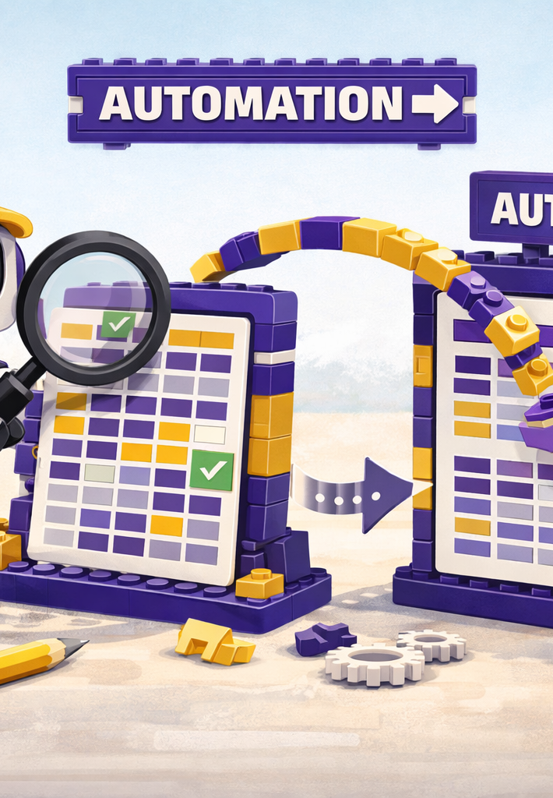
Where we will go next
Spreadsheets
Controls
Costs and benefits of RPA
Selection of Tasks for RPA versus Agent
Manipulation of files

Slide 9
Thank you

