Slide 1
Accounting & Finance Function 3
Data Analytics for Professional Accountants (ACCTG 522)
Class 15 | MPAcc Class of 2026

Slide 2
Welcome!
Class Agenda
Review
PollEverywhere
Mini-Exercise
Lab:
Case 4/Mini-Exercise 2: Int. Group Tax -- Shortened
Case 5. Organizing Fin Data
Case 6. Sales Tax Use Estimates
Conclusion and look ahead

Slide 3
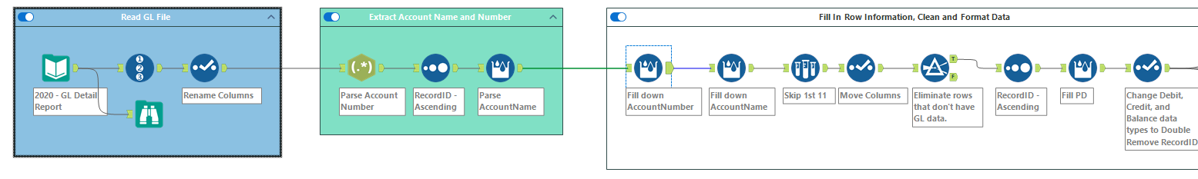
Multi-Row Formula Tool
Parse related field like row1:number, row2:name
Fill in missing values within a field (i.e., column)

Slide 4
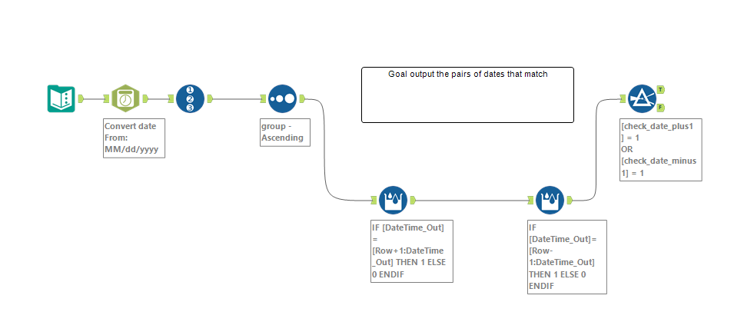

Slide 5
Welcome!
Class Agenda
Review
PollEverywhere
Mini-Exercise
Lab:
Case 4/Mini-Exercise 2: Int. Group Tax -- Shortened
Case 5. Organizing Fin Data
Case 6. Sales Tax Use Estimates
Conclusion and look ahead

Slide 6
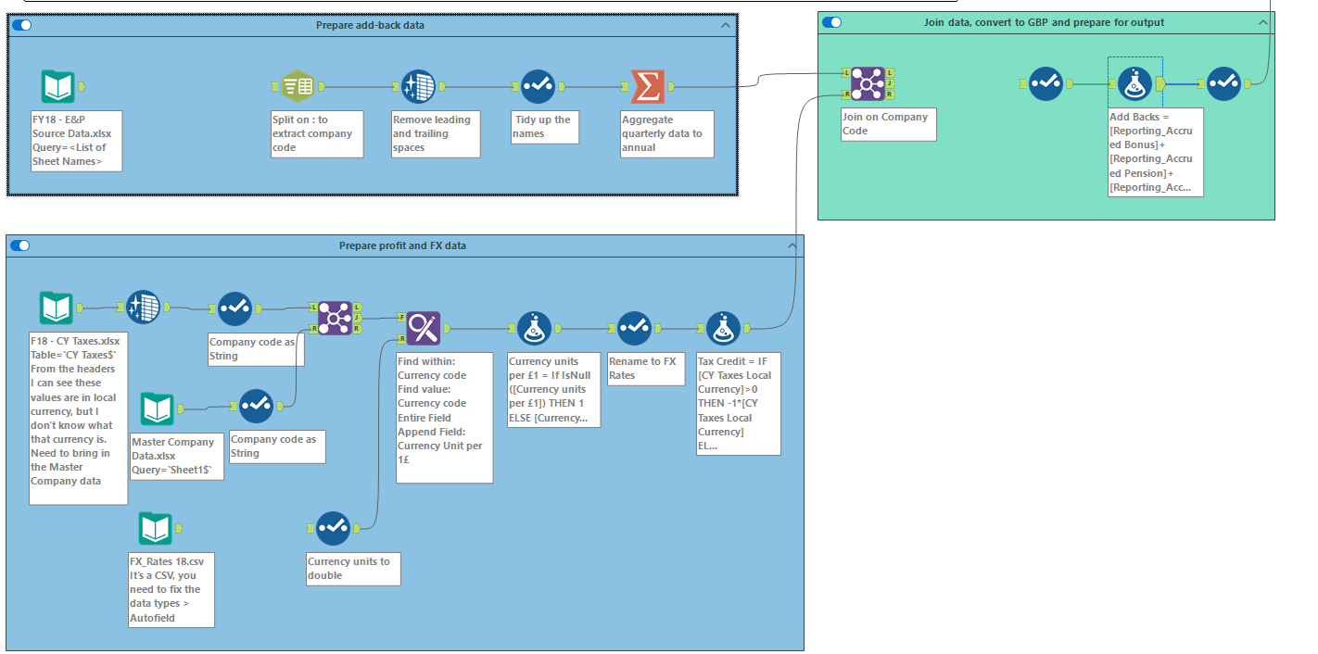
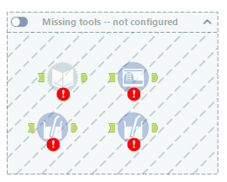

Slide 7
Welcome!
Class Agenda
Review
PollEverywhere
Mini-Exercise
Lab:
Case 4/Mini-Exercise 2: Int. Group Tax -- Shortened
Case 5. Organizing Fin Data
Case 6. Sales Tax Use Estimates
Conclusion and look ahead

Slide 8
Organizing Financial Data

Slide 9
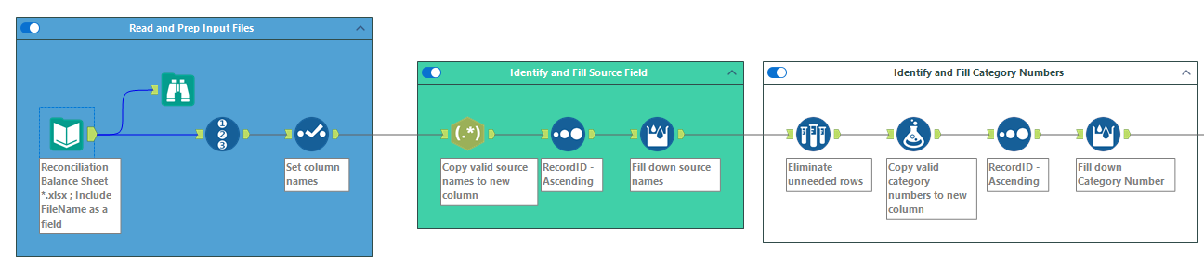
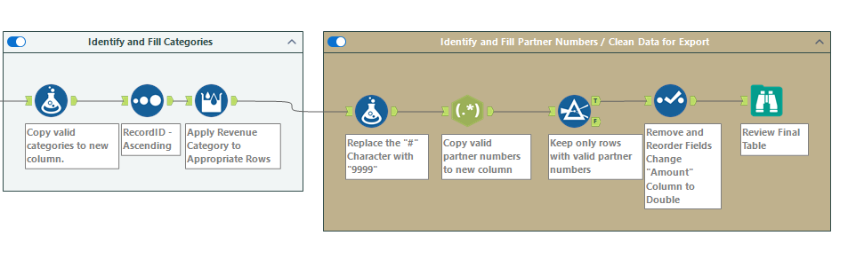

Slide 10
Sales Tax Use Estimates

Slide 11
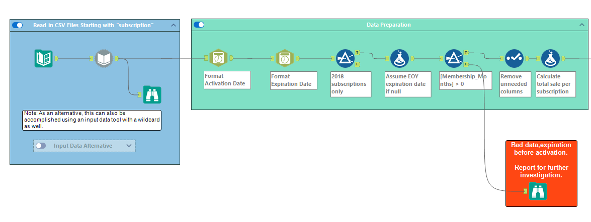
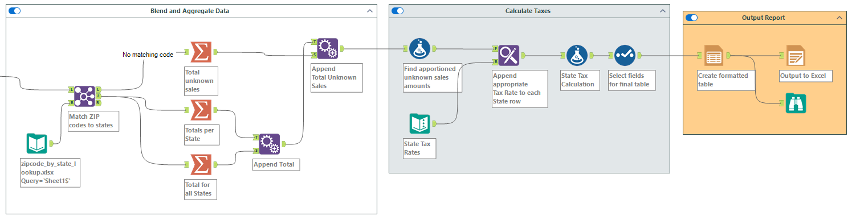

Slide 12
Conclusion and look-ahead
Next class:
Alteryx Escape Room Challenge.

Slide 13

Thank you!

