Slide 1
Transaction Analytics: Understanding Transactions
ACCTG 320
Accounting Systems and Analytics
Class 06 | Autumn | 2026

Slide 2
Agenda
Review
Data exercises both in Tableau:
  ETL for both cases
  Start visualizing data (use case documents as the guide), both cases
  Begin communicating insight
Conclusion and look ahead

Slide 3
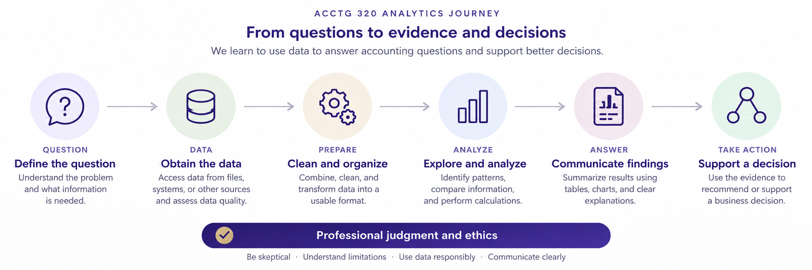

Slide 5
Agenda
Review
Data exercises both in Tableau:
  ETL for both cases
  Start visualizing data (use case documents as the guide), both cases
  Begin communicating insight
Conclusion and look ahead

Slide 6
Review
Key takeaway: We are working on gaining insight into various business processes by analyzing transaction level data.
Visualizing data and calculating key measures (sums, averages) and key filters, help us identify our answers and help communicate them.

Slide 8
Next steps
Next topic: Transaction Analytics: Understanding Transactions (continued in part 2)
We will introduce transaction-level analytics
Consider how financial data can be analyzed to understand various business problems
Thank you!

