Slide 1
ETL: Combining and Summarizing Data
ACCTG 320
Accounting Systems and Analytics
Class 03 | Autumn | 2026

Slide 2
Agenda
Review
Why is correctly joining data important?
Data exercises:
  Joining Data Exercise (in PowerBI)
  Optional: Joining data in Tableau
Conclusion and look ahead

Slide 3
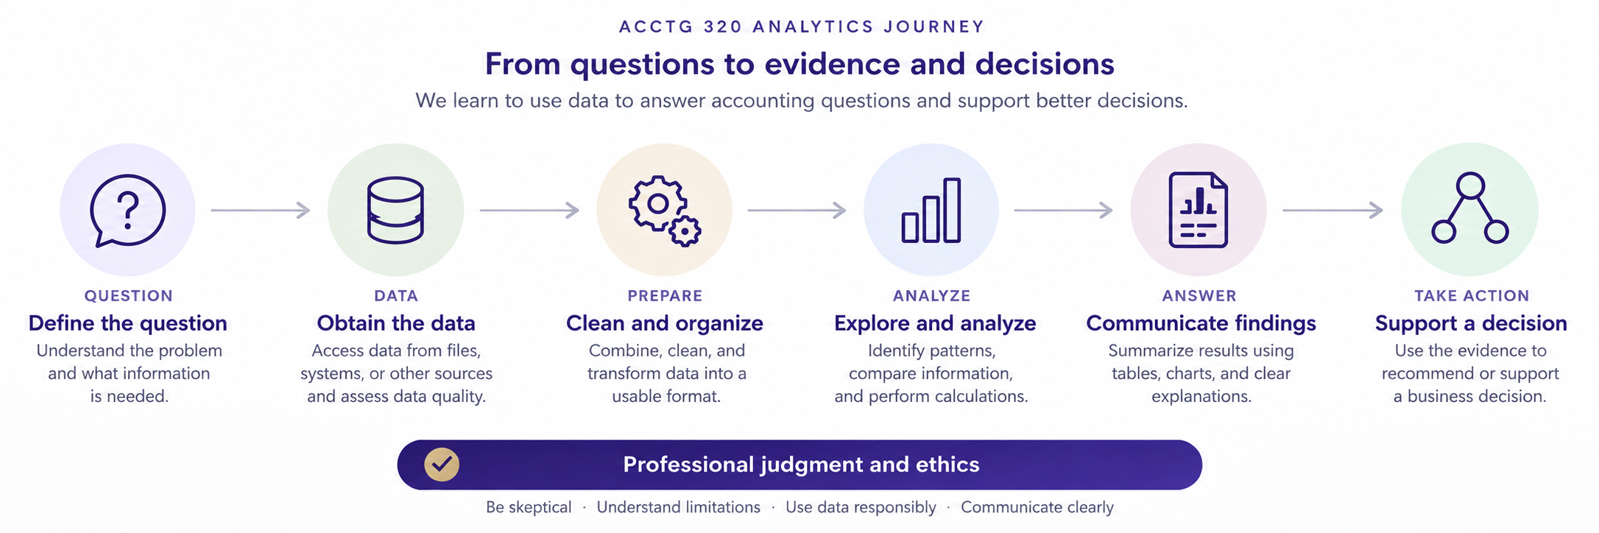

Slide 4
Review: What are we trying to do?
Question → Data → Prepare → Analyze → Visualize → Business Decision
Data and Prepare/ETL are not mechanical steps.
Bad data or prep clouds analysis and the wrong business actions can be taken.
(e.g., the overspend by the Virginia Public Bus System)

Slide 5
Agenda
Review
Why is correctly joining data important?
Data exercises:
  Joining Data Exercise (in PowerBI)
  Optional: Joining data in Tableau
Conclusion and look ahead

Slide 7
Joining data
Joining data is a fundamental step in the ETL process, as in most cases, developing insight will require data from different databases.
Joining data can sometimes be referred to as merging data, blending data, or combining data.

Slide 8
Joining data
Financial data about AAPL
Market return data about AAPL
Ticker, REV, NI
AAPL, 466.8B, 128.9B
NVIDIA, 60.92B, 29.76B
Ticker, MarketCap, Return
NVIDIA, 5.72T, 28.06%
AAPL, 4.9T, 31.00%
Often the ids can be different across datasets
Ticker, REV, NI, MarketCap, Return
AAPL, 466.8B, 128.9B, 4.9T, 31.00%

Slide 9
What can go wrong?
Incorrect joins are a data quality issue, incorrect joins can:
  crash (or really slow down) our programs!
  have us lose important data.
  Have us generate incorrect conclusions/insight from our analysis.

Slide 10
How do joins work?
Two important features:
Join type
Cardinality

Slide 11
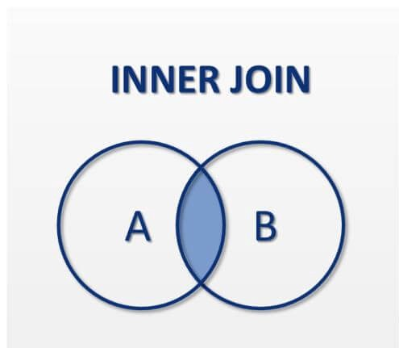
Keys in A
APPL, … A data, …
NVIDIA, … A data, …
MSFT, … A data, …
Keys in B
APPL, … B data, …
MSFT, … B data, …
Output keys in both A and B
APPL, … A data, … , … B data, …
MSFT, … A data, … , … B data, …

Slide 12
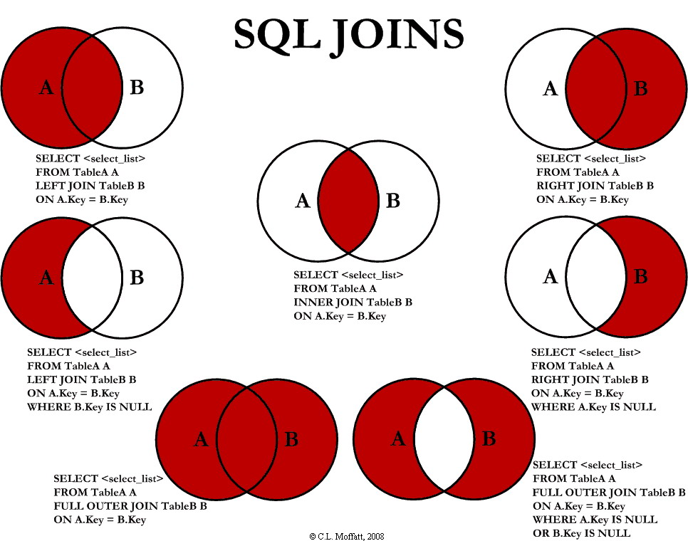

Slide 14
Cardinality
How many keys in Dataset A are expected to match to Dataset B?
1:1
1:Many
Many:Many

Slide 15
Why is this fundamentally important?
Question → Data → Prepare → Analyze → Visualize → Business Decision
Incorrect joins associate incorrect data from one dataset to another.
(e.g., attributing NVIDIA’s performance to AAPL or the other way around)

Slide 16
Agenda
Review
Why is correctly joining data important?
Data exercises:
  Joining Data Exercise (in PowerBI)
  Optional: Joining data in Tableau
Conclusion and look ahead

Slide 17
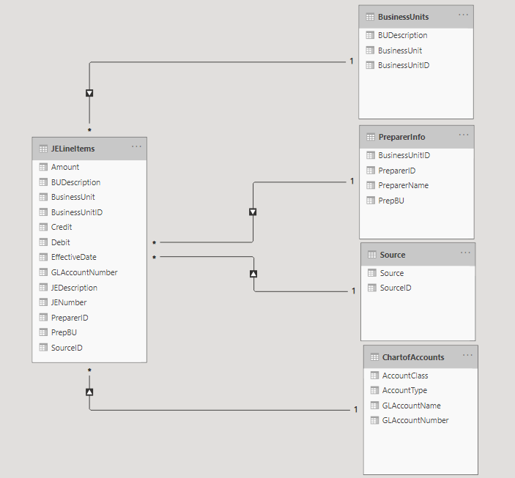
PowerBI
Expresses joins as relationships
Between keys in different datasets
With Cardinality
*Exercise solution preview

Slide 18
Joining Data Exercise (in PowerBI)
Question: Which department (individual) posts the most manual journal entries?
Follow-up: Is there anything unusual, irregular, about the data?
Steps:
Join data from the incoming xlsx spreadsheet
  ID the keys, use PowerBI to make the join.
Open a visual tab and summarize the JE data by department (individual).

Slide 19
Next steps
Next topic: Extract, Transform, and Load (ETL) Changing Fields
Define and implement some transformation steps using formulas (changing a field)
Develops transformation data skills with calculations and formulas
Thank you!

Slide 20
Appendix
PowerBI workflow (work ahead)
Tableau optional exercise tips

Slide 21
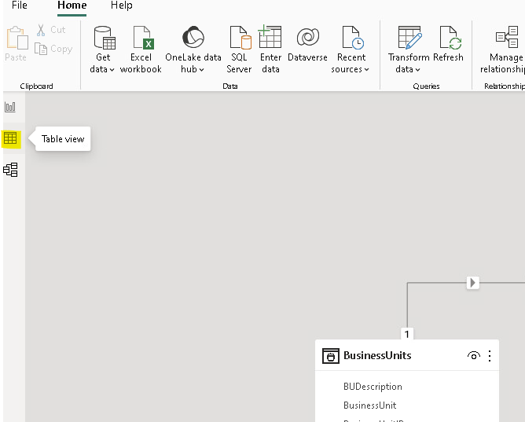
PowerBI Workflow
Go to Table view on left index

Slide 22
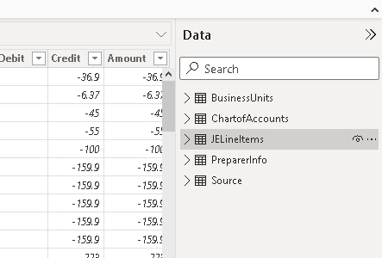
On the right hand menu select
the JELineitems dataset

Slide 23
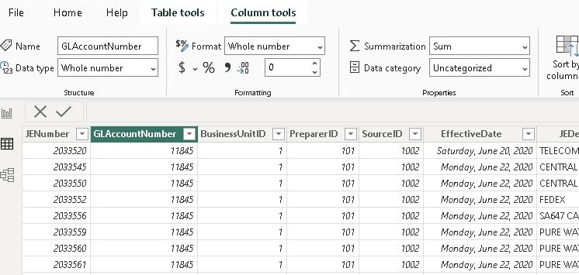
Select the GLAccountNumber Field / Column
Note Dat type is
whole number

Slide 24
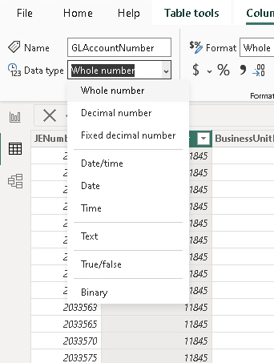
Change to “Text”

Slide 25
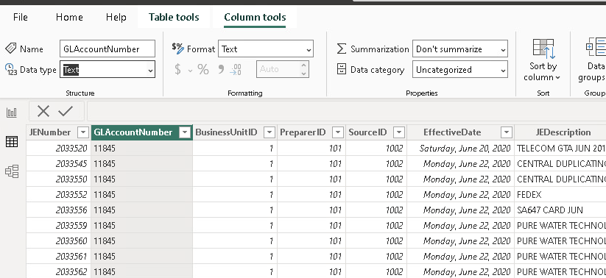
Note format is just how the data is displayed, and it updates automatically to text (Data Type is how it is recognized by PowerBI).
Confirm the change and how it affects format
Numbers, italicized, right aligned
Text, left aligned

Slide 26
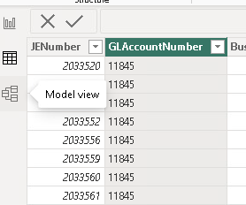
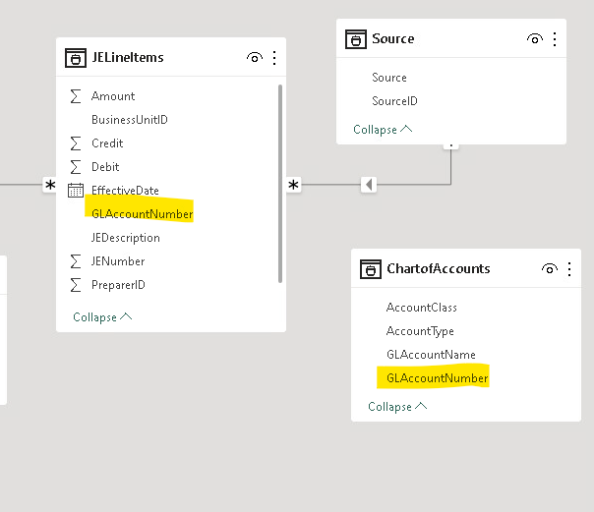
1 return to model view
Confirm GLAccountNumber is text in both (neither include the summation sign)

Slide 27
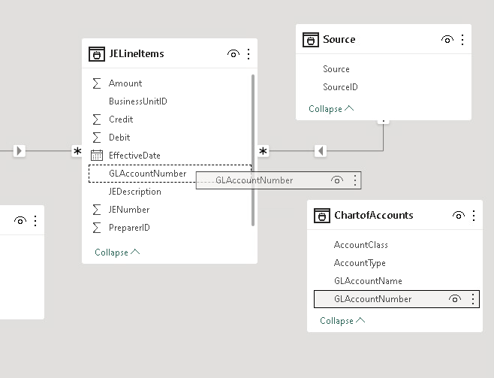
Drag GLAccountNumber from ChartOfAccounts to JELineItems and match it with GLAccountNumber

Slide 28
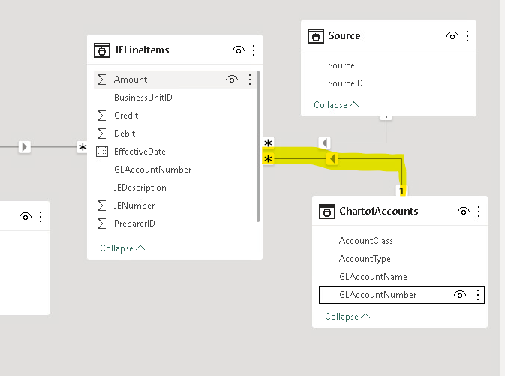
New Relationship Arrow appears in the data model

Slide 29
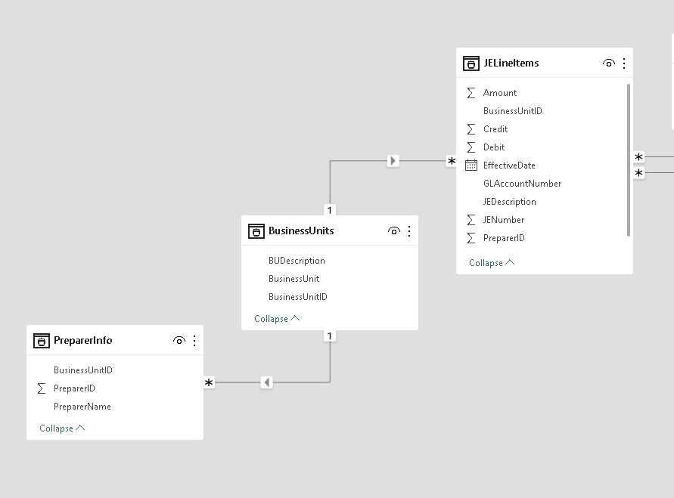
Like before we want:
BusinessUnitID AND PreparerID
1. Delete the current connection
Let’s make it possible to connect PrepareInfo directly (in case we just want preparer names)

Slide 30
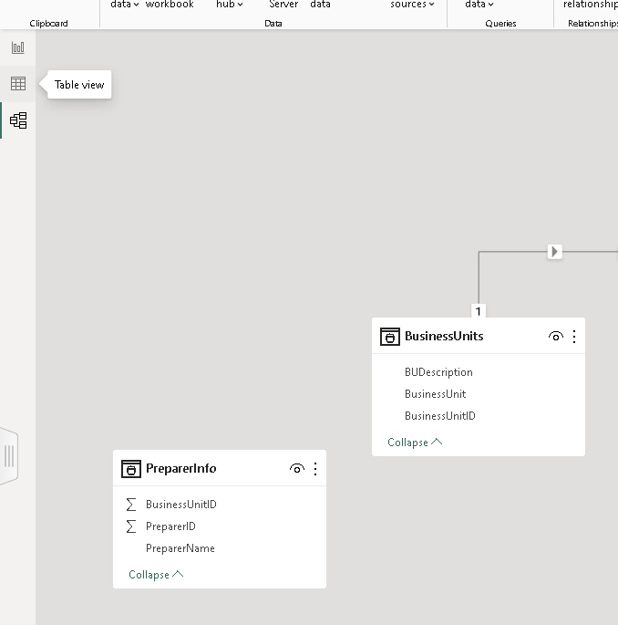
2. Return to Table View

Slide 31
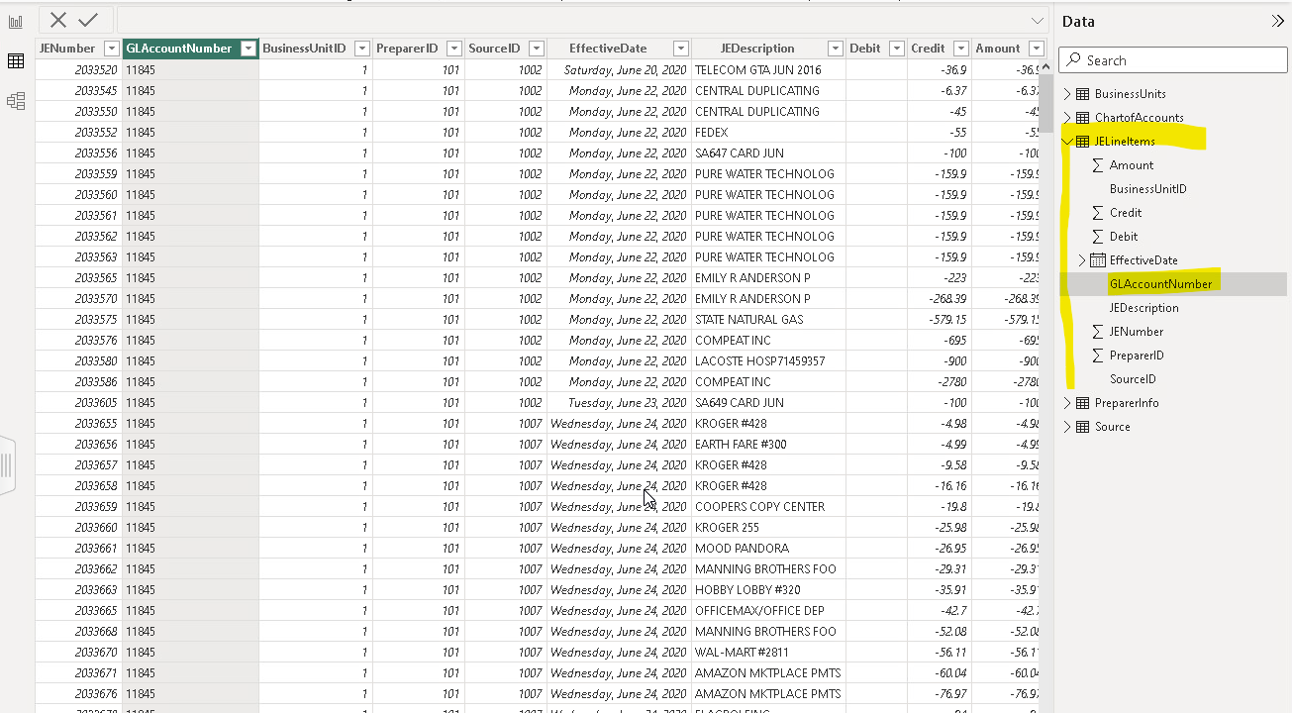
3. Confirm you are in the JELineItems dataset: Arrow pointed down, contents of dataset visible
Which is the most likely default given we just edited GLAccountnumber which is likely selected.

Slide 32
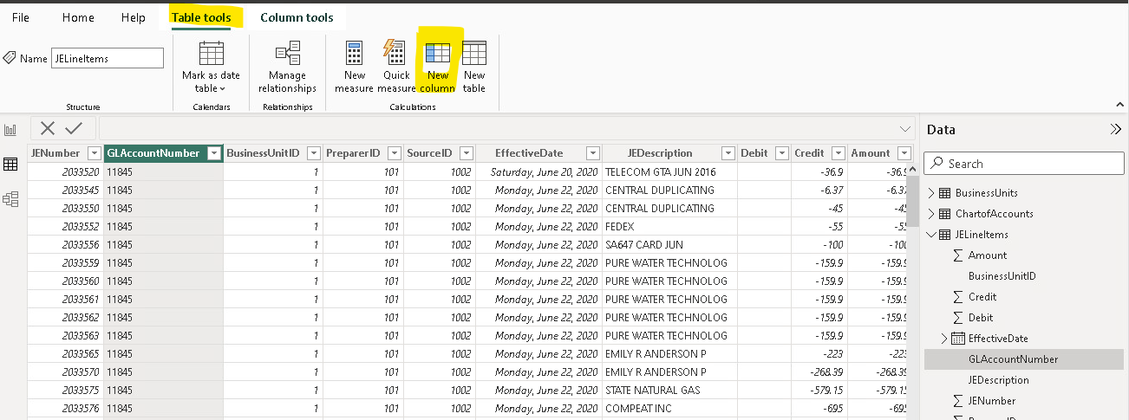
4. Confirm or navigate to Table Tools
5. Create a new column

Slide 33
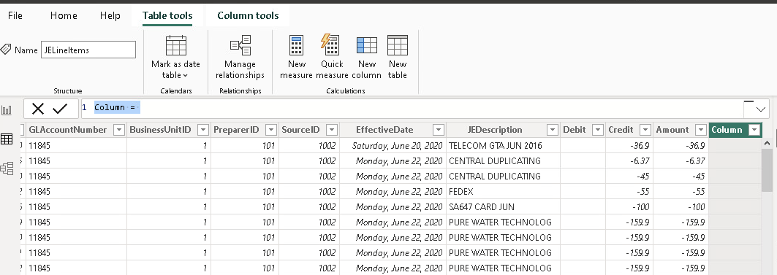
6. Confirm new column and …
… 7. Edit the column formula here
Our formula goal is to concatenate BusinessUnitID and PreparerID to create a unique key i.e., 1-101, 2-101 etc.

Slide 34
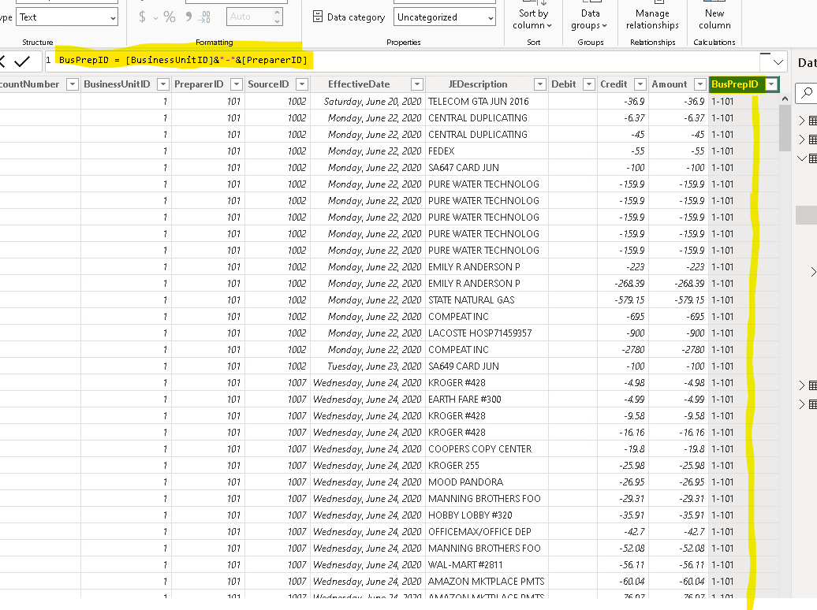
Our formula goal is to concatenate BusinessUnitID and PreparerID to create a unique key i.e., 1-101, 2-101 etc.
8. Replace Column = with:
BusPrepID = [BusinessUnitID]&”-”&[PreparerID]
Then press Enter

Slide 35
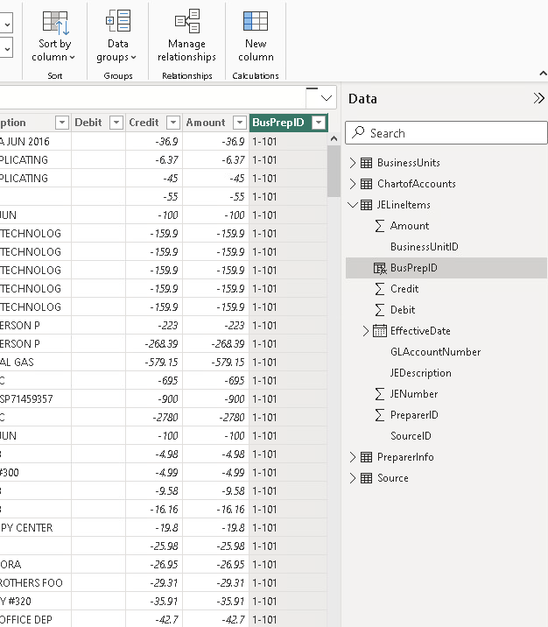
10. Still in Tables, select the PreparerInfo Dataset and create the same new column “BusPrepID”

Slide 36
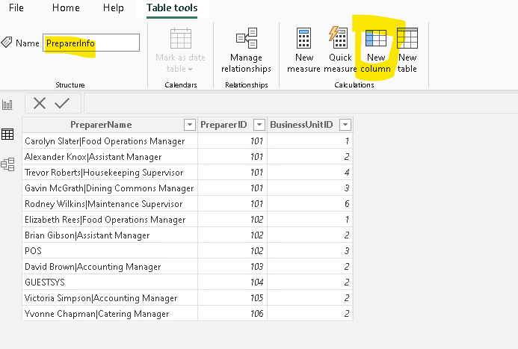

Slide 37
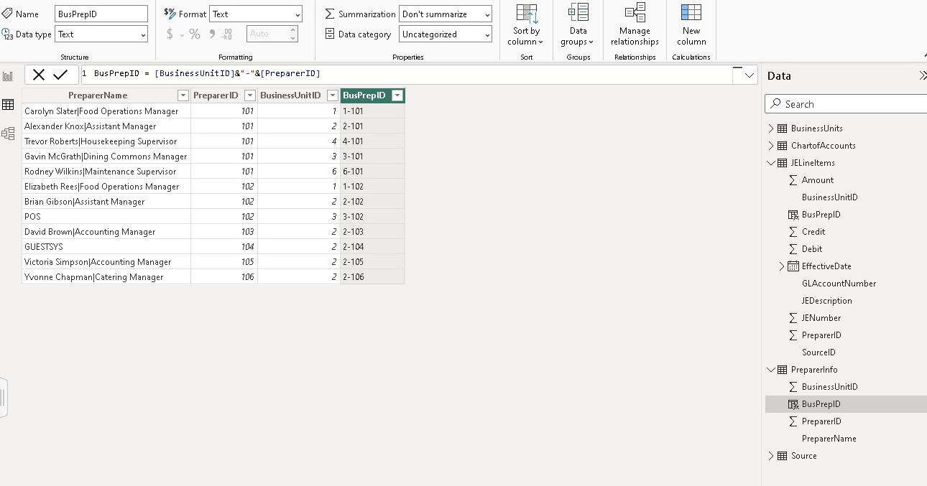
Update formula
Note that this column, BusPrepID, is now:
In JELineItems, and
PreparerInfo

Slide 38
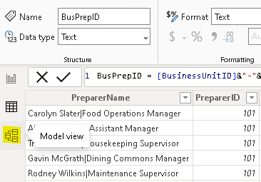
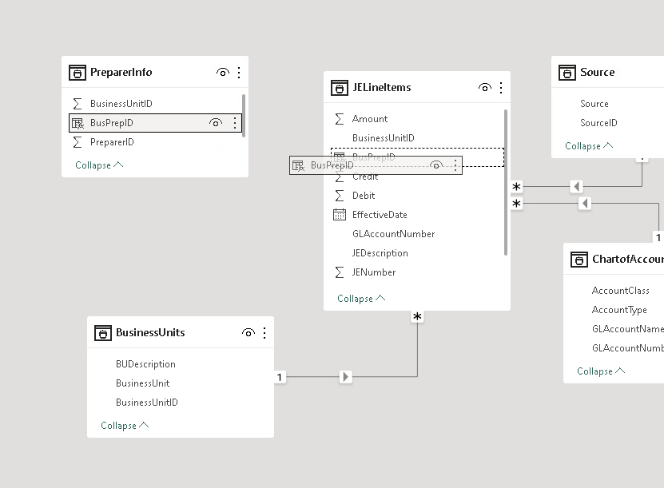
Return to model view
Connect PreparerInfo and JELineItems by dragging the new unique key “BusPrepID”

Slide 39
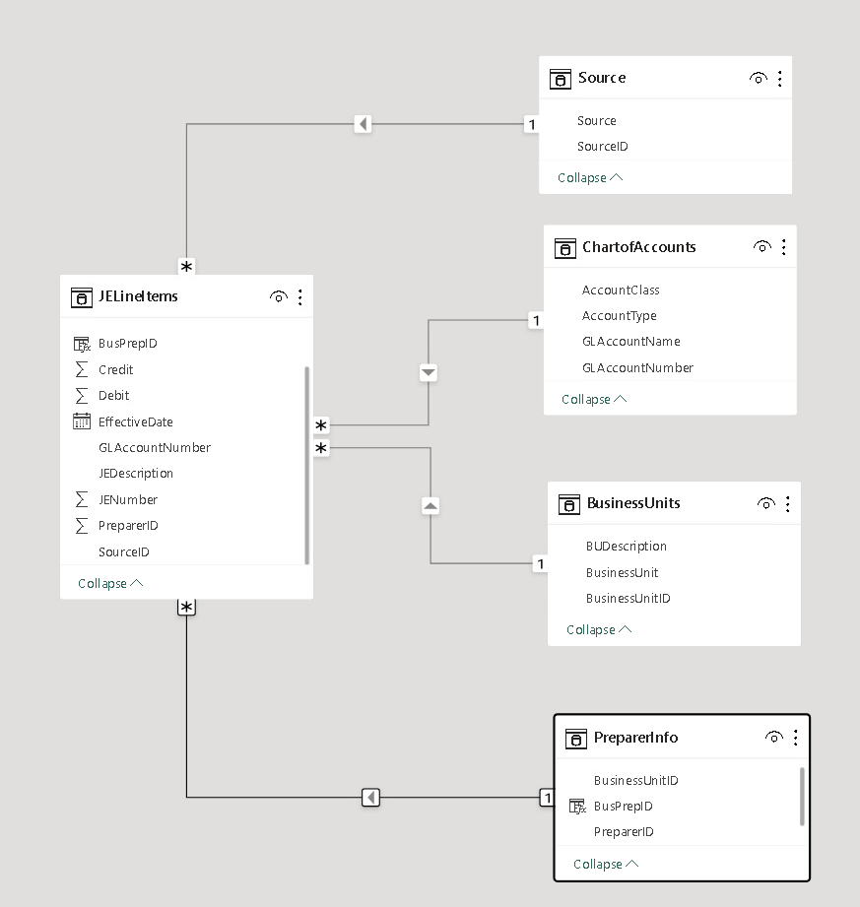
PowerBI Completed
Confirm the new BusPrepID connection and the data relationship model is complete.
Note it should be
one (1)
to many (*)

Slide 40
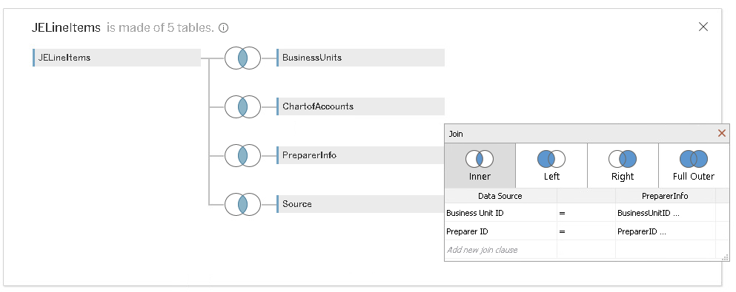
Tableau Join Version Tips
Defaults to inner joins, we are expecting 789 line items (rows), but get 639 rows of data (missing 150 rows / JE’s).
Edit the Preparer Info Join to join on both
preparerID and BusinessUnit

Slide 41
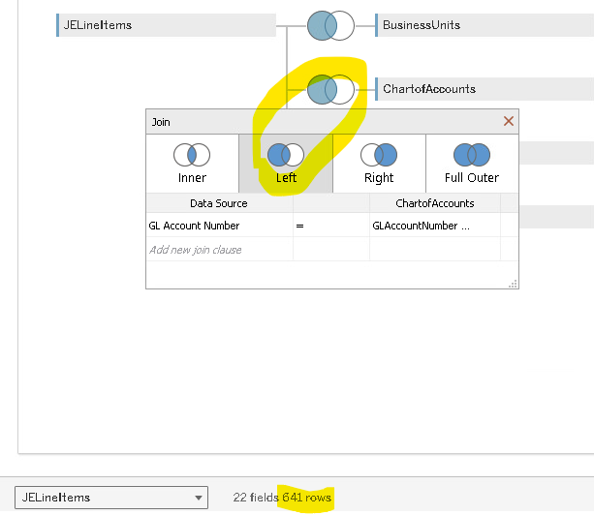
Tableau Join Version
Change to left join,
confirm that 641 rows exists
**This occurs when we left join to the ChartofAccounts tab, implying that 2 JELineItems have a GLAccountNumber not in the summary ChartOfAccounts dataset.

Slide 42
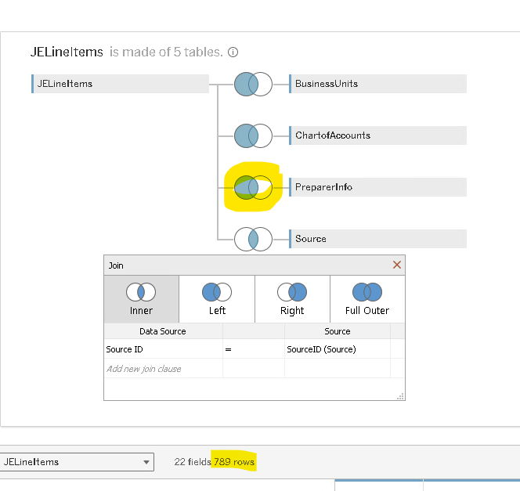
Tableau Join Version
Change to left join,
confirm that 789 rows exists
Edit the Preparer Info Join to join on both
preparerID and BusinessUnit
**This occurs when we left join to the PreprerInfo tab, implying that 148 JELineItems have a preparerID not in the summary PreparerInfo dataset.

Slide 43
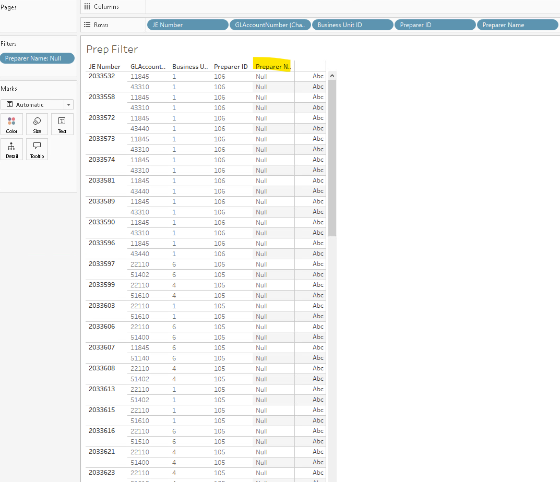
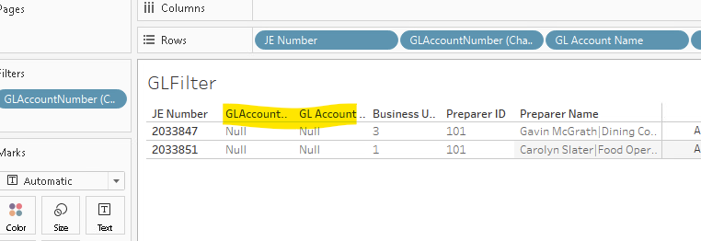
Filtering the data we find 148 rows with businessUnit-PreparerID pairs that are not in the PreparerInfo dataset (and so we do not know the preparer name, which is “Null”).
And 2 with missing GLNumbers/Names

Slide 44
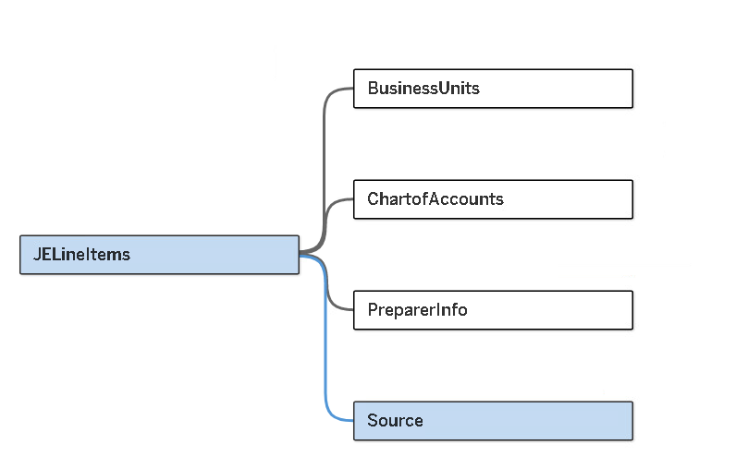
Tableau Completed
Add the Source dataset and the data relationship is complete.

