Slide 1
Analytical Workflows with Alteryx
ACCTG 522
Data Analytics for Professional Accountants (Assessment/Project teams)
MPAcc Class of 2027
Class 10 | Autumn | 2026

Slide 2
Agenda
Review
Overview and Discussion
Labs and Mini Alteryx Challenge
Conclusion & Look Ahead

Slide 3
Review
Final Common Project – Screening Deadline is approaching
Initial data requests (need to finalize today)
Choice to be made add external data to factset, or rely on calculations in factset (explain and append).
For external data:
  Need a workflow as part of your submission:
    Typically read factset, read external data
    Perform any calculations and any other required ETL
    Join dataset by unique key
    Calculate weighted screening measure / filter by various measures.
    Output final long/short candidates (or pair)

Slide 4
Agenda
Review
Overview and Discussion
Labs and Mini Alteryx Challenge
Conclusion & Look Ahead

Slide 5
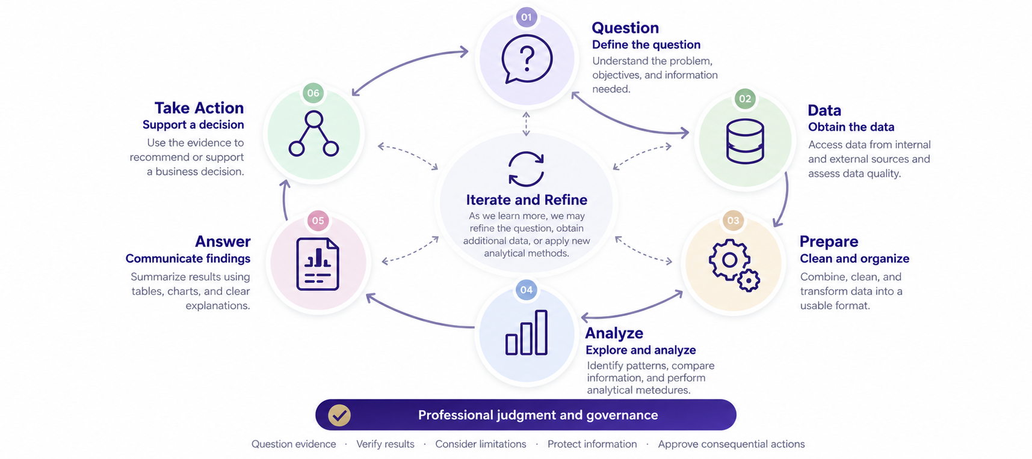

Slide 6

Data Analytic Workflows
Data Analytics, is a sequence of task, or a workflow:
Examples of workflows:
Combine monthly transaction files
Bank reconciliation
Duplicate invoice screening
Accounts receivable aging
Budget-to-actual analysis
Sales and gross-margin analysis
Employee expense compliance

Slide 7

Why Alteryx?
Alteryx brings data preparation and analysis into a visual workflow, allowing us to connect analytical steps in a logical sequence that is easy to follow, check, and repeat.

Slide 8
Agenda
Review
Overview and Discussion
Labs and Mini Alteryx Challenge
Conclusion & Look Ahead

Slide 9
Labs
Git pull in datasets.io
Locate 08_sparked_cases
Copy entire folder to mywork
Start with Suspect Vendors (as a class)

Slide 10
Alteryx challenge
Cases have increasing difficulty/complexity:
PO Splitting
GL Clean up
Organizing Financial Data
International Group Taxes
Sales & Use Tax
How many can your team solve in class?

Slide 11
Next steps
Next topic: Wrapping up workflows and screening
Consider how to verify/assess Generative AI assistance.
Select tool(s).
Incorporate external data.
Wrap up screens and discuss final logic.
Thank you!

