Slide 1
Data Quality
ACCTG 320
Accounting Systems and Analytics
Class 02 | Autumn | 2026

Slide 2
Agenda
Review
Why is data quality important?
Data exercises:
  Scavenger hunt
  Messy data
  PPP loan incomplete data
Conclusion and look ahead

Slide 3
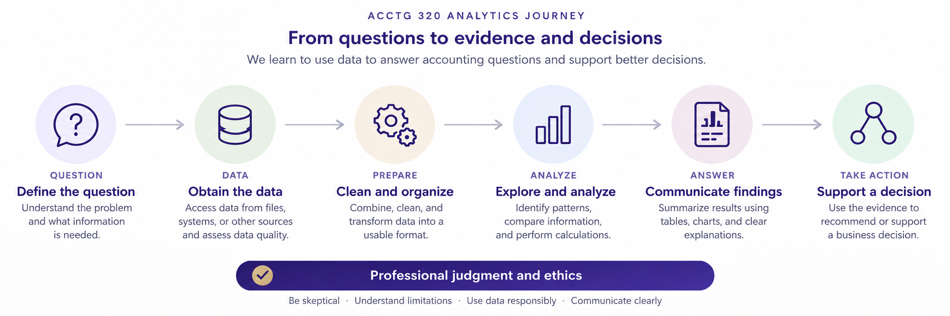

Slide 4
Review: What are we trying to do?
Question → Data → Prepare → Analyze → Visualize → Business Decision
Analytics is not simply applying a tool to a dataset.
The objective is to develop evidence that helps answer a business question.

Slide 5
Agenda
Review
Why is data quality important?
Data exercises:
  Scavenger hunt
  Messy data
  PPP loan incomplete data
Conclusion and look ahead

Slide 7
A complication:
The data we want is not always the data we have
The data we would ideally collect
The data that actually exist
The data that we can access
The data that we can correctly interpret
The data that are suitable for our analytical question
These may all be different.

Slide 8
ETL: from available data to usable evidence
Extract — obtain data from its source.
Transform — clean, combine, standardize, validate, and restructure data.
Load — place the resulting data where it can be used for analysis or storage.
ETL is a process, not a particular software product.

Slide 9
Extract is an interface problem
Different sources require different ways of obtaining and interpreting data:
  Files e.g.: spreadsheets, text files, exports
  Databases , Websites and APIs, Documents and other less structured sources

Slide 10
Before we analyze data, we have to open it
What type of file is it?
What application or language can interpret it?
Does the file require particular options?
  Delimiter
  Encoding
  Version or schema
A file extension is a useful clue — but the extension is not the data itself.

Slide 11
Open and application-specific representations
Text / broadly documented representations
  CSV — delimited text
  JSON — objects and arrays
  XML — tagged hierarchical data
Application-specific formats
  Excel — .xlsx / .xls
The important question: what rules are required to interpret the bytes in the file?

Slide 12
Agenda
Review
Why is data quality important?
Data exercises:
  Scavenger hunt
  Messy data
  PPP loan incomplete data
Conclusion and look ahead

Slide 13
Exercise 1: Scavenger Hunt
Go to remote labs:
Navigate to your U: Drive
In the windows path, type cmd then enter
A command window will open up inside the U-Drive
Write the following commands (enter after each one):
  git clone --filter=blob:none --sparse https://github.com/ashercurtis/datasets.io.git
  cd datasets.io
  git sparse-checkout set acctg320

Slide 14
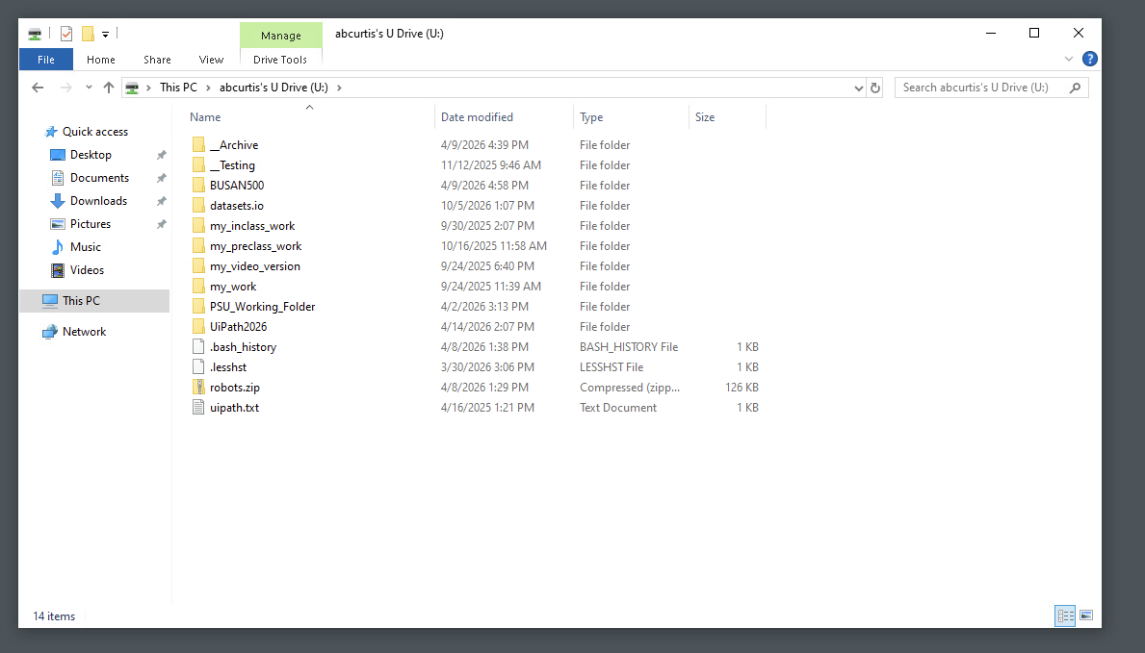
File path

Slide 15
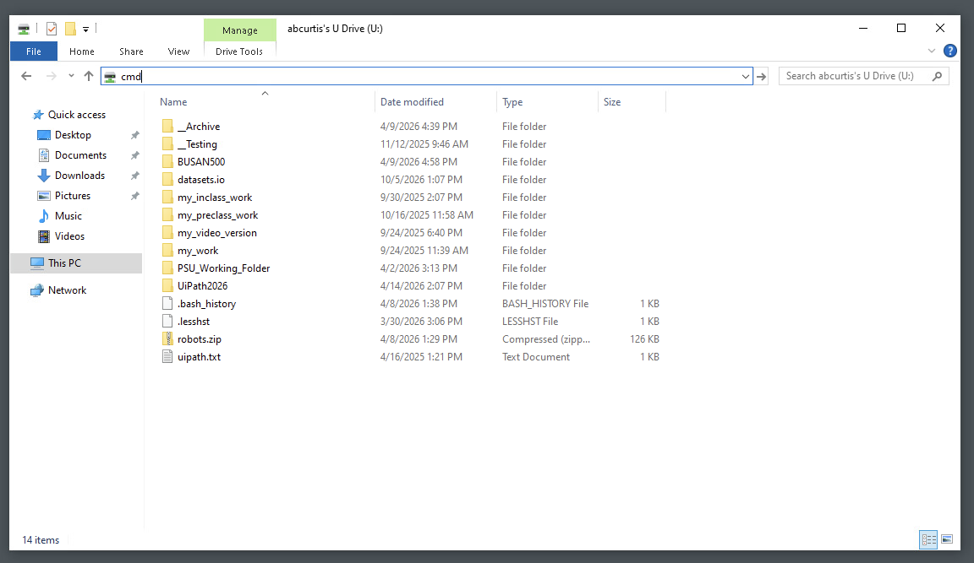
Type cmd in the filepath

Slide 16
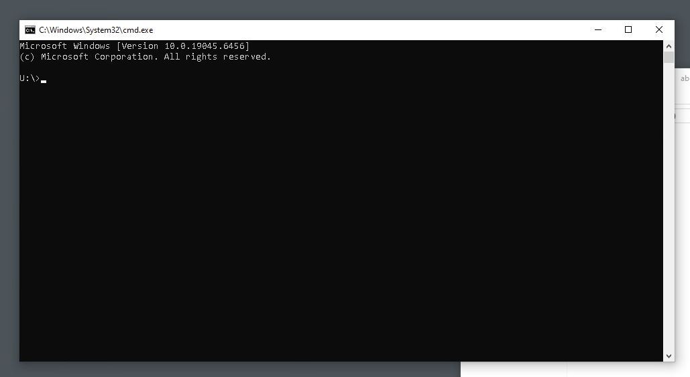
Verify U-drive i.e., U:\ not C:\

Slide 17
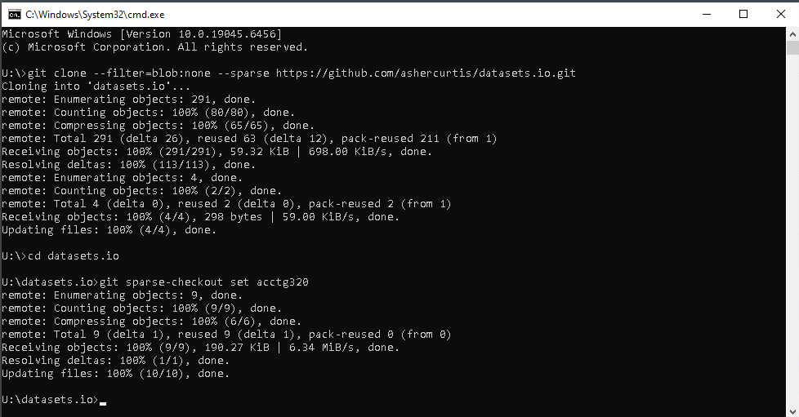

Slide 18
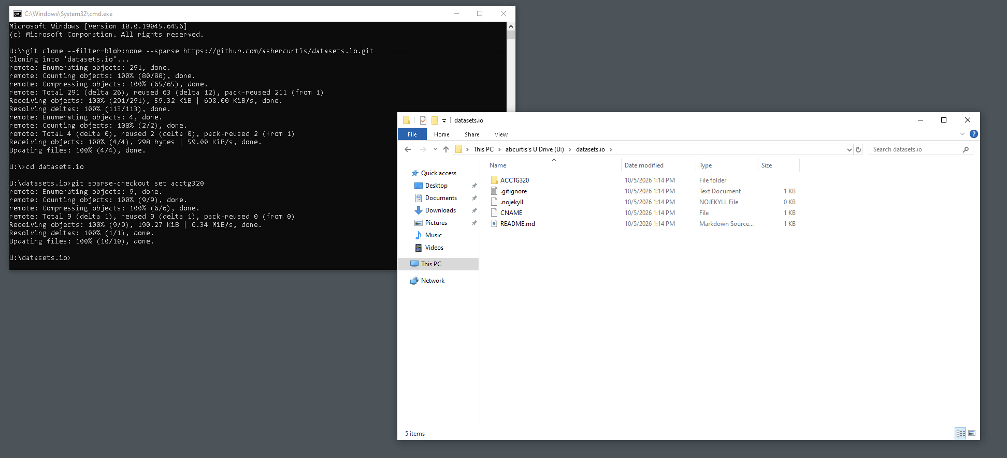
Data has been extracted!

Slide 19
What happens when the extension disappears?
Windows often uses an extension to decide which application should open a file.
Removing the extension does not necessarily change the file contents.
Your task is to infer the underlying format and find a way to open it.
Think like an analyst: inspect first; do not simply guess.

Slide 20
Scavenger Hunt: Objective
Can you find all the keywords?
5 files contain hidden keywords
Open correctly to view the files and find the keywords
Be prepared to explain HOW you identified the file type — not just the keyword.

Slide 21
Scavenger Hunt: Clues
Can the file be inspected in a text editor?
Is the content human-readable?
Does the beginning of the file contain recognizable structure or a signature?
Does a particular application recognize the contents?
What happens if the extension is changed?
What did the extension contribute, and what remained unchanged?

Slide 22
Scavenger Hunt: Debrief
Data are encoded according to rules.
Software must know enough about those rules to interpret the data correctly.
A successful 'open' does not guarantee a correct interpretation.
Extraction therefore includes understanding what was extracted and how it was represented.
This is our first ETL problem: extraction includes understanding what we extracted.

Slide 23
Exercise 2: Identifying data problems
Identifiers
The following extract contains many data errors, can we find them all?
The data is financial data, containing:
Ticker symbols, name of the company, fiscal year
Cash, A/R, Inventories, Total Current Assets, Total Depreciation (expense)
Financial data

Slide 24
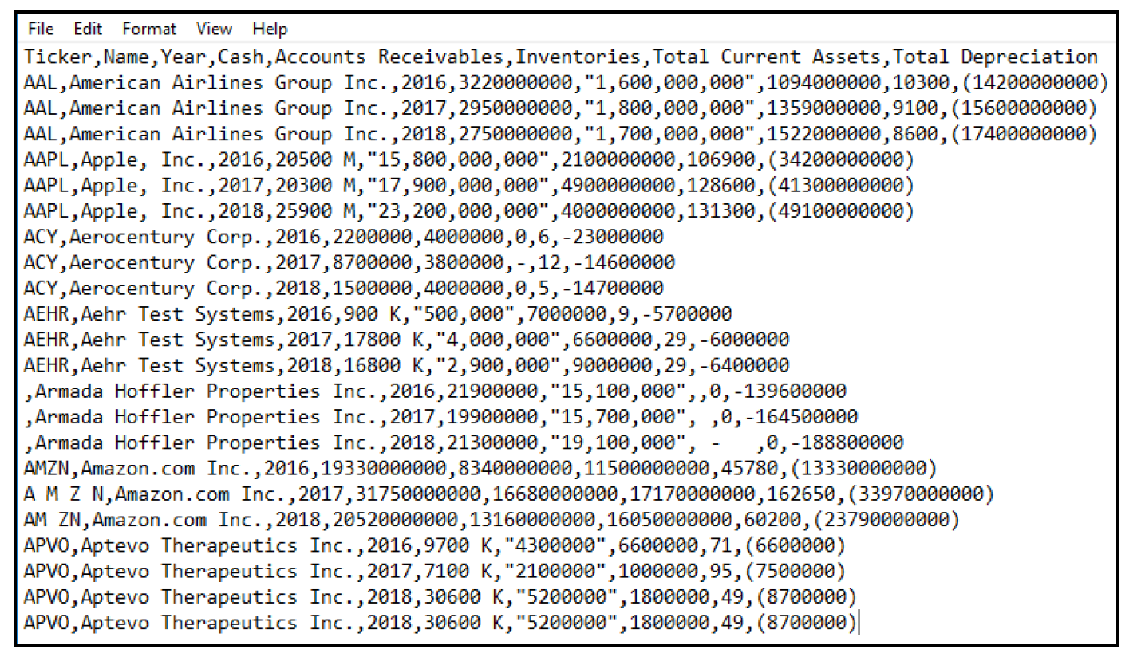

Slide 25
From opening data to understanding data
Opening a dataset answers: Can we read it?
Understanding a dataset asks: What does it actually represent?
Before analysis, we need to understand:
  Where the data came from
  How the data were generated
  What each observation and field represents
  What may be missing or measured imperfectly

Slide 26
Exercise 2 — Paycheck Protection Program (PPP)
The PPP provided forgivable loans intended to help eligible organizations maintain payroll and cover certain expenses during the COVID-19 disruption.
Public loan-level data create an opportunity to examine how the program operated.
But the existence of a large public dataset does not mean every interesting question can be answered.

Slide 27
Start with the question — not the spreadsheet
What would we like to know?
  Who received PPP loans?
  Where did the money go?
  Which industries received the most support?
  Did PPP preserve jobs?
  Did recipients comply with program requirements?
  Was there fraud?
Do we have the same data requirements for each question?

Slide 28
Where did the PPP data come from?
A business applies for a loan.
Information is supplied by the applicant.
A lender processes the application.
Program rules determine what information is requested and retained.
Government systems aggregate and publish loan-level records.
The public dataset is therefore the output of a process involving people, systems, rules, and incentives.

Slide 29
Where could problems enter the data?
Applicant
  Mistake, misunderstanding, missing information, or intentional misstatement
Lender
  Different procedures, interpretation, validation, or data entry
Government / program administration
  Changing rules, system design, aggregation, and publication decisions
Analyst
  Incorrect assumptions about what fields mean or what the dataset can establish

Slide 30
Exercise 2: PPP data
Navigate to your datasets.io/ACCTG320 folder and look for:
02_PPP_extract/ in this folder is a file “PPP Data – Washington sample.csv”
Read the data using excel.

Slide 31
What does a field actually measure?
Suppose JobsReported = 25.
Does that mean:
  25 people worked at the business?
  25 jobs were supported by the loan?
  25 jobs would have disappeared without PPP?
  25 is the value reported through the program process?
A field name is not a complete measurement definition.

Slide 32
Measurement versus the question we want to answer
Question: Did PPP save jobs?
Available variable: JobsReported
Potential problem: the observed field may not measure the counterfactual outcome we care about.
A clean variable can still be inadequate evidence for the question.
Data limitation ≠ data cleaning problem.

Slide 33
Another example: Did PPP help small businesses?
First define 'small business.'
Possible measures:
  Number of employees
  Revenue
  Loan amount
  Industry-specific eligibility rules
If our dataset does not contain the variable needed for our definition, cleaning the dataset will not solve the problem.

Slide 34
Another example: Who benefited from PPP?
We may want to compare recipients across owner demographics or other characteristics.
What happens if relevant fields are missing for many observations?
  Missingness may not be random.
The absence of data can itself affect what conclusions are supportable.
Before calculating a percentage, ask: percentage of what observable population?

Slide 35
PPP activity — inspect the Washington sample
Open the Washington PPP sample. Do not begin by calculating an answer.
First identify:
  What is one row?
  What fields are available?
  Which fields appear complete?
  Which fields require interpretation?
  What looks unusual?
Record at least three potential limitations or quality concerns.

Slide 36
What kinds of issues can we observe?
Missing values
Duplicate or potentially duplicate records
Inconsistent identifiers or categories
Unexpected numeric values or ranges
Incorrect or inconvenient data types
Inconsistent text / spelling / capitalization
Dates that do not make sense
Values that are valid syntactically but questionable economically

Slide 37
Three different problems
1. Data quality problem
  The recorded value may be wrong, incomplete, duplicated, or inconsistent.
2. Data definition / measurement problem
  The field may not mean what we initially think it means.
3. Data suitability problem
  Even perfectly recorded data may not answer our business question.
These problems require different responses.

Slide 38
Introduction to Data Quality
Data quality asks whether data are fit for their intended use.
Useful dimensions include:
  Accuracy — does the value reflect reality?
  Completeness — are required observations or fields present?
  Consistency — are comparable items represented consistently?
  Validity — do values conform to expected rules or ranges?
  Uniqueness — are records duplicated?
  Timeliness — are the data current enough for the decision?

Slide 39
What would you do next?
If you find a suspicious value, should you:
  Delete it?
  Correct it?
  Replace it?
  Leave it unchanged?
  Flag it for investigation?
Cleaning data requires judgment — and changes should be explainable and reproducible.

Slide 40
Agenda
Review
Why is data quality important?
Data Exercises:
  Scavenger hunt
  PPP loan data
Conclusion and look ahead

Slide 42
Takeaway
Today's key takeaway: Data and Prepare/ETL are not mechanical steps.

Slide 43
Three questions to carry forward
1. Did we obtain the right data?
2. Did we understand and transform the data correctly?
3. Can the resulting data actually answer our question?

Slide 44
Next steps
Next topic: Extract, Transform, and Load (ETL) Fundamentals
Define and implement some transformation steps with a small dataset
Develops transformation data skills with calculations and formulas
Thank you!

