Slide 1
Audit Risk and Materiality
Adv Cases in Assurance Services (ACCTG 521)
Class 3 | MPAcc class of 2026

Slide 2
Agenda
Review
Audit Risk and Planning
Overview
Qualitative Exercise: Identify Risks & Classify Accounts
Materiality Discussion
Semi-Quantitative / Qualitative Assessments of Materiality
Dynamic Audit Planning Exercise

Slide 3
Review
Conflicting incentives for firms to disclose and withhold information
Conflicting incentives for firms to undertake audits (or information verification)
Factors that influence demand for audit and therefore audit fee include:
Agency conflicts
Information asymmetry
Risk of intentional manipulation
Risk of unintentional errors

Slide 4
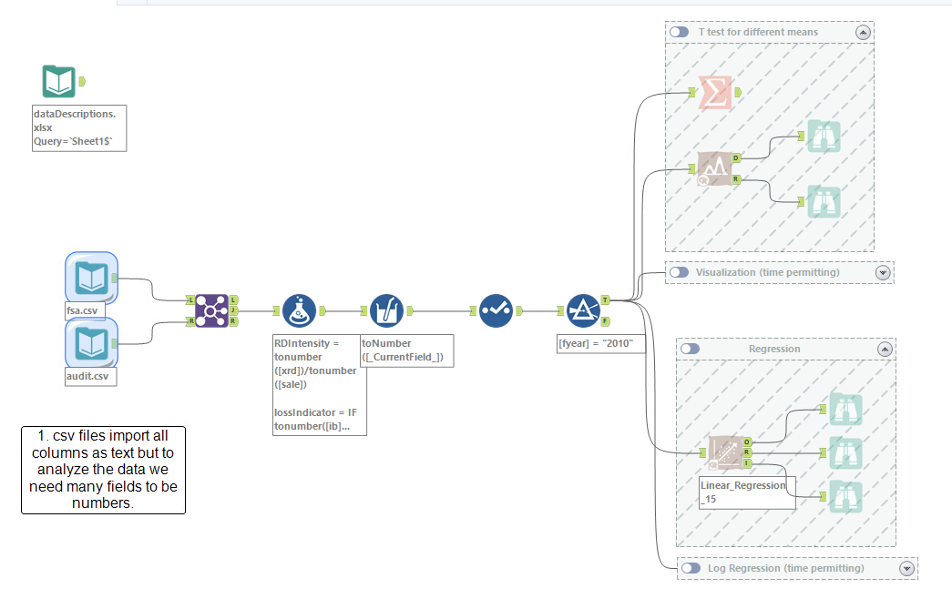
Two sample t-test
Multi-Field Formula
Linear regression

Slide 5
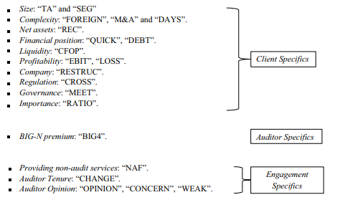
Review – Evidence on the determinants of audit fees
Source: “What is it going to cost? Empirical evidence from a systematic literature review of audit fee determinants” Wiedmann et al. (2021) Management Review Quarterly

Slide 6
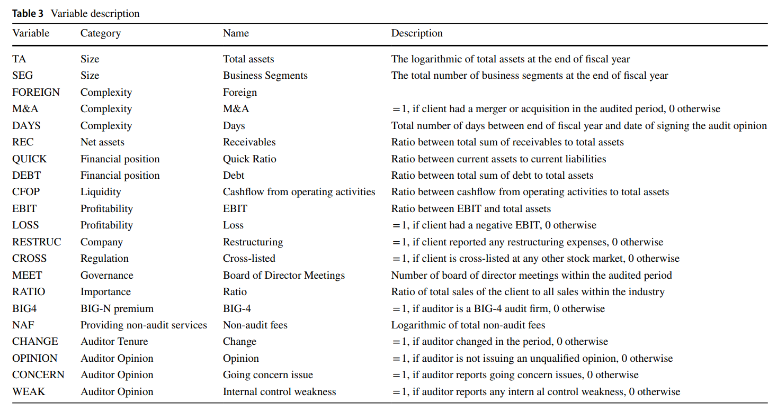
Missing in paper, likely =1 if foreign subs are in 10-K exhibit 21.

Slide 7
Agenda
Review
Audit Risk and Planning
Overview
Qualitative Exercise: Identify Risks & Classify Accounts
Materiality Discussion
Semi-Quantitative / Qualitative Assessments of Materiality
Dynamic Audit Planning Exercise

Slide 8
Audit Risk and Planning: Overview

Slide 9
Team Assignments (reminder)
1 | Duy Pham |  | 5 | Ross Aylward | 9 | Amanda Swetish
1 | Jase Kobayakawa |  | 5 | Beau Anable | 9 | Chance Chittim
1 | Lance Raymundo |  | 5 | Bobby Larson | 9 | Nathan Pettit
1 | Anastasiya Alekseeva |  | 5 | Max Burke | 9 | Marta Eimer
2 | Cade Farrington |  | 6 | Inga Damdin | 9 | Nathan Evans
2 | Griffin Chadwick Knowles |  | 6 | Faye Izatt | 10 | Esther Han
2 | Graham Allan Brower |  | 6 | Zach Kistner | 10 | Reece Campbell
2 | Tricia Lu |  | 6 | Chloe Ibrahim | 10 | Maithili Patel
3 | Elizabeth Nadrich |  | 7 | Karissa Geyer | 10 | Wanqi Dong
3 | Garrett Packebush |  | 7 | Adriana Fachiol | 10 | Peter Yang
3 | Annika Blumenstein |  | 7 | Sophia Carney
3 | Kelly Huang |  | 7 | Felicity Grimm
4 | Yanning Su |  | 8 | Ruiqing Cui
4 | Ryan Zhu |  | 8 | Trae Tingelstad
4 | Jinrong Zhang |  | 8 | Shay Sanchez
4 | William Jiang |  | 8 | Priscilla Hotzman

Slide 10
Company Assignments for Today:
Team | Company | Headquarters
Team 1 | Amazon.com, Inc. (Ticker: AMZN) | Seattle, WA
Team 2 | Microsoft Corporation (Ticker: MSFT) | Redmond, WA
Team 3 | Starbucks Corporation (Ticker: SBUX) | Seattle, WA
Team 4 | Costco Wholesale Corporation (Ticker: COST) | Issaquah, WA
Team 5 | Alaska Air Group, Inc. (Ticker: ALK) | Seattle, WA
Team 6 | Expedia Group, Inc. (Ticker: EXPE) | Seattle, WA
Team 7 | Nordstrom, Inc. (Ticker: JWN) | Seattle, WA
Team 8 | Zillow Group, Inc. (Ticker: ZG) | Seattle, WA
Team 9 | F5, Inc. (Ticker: FFIV) | Seattle, WA
Team 10 | PACCAR Inc. (Ticker: PCAR) | Bellevue, WA

Slide 11
Audit Risk Model
Audit Risk: risk that the auditor expresses an inappropriate audit opinion when the financial statements are materially misstated
AR = IR x CR x DR
RMM
Inherent Risk: risk that a management assertion is materially misstated (before considering internal controls)
Control Risk: risk that internal controls fail to detect a misstatement
Detection Risk: risk that auditors fail to detect a misstatement

Slide 12
Identifying Significant Accounts
AS 2110 – To identify significant accounts and disclosures and their relevant assertions, auditors should consider:
Size and composition of the account
Susceptibility to misstatement due to error or fraud
Volume of activity, complexity, and homogeneity of individual transactions
Nature of the account and disclosure
Accounting and reporting complexities
Exposure to losses
Possibility of significant contingent liabilities
Existence of related party transactions
Changes from prior period

Slide 13
Business Risk: Auditor’s Perspective
AS 2110 – during the planning phase of the engagement, auditors should obtain an understanding of the company and its environment, including:
The nature of the company
Objectives and strategies and related business risks that might reasonably be expected to result in risks of material misstatement
Relevant industry, regulatory, and other external factors
Selection and application of accounting principles and related disclosures
Measurement and analysis of financial performance

Slide 14
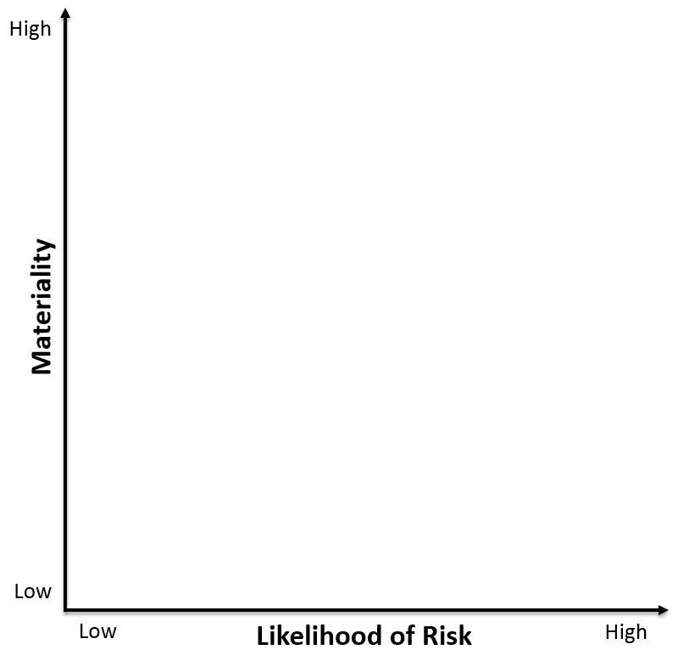
Misstatement Risk
Function of Materiality and Probability
2
1
3
4

Slide 15
Group Exercise – part 1
Applying the misstatement risk framework to the company selected by your group:
Prepare a brief 30-second overview of your company's business (nature, objectives, strategies) for the class.
Identify 1 account that falls into each of the 4 categories. Where does it fall within the quadrant, and why? In other words, assess the materiality and likelihood of risk associated with the account.
2
1
3
4

Slide 16
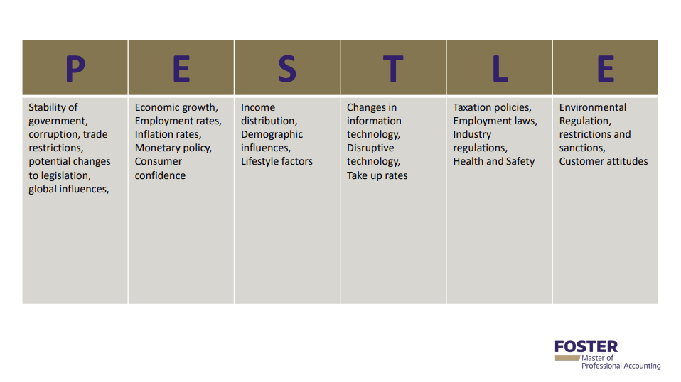

Slide 17
Required Risk Disclosures
Item 1a – Companies are required to disclose “the most significant factors that make an investment in a registrant’s securities speculative or risky”
Broad definition with little authoritative guidance
Examples provided by SEC (unchanged since 1964): lack of operating history, lack of profitability in recent periods, financial position, businesses or proposed businesses, lack of market in the company’s securities
Boilerplate or relevant information?
Listed in order of significance

Slide 18
Required Risk Disclosures
Critical Accounting Policies/Estimates (CAPs) – companies should consider whether they have made accounting estimates or assumptions where:
Nature of estimates/assumptions is material due to levels of subjectivity, judgment, and uncertainty
The impact of the estimates and assumptions is material
If so, the company should disclose in CAPs section of MD&A

Slide 19
Group Exercise – part 1
Applying the misstatement risk framework to the company selected by your group:
Prepare a brief 30-second overview of your company's business (nature, objectives, strategies) for the class.
Identify 1 account that falls into each of the 4 categories. Where does it fall within the quadrant, and why? In other words, assess the materiality and likelihood of risk associated with the account.
2
1
3
4

Slide 20
Agenda
Review
Audit Risk and Planning
Overview
Qualitative Exercise: Identify Risks & Classify Accounts
Materiality Discussion
Assessments of Materiality and Dynamic Audit Planning Exercise

Slide 21
Materiality

Slide 22
What is Materiality?
AS 2105.03: "… the auditor should plan and perform audit procedures to detect misstatements that, individually or in combination with other misstatements, would result in material misstatement of the financial statements."
SAB 99: "a fact is material if there is a substantial likelihood that the … fact would have been viewed by the reasonable investor as having significantly altered the 'total mix' of the information made available."
i.e., Influences the economic decisions of users
How do we translate this to numbers?

Slide 23
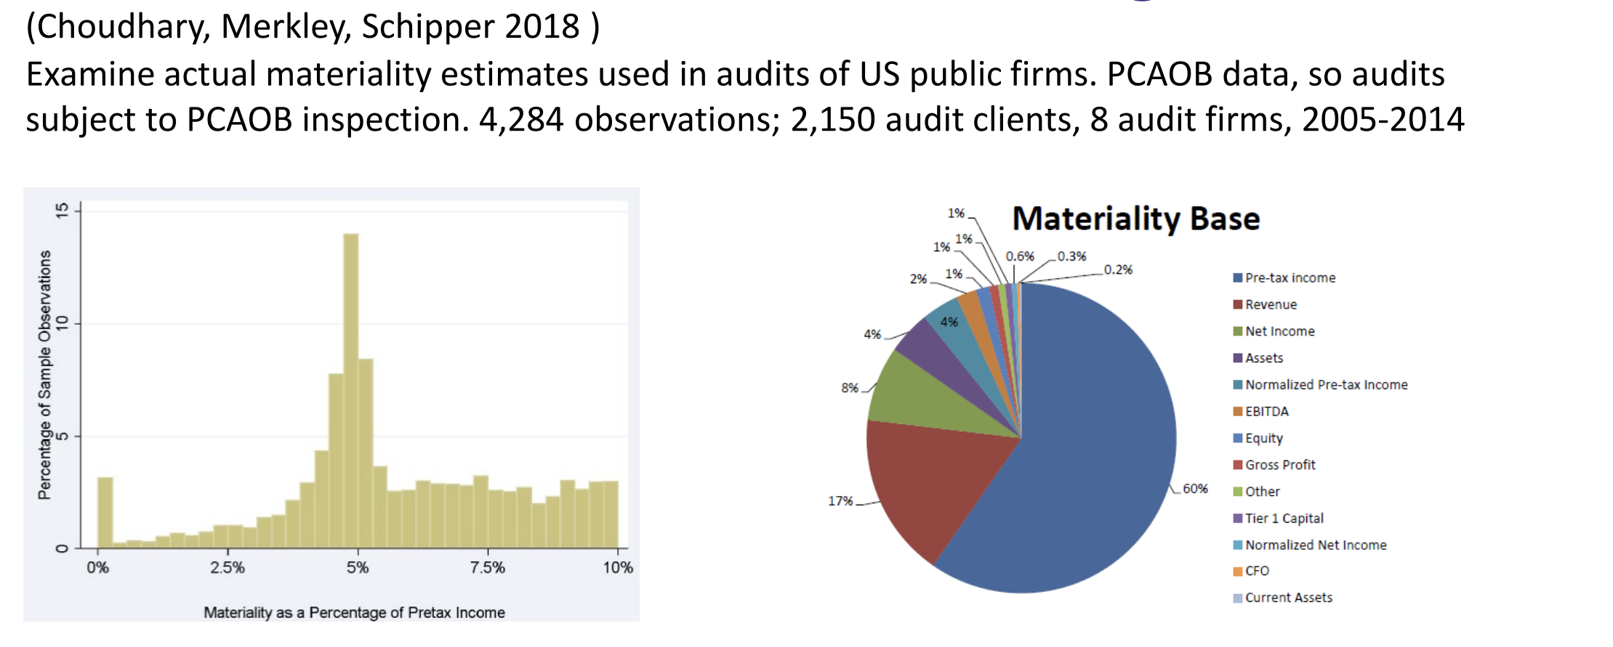
What the data suggests:

Slide 24
Agenda
Review
Audit Risk and Planning
Overview
Qualitative Exercise: Identify Risks & Classify Accounts
Materiality Discussion
Assessments of Materiality and Dynamic Audit Planning Exercise

Slide 25
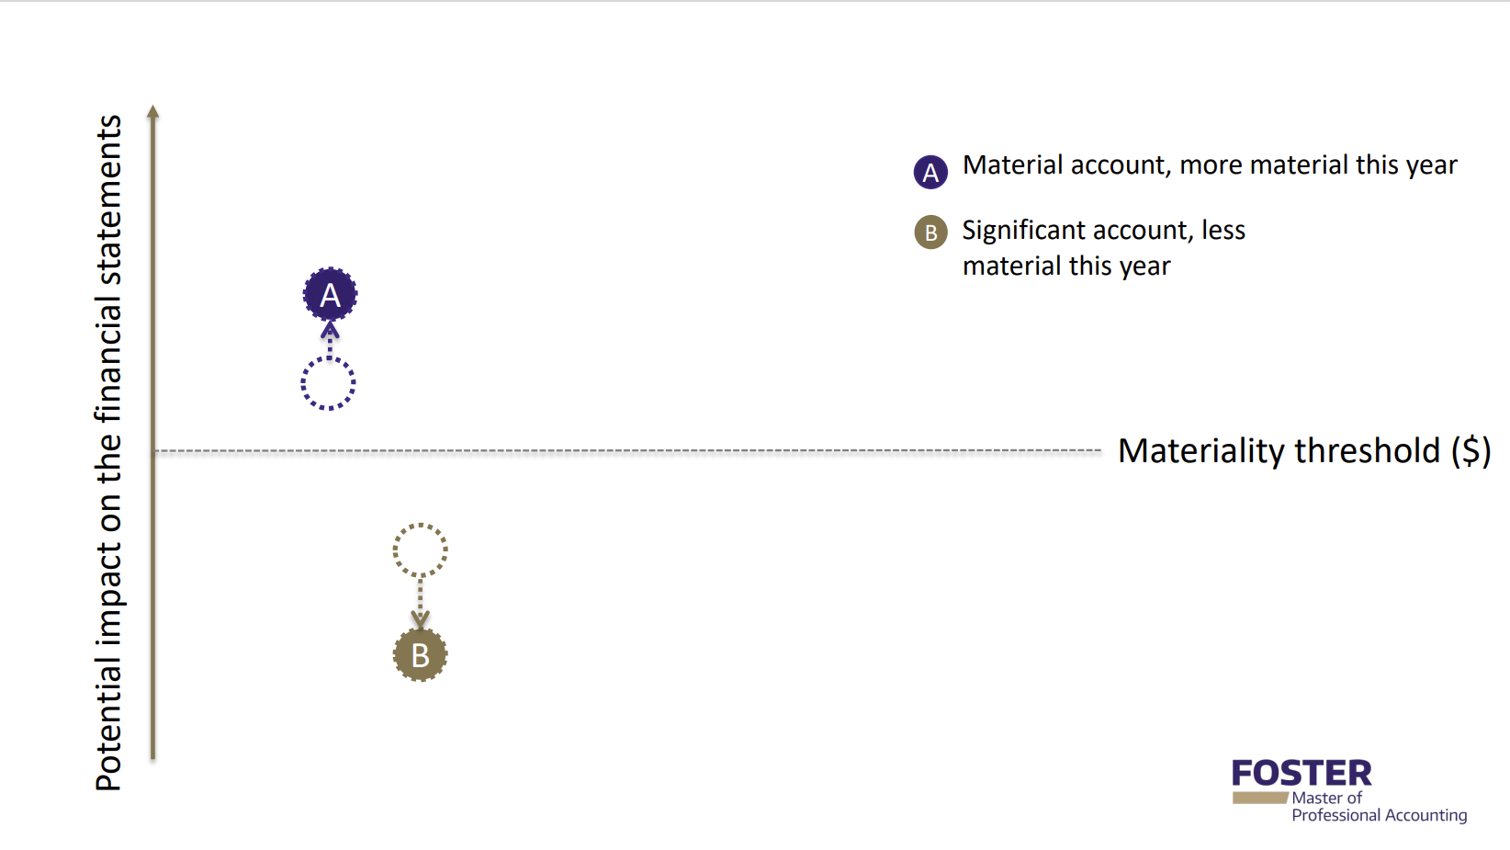

Group Exercise – part 2
Remind the class of your company.
Identify 1 to 3 material accounts that you can provide reasons for a potential change in risk, either becoming more material or more risky (e.g., C). Explain why for each account.
Present your number 1 increased risk account and why
C

Slide 26
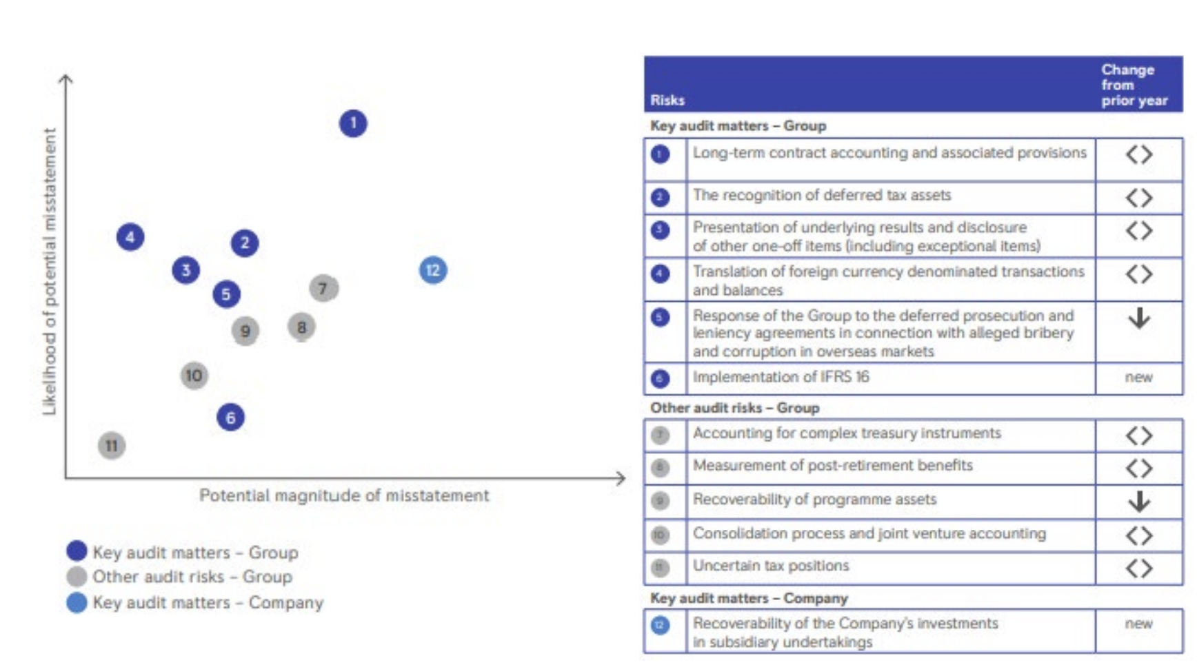
Dynamic Audit Planning - Viz

Slide 27
You can use any tool, either powerpoint (see next slide)
or something like LuidChart (free – login with Google, link below)
Lucid Chart Audit Planning Template

Slide 28
Potential impact on financial statements
B
Important Risk
A
B
Risk that used to be important, but clearly is less important now
A
C
Important Risk that became more likely
C
C
B
Likelihood of material misstatement

Slide 29
THANK YOU

