Slide 1
Advanced ETL and Textual Analysis 2
Data Analytics for Professional Accountants (ACCTG 522)
Class 5 | MPAcc Class of 2026

Slide 2
Welcome!
Class Agenda
Case Review: Enron Emails Case
Case Deliverable Overview
Lab Tool and workflow overviews:
DateTime parsing functions
Sentiment Analysis
Phrase Analysis
Individual Forensic Workflow
Lab Forensic Analysis

Slide 3
Case Overview:
Enron Emails Case

Slide 4
Parsing Text using Regex
Our test email:
Message-ID: <25828831.1075855376669.JavaMail.evans@thyme> Date: Mon, 26 Nov 2001 07:25:16 -0800 (PST) From: k..allen@enron.com To: jsmith@austintx.com Subject: RE: Additional properties in San Antonio Jeff, Can you resend the info on the three properties you mailed and the one you faxed on Tuesday. I was out of the office last week. Phillip -----Original Message----- From: "JEFF SMITH" <jsmith@austintx.com>@ENRON Sent: Tuesday, November 20, 2001 3:43 PM To: Allen, Phillip K. Subject: Additional properties in San Antonio Phillip, I am waiting to get info. on two more properties in San Antonio. The broker will be faxing info. on Monday. One is 74 units for $1,900,000, and the other is 24 units for $550,000. Also, I have mailed you info. on three other properties in addition to the 100 unit property that I faxed this AM. Let me know if you have any questions. Jeff Smith The Smith Company 9400 Circle Drive Austin, TX 78736 512-394-0908 office 512-394-0913 fax 512-751-9728 mobile jsmith@austintx.com

Slide 5
Parsing Text using Regex
Unique Key
Our test email:
Message-ID: <25828831.1075855376669.JavaMail.evans@thyme>
Date: Mon, 26 Nov 2001 07:25:16 -0800 (PST)
From: k..allen@enron.com
To: jsmith@austintx.com
Subject: RE: Additional properties in San Antonio Jeff, Can you resend the info on the three properties you mailed and the one you faxed on Tuesday. I was out of the office last week. Phillip -----Original Message----- From: "JEFF SMITH" <jsmith@austintx.com>@ENRON Sent: Tuesday, November 20, 2001 3:43 PM To: Allen, Phillip K. Subject: Additional properties in San Antonio Phillip, I am waiting to get info. on two more properties in San Antonio. The broker will be faxing info. on Monday. One is 74 units for $1,900,000, and the other is 24 units for $550,000. Also, I have mailed you info. on three other properties in addition to the 100 unit property that I faxed this AM. Let me know if you have any questions. Jeff Smith The Smith Company 9400 Circle Drive Austin, TX 78736 512-394-0908 office 512-394-0913 fax 512-751-9728 mobile jsmith@austintx.com
Unstructured data
Key identifier variables

Slide 6
Parsing Text using Regex
Unique Key
Our test email:
Message-ID: <25828831.1075855376669.JavaMail.evans@thyme>
Date: Mon, 26 Nov 2001 07:25:16 -0800 (PST)
From: k..allen@enron.com
To: jsmith@austintx.com
Subject: RE: Additional properties in San Antonio Jeff, Can you resend the info on the three properties you mailed and the one you faxed on Tuesday. I was out of the office last week. Phillip -----Original Message----- From: "JEFF SMITH" <jsmith@austintx.com>@ENRON Sent: Tuesday, November 20, 2001 3:43 PM To: Allen, Phillip K. Subject: Additional properties in San Antonio Phillip, I am waiting to get info. on two more properties in San Antonio. The broker will be faxing info. on Monday. One is 74 units for $1,900,000, and the other is 24 units for $550,000. Also, I have mailed you info. on three other properties in addition to the 100 unit property that I faxed this AM. Let me know if you have any questions. Jeff Smith The Smith Company 9400 Circle Drive Austin, TX 78736 512-394-0908 office 512-394-0913 fax 512-751-9728 mobile jsmith@austintx.com
Unstructured data
What patterns can we use to extract meaning from the Subject/Body of the email (just this email)?
Key identifier variables

Slide 7
What patterns can we use to extract meaning from the Subject/Body of the email (just this email)?
Pattern meaning
Subject: RE: Additional properties in San Antonio Jeff, Can you resend the info on the three properties you mailed and the one you faxed on Tuesday. I was out of the office last week. Phillip -----Original Message----- From: "JEFF SMITH" <jsmith@austintx.com>@ENRON Sent: Tuesday, November 20, 2001 3:43 PM To: Allen, Phillip K. Subject: Additional properties in San Antonio Phillip, I am waiting to get info. on two more properties in San Antonio. The broker will be faxing info. on Monday. One is 74 units for $1,900,000, and the other is 24 units for $550,000. Also, I have mailed you info. on three other properties in addition to the 100 unit property that I faxed this AM. Let me know if you have any questions. Jeff Smith The Smith Company 9400 Circle Drive Austin, TX 78736 512-394-0908 office 512-394-0913 fax 512-751-9728 mobile jsmith@austintx.com

Slide 8
Another example email
Subject: Rick: As I am sure you have read by now, Jeff Skilling has chosen to leave Enron. Jeff is resigning for personal reasons and his decision is voluntary. I regret his decision, but I accept and understand it. I have worked closely with Jeff for more than 15 years, including 11 here at Enron, and have had few, if any, professional relationships that I value more. I am pleased to say that he has agreed to enter into a consulting arrangement with the company to advise me and the Board of Directors. I want to assure you that Jeff's departure will in no way affect the relationship that Enron has with Microsoft and more specifically MSN. I have been briefed on the MSNIA project, by my team, and they assure me that we are on track to meet your Broadband Internet Access roll-out plans in early October. I look forward to getting more personally involved with Microsoft to help insure that our ongoing relationship and partnership continues to mature and flourish. I will contact you in the near future to discuss with you this transition. In the meantime, if you have any questions or concerns please do not hesitate to contact my office. Ken

Slide 9
Welcome!
Class Agenda
Case Review: Enron Emails Case
Case Deliverable Overview
Lab Tool and workflow overviews:
DateTime parsing functions
Sentiment Analysis
Phrase Analysis
Individual Forensic Workflow
Lab Forensic Analysis

Slide 10


Slide 11
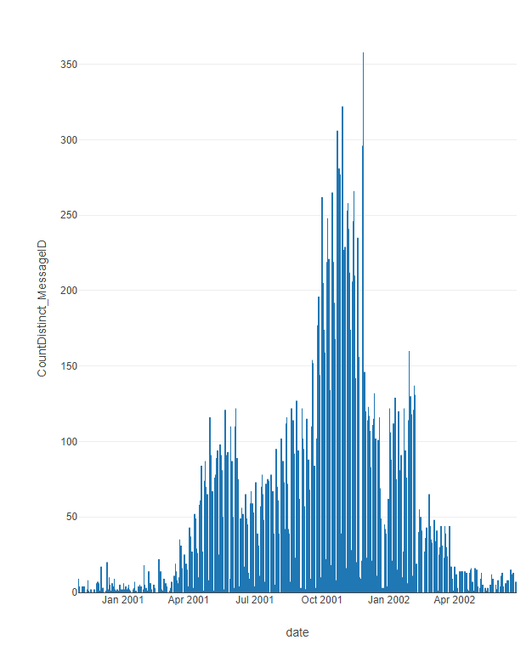
Enron Key Timeline
1999–2000 → Enron at peak: rapid growth, accounting complexity.
Aug 2001 → Skilling resigns, Watkins memo.
Oct 2001 → Massive loss and equity reduction disclosed.
Oct–Nov 2001 → SEC investigation begins.
Nov 2001 → Restatement and Dynegy merger collapse.
Dec 2001 → Bankruptcy (at time biggest ever).
2002 → Andersen indicted and collapses.
2002–2006 → Enron Task Force prosecutes key executives.

Slide 12
Case Deliverable Question
Conduct a forensic review of internal communications from the Enron email corpus. What evidence, if any, points to failures of governance, accountability, or integrity within the organization? Submit a memo and attach supporting exhibits from your analysis.

Slide 13
Memo Structure
To: Asher Curtis From: [Student Name], Forensic Analyst Subject: Summary of Evidence from Enron Email Corpus Date: [Insert date]
Summary of Findings (1–2 paragraphs)
Brief overview of evidence discovered
Relevance to possible fraud or ethical violations
Analytical Methods Used
Regex and/or keyword and/or individual search
Sentiment analysis or topic clustering
Network mapping or anomaly detection
Evidence Highlights (with attachments)
Include 2–3 key emails or message excerpts
Visualizations: network graphs, frequency plots, etc.
Interpretation and Recommendations
Explain significance
Suggest further investigative steps (e.g., deeper audit of certain users)
Attachments

Slide 14
Agenda
Class Agenda
Case Review: Enron Emails Case
Case Deliverable Overview
Lab Tool and workflow overviews:
DateTime parsing functions
Sentiment Analysis
Phrase Analysis
Individual Forensic Workflow
Lab Forensic Analysis

Slide 15
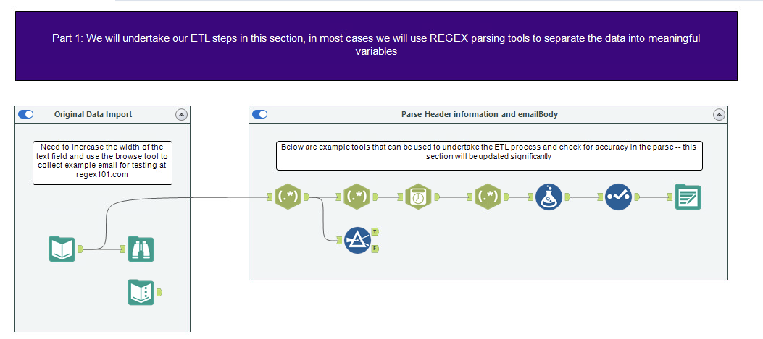
Enron Emails ETL Overview
“Custom” Date-Time Parsing
Additional Formulas
Input data and browse to look at it
Retain and output data we want to keep
Regular Expressions to break apart the text fields
One example email for practice

Slide 16
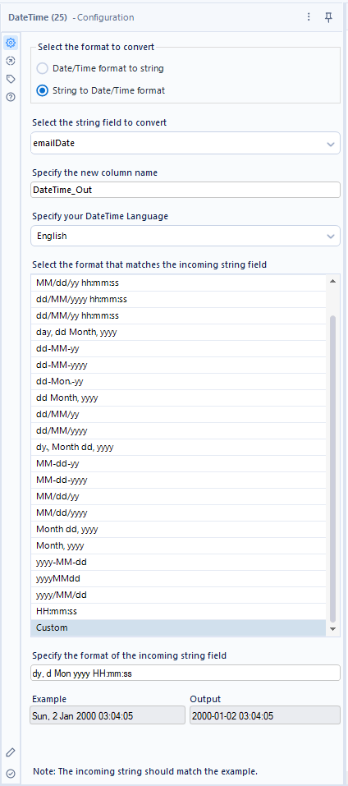

“Custom” Date-Time Parsing
Specifying: dy, d Mon yyyy HH:mm:ss
**Warning: Sometimes this tool will default back to unconfigured, losing the info in Custom. Type in the date format above exactly to have it run correctly.

Slide 17
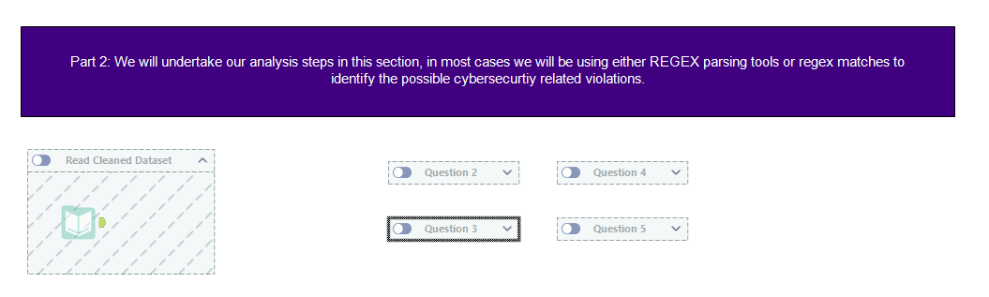

Enron Emails Analysis Overview
Save dataset from part 1 and read it into Alteryx

Slide 18
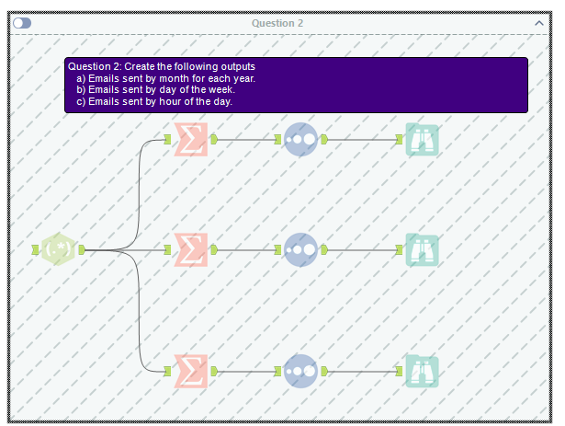
Enron Emails Analysis

Slide 19
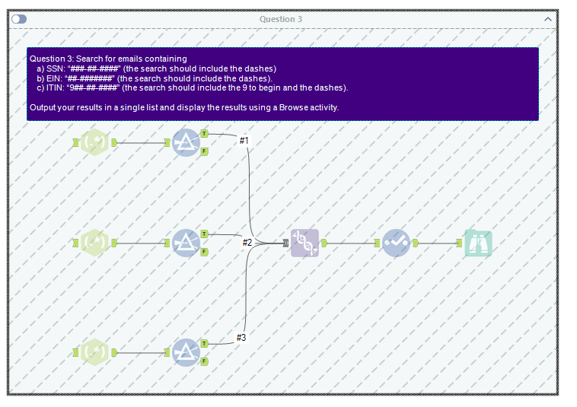
Enron Emails Analysis

Slide 20
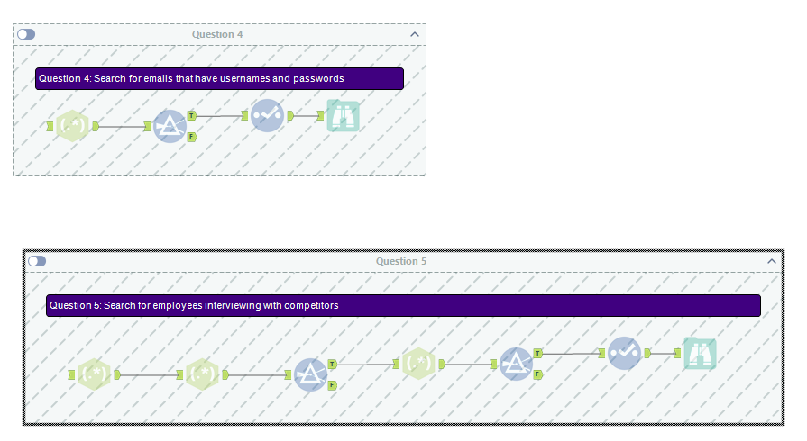
Enron Emails Analysis

Slide 21
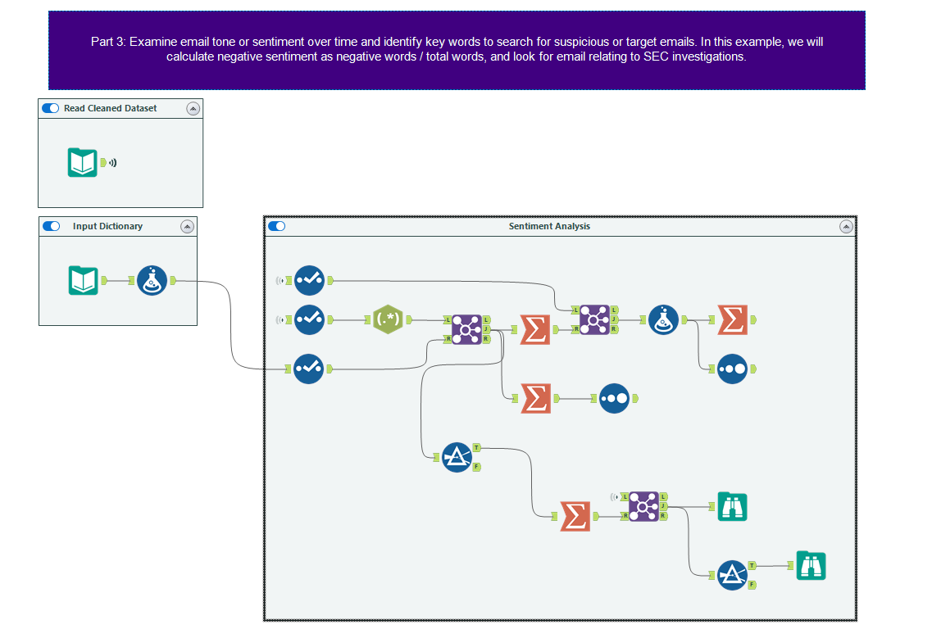
The parsed dataset
Formula tool to transform data for analysis
Extracts individual “words” \<\w+\> with Tokenize
2
Summarize tool used four different ways
1
Dictionary of positive/negative words
Sorting tool
3
Three different joins for different purposes

Slide 22
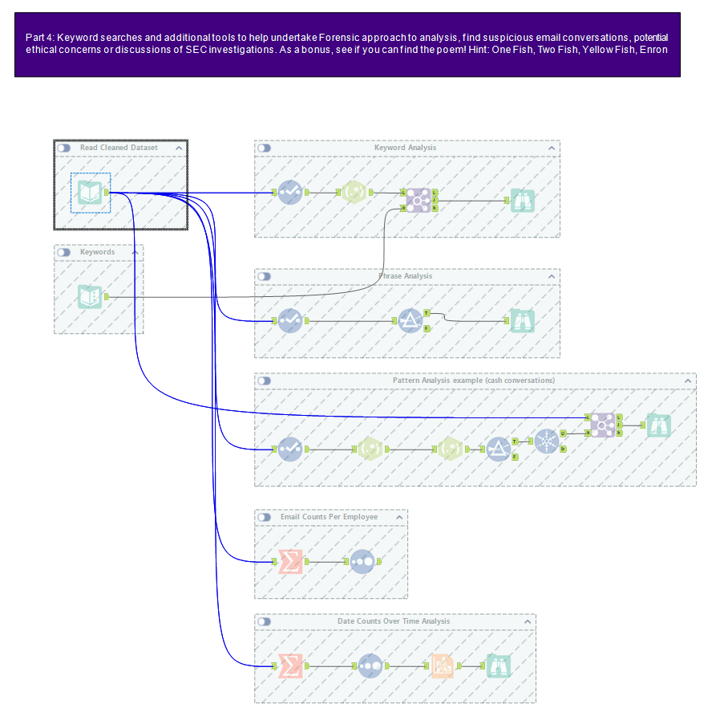
Clean dataset
Keyword Analysis
Editable keywords input
Phrase analysis (i.e., multiple words)
Pattern analysis using RegEx, identify any cash conversations
Base employee analysis (everyone w/ counts)
Base Time Analysis (all dates w/counts)

Slide 23
Agenda
Class Agenda
Case Review: Enron Emails Case
Case Deliverable Overview
Lab Tool and workflow overviews:
DateTime parsing functions
Sentiment Analysis
Phrase Analysis
Individual Forensic Workflow
Lab Forensic Analysis

Slide 24
Conclusion and look-ahead
We have undertaken a sophisticated analysis of unstructured data.
Please submit your case deliverable by Friday.

Slide 25

Thank you!

