Slide 1
ETL and Textual Analytics
Data Analytics for Professional Accountants
(ACCTG 522)
Class 3 | MPAcc class of 2026

Slide 2
Welcome!
Class Agenda
Review and ETL Overview
ETL Cases in the FSB Remote Labs
Conclusion and look ahead

Slide 3
Review: ETL Overview

Slide 4
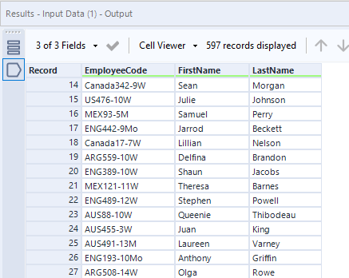
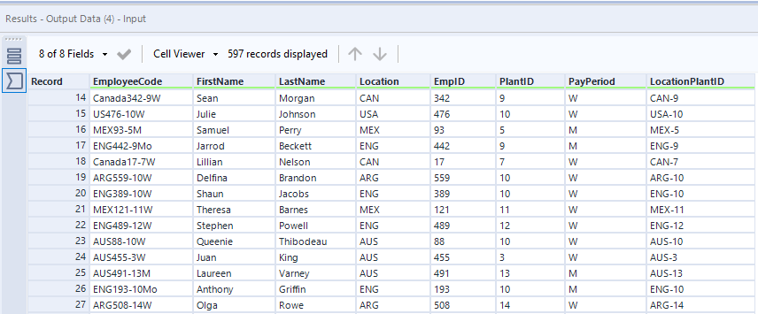
5 new output fields again

Slide 5
Extension
Using RegEx101 tool attempt to Transform these similar EmployeeCodes:
Canada1234-1Mo
Mexico0001234-121Monthly
Australia45789-13Annual
AUS123-13M
FRA334455-145weekly
GRE67 1a

Slide 6
Take aways
Regular expressions:
[A-Za-z] lists of acceptable terms (alphabetic)
[A-Za-z0-9] as above, alphanumeric
*,+ zero, one or more
^,$ beginning, end of the line
| or
\d any digit, \d{N} a specific “N” number of digits
. Any character, \. A full stop (escaping)

Slide 7
Extra RegEx examples
Dates:
Invoice Date: 03/15/2025
Payment Due: 04/14/2025
Invoices:
INV-100234
INV-567890
Reference: INV-456

Slide 8
Extra RegEx examples
Firm Identifiers:
CIK: 0000320193
Ticker: TSLA
Ticker: AAPL
Matching dollar amounts and accounts:
Total: $12,450.00
Late Fee: $25
Refund: ($1,200)

Slide 9
Extra RegEx examples
Phone numbers, email, credit card numbers:
206-123-4567
real_person@example.com
Potential fraud detected: 4532-9876-1234-5678

Slide 10
ETL Cases in the FSB Remote Labs

Slide 11
ETL Cases, Continued
Today we will examine “Joining Data”:
Joining data is another fundamental step in the ETL process, as in most cases, developing insight will require data from different databases.
Joining data can sometimes be referred to as merging data, blending data, or combining data.

Slide 12
Why is joining data important?
Joining data is part of the transforming step in ETL.
Incorrect joins are a data quality issue, incorrect joins can:
crash (or really slow down) our programs!
have us lose important data.
Have us generate incorrect conclusions/insight from our analysis.

Slide 13
Joining using unique keys
In all cases we will use unique keys to join the data.
All the unique keys are described in the case
One of them was tricky, can you remember which one?

Slide 14
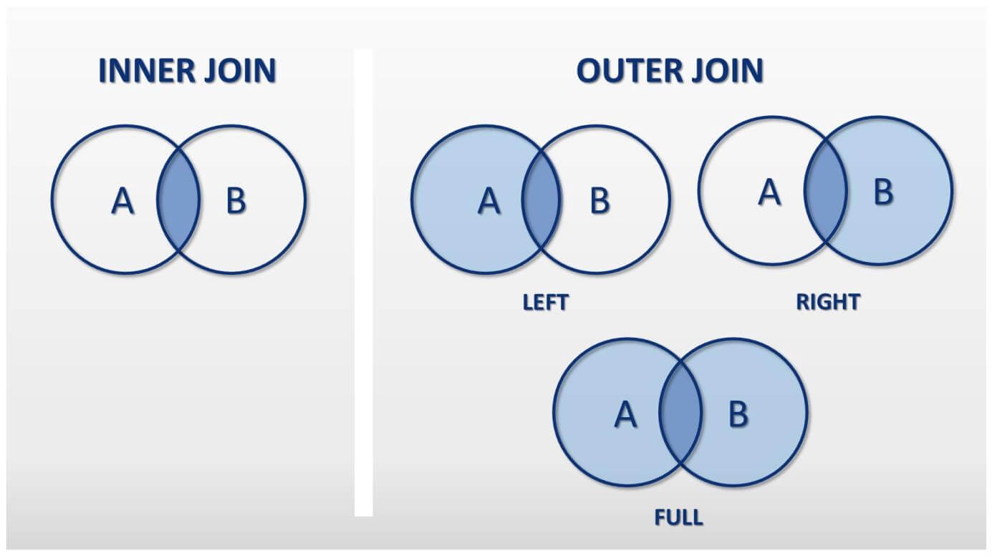

Slide 15
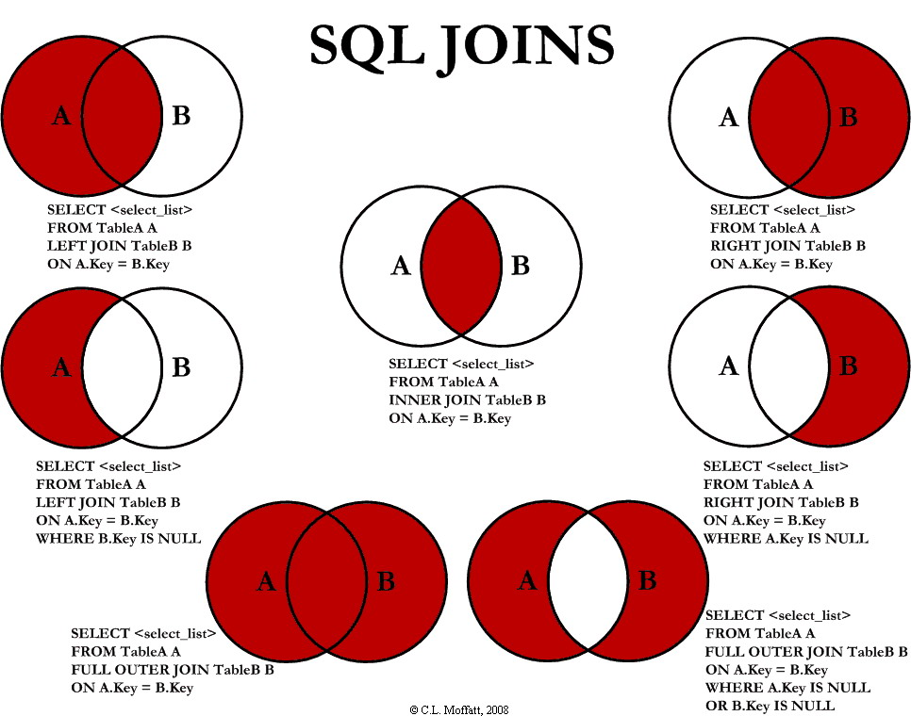

Slide 16
Joining using unique keys
In all joins we will use “one to many” matches.
Joining the large information source (“JELineItems”) to the smaller set of information in the other data sheets.

Slide 17
Why join across multiple software?
Because joining data is so fundamental, we want to work towards becoming software agnostic.
Working with cutting-edge software allows you to:
Become adaptable and resilient to new software.
Impress recruiters with practical discussions of cutting-edge software.

Slide 18
Joining across different tools:
Some terminolgy:
Alteryx: drag and drop “Join” and “Union” tools
PowerBI: data relationships tab
Python: code-level with package “pandas”
SQL: base code-level
Tableau: Both relationships and joins.

Slide 19
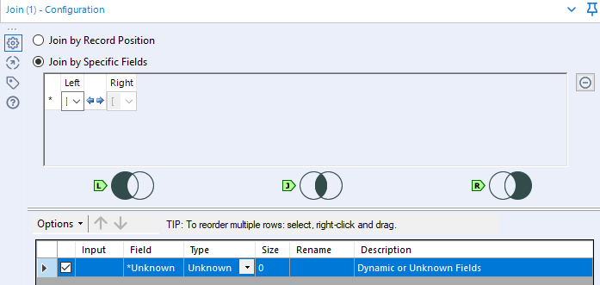

Alteryx Joins:

Slide 20
import pandas as pd
# Example: read from Excel file (each sheet as DataFrame)
file_path = "your_file.xlsx"
# Load the two sheets
JELineitems = pd.read_excel(file_path, sheet_name="JELineitems")
BusinessUnits = pd.read_excel(file_path, sheet_name="BusinessUnits")
# Perform SQL-style join on BusinessUnitID
# Equivalent to: SELECT * FROM JELineitems
# INNER JOIN BusinessUnits
# ON JELineitems.BusinessUnitID = BusinessUnits.BusinessUnitID;
merged_df = JELineitems.merge(
BusinessUnits,
on="BusinessUnitID",
how="inner" # can also use 'left', 'right', or 'outer'
)
SQL/Python:
SELECT
JEL.*,
BU.*
FROM JELineitems AS JEL
LEFT JOIN BusinessUnits AS BU
ON JEL.BusinessUnitID = BU.BusinessUnitID;
SELECT
JEL.*,
BU.*
FROM JELineitems AS JEL
RIGHT JOIN BusinessUnits AS BU
ON JEL.BusinessUnitID = BU.BusinessUnitID;

Slide 21
Lab Agenda
Open files in excel / open case and identify the keys
Compare Tableau and Power BI

Slide 22
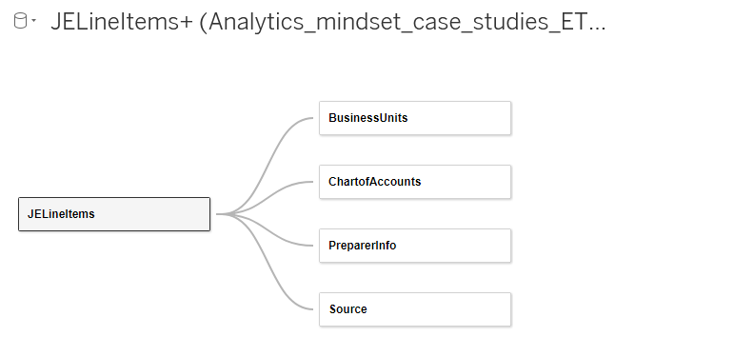
Tableau Relationships

Slide 23
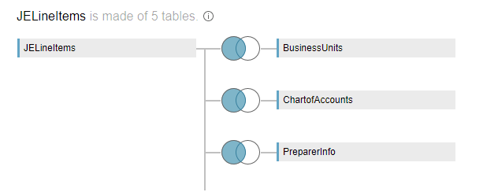
Tableau Joins

Slide 24
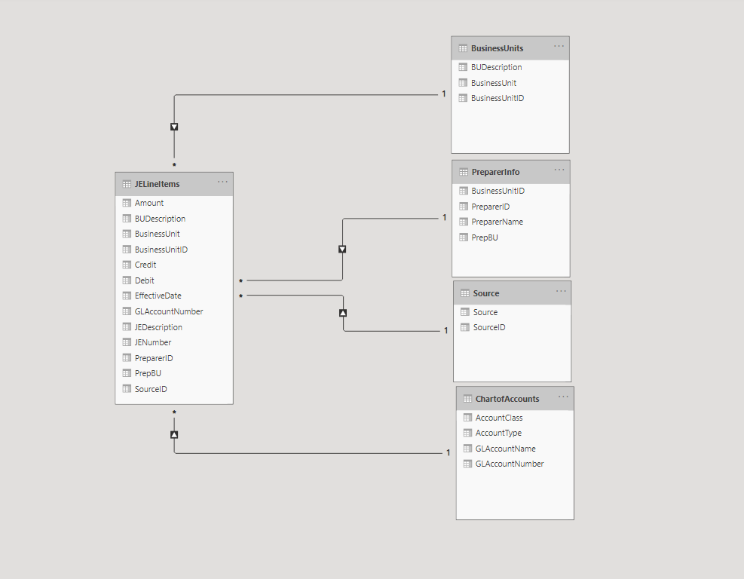
Power BI Data Relationships

Slide 25
To FSB remote labs
Again I recommend saving screenshots of your work in Alteryx (I’ve added blank slides if you want to save them in this ppt document, ctrl+m adds more slides)

Slide 28
Conclusion and look-ahead
ETL is the first step in the analytical process – we cannot undertake data analytics without data!
ETL is especially important when the data needs to be cleaned or transformed for use in analytics.

Slide 29
Conclusion and look-ahead
Wednesday:
Cases: Enron Emails Case – RegEx Heavy

Slide 30

Thank you and Congratulations!

