Slide 1
Transaction Analysis (Testing internal controls)
Advanced Cases in Assurance Services (ACCTG 521)
Class 6 | MPAcc class of 2026

Slide 2
Agenda
Review
Transaction Analytics
Lab: P-Card Case
Review and Agenda
Discussion Team Assignments
Task 4 and Discussion
Task 5 and Discussion

Slide 3
Audit Risk Model
Audit Risk: risk that the auditor expresses an inappropriate audit opinion when the financial statements are materially misstated
AR = IR x CR x DR
RMM
Inherent Risk: risk that a management assertion is materially misstated (before considering internal controls)
Control Risk: risk that internal controls fail to detect a misstatement
Detection Risk: risk that auditors fail to detect a misstatement

Slide 4
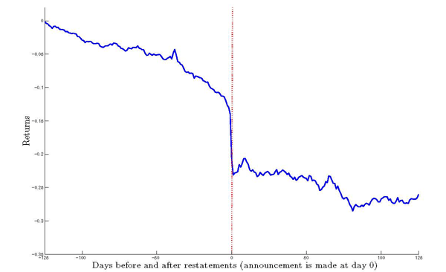
Market response to restating firm
Average abnormal returns below negative 9%
Why might investors perceive a restatement as bad news?

Slide 5
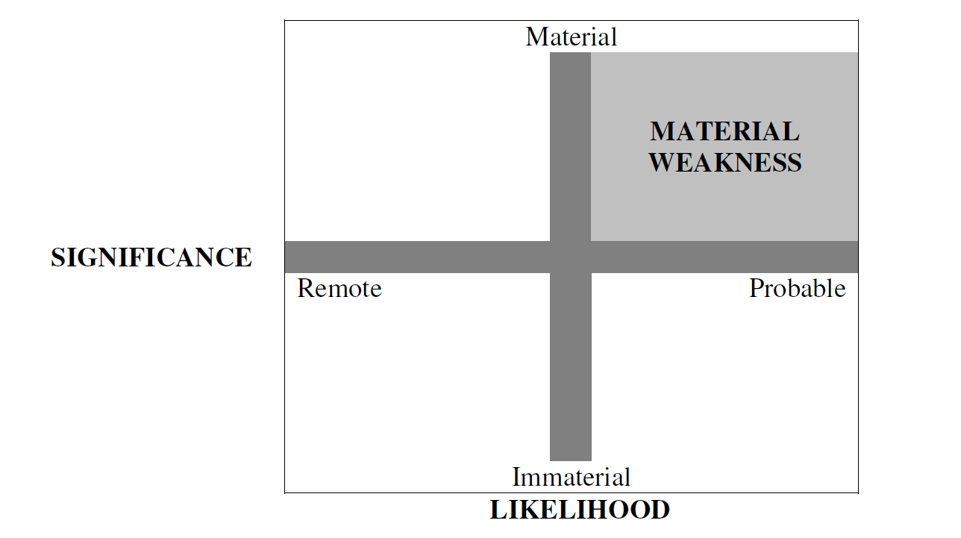
What are material weaknesses and significant deficiencies?
Material weaknesses need to be disclosed in the 10-K under Section 302 (and 404)
Significant deficiencies do not need to be publicly disclosed, but must be disclosed to the audit committee
Significant Deficiency
Significant Deficiency

Slide 6
Disclosure requirements
Annual report
Required
Section 302
Section 404a
Section 404b
Management
Disclosure
Management
Document and Test
Auditor Opinion

Slide 7
Agenda
Review
Transaction Analytics
Lab: P-Card Case
Review and Agenda
Discussion Team Assignments
Task 4 and Discussion
Task 5 and Discussion

Slide 8
Why is transaction analysis important?
Notes:
We will establish the importance of the analytical mindset using the model developed for the MPAcc, but can easily be applied to any career path.

Slide 9
Effective Financial Reporting Governance
Board
Management
Independent Auditor
Audit Committee
Chief Financial Officer
Chief Accounting Officer
National Office
Engagement Teams
Internal Audit
Technology and Systems
Rule- and Standard-Setters:
SEC, Exchanges, PCAOB, FASB, IASB, COSO, IIA
Sound Financial Reporting

Slide 10
Management
Audit
First Line of Defense
Second Line of Defense
Third Line of Defense
Management Control
Enterprise Risk Management
Internal Audit
Legal & Privacy
Physical Security
The Business / Operations
Third Party Risk Management
Cybersecurity
Business Continuity Management
Compliance

Slide 11
Transaction analytics
Why is analyzing transaction data important:
Central to both the external audit function and internal audit function.
Transaction analysis can also be used by management to assess operational decisions.

Slide 12
Transaction analytics
External auditors provide opinions a company’s financial statements are presented fairly, in all material respects, in accordance with financial reporting framework (such as GAAP).
External auditors can also provide advisory services to help the company become more financially secure/agile, among other areas.
Internal auditors ensure that company policies and procedures are followed and that the company is financially efficient.

Slide 13
Transaction analytics
Internal auditors ensure that company policies and procedures are followed and that the company is financially efficient.
Better financial reporting governance leads to better quality financial reporting.
One potential avenue is from detecting and preventing fraud.
Transaction analytics for fraud prevention and detection is seen as a major step towards efficiently reducing fraud.

Slide 14
Agenda
Review
Transaction Analytics
Lab: P-Card Case
Review and Agenda
Discussion Team Assignments
Task 4 and Discussion
Task 5 and Discussion

Slide 15
Team | Risk | Control
1 | Unauthorized cardholder | Make cardholder always have ID when purchasing
2 | Splitting purchases | Look for similar purchase amounts on the same day from same company
3 | P-Card purchases in prohibited categories | Test how many p card transactions are in each category
4 | Cash credit/Cash advance | Generate withdrawal receipts at ATMs
5 | Purchases at gas stations | Have a system flag purchases at gas stations
6 | Can spend an abundant amount of money | Credit limit and spending limit
7 | Not enough evidence to prove policy violation | Require receipts to be submitted with most/every purchase
8 | OSU Gets charged too much for purchase | Require user to keep receipts
9 | Pay Oklahoma sales tax | Check location of purchases
10 | Personal purchases on P-Card | Review receipts/approve purchases

Slide 16
P-Card Case Overview
Task 1: Overview (Discussed Earlier)
Task 2: Describing Data (Skip – work into Task 4)
Task 3: ETL Process (Skip – optional see workflow)
Task 4: Descriptive Data Analysis (24Qs)
Task 5: Control tests (7 tests)
Task 6: Prohibited Transactions Tests (Word searches)
Task 7: Forensic Audit (Multiple ledger-level tests)
Real-Time Analysis 07-09, 2025 and memo write-up (Individual Deliverable -- Thursday)

Slide 17
Control Test Assignments
Discussion Team | Agency Name | Agency Number | Calendar_Year | Sum_Amount | Count
1 | OKLAHOMA STATE UNIVERSITY | 1000 | 2010 | 10069808.98 | 22653
2 | OKLAHOMA STATE UNIVERSITY | 1000 | 2011 | 44939177.45 | 116188
3 | OKLAHOMA STATE UNIVERSITY | 1000 | 2012 | 41568372.2 | 117711
4 | OKLAHOMA STATE UNIVERSITY | 1000 | 2013 | 34331217.29 | 116595
5 | OKLAHOMA STATE UNIVERSITY | 1000 | 2014 | 33504148.34 | 116031
6 | UNIVERSITY OF OKLAHOMA | 76000 | 2010 | 33982135.44 | 83210
7 | UNIVERSITY OF OKLAHOMA | 76000 | 2011 | 38380465.59 | 97547
8 | UNIVERSITY OF OKLAHOMA | 76000 | 2012 | 34736171.04 | 90434
9 | UNIVERSITY OF OKLAHOMA | 76000 | 2013 | 28185725.01 | 76118
10 | UNIVERSITY OF OKLAHOMA | 76000 | 2014 | 26021689.11 | 77321

Slide 18
Agenda
Review
Transaction Analytics
Lab: P-Card Case
Review and Agenda
Discussion Team Assignments
Task 4 and Discussion
Task 5 and Discussion

Slide 19
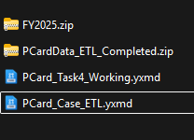
Set up
cd to datasets.io folder and run git pull
New files Pcard_V2
Copy and paste to your
/my_work/ folder
Unzip this file
Use this file

Slide 20
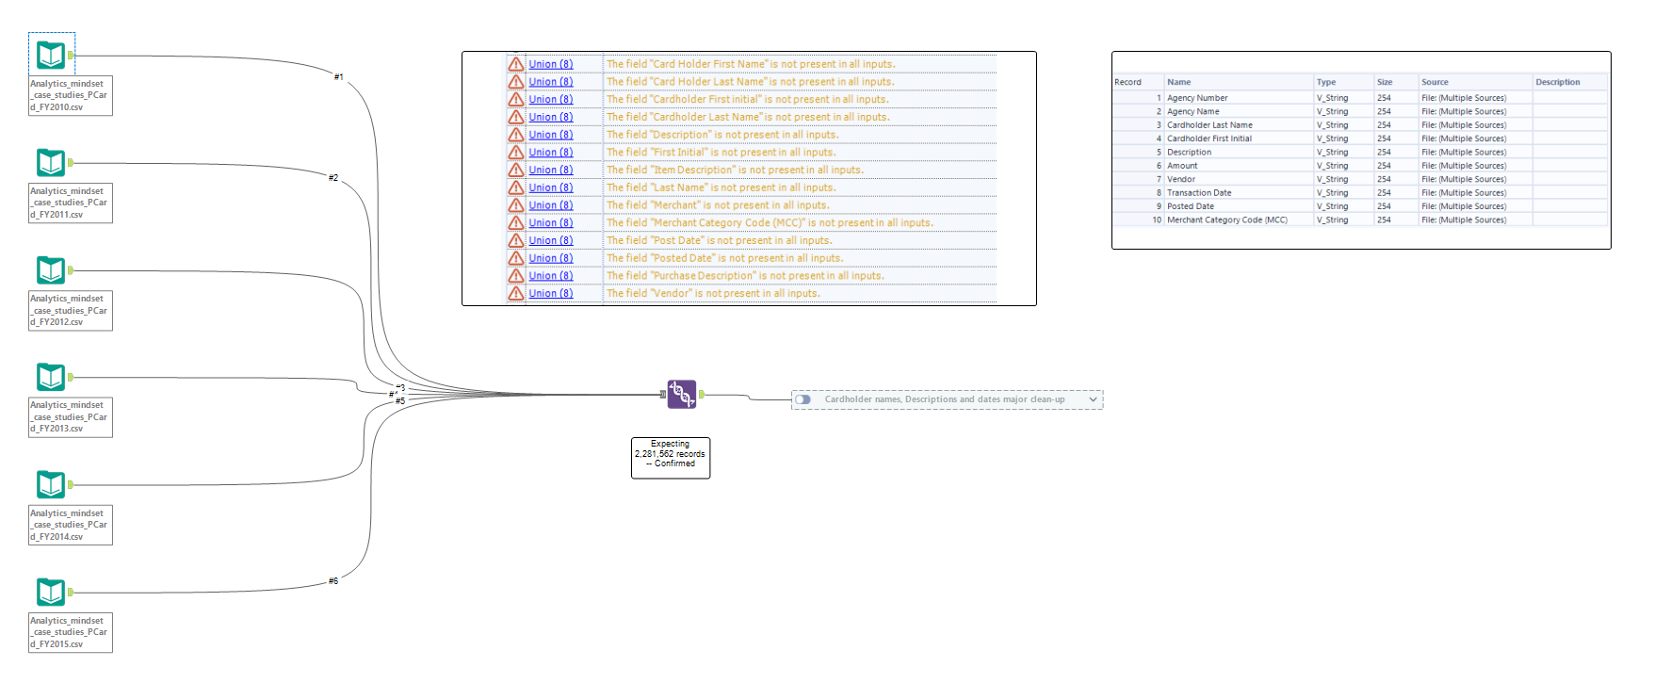
Input the original 6 files
Union tool
Problem 1, header inconsistency (different names for the same fields)

Slide 21
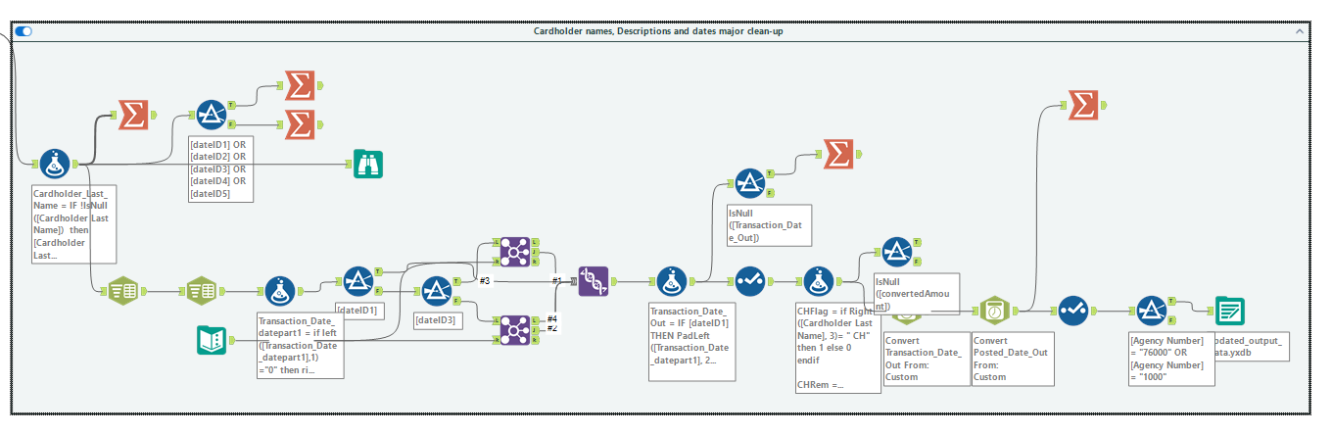
Problem 2, Date format inconsistencies:
dd-Mon.-yy (01-Jan-14)
d/M/yyyy (1/1/14)
dd.MM.yyyy HH:mm:ss (01.01.2014 00:00:00)
dd/MM/yyyy H:mm (01/01/2014 0:00)
d/M/yyyy H:mm (1/1/2014 0:00)
Solution
Checks
Converting

Slide 22
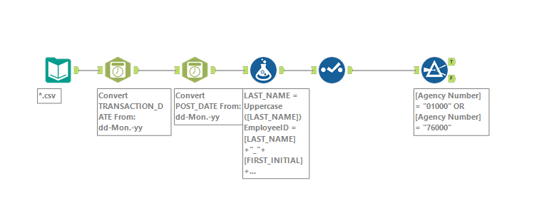
Some good news: Real Time 2025 files are formatted consistently!

Slide 23
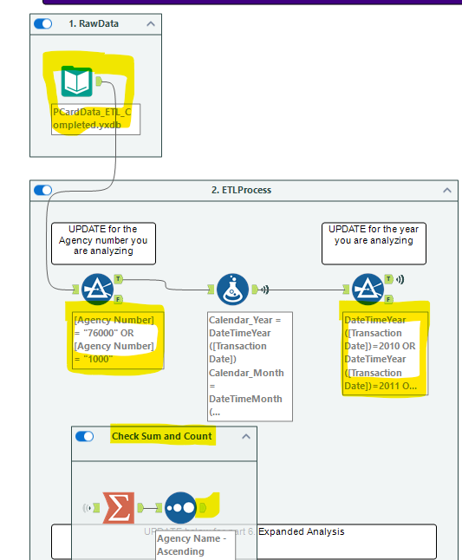
Task 4 Set up
Import unzipped data
Update Filter 1 to your Agency#
Update Year in the second filter
Run workflow with “Check Sum and Count” active and check your output matches mine.

Slide 24
Control Test Assignments
Discussion Team | Agency Name | Agency Number | Calendar_Year | Sum_Amount | Count
1 | OKLAHOMA STATE UNIVERSITY | 1000 | 2010 | 10069808.98 | 22653
2 | OKLAHOMA STATE UNIVERSITY | 1000 | 2011 | 44939177.45 | 116188
3 | OKLAHOMA STATE UNIVERSITY | 1000 | 2012 | 41568372.2 | 117711
4 | OKLAHOMA STATE UNIVERSITY | 1000 | 2013 | 34331217.29 | 116595
5 | OKLAHOMA STATE UNIVERSITY | 1000 | 2014 | 33504148.34 | 116031
6 | UNIVERSITY OF OKLAHOMA | 76000 | 2010 | 33982135.44 | 83210
7 | UNIVERSITY OF OKLAHOMA | 76000 | 2011 | 38380465.59 | 97547
8 | UNIVERSITY OF OKLAHOMA | 76000 | 2012 | 34736171.04 | 90434
9 | UNIVERSITY OF OKLAHOMA | 76000 | 2013 | 28185725.01 | 76118
10 | UNIVERSITY OF OKLAHOMA | 76000 | 2014 | 26021689.11 | 77321

Slide 25
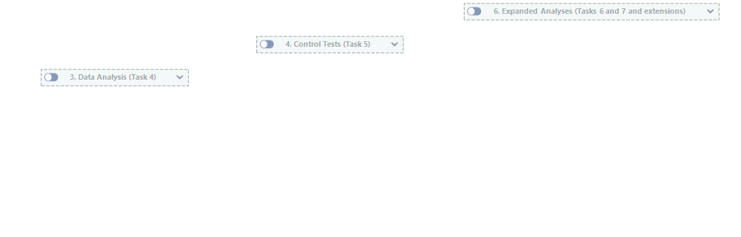
Preconfigured
Needs to be configured for each control test

Slide 26
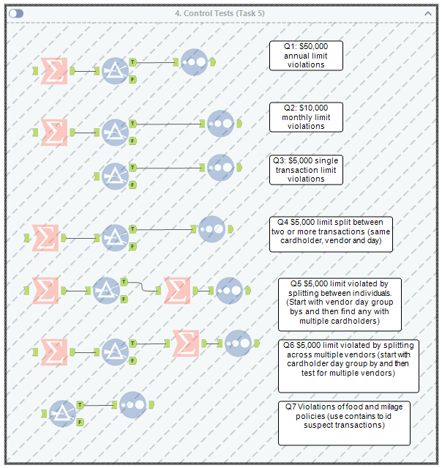
Control tests required are either:
Summarize the data to find an aggregate (summed) amount (e.g., spending limits) followed by filters and sorts
Flagging individual transactions by filtering data and then sorting by $ amount.
Trickier but same process just in multiple steps

Slide 27
Task 4 & 5 Discussion
Run the analysis, use Task 4 output:
To help you understand the data and types of transactions being made on the PCard.
From the 24 question outputs, highlight the most interesting 1-3 of the outputs and be prepared to talk about them.
Configure Task 5, internal controls tests:
Run the workflow, identify and be prepared to discuss the potential violations using the output.
Each Team will present their findings
Approx 2-3mins starting @ 2:50pm.

Slide 28
Agenda for next class
Brief Review
Lab: P-Card Case
Task 6 & 7 and Discussion
Real Time ETL
Real Time Analysis
Memo Deliverable (Individual)

Slide 29

Thank you!

