Slide 1
Transaction Analysis (Testing internal controls)
Advanced Cases in Assurance Services (ACCTG 521)
Class 7 | MPAcc class of 2026

Slide 2
Agenda
Brief Review
Lab: P-Card Case
Real Time ETL
Task 6 & 7 and Discussion
Real Time Analysis
Memo Deliverable (Individual)

Slide 3
Management
Audit
First Line of Defense
Second Line of Defense
Third Line of Defense
Management Control
Enterprise Risk Management
Internal Audit
Legal & Privacy
Physical Security
The Business / Operations
Third Party Risk Management
Cybersecurity
Business Continuity Management
Compliance

Slide 4
P-Card Case Review
Task 1: Overview (Discussed Earlier)
Task 2: Describing Data (Skip – work into Task 4)
Task 3: ETL Process (Skip – optional see workflow)
Task 4: Descriptive Data Analysis (24Qs)
Task 5: Control tests (7 tests)
Task 6: Prohibited Transactions Tests (Word searches)
Task 7: Forensic Audit (Multiple ledger-level tests)
Real-Time Analysis 07-09, 2025 and memo write-up (Individual Deliverable -- Thursday)

Slide 5
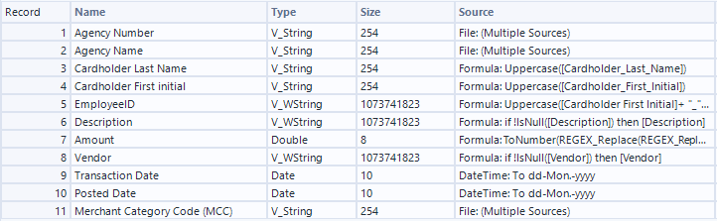
Review: PCard metadata

Slide 6
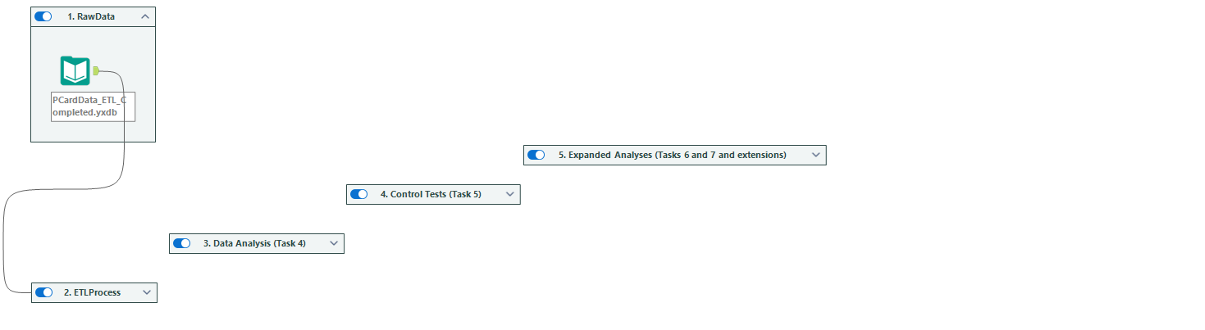
Review: PCard metadata
MetaData for the input tool
Which runs all the analysis

Slide 7
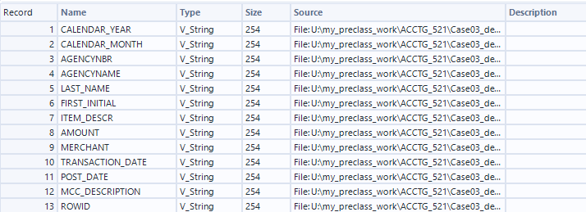
Incoming Metadata

Slide 8
Agenda
Brief Review
Lab: P-Card Case
Real Time ETL
Task 6 & 7 and Discussion
Real Time Analysis
Memo Deliverable (Individual)

Slide 9
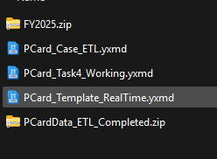
Set up
cd to datasets.io folder and run git pull
New files Pcard_V2
Copy and paste to your
/my_work/ folder
Unzip this file
Use this file

Slide 10
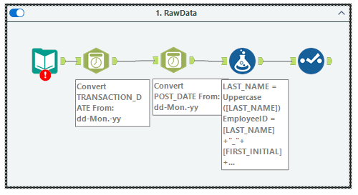
Real Time ETL
1. Input the three csv files & union them
3. Compute ID and convert Amount
Goal prepare the data for use with the existing workflow (i.e., match the original metadata)
2. Update date formats
4. Rename fields

Slide 11
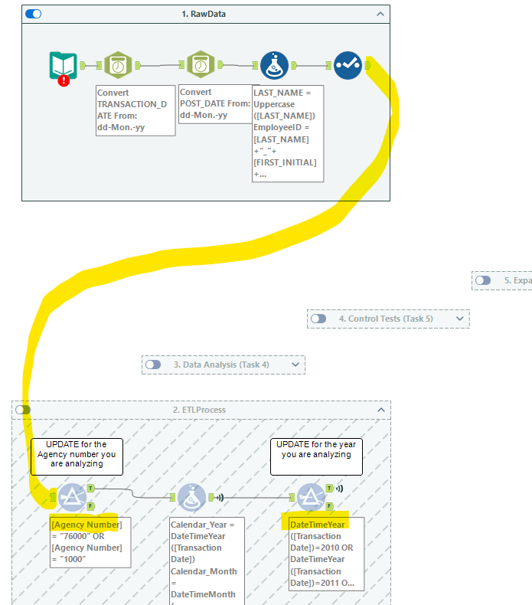
Connect to the ETL workflow
Update Agency filter to chosen university (or any other organization) or is not null for all OK agencies.
Update Year Filter to 2025 (or you’ll get no data)
The rest is connected, enable all the containers and run the workflow.
Undertake your analysis.

Slide 12
Agenda
Brief Review
Lab: P-Card Case
Real Time ETL
Task 6 & 7 and Discussion
Real Time Analysis
Memo Deliverable (Individual)

Slide 13
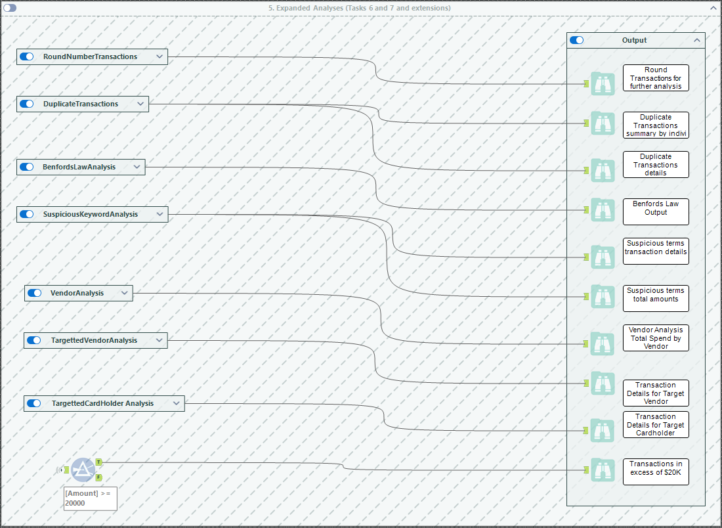

Slide 14
Agenda
Brief Review
Lab: P-Card Case
Real Time ETL
Task 6 & 7 and Discussion
Real Time Analysis
Memo Deliverable (Individual)

Slide 15
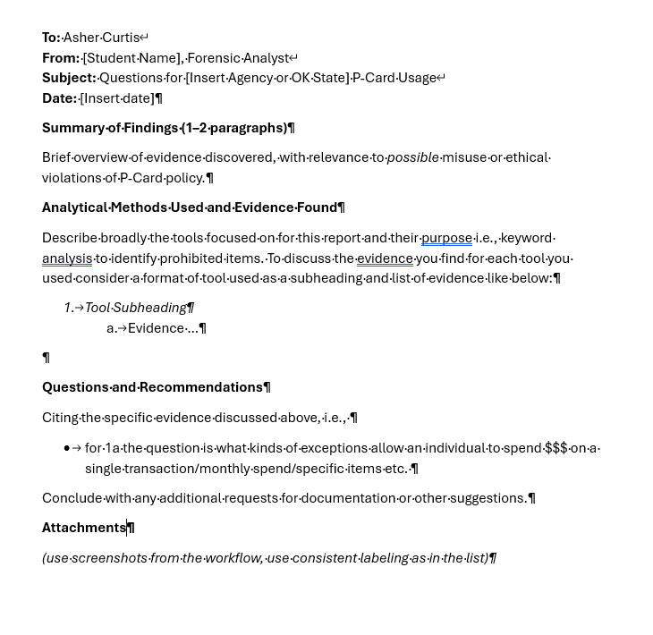

Slide 16

Thank you!

