Slide 1
Integrating Analytical Skills: Conclusion
ACCTG 320
Accounting Systems and Analytics
Class 11 | Autumn | 2026

Slide 2
Agenda
Review of integrated workflows
  SparkEd Case 1: Suspect Vendors
  SparkEd Case 2: Purchase Order Splitting
Labs: Alteryx SparkEd Cases (work at your own pace in small groups):
  GL Clean up (start with this one, choose one of the next 3)
  Organizing Financial Data
  International Group Taxes
  Sales & Use Tax
Conclusion and look ahead

Slide 3


Slide 4

Why Alteryx?
Alteryx brings data preparation and analysis into a visual workflow, allowing us to connect analytical steps in a logical sequence that is easy to follow, check, and repeat.

Slide 5
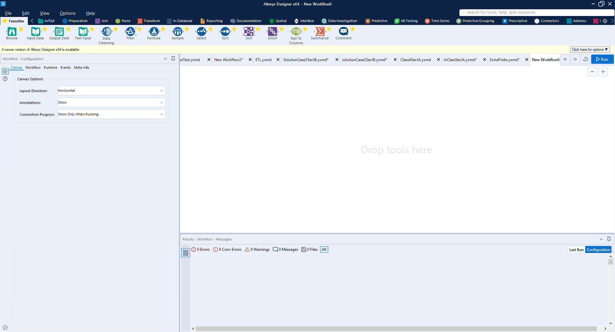
Tool Bar
Workflow
Configuration Window
Workflow Log & Preview Window

Slide 6
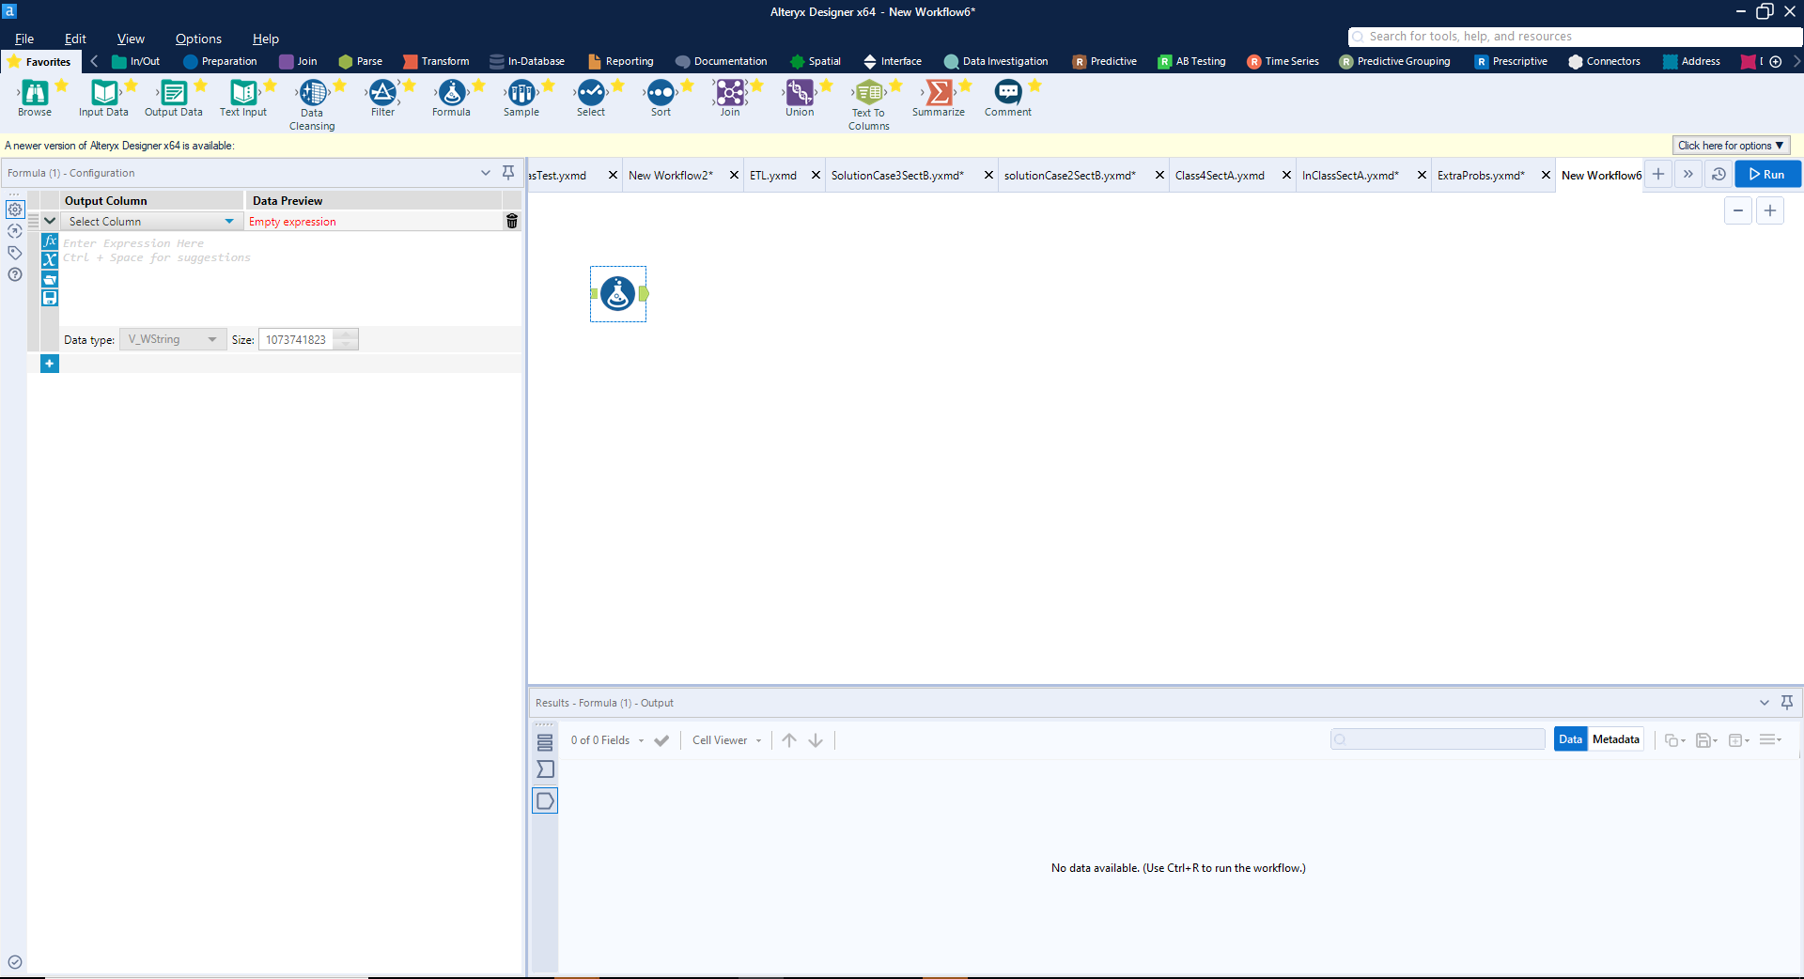
Drag a Tool onto/into the Workflow
Configuration Window
Updates to the tool
selected

Slide 7
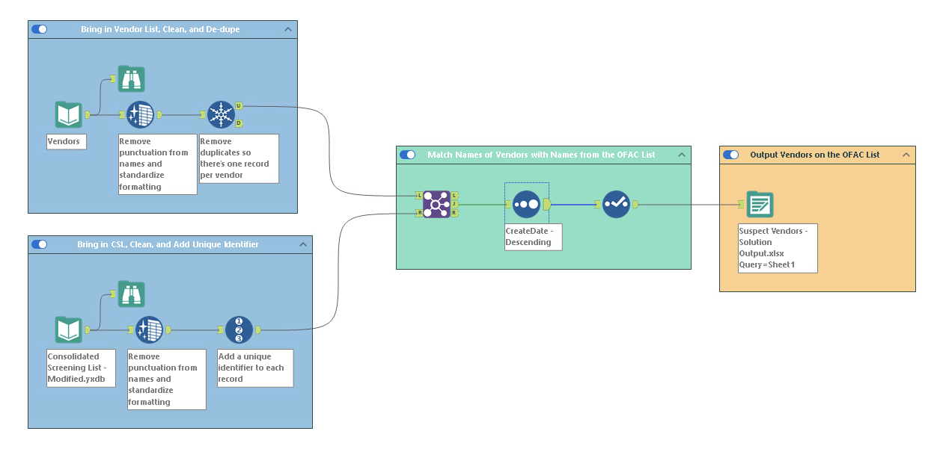
Suspect Vendors
10 Records match

Slide 8
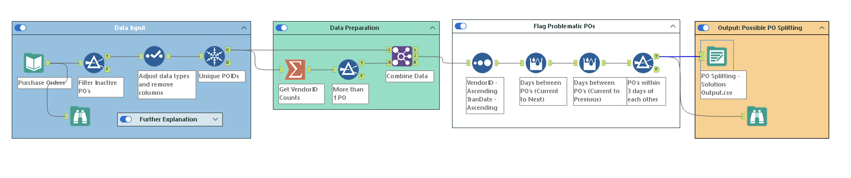
Purchase order splitting
186 records
10 records

Slide 9
Agenda
Review of integrated workflows
  SparkEd Case 1: Suspect Vendors
  SparkEd Case 2: Purchase Order Splitting
Labs: Alteryx SparkEd Cases (work at your own pace in small groups):
  GL Clean up (start with this one, choose one of the next 3)
  Organizing Financial Data
  International Group Taxes
  Sales & Use Tax
Conclusion and look ahead

Slide 10
Labs
https://fprod-hcs.foster.uw.edu/

Slide 11
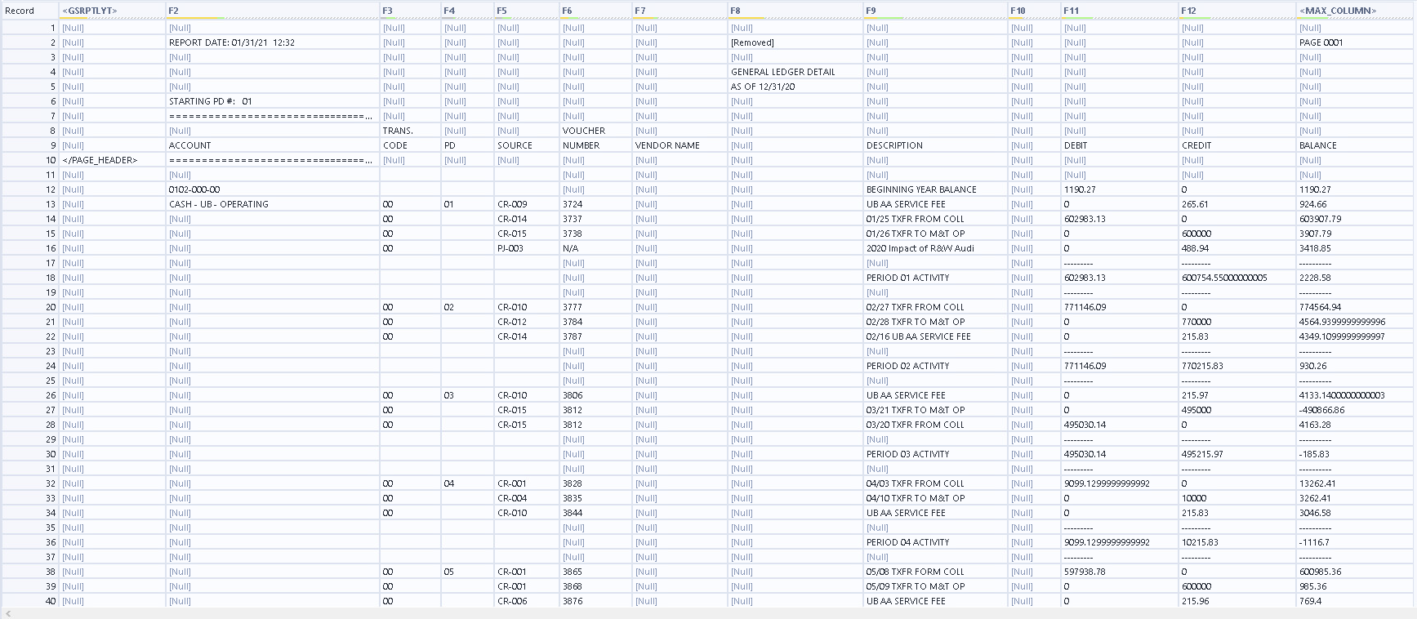
GL Clean up

Slide 12
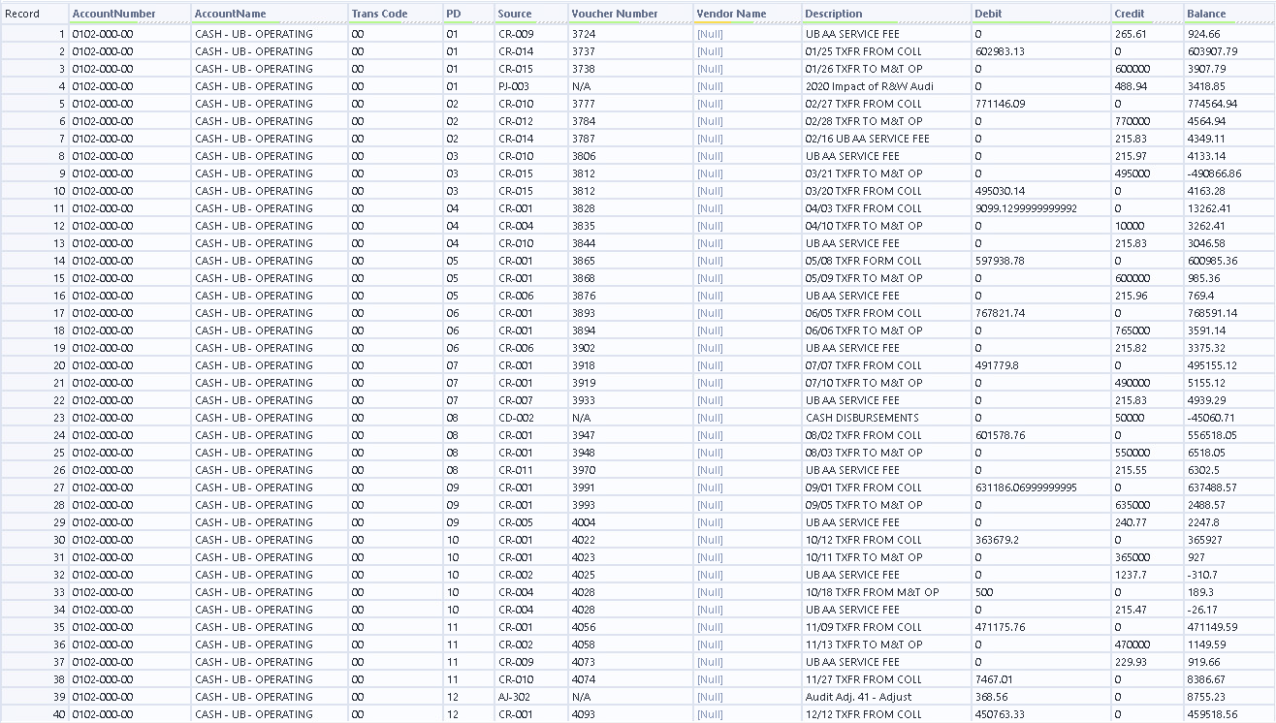
GL Clean up output (18,806 records)

Slide 13
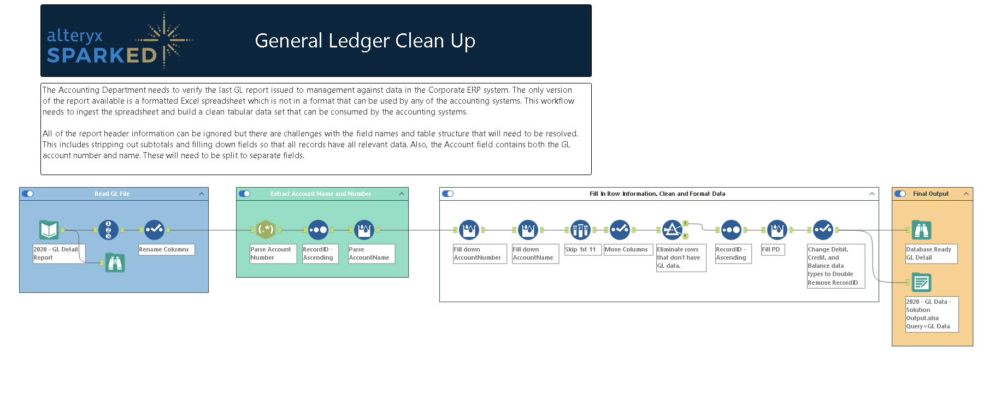
Similar steps with multi-Row Formular Tool
First hurdle, RegEx
Reminder \d is for digits; RegEx wants a pattern for account numbers.
18,806 records

Slide 14
Next steps
Next topic: Financial Statement Analysis and Deliverable 1
We will continue to use Alteryx workflows to better understand business problems/decisions
Consider how financial statement analysis can answer specific questions and understand business strategy
Thank you!

