Slide 1
Transaction Analysis (Testing internal controls)
Advanced Cases in Assurance Services (ACCTG 521)
Class 5 | MPAcc class of 2026

Slide 2
Agenda
Review
Audit Risk Conclusion
Material Weaknesses
Memo Deliverable
Transaction Analytics
Lab: P-Card Case
P-Card set-up and workflow overview

Slide 3
Audit Risk Model
Audit Risk: risk that the auditor expresses an inappropriate audit opinion when the financial statements are materially misstated
AR = IR x CR x DR
RMM
Inherent Risk: risk that a management assertion is materially misstated (before considering internal controls)
Control Risk: risk that internal controls fail to detect a misstatement
Detection Risk: risk that auditors fail to detect a misstatement

Slide 4
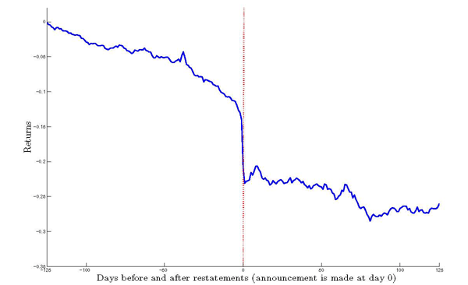
Market response to restating firm
Average abnormal returns below negative 9%
Why might investors perceive a restatement as bad news?

Slide 5
Agenda
Review
Audit Risk Conclusion
Material Weaknesses
Memo Deliverable
Transaction Analytics
Lab: P-Card Case
P-Card set-up and workflow overview

Slide 6
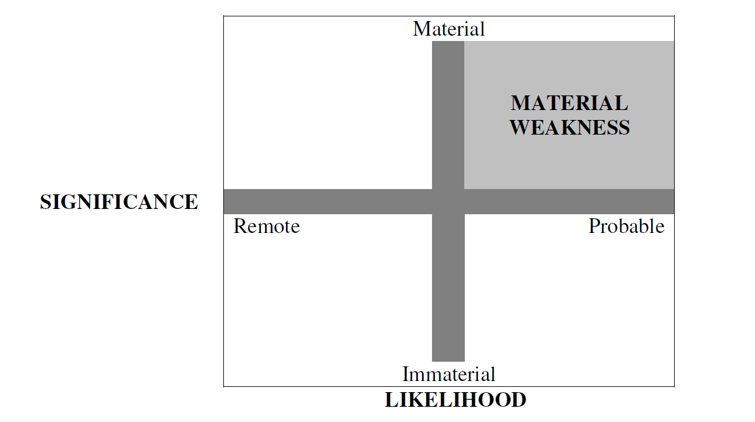
What are material weaknesses and significant deficiencies?
Material weaknesses need to be disclosed in the 10-K under Section 302 (and 404)
Significant deficiencies do not need to be publicly disclosed, but must be disclosed to the audit committee
Significant Deficiency
Significant Deficiency

Slide 7
How does this all work?
Example: Material weakness over allowance for doubtful accounts.
A firm does not have a policy for estimating allowance for doubtful accounts, instead just using last year’s percentage as the estimate.
If the credit-worthiness of the client base has worsened (e.g., because salespeople are trying to meet quotas, or because there is a systematic shock such as the financial crisis), then the allowance for doubtful accounts will be too low and could result in a misstatement.

Slide 8
How does this all work?
Example: Material weakness over inventory tracking.
A firm does not have an inventory tracking system.
When the inventory is counted at the end of the year, the inventory balance is updated. But if some inventory is not seen, in a warehouse closet, then inventory is misreported and there could be a subsequent misstatement.

Slide 9
Disclosure requirements
Annual report
Required
Section 302
Section 404a
Section 404b
Management
Disclosure
Management
Document and Test
Auditor Opinion

Slide 10
Material Weaknesses and Financial Reporting Quality
Are Material Weaknesses Correlated with Restatements?
Yes, internal control weaknesses and restatements are positively related
Why doesn’t substantive testing fix this?
It does, sometimes. When the material weaknesses are account specific, they do NOT have more restatements (i.e., substantive testing works)
BUT when the problem is more general (e.g., segregation of duties, IT weaknesses), it is hard to know where to apply additional substantive testing. (Ge et al. 2007)

Slide 11
Deliverable
Objective:
Analyze recent 8-K disclosures for companies that reported both a financial restatement and a material weakness in internal control (use the Alteryx packaged workbook, or Tuesday’s workflow).
Write a short memo assessing the severity and implications of the weakness.

Slide 12
Hints and tips:
Select one company from the provided dataset.
Read the 8-K disclosure describing the restatement and material weakness.
Identify key elements:
Nature and scope of the weakness
Affected accounts or processes
If the restatement is linked to a material weakness, separate (incidental), or broader.
Management’s response or remediation plan
Auditor involvement (if disclosed, hint is it 302-Management, or 404 auditor)
Write a short memo (≈300–400 words) addressing:
How severe is the weakness?
What evidence supports your assessment? (screenshot attachments can be used if referenced)
How might this weakness have contributed to the restatement?
What should management and the audit committee do next?

Slide 13
Agenda
Review
Audit Risk Conclusion
Material Weaknesses
Memo Deliverable
Transaction Analytics
Lab: P-Card Case
P-Card set-up and workflow overview

Slide 14
Transaction analytics
Today we will start analyzing transaction data:
Central to both the external audit function and internal audit function.
Transaction analysis can also be used by management to assess operational decisions.

Slide 15
Transaction analytics
External auditors provide opinions a company’s financial statements are presented fairly, in all material respects, in accordance with financial reporting framework (such as GAAP).
External auditors can also provide advisory services to help the company become more financially secure/agile, among other areas.
Internal auditors ensure that company policies and procedures are followed and that the company is financially efficient.

Slide 16
Transaction analytics
Internal auditors ensure that company policies and procedures are followed and that the company is financially efficient.

Slide 17
Why is transaction analysis important?
Notes:
We will establish the importance of the analytical mindset using the model developed for the MPAcc, but can easily be applied to any career path.

Slide 18
Effective Financial Reporting Governance
Board
Management
Independent Auditor
Audit Committee
Chief Financial Officer
Chief Accounting Officer
National Office
Engagement Teams
Internal Audit
Technology and Systems
Rule- and Standard-Setters:
SEC, Exchanges, PCAOB, FASB, IASB, COSO, IIA
Sound Financial Reporting

Slide 19
Management
Audit
First Line of Defense
Second Line of Defense
Third Line of Defense
Management Control
Enterprise Risk Management
Internal Audit
Legal & Privacy
Physical Security
The Business / Operations
Third Party Risk Management
Cybersecurity
Business Continuity Management
Compliance

Slide 20
Why is transaction analysis important?
Better financial reporting governance leads to better quality financial reporting.
One potential avenue is from detecting and preventing fraud.
Transaction analytics for fraud prevention and detection is seen as a major step towards efficiently reducing fraud.

Slide 21
Agenda
Review
Audit Risk Conclusion
Material Weaknesses
Memo Deliverable
Transaction Analytics
Lab: P-Card Case
P-Card set-up and workflow overview

Slide 22
P-Card Case Overview
Task 1: Overview (Discuss today)
Task 2: Describing Data (Skip – work into Task 4)
Task 3: ETL Process (Skip – done for you)
Task 4: Descriptive Data Analysis (24 Qs Start today)
Task 5: Control tests (7 test, Tuesday)
Task 6: Prohibited Transactions Tests (Tuesday)
Task 7: Forensic Audit (Tuesday)
Memo write-up (Tuesday / outside of class)
(opens Thu Oct 16 for Gen AI)

Slide 23
Task 1
► Gain a more in-depth understanding of the OSU P-card guidelines and objectives by reviewing the P-card guidelines in the appendix following. As you review the guidelines, consider the risks OSU faces and what controls it has implemented around those risks.
► Prepare a list of questions that you would like to test to see if employees are following OSU P-card guidelines. Your questions should be informed by thinking about the risks OSU faces and the internal controls it has implemented. Make sure you focus on questions that can be answered using data.

Slide 24
Team | Risk | Control
1
2
3
4
5
6
7
8
9
10

Slide 25
Transaction Analysis: P-Card Labs

Slide 26
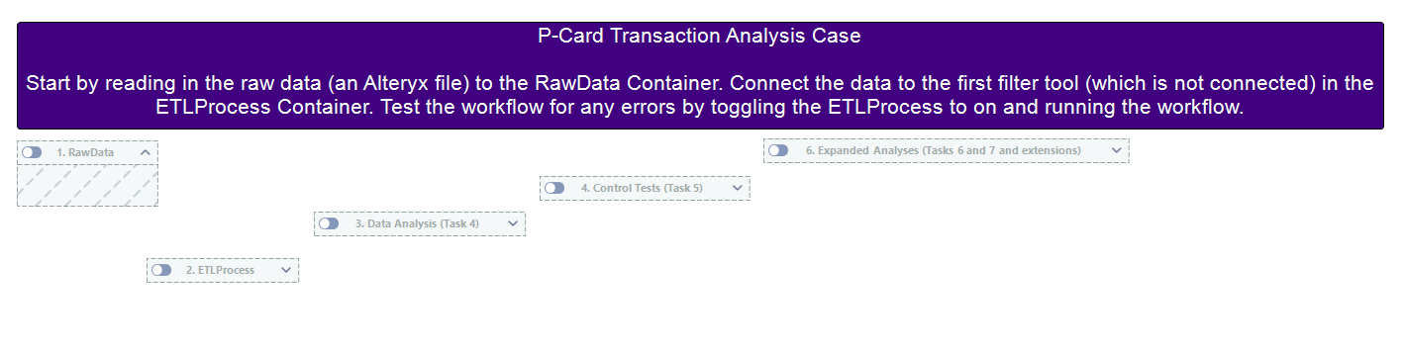

Slide 27
Conclusion
Better financial reporting governance leads to better quality financial reporting.
One potential avenue is from detecting and preventing fraud.
Transaction analytics for fraud prevention and detection is seen as a major step towards efficiently reducing fraud.

Slide 28

Thank you!

