Slide 1
Data Veracity: Generative AI 1
Advanced Cases in Assurance Services (ACCTG 521)
Class 13 | MPAcc class of 2026

Slide 2
Agenda
Review: Mindbridge AI
Overview: Individual Deliverable (Due Nov 13th)
Labs:
Preliminary Tests on Pure Oils Test Data
Check Another File (time permitting, helps w/ heading 2)
Time for Memo Drafting (headings 1 & 2 and Appendix 1).

Slide 3
Agenda
Review: Mindbridge AI
Overview: Individual Deliverable (Due Nov 13th)
Labs:
Preliminary Tests on Pure Oils Test Data
Check Another File (time permitting, helps w/ heading 2)
Time for Memo Drafting (headings 1 & 2 and Appendix 1).

Slide 4

Swindler Case Part 2
??

Slide 5
Part Two Requirements
Perform at least seven tests that will help determine if the data set is real or fake. Your tests can use the data included in the file Skylar sent you or you can add external data. If you add external data, include the link in the test explanation showing where you acquired the data.

Slide 6
Memo Requirements
Documentation of Preliminary Testing Environment (started today)
Outline of Expectations (more sophisticated Generative AI, next class)
Analysis of Increasing Gen AI sophistication and implications (next class)

Slide 7
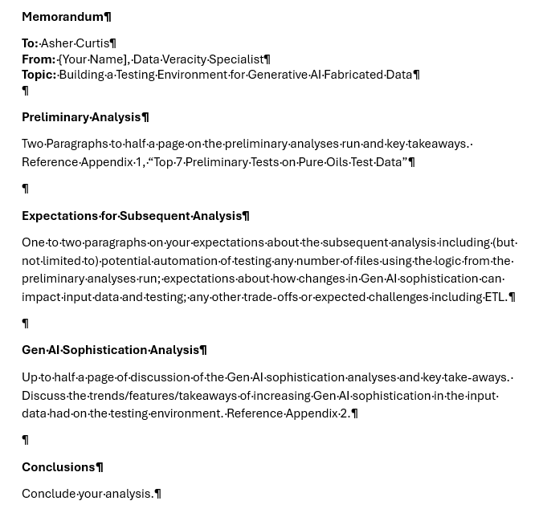

Slide 8
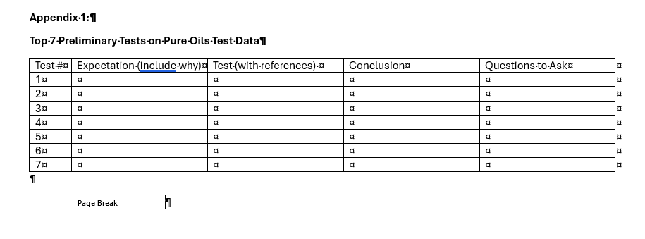
Directly from Case
+ Ask the Right Questions
Based on the conclusion from the test, what question would you ask the hypothetical manager / borrower?

Slide 9
Agenda
Review: Mindbridge AI
Overview: Individual Deliverable (Due Nov 13th)
Labs:
Preliminary Tests on Pure Oils Test Data
Check Another File (time permitting, helps w/ heading 2)
Time for Memo Drafting (headings 1 & 2 and Appendix 1).

Slide 10
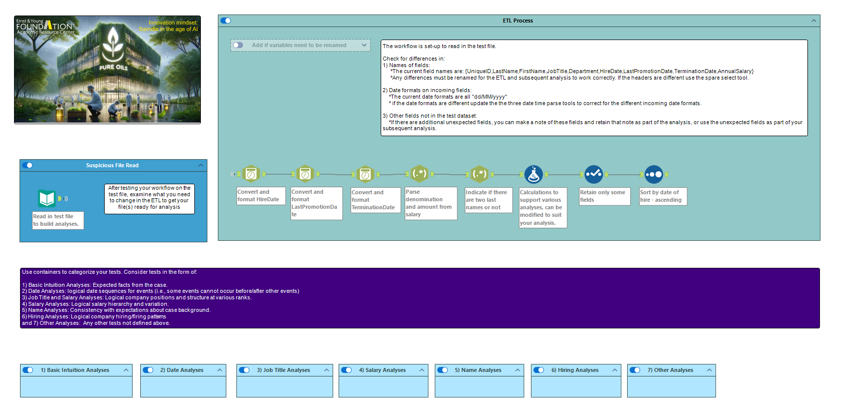

Slide 11

Thank you!

