Slide 1
Mini- Cases in Automation: Part 2
Adv. Advisory | ACCTG 528 | Class 08
MPAcc Class of 2026

Slide 2

What will we do today?
Review
Mini-Cases
Admin: Final Project Teams & Topics
RPA Mini-Case 3
Start with Mini-Case 1 (Monday) Web to spreadsheet
Update to include Governance & Logging
RPA Mini-Case 4
Web-scraper set-up (as a class)
Open ended workflow

Slide 3
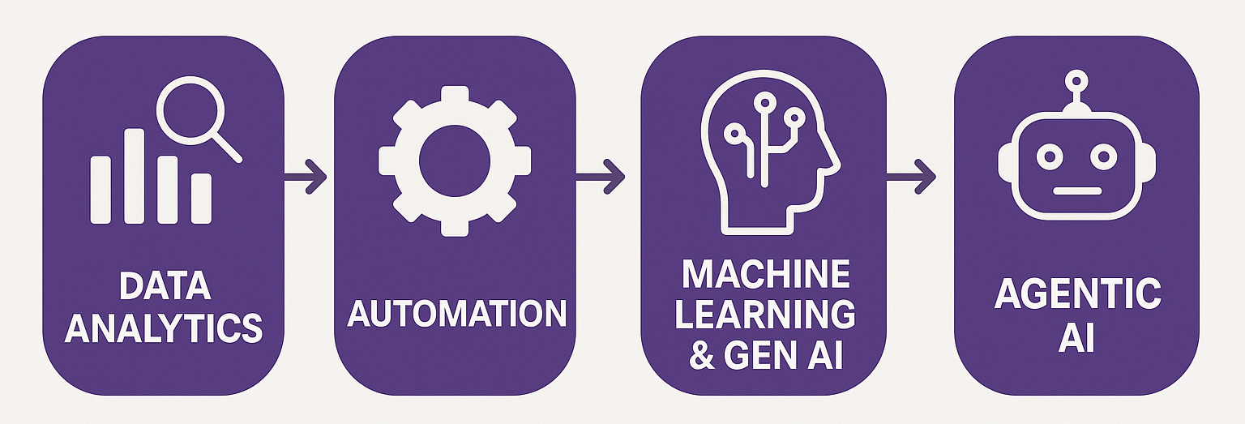
Course Diagram (high-level)

Slide 4











UiPath Agentic Automation
Notes:
Everything happens in one place: the UiPath Platform—where AI Agents aren’t just assistants, they’re true work partners, transforming complexity into a seamless, orchestrated operation.
We break it down into three powerful layers: Activities (the building blocks—reading, processing, integrating), Workflows (connecting the dots with human-in-the-loop and testing), and Processes (the big picture—managing, optimizing, and enhancing enterprise operations).
Agentic Orchestration / Maestro takes automation even further—coordinating UiPath Agents, third-party AI models, people, robots, and tools into a single, intelligent system.
Your existing systems don’t need to be reinvented—our platform integrates seamlessly with your data, applications, and workflows while maintaining enterprise-grade security, governance, and AI trust.
We’re not just compatible with your tech stack—we enhance it. From cloud providers like AWS, Google, and Azure to enterprise apps like Salesforce and SAP, we turn digital chaos into a symphony of efficiency.

Slide 5
Looking ahead
Where do your individual and team projects go next?
Individual:
Appropriate identification rules-based automation
Selection of appropriate automation spectrum model
Team:
Appropriate mix of RPA, Agent, and human in the loop
Selection of best cases for agent decision enhancement

Slide 6
What will we do today?
Review
Mini-Cases
Admin: Final Project Teams & Topics
RPA Mini-Case 3
Start with Mini-Case 1 (Monday) Web to spreadsheet
Update to include Governance & Logging
RPA Mini-Case 4
Web-scraper set-up (as a class)
Open ended workflow

Slide 7
RPA Mini-Case 3
Input data: Wikipedia Table of World population by Country
Output data: A spreadsheet with numerical populations for the top 20 countries by population, a sum of the top 20 countries population, and a percentage of the world’s population.
Add steps to log key elements of the workflow, how do we know that the robot is running effectively and as planned?
Governance: Are we getting the correct output? Has someone changed the workflow from what we were expecting?
Logs: Checking key steps in the bot are operating correctly using a log.

Slide 8
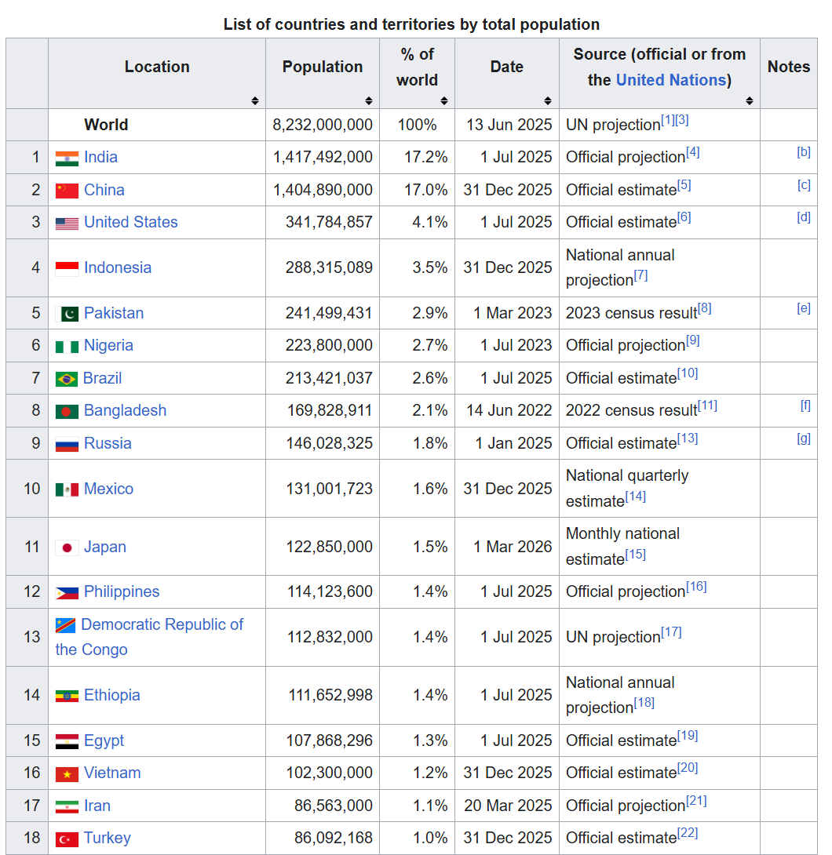
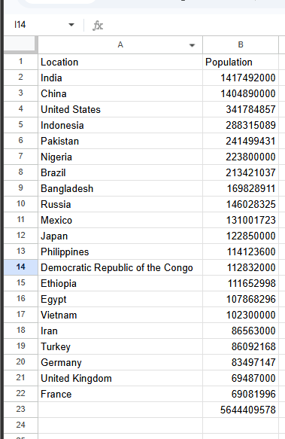


Slide 9
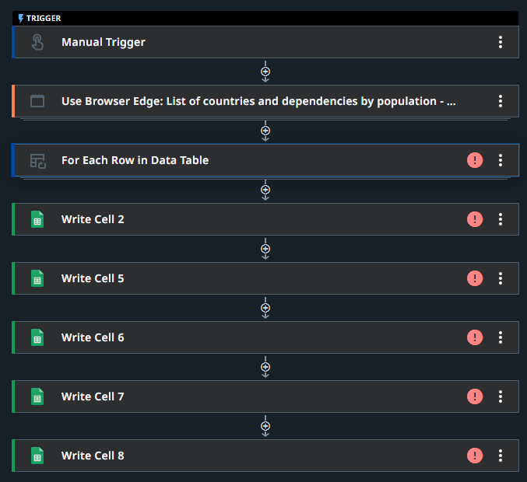
Starter file:
Import to studio web
Process flow is set-up
Red warning signs indicate an unconfigured step

Slide 10
In the bot, identify:
How to set-up governance & logging, activity hints:
Comment (adds a message to the workflow but doesn’t trigger any changes in the workflow)
Write line (writes a message to the console)
Assign (stores or updates a variable)
Output to only console or have a backup to another other document (e.g., google docs)

Slide 11
What will we do today?
Review
Mini-Cases
Admin: Final Project Teams & Topics
RPA Mini-Case 3
Start with Mini-Case 1 (Monday) Web to spreadsheet
Update to include Governance & Logging
RPA Mini-Case 4
Web-scraper set-up (as a class)
Open ended workflow

Slide 12
RPA Mini-Case 4
Map out a use case for data scraped from the web, and implement it.
As a class we will start by scraping S&P500 constituent data from Wikipedia.
Repeat these steps with another website of interest.
What is next in the process to make this data useful?
Implement as much as possible adding a comment on the next steps you would use when time is up.

Slide 13
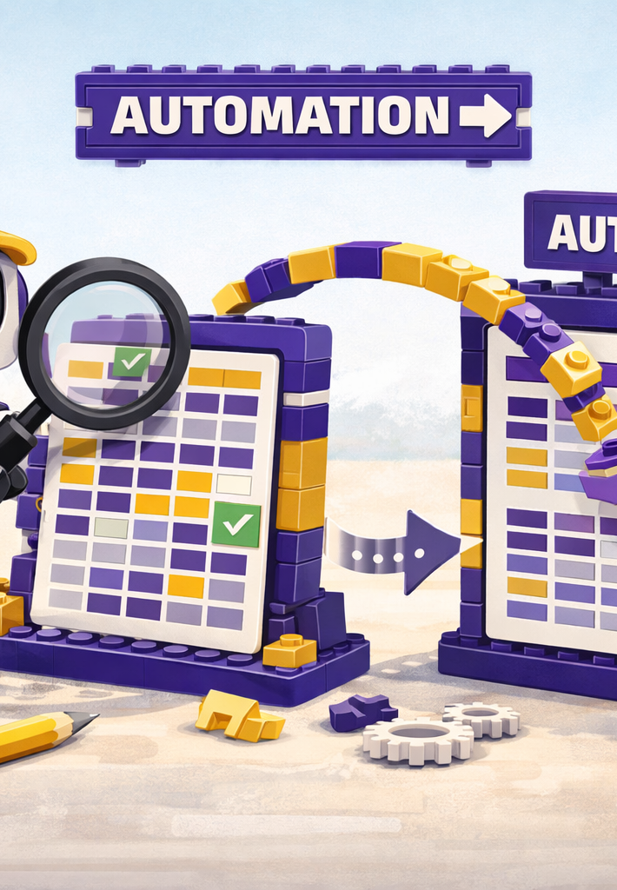
Where we will go next
RPA
Manipulation of files, components
Triggers, Controls, Governance
Costs and benefits of RPA
Agentic
BPMN revision and extension
Tasks for RPA versus Agent
Advanced Prompt Engineering
Scalability

Slide 14
Thank you

