Slide 1
EDGAR Explorer: XBRL and APIs
Data Analytics for Professional Accountants (ACCTG 522)
Class 8 | MPAcc Class of 2026

Slide 2
Welcome!
Class Agenda
Review
XBRL Filings
Mini-Lab:
EDGAR Explorer Case: Examine a company XBRL filing.
Labs (both XBRL based):
Accessing the SEC EDGAR Filings API
Accessing the SEC Company Facts
Conclusion and look ahead.

Slide 3
Core Capabilities: Doc & Data Intelligence
Doc Intelligence
Automated understanding and summarization of documents
Quick extraction of important points and data from any text
Comparison of document contents to identify key differences
Accurate language translation for diverse document types
Trend and pattern detection within large volumes of text
Data Intelligence
Connect to any data source, integrating seamlessly with AI.
Utilize AI to uncover deep insights from complex datasets.
Empower finance to do real-time decision-making with dynamic, AI-driven data analysis.
Leverage predictive analytics to forecast trends and guide strategic planning.

Slide 4
Welcome!
Class Agenda
Review
XBRL Filings
Mini-Lab:
EDGAR Explorer Case: Examine a company XBRL filing.
Labs (both XBRL based):
Accessing the SEC EDGAR Filings API
Accessing the SEC Company Facts
Conclusion and look ahead.

Slide 5
XBRL Filings
In assessment teams:
Pick a stock you believe is over or undervalued
Update the Table below:
Sock selected | Under/Over Valued
Sock selected | Under/Over Valued

Slide 6
XBRL Filings
Use the EDGAR Search Tool
SEC.gov | Search Filings (www.sec.gov/search-filings).
Obtain the most recent 10-K of your target company.
Access the XBRL instance of the 10-K.

Slide 7
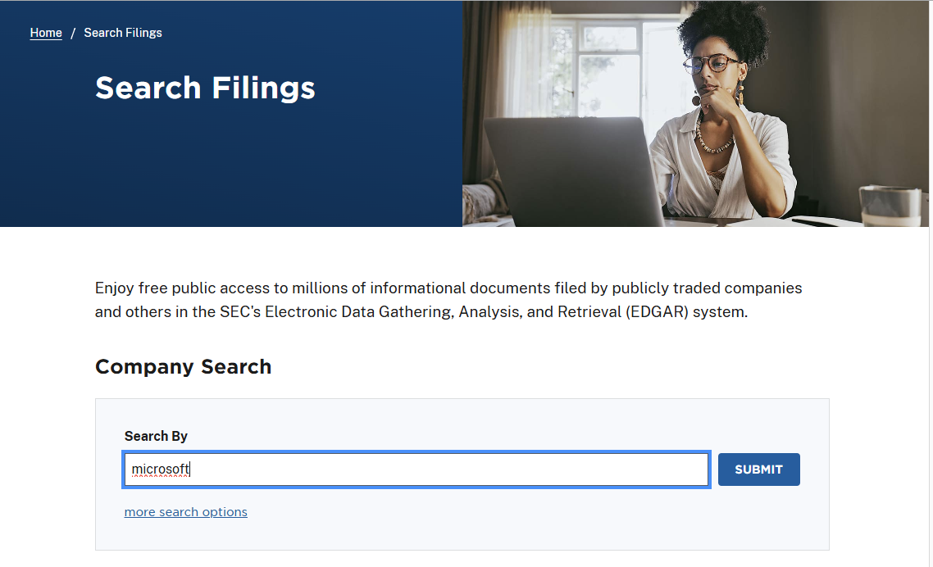

Slide 8
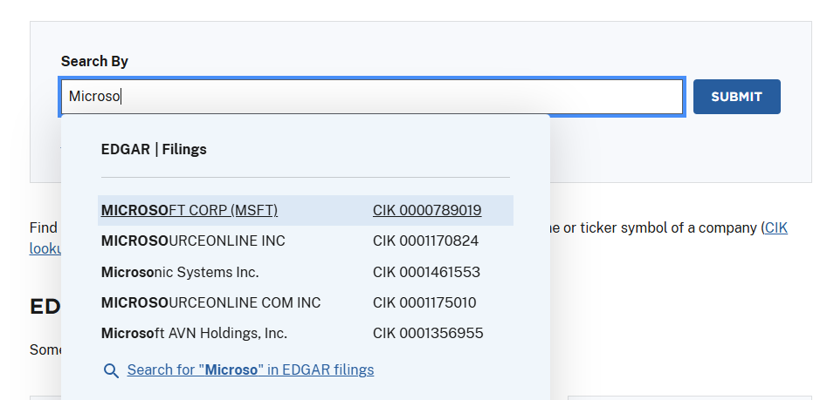

Slide 9
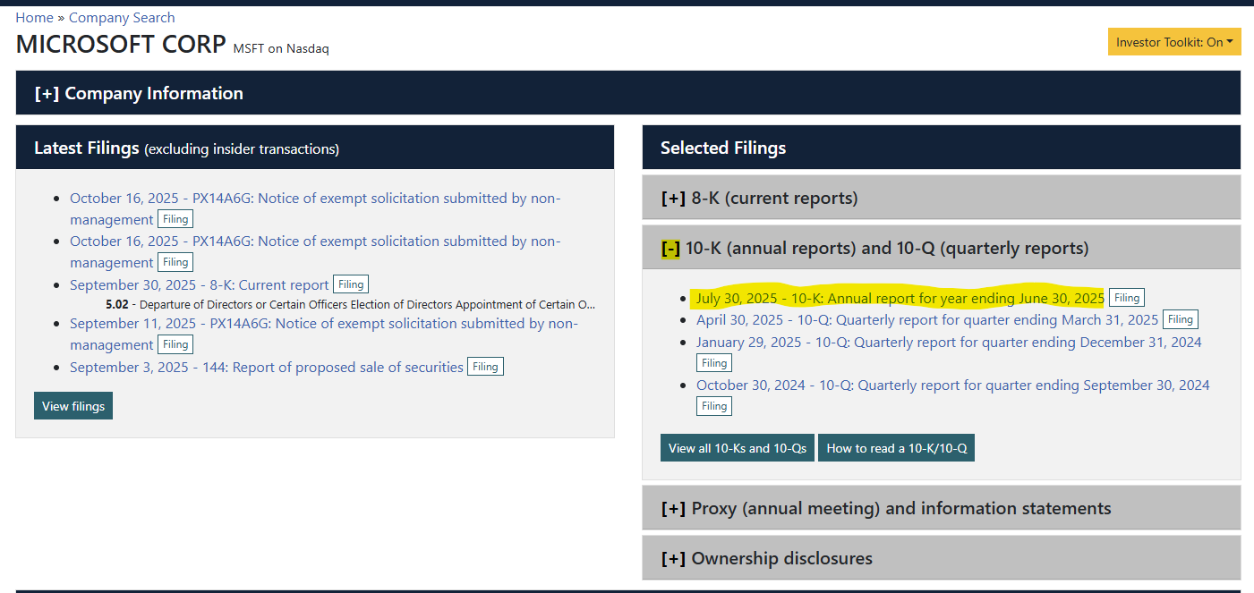

Slide 10
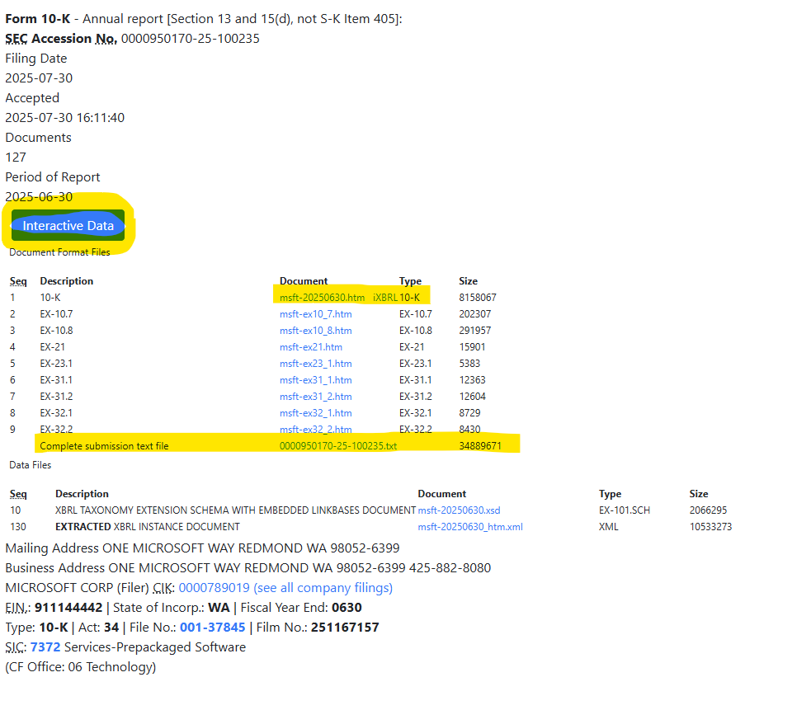

Slide 11
Welcome!
Class Agenda
Review
XBRL Filings
Mini-Lab:
EDGAR Explorer Case: Examine a company XBRL filing.
Labs (both XBRL based):
Accessing the SEC EDGAR Filings API
Accessing the SEC Company Facts
Conclusion and look ahead.

Slide 12
Accessing the SEC EDGAR Filings API
Goal: To obtain a specific filing (e.g., most recent 10-K) in complete submission format.
For human viewing online
For downloading and computer processing

Slide 13
Accessing the SEC EDGAR Filings API
Three main steps:
Request the list of filings for a specific CIK.
Save and parse the filings data
ID the file of interest and download it.
Requests are made using the submissions API, the file is downloaded directly from the SEC/Archives.

Slide 14
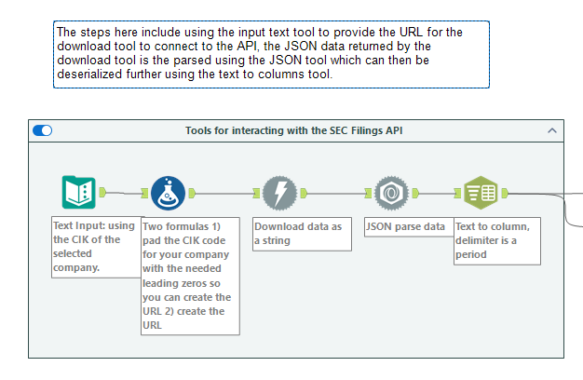
JSON data parsing tool
(JSON is the data format we receive from SEC APIs and many others)
Download tool

Slide 15
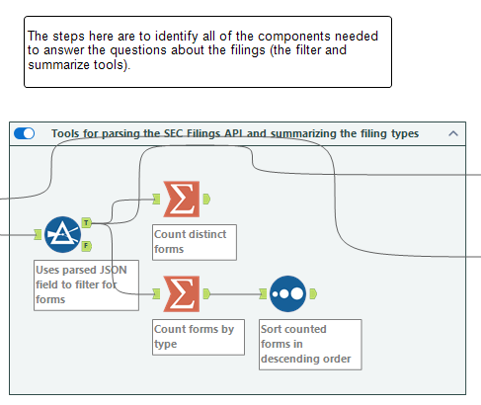
Check into the files for a sanity check
Should be 8-ks and form 4’s filed frequently, one 10-K per year and 3 Q’s, /A for amended filings.

Slide 16
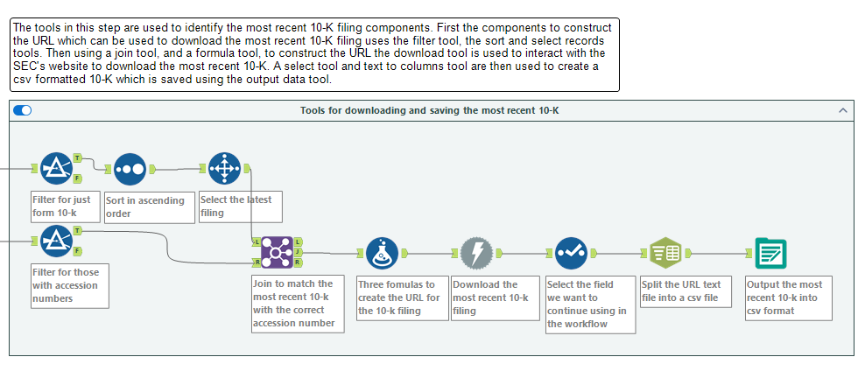
Downloads the full submission file as plain text.
Accession number is a unique SEC filing key (unique per filing)

Slide 17
Welcome!
Class Agenda
Review
XBRL Filings
Mini-Lab:
EDGAR Explorer Case: Examine a company XBRL filing.
Labs (both XBRL based):
Accessing the SEC EDGAR Filings API
Accessing the SEC Company Facts
Conclusion and look ahead.

Slide 18
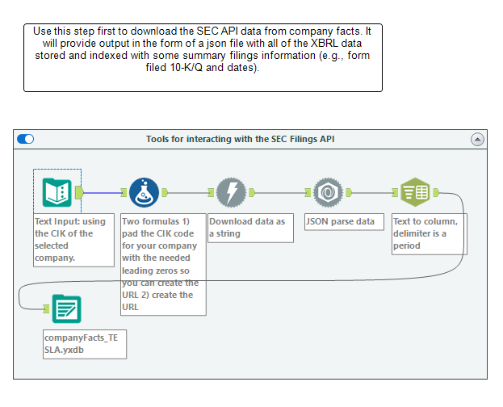
Company Facts Data API returns JSON variables with historical XBRL tags and value pairs (and other indexing information like year, currency etc).
Parse and save as a flat file.

Slide 19
Welcome!
Class Agenda
Review
XBRL Filings
Mini-Lab:
EDGAR Explorer Case: Examine a company XBRL filing.
Labs (both XBRL based):
Accessing the SEC EDGAR Filings API
Accessing the SEC Company Facts
Conclusion and look ahead.

Slide 20
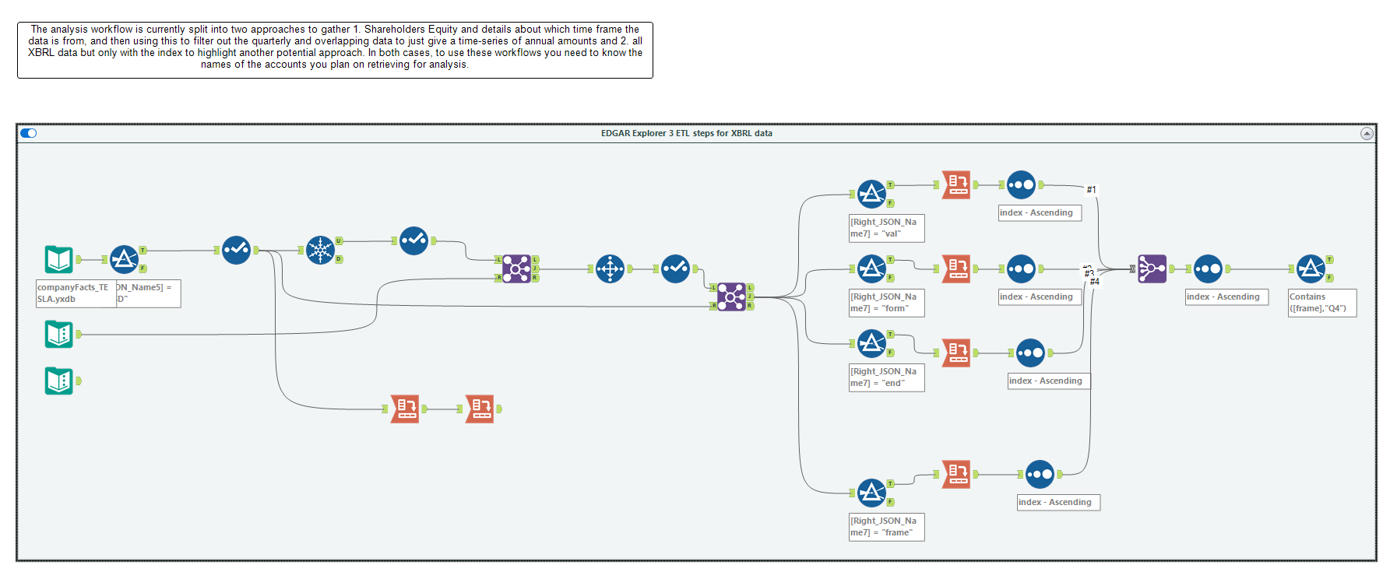
An example workflow for examining company facts, ID specific XBRL tags and output them (below).
For the full-text filing, an example further analysis is the sentiment analysis (e.g., in the Enron case), we’d typically run it on the MD&A.

Slide 21
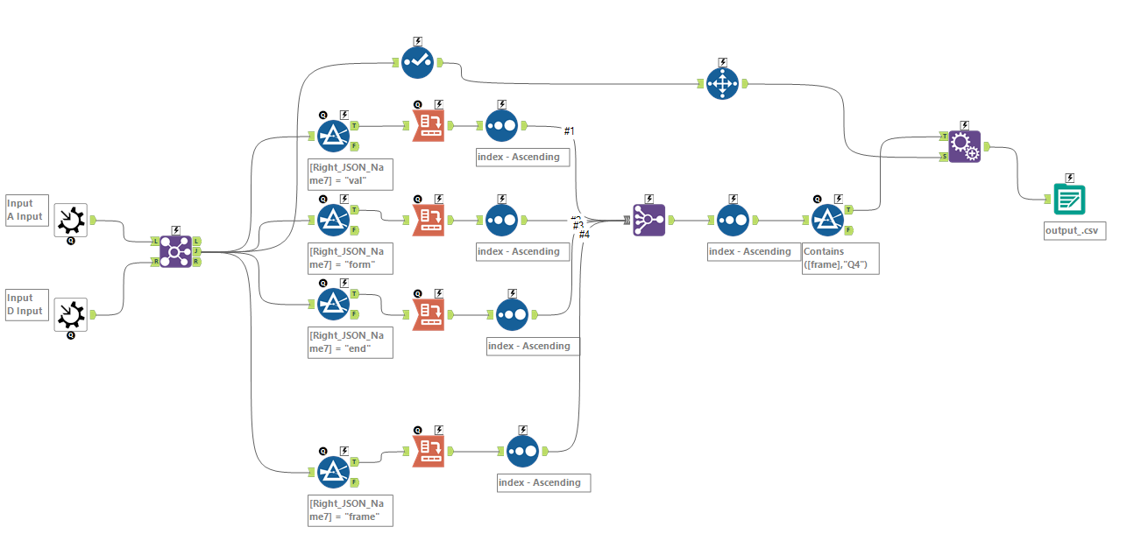
Macro workflow anchors

Slide 22
Team Deliverable Today
One submission per assessment team:
Proposed analyses of EDGAR data:
Outline the goal of the analyses.
Identify the API to connect to.
Identify the data challenges to be address (use the example output from today’s lab).
You can propose more than one analysis.
One email submission on behalf of your team abcurtis@uw.edu

Slide 23

Thank you!

