Slide 1
ETL and Textual Analytics
Data Analytics for Professional Accountants
(ACCTG 522)
Class 3 | MPAcc class of 2026

Slide 2
Welcome!
Class Agenda
Review and ETL Overview
ETL Cases in the FSB Remote Labs
Conclusion and look ahead

Slide 3
Review: ETL Overview

Slide 4
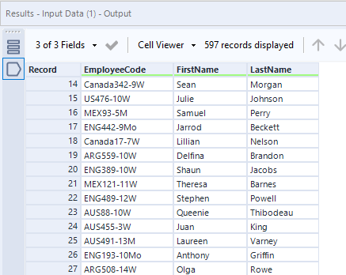
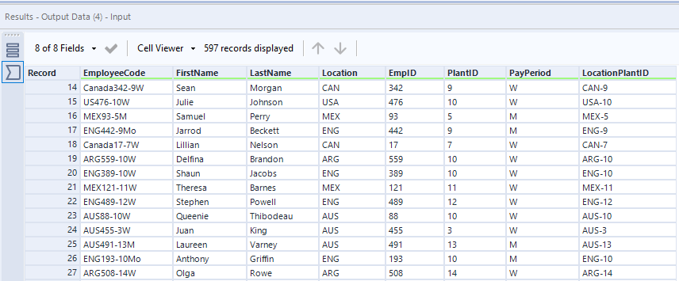
5 new output fields again

Slide 5
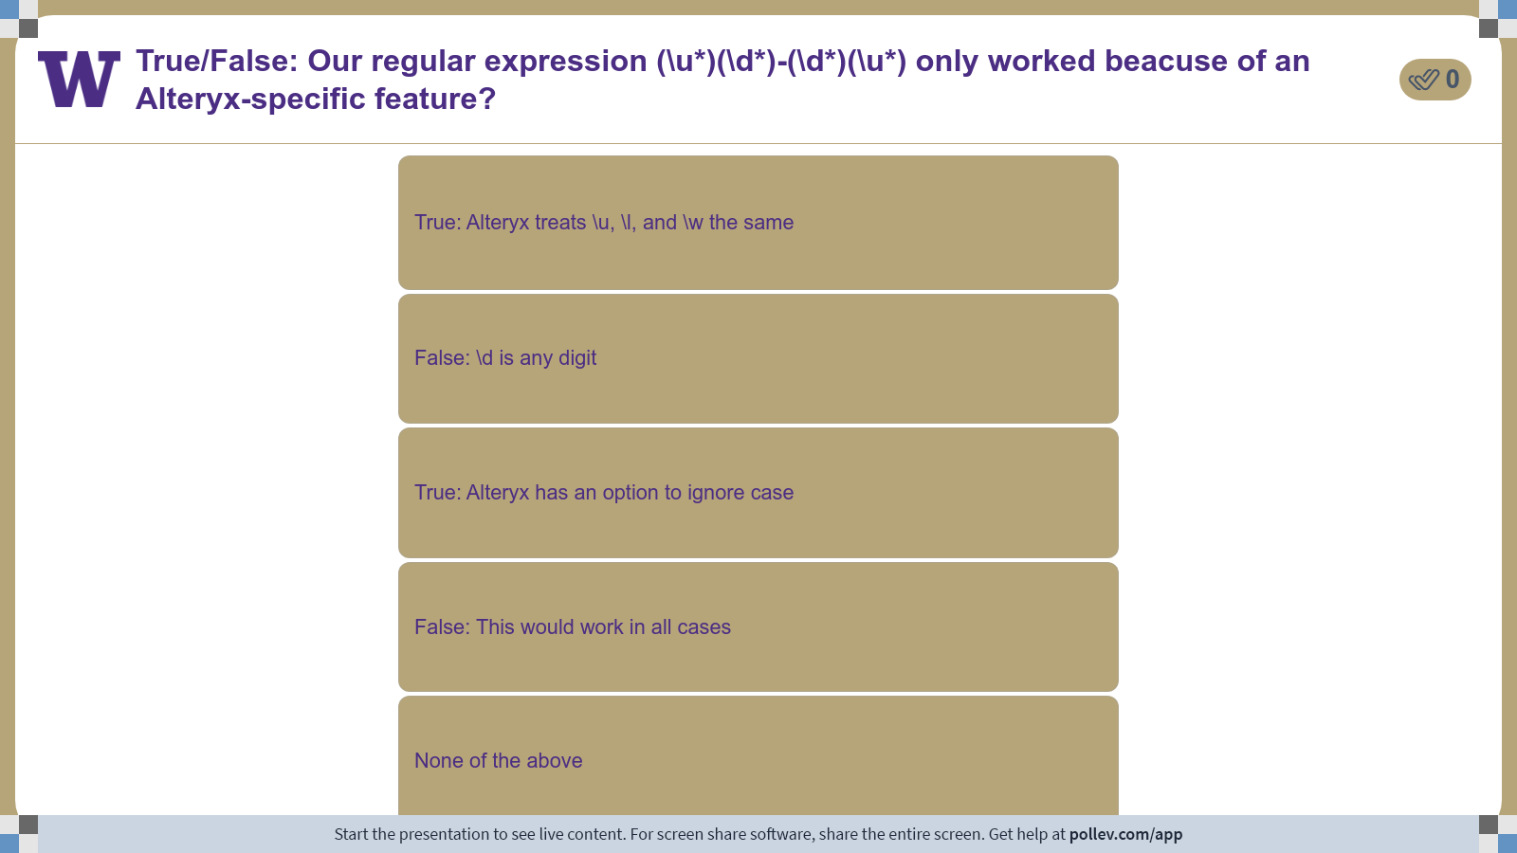
Notes:
Poll Title: Do not modify the notes in this section to avoid tampering with the Poll Everywhere activity. More info at polleverywhere.com/support True/False: Our regular expression (\\u*)(\\d*)-(\\d*)(\\u*) only worked beacuse of an Alteryx-specific feature? https://www.polleverywhere.com/multiple_choice_polls/ARsWKp1T199f50dbdnDMX?display_state=instructions&activity_state=opened&state=opened&flow=Engagement&onscreen=persist

Slide 6
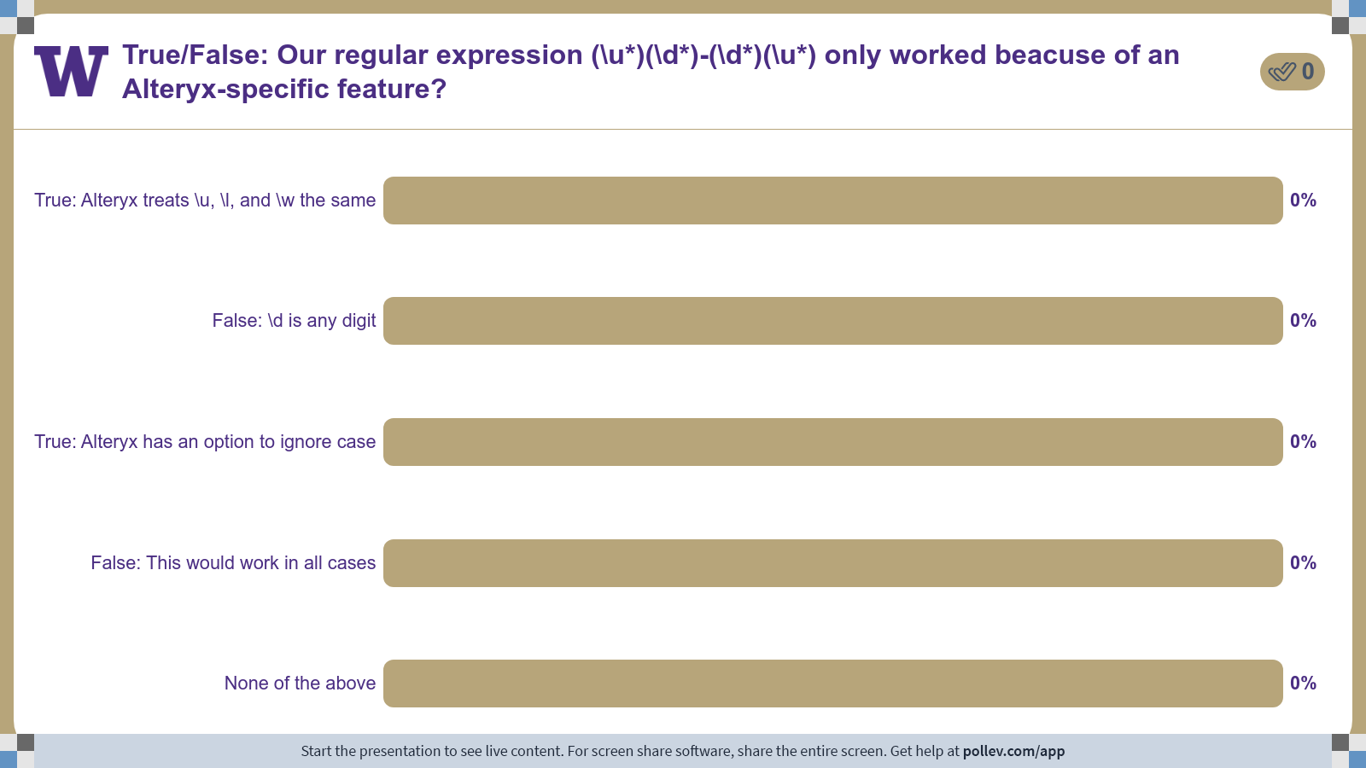
Notes:
Poll Title: Do not modify the notes in this section to avoid tampering with the Poll Everywhere activity. More info at polleverywhere.com/support True/False: Our regular expression (\\u*)(\\d*)-(\\d*)(\\u*) only worked beacuse of an Alteryx-specific feature? https://www.polleverywhere.com/multiple_choice_polls/ARsWKp1T199f50dbdnDMX?display_state=chart&activity_state=opened&state=opened&flow=Engagement&onscreen=persist

Slide 7

Notes:
Poll Title: Do not modify the notes in this section to avoid tampering with the Poll Everywhere activity. More info at polleverywhere.com/support True/False: Our regular expression (\\u*)(\\d*)-(\\d*)(\\u*) only worked beacuse of an Alteryx-specific feature? https://www.polleverywhere.com/multiple_choice_polls/ARsWKp1T199f50dbdnDMX?display_state=chart&activity_state=closed&state=closed&flow=Engagement&onscreen=persist

Slide 8
Extension
Using RegEx101 tool attempt to Transform these similar EmployeeCodes:
Canada1234-1Mo
Mexico0001234-121Monthly
Australia45789-13Annual
AUS123-13M
FRA334455-145weekly
GRE67 1a

Slide 9
Take aways
Regular expressions:
[A-Za-z] lists of acceptable terms (alphabetic)
[A-Za-z0-9] as above, alphanumeric
*,+ zero, one or more
^,$ beginning, end of the line
| or
\d any digit, \d{N} a specific “N” number of digits
. Any character, \. A full stop (escaping)

Slide 10
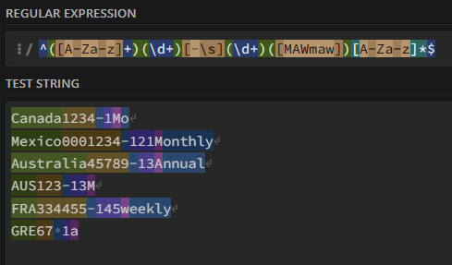
Extension Exercise
^[A-Za-z]+\d+(-|\s)\d+[MAWmaw]
^[A-Za-z]+\d+[-\s]\d+[MAWmaw]
After Class Solution:
^([A-Za-z]+)(\d+)[-\s](\d+)([MAWmaw])[A-Za-z]*$
Captured (line 1, 4 separate outputs):
Canada,1234,1,M
Discarded (line 1):
-,o

Slide 11
Extra RegEx examples
Dates:
Invoice Date: 03/15/2025
Payment Due: 04/14/2025
^\D*\s*(\S*)
\d*\/\d*\/\d*
Invoices:
INV-100234 ^(?!Reference :)INV-\d+$
INV-567890
Reference: INV-456
^([A-Z]+)-(\d*)
INV-(\d{6})

Slide 12
Extra RegEx examples
Firm Identifiers:
CIK: 0000320193
Ticker: TSLA
Ticker: AAPL
[CIK|Ticker]+: (\d+|[A-Z]+)
Matching dollar amounts and accounts:
Total: $12,450.00 ^Total:\s([$]\d+,*\d+.*\d*)$
Late Fee: $25
Refund: ($1,200)
.+: (.+)

Slide 13
Extra RegEx examples
Phone numbers, email, credit card numbers:
206-123-4567
^\d{3}-\d{3}-\d{4}$
real_person@example.com
Potential fraud detected: 4532-9876-1234-5678
(\d+-\d+-\d+)($|-(\d+))|([A-Za-z]+)([@_.]) ([A-Za-z]+)([@_.]) ([A-Za-z]+)([@_.])([A-Za-z]+)

Slide 14
ETL Cases in the FSB Remote Labs

Slide 15
ETL Cases, Continued
Today we will examine “Joining Data”:
Joining data is another fundamental step in the ETL process, as in most cases, developing insight will require data from different databases.
Joining data can sometimes be referred to as merging data, blending data, or combining data.

Slide 16
Why is joining data important?
Joining data is part of the transforming step in ETL.
Incorrect joins are a data quality issue, incorrect joins can:
crash (or really slow down) our programs!
have us lose important data.
Have us generate incorrect conclusions/insight from our analysis.

Slide 17
Joining using unique keys
In all cases we will use unique keys to join the data.
All the unique keys are described in the case
One of them was tricky, can you remember which one?

Slide 18
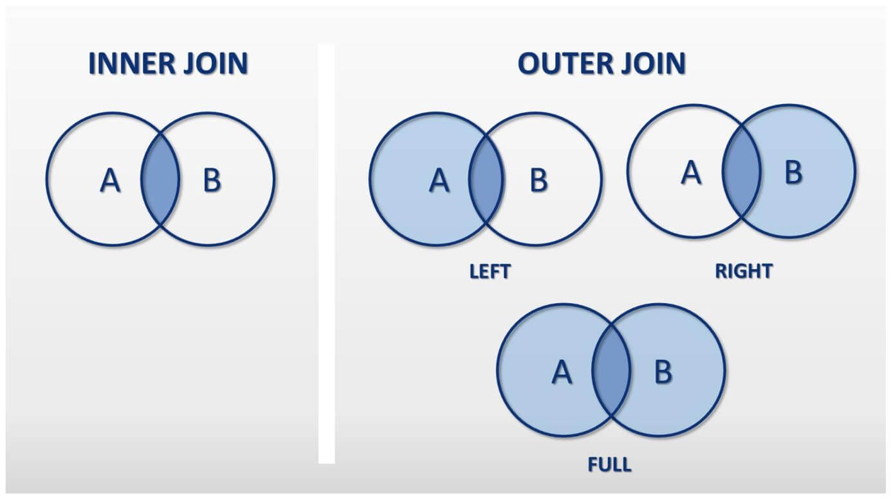

Slide 19
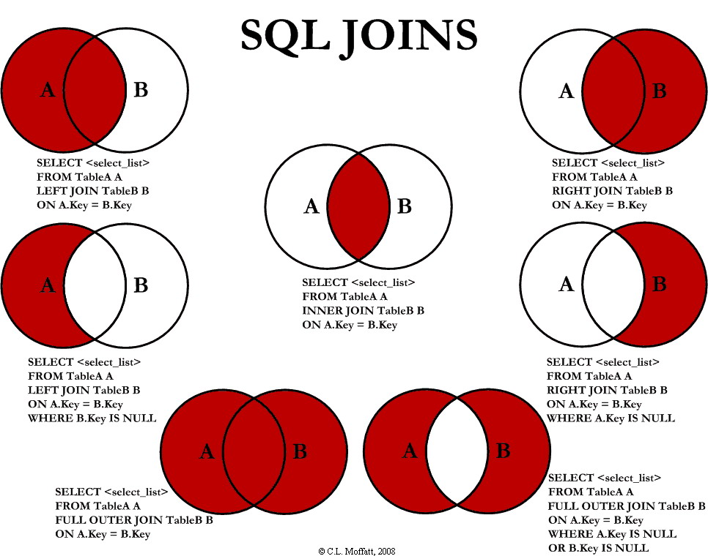

Slide 20
Joining using unique keys
In all joins we will use “one to many” matches.
Joining the large information source (“JELineItems”) to the smaller set of information in the other data sheets.

Slide 21
Why join across multiple software?
Because joining data is so fundamental, we want to work towards becoming software agnostic.
Working with cutting-edge software allows you to:
Become adaptable and resilient to new software.
Impress recruiters with practical discussions of cutting-edge software.

Slide 22
Joining across different tools:
Some terminolgy:
Alteryx: drag and drop “Join” and “Union” tools
PowerBI: data relationships tab
Python: code-level with package “pandas”
SQL: base code-level
Tableau: Both relationships and joins.

Slide 23
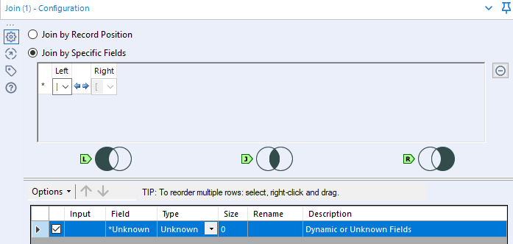

Alteryx Joins:

Slide 24
import pandas as pd
# Example: read from Excel file (each sheet as DataFrame)
file_path = "your_file.xlsx"
# Load the two sheets
JELineitems = pd.read_excel(file_path, sheet_name="JELineitems")
BusinessUnits = pd.read_excel(file_path, sheet_name="BusinessUnits")
# Perform SQL-style join on BusinessUnitID
# Equivalent to: SELECT * FROM JELineitems
# INNER JOIN BusinessUnits
# ON JELineitems.BusinessUnitID = BusinessUnits.BusinessUnitID;
merged_df = JELineitems.merge(
BusinessUnits,
on="BusinessUnitID",
how="inner" # can also use 'left', 'right', or 'outer'
)
SQL/Python:
SELECT
JEL.*,
BU.*
FROM JELineitems AS JEL
LEFT JOIN BusinessUnits AS BU
ON JEL.BusinessUnitID = BU.BusinessUnitID;
SELECT
JEL.*,
BU.*
FROM JELineitems AS JEL
RIGHT JOIN BusinessUnits AS BU
ON JEL.BusinessUnitID = BU.BusinessUnitID;

Slide 25
Lab Agenda
Open files in excel / open case and identify the keys
Compare Tableau and Power BI

Slide 26
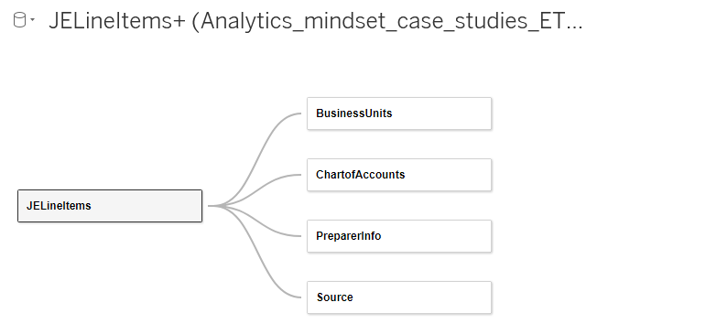
Tableau Relationships

Slide 27
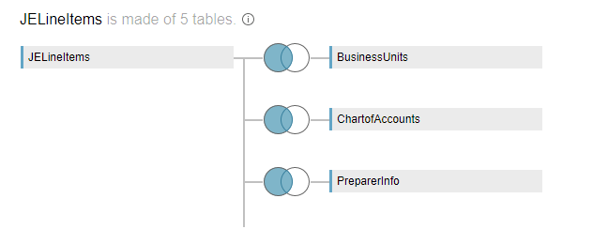
Tableau Joins

Slide 28
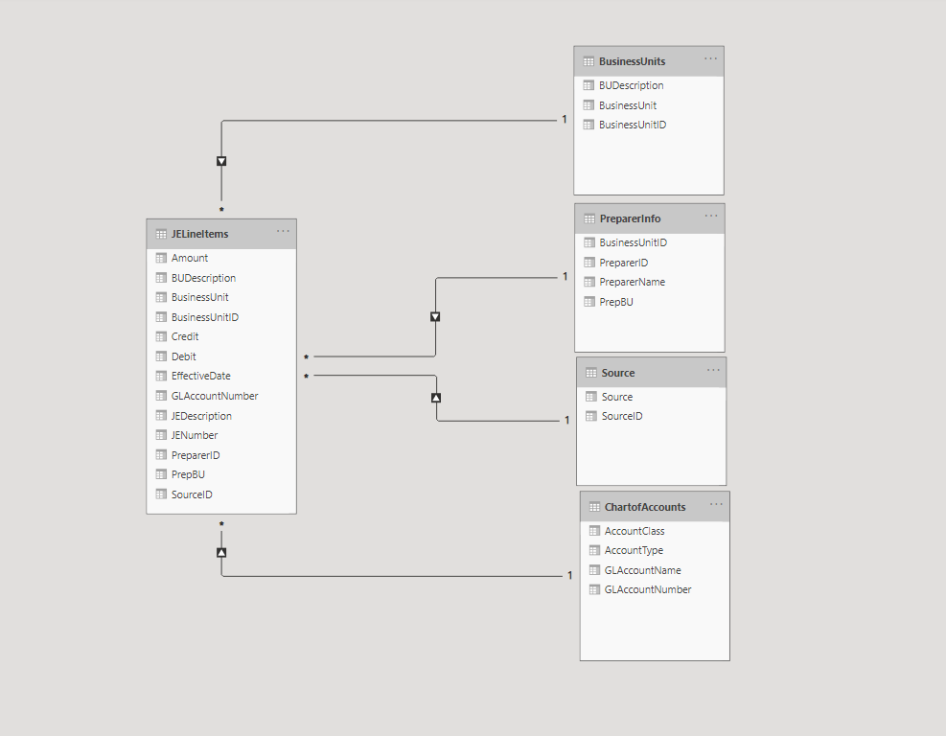
Power BI Data Relationships

Slide 29
To FSB remote labs
Again I recommend saving screenshots of your work in Alteryx (I’ve added blank slides if you want to save them in this ppt document, ctrl+m adds more slides)

Slide 30
Two Potential Issues Explained:
Issue 1 In the underlying dataset PreparerID is not unique:
For example ID 101 appears 6 times, repeating once for each BusinessUnit
PreparerName | PreparerID | BusinessUnitID
Carolyn Slater|Food Operations Manager | 101 | 1
Alexander Knox|Assistant Manager | 101 | 2
Trevor Roberts|Housekeeping Supervisor | 101 | 4
Gavin McGrath|Dining Commons Manager | 101 | 3
Rodney Wilkins|Maintenance Supervisor | 101 | 6

Slide 31
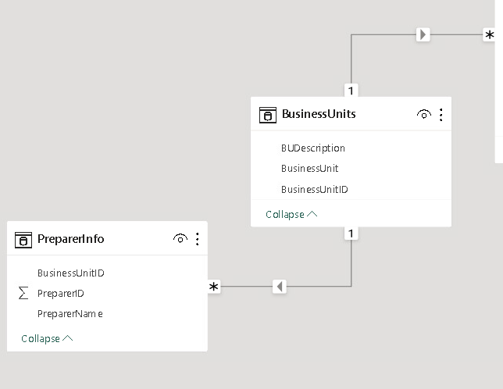
Two Potential Issues Explained:
PowerBI: maps the multiple prepareIDs to a unique BusinessUnitID, allowing it to join both datasets to JELineItems via BusinessUnitID.

Slide 32
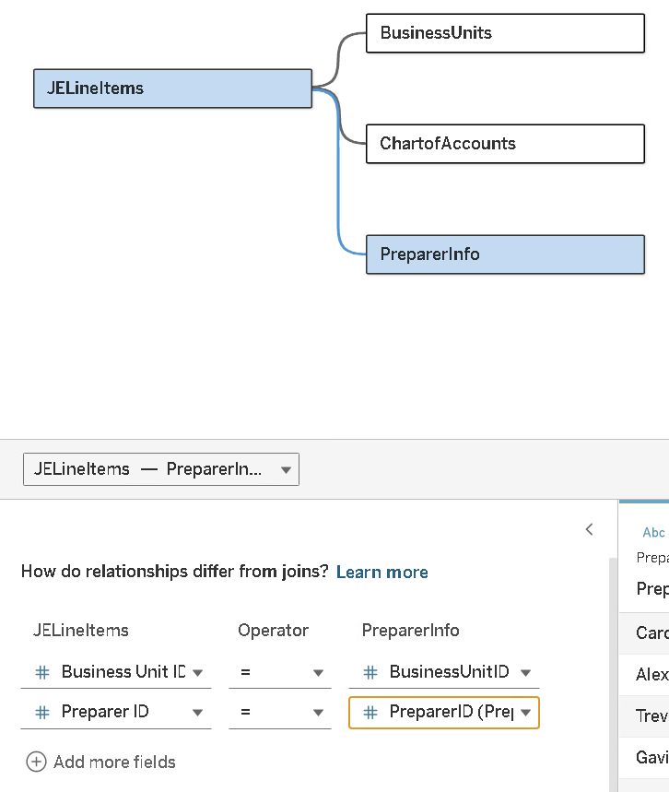
Two Potential Issues Explained:
Tableau: we can resolve the alert by filling out the keys which are
BusinessUnitID= BusinessUnitID
AND
PreparerID = PreparerID.
Which means it has to match both keys.

Slide 33
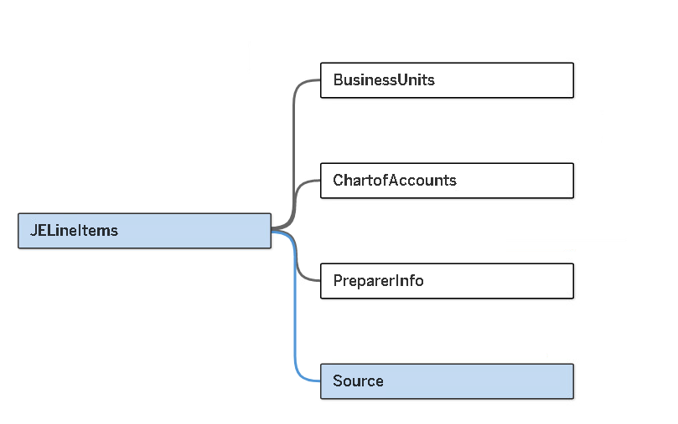
Tableau Completed
Add the Source dataset and the data relationship is complete.

Slide 34
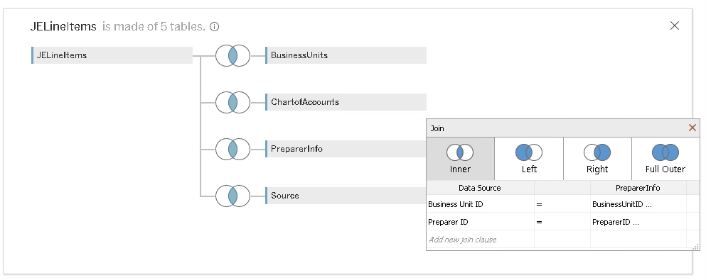
Tableau Join Version
Defaults to inner joins, we are expecting 789 line items (rows), but get 639 rows of data (missing 150 rows / JE’s).
Edit the Preparer Info Join to join on both
preparerID and BusinessUnit

Slide 35
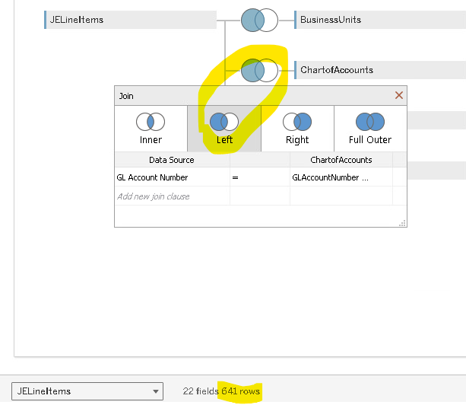
Tableau Join Version
Change to left join,
confirm that 641 rows exists
**This occurs when we left join to the ChartofAccounts tab, implying that 2 JELineItems have a GLAccountNumber not in the summary ChartOfAccounts dataset.

Slide 36
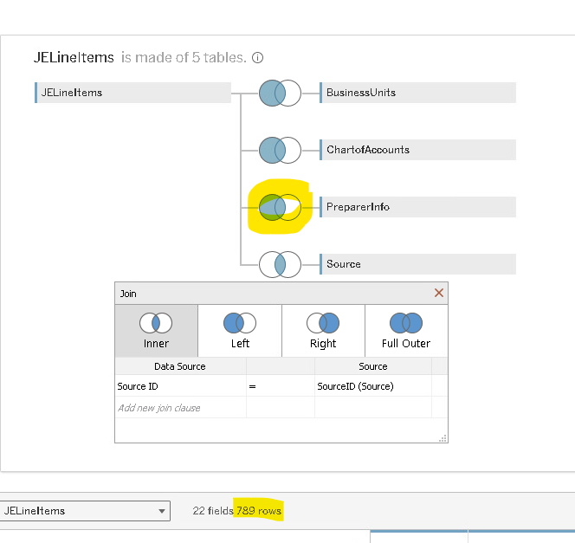
Tableau Join Version
Change to left join,
confirm that 789 rows exists
Edit the Preparer Info Join to join on both
preparerID and BusinessUnit
**This occurs when we left join to the PreprerInfo tab, implying that 148 JELineItems have a preparerID not in the summary PreparerInfo dataset.

Slide 37
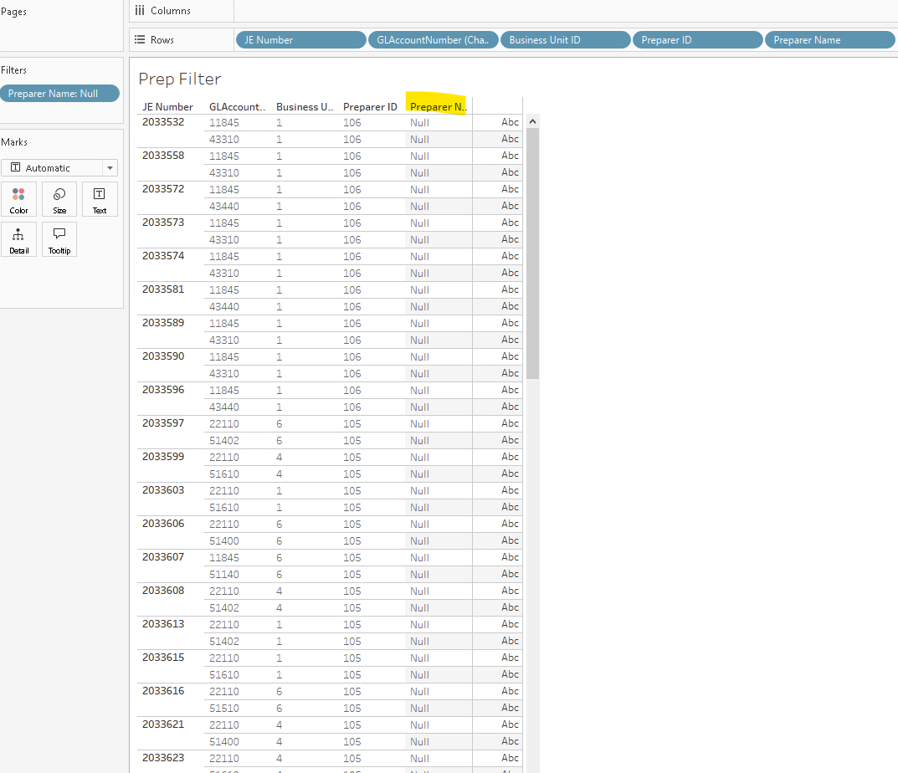
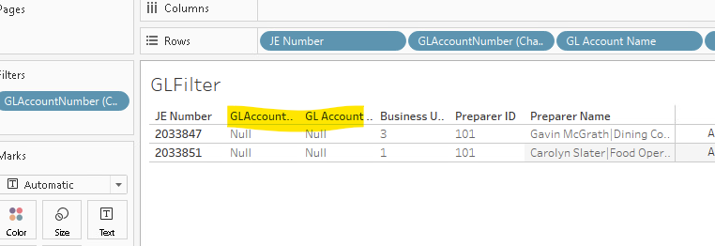
Filtering the data we find 148 rows with businessUnit-PreparerID pairs that are not in the PreparerInfo dataset (and so we do not know the preparer name, which is “Null”).
And 2 with missing GLNumbers/Names

Slide 38
Two Potential Issues Explained:
Issue 2 GLAccounts not mapped in PowerBI:
PowerBI read GLAccountNumbers as numbers instead of string format (warned us with 2 read errors)

Slide 39
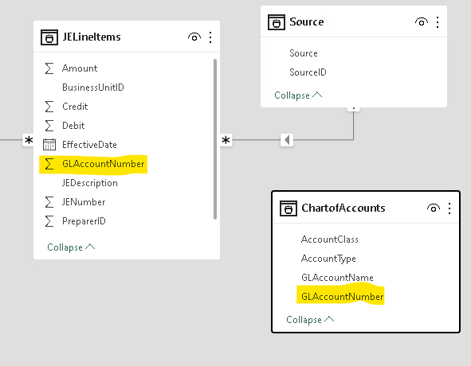
PowerBI Workflow
Notice that GLACccountNumber is summed (numeric) in JELineItems but not in Chart of accounts (means it is string).
*Joins can’t be between numbers and string because:
“1”≠1

Slide 40
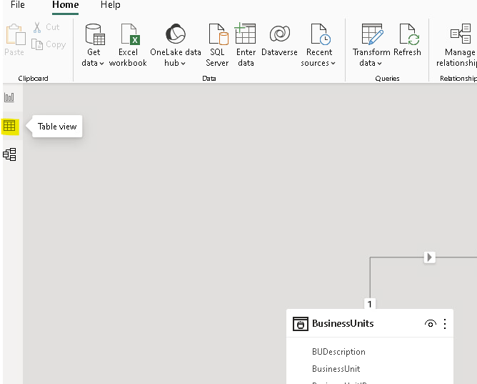
PowerBI Workflow
Go to Table view on left index

Slide 41
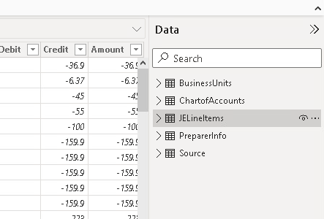
On the right hand menu select
the JELineitems dataset

Slide 42
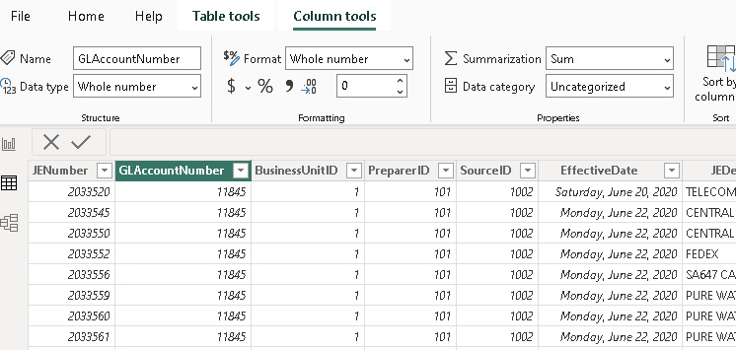
Select the GLAccountNumber Field / Column
Note Dat type is
whole number

Slide 43
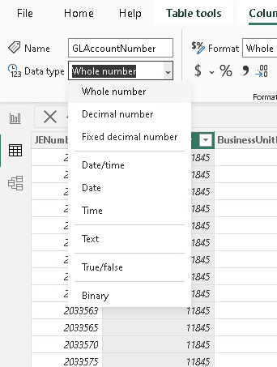
Change to “Text”

Slide 44
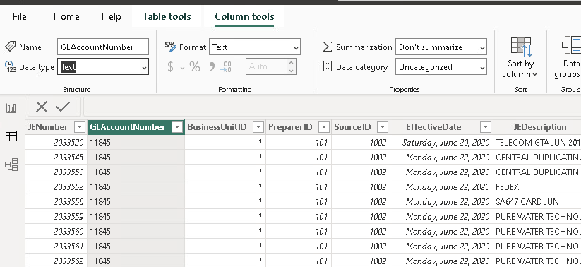
Note format is just how the data is displayed, and it updates automatically to text (Data Type is how it is recognized by PowerBI).
Confirm the change and how it affects format
Numbers, italicized, right aligned
Text, left aligned

Slide 45
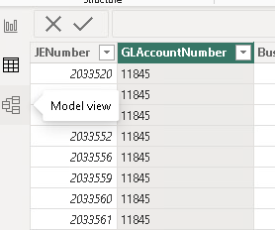
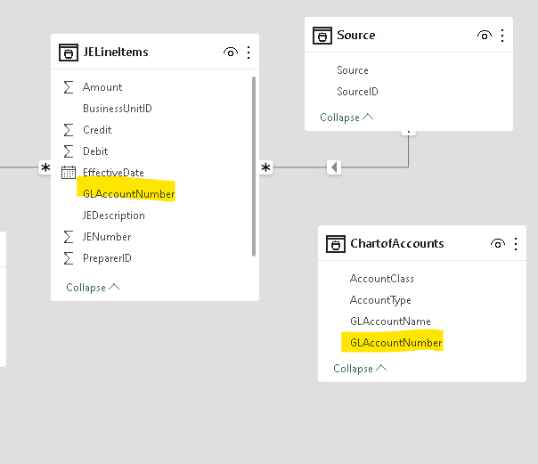
1 return to model view
Confirm GLAccountNumber is text in both (neither include the summation sign)

Slide 46
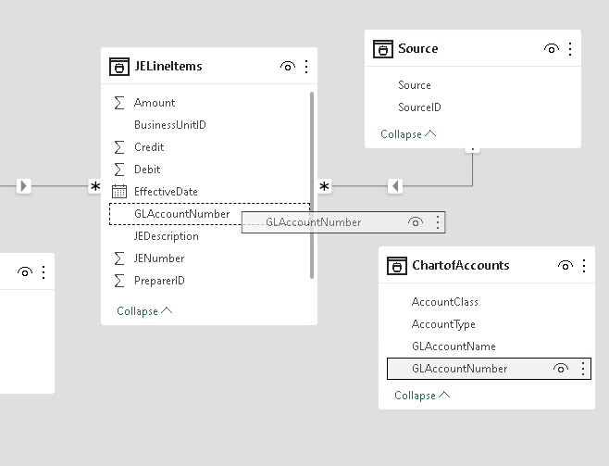
Drag GLAccountNumber from ChartOfAccounts to JELineItems and match it with GLAccountNumber

Slide 47
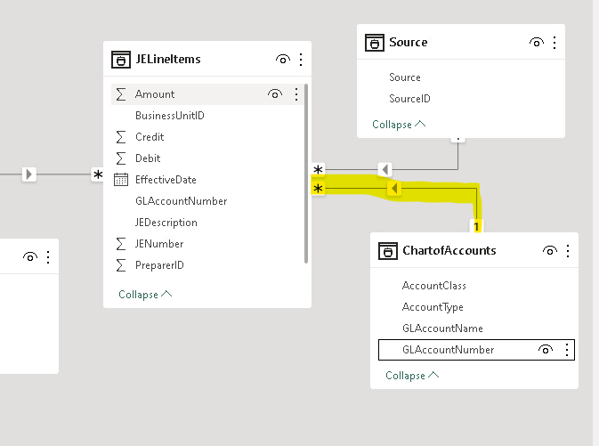
New Relationship Arrow appears in the data model

Slide 48
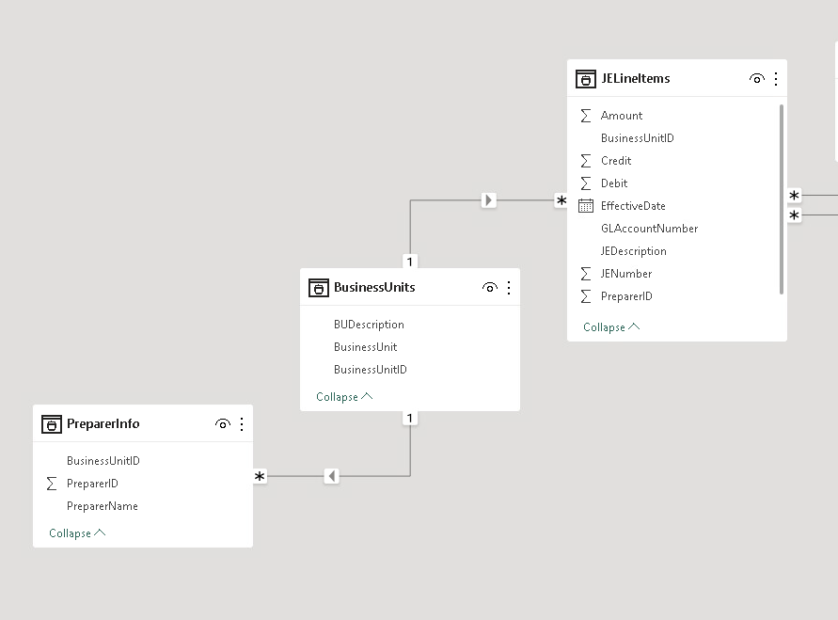
Like before we want:
BusinessUnitID AND PreparerID
1. Delete the current connection
Let’s make it possible to connect PrepareInfo directly (in case we just want preparer names)

Slide 49
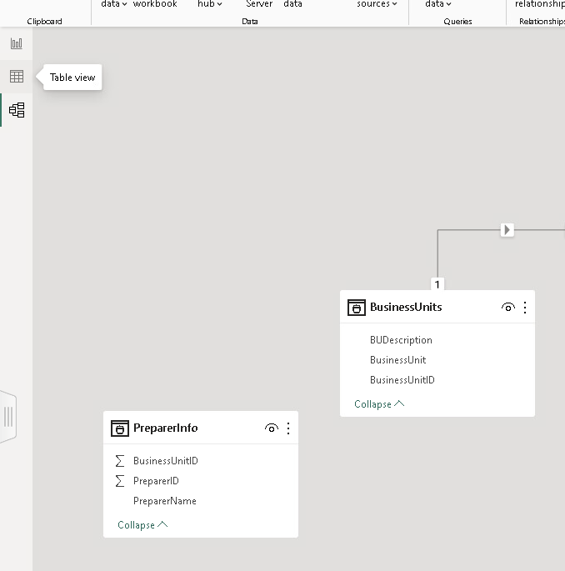
2. Return to Table View

Slide 50
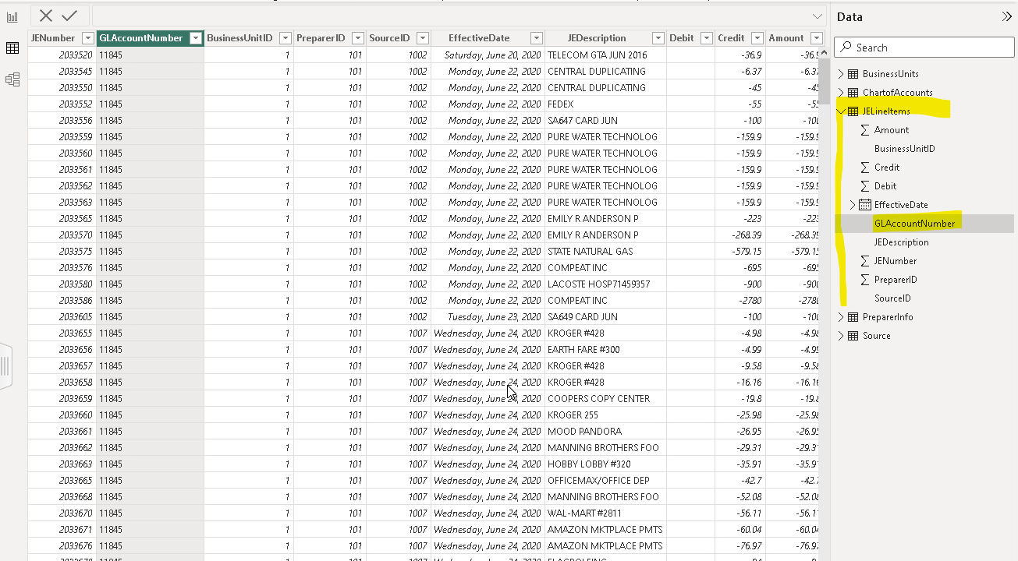
3. Confirm you are in the JELineItems dataset: Arrow pointed down, contents of dataset visible
Which is the most likely default given we just edited GLAccountnumber which is likely selected.

Slide 51
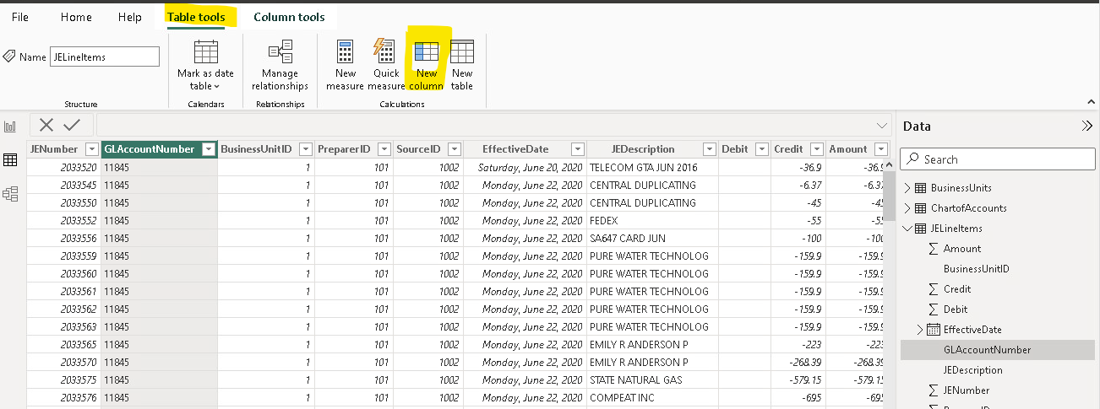
4. Confirm or navigate to Table Tools
5. Create a new column

Slide 52
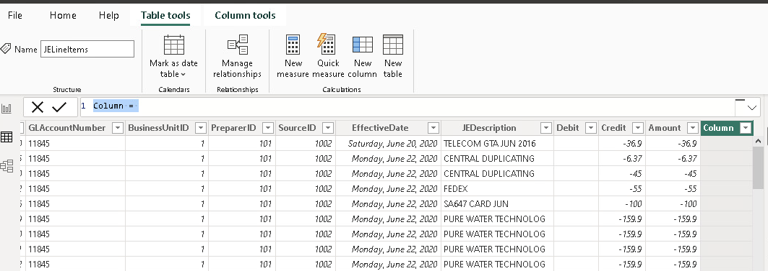
6. Confirm new column and …
… 7. Edit the column formula here
Our formula goal is to concatenate BusinessUnitID and PreparerID to create a unique key i.e., 1-101, 2-101 etc.

Slide 53
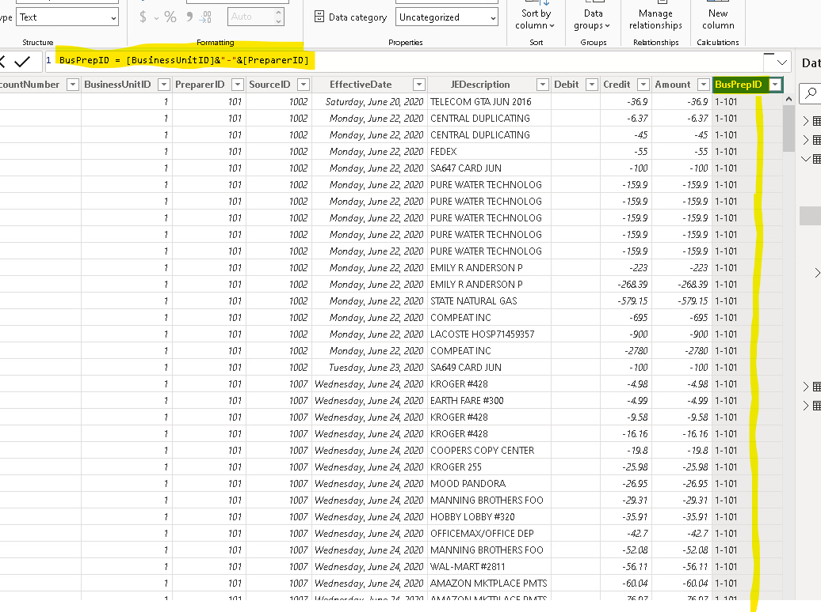
Our formula goal is to concatenate BusinessUnitID and PreparerID to create a unique key i.e., 1-101, 2-101 etc.
8. Replace Column = with:
BusPrepID = [BusinessUnitID]&”-”&[PreparerID]
Then press Enter

Slide 54
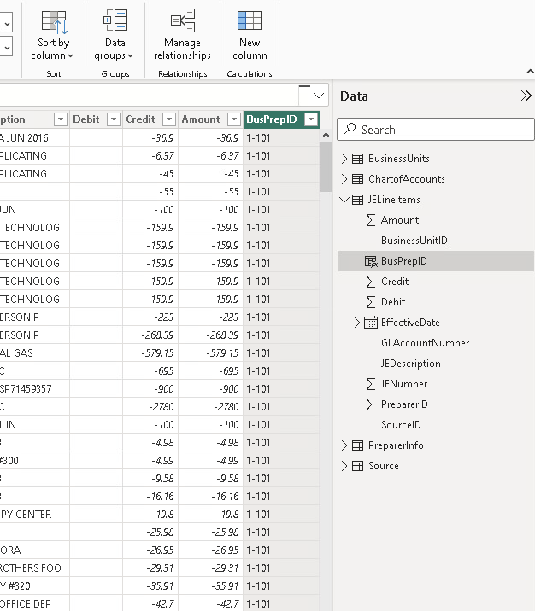
10. Still in Tables, select the PreparerInfo Dataset and create the same new column “BusPrepID”

Slide 55
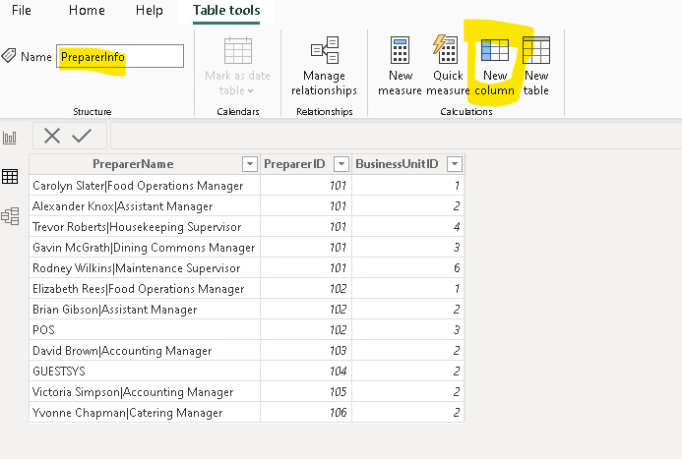

Slide 56
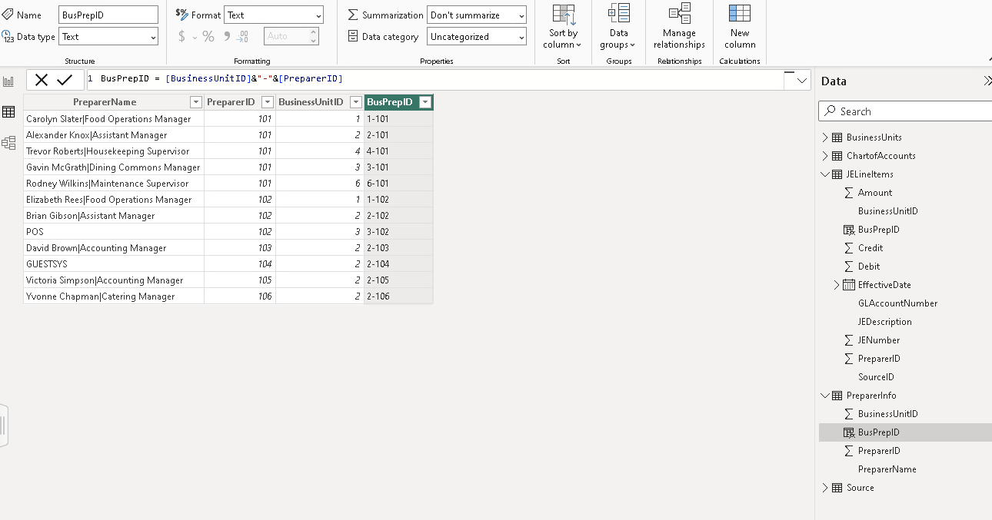
Update formula
Note that this column, BusPrepID, is now:
In JELineItems, and
PreparerInfo

Slide 57
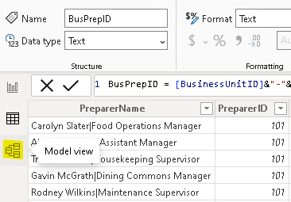
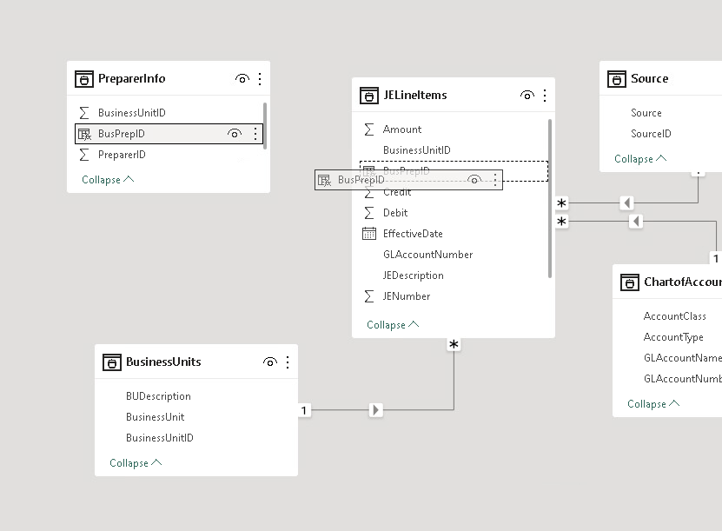
Return to model view
Connect PreparerInfo and JELineItems by dragging the new unique key “BusPrepID”

Slide 58
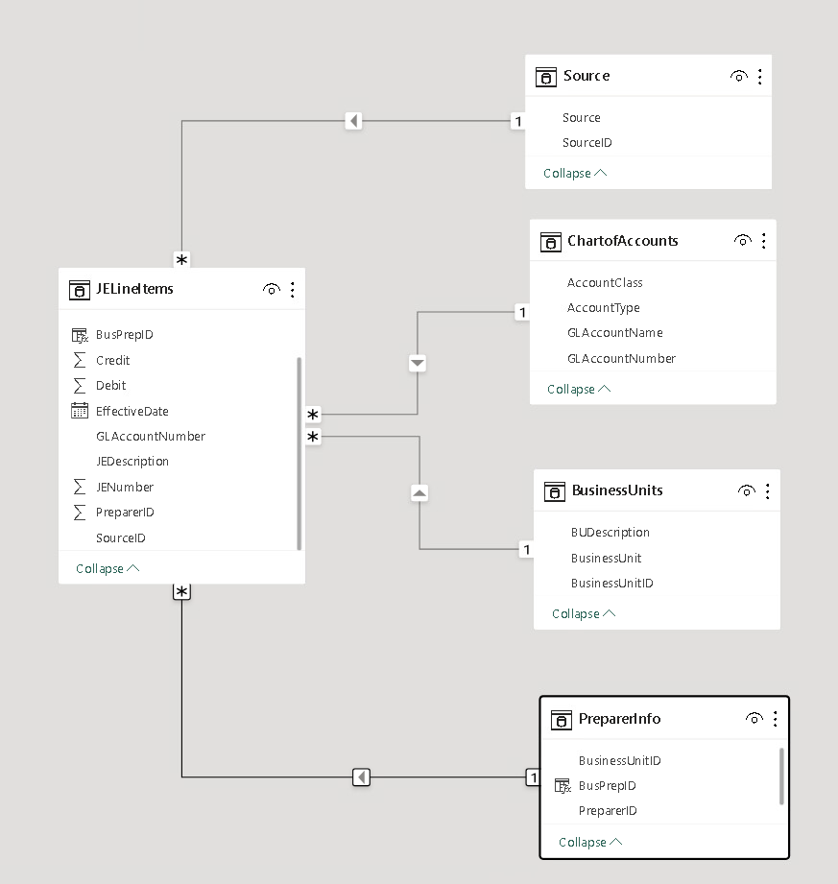
PowerBI Completed
Confirm the new BusPrepID connection and the data relationship model is complete.
Note it should be
one (1)
to many (*)

Slide 59
Conclusion and look-ahead
ETL is the first step in the analytical process – we cannot undertake data analytics without data!
ETL is especially important when the data needs to be cleaned or transformed for use in analytics.

Slide 60
Conclusion and look-ahead
Monday & Wednesday:
Case: Enron Emails Case – RegEx Heavy

Slide 61

Thank you and Congratulations!

