Slide 1
Cases in Automation: Loops
Adv. Advisory | ACCTG 528 | Class 07
MPAcc Class of 2026

Slide 2

What will we do today?
Review
Design Concepts
RPA Mini-Case 1
Web to spreadsheet
RPA Mini-Case 2
Merge two spreadsheets

Slide 3
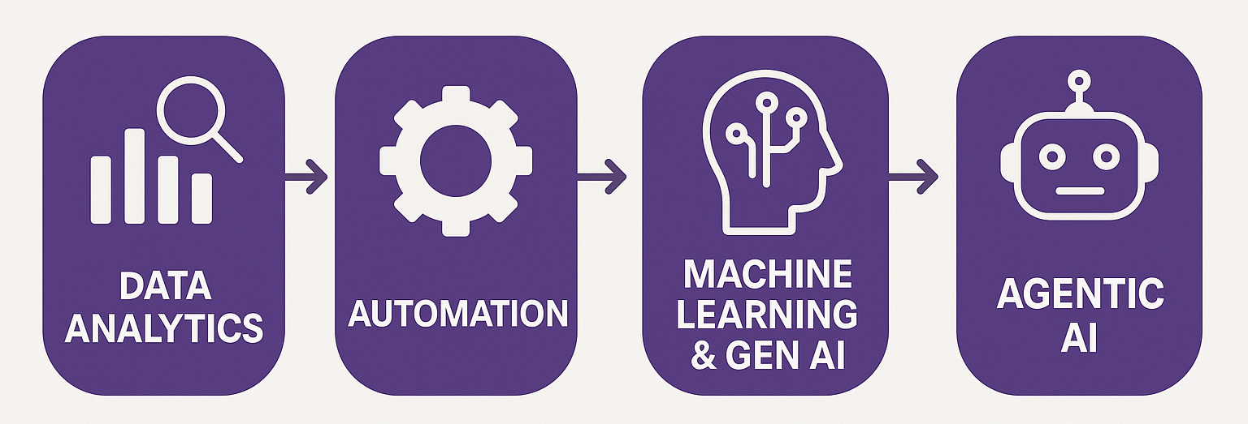
Course Diagram (high-level)

Slide 4











UiPath Agentic Automation
Notes:
Everything happens in one place: the UiPath Platform—where AI Agents aren’t just assistants, they’re true work partners, transforming complexity into a seamless, orchestrated operation.
We break it down into three powerful layers: Activities (the building blocks—reading, processing, integrating), Workflows (connecting the dots with human-in-the-loop and testing), and Processes (the big picture—managing, optimizing, and enhancing enterprise operations).
Agentic Orchestration / Maestro takes automation even further—coordinating UiPath Agents, third-party AI models, people, robots, and tools into a single, intelligent system.
Your existing systems don’t need to be reinvented—our platform integrates seamlessly with your data, applications, and workflows while maintaining enterprise-grade security, governance, and AI trust.
We’re not just compatible with your tech stack—we enhance it. From cloud providers like AWS, Google, and Azure to enterprise apps like Salesforce and SAP, we turn digital chaos into a symphony of efficiency.

Slide 5
Looking ahead
Where do your individual and team projects go next?
Individual:
Appropriate identification rules-based automation
Selection of appropriate automation spectrum model
Team:
Appropriate mix of RPA, Agent, and human in the loop
Selection of best cases for agent decision enhancement

Slide 6
What will we do today?
Review
Design Concepts
RPA Mini-Case 1
Web to spreadsheet
RPA Mini-Case 2
Merge two spreadsheets

Slide 7
RPA Mini-Case 1
Input data: Wikipedia Table of World population by Country
Output data: A spreadsheet with numerical populations for the top 20 countries by population, a sum of the top 20 countries population, and a percentage of the world’s population.

Slide 8
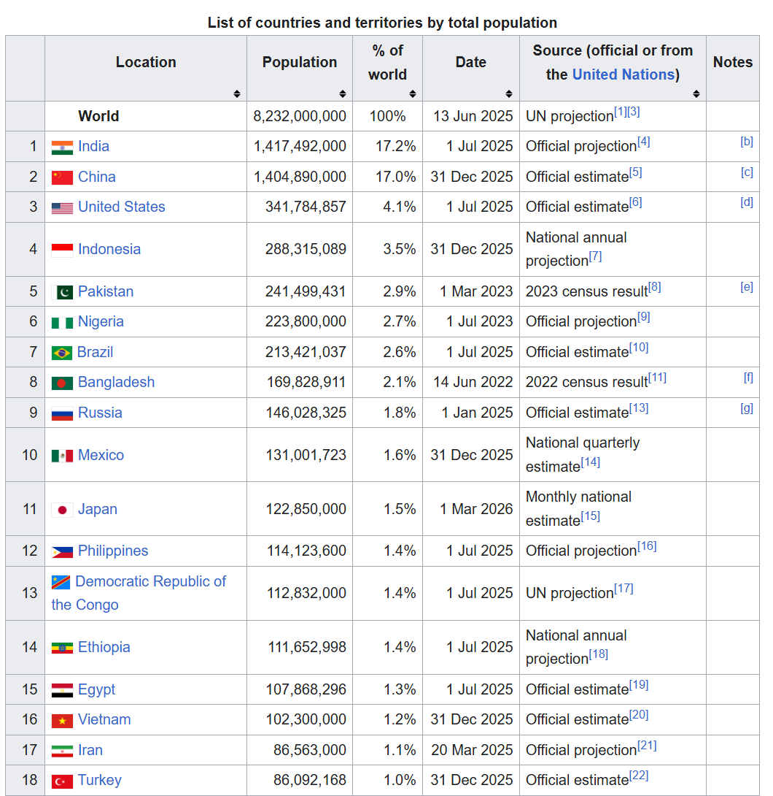
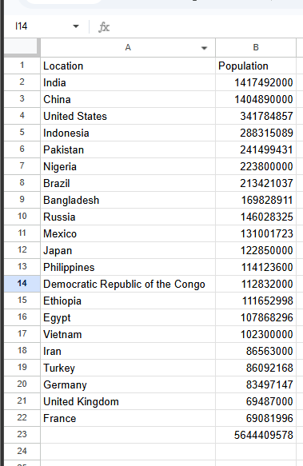


Slide 9
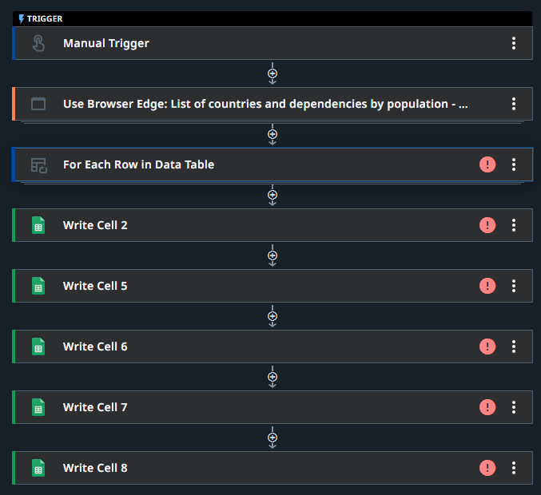
Starter file:
Import to studio web
Process flow is set-up
Red warning signs indicate an unconfigured step

Slide 10
What will we do today?
Review
Design Concepts
RPA Mini-Case 1
Web to spreadsheet
RPA Mini-Case 2
Merge two spreadsheets

Slide 11
RPA Mini-Case 2
Input data: Budget and actual data by department.
Output data: A spreadsheet comparing budgets and actuals by department with variances (budget – actual).

Slide 12
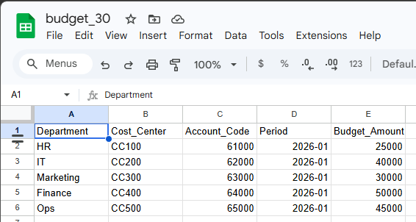
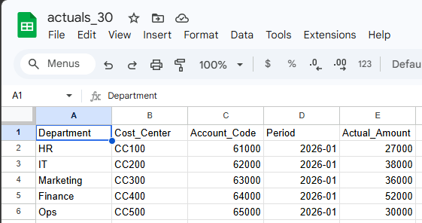
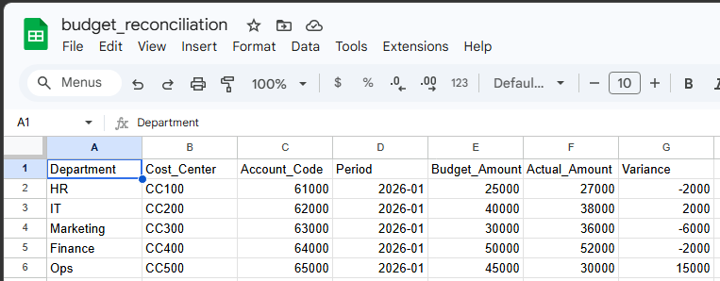
Calculate
Budget - Actual

Slide 13
Starter file
A zip file with both files budget_30 and actuals_30 and the starter file example_join_starter.uis.
Unzip all files
Save budget_30 & actual_30 to google sheets/drive
Import the starter uis file to UiPath Studio Web

Slide 14
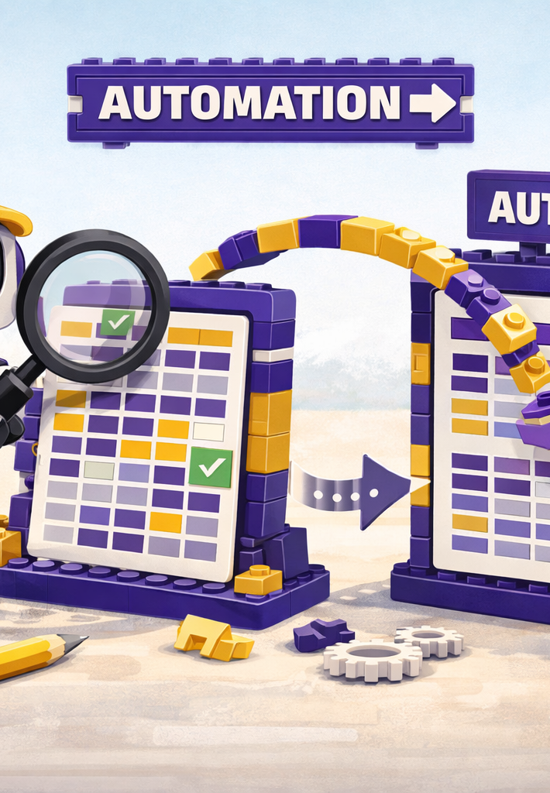
Where we will go next
RPA
Manipulation of files, components
Triggers, Controls, Governance
Costs and benefits of RPA
Agentic
BPMN revision and extension
Tasks for RPA versus Agent
Advanced Prompt Engineering
Scalability

Slide 15
Thank you

