Slide 1
AI Assisted Audit Analysis 1
Advanced Cases in Assurance Services (ACCTG 521)
Class 11 | MPAcc class of 2026

Slide 2
Agenda
Review
Overview: Mindbridge AI
Labs (in discussion teams)
Outline of individual deliverables (Due Nov 6th)
Mindbridge University Cases A, B, and C.
Optional Final Project.

Slide 3
Why is transaction analysis important?
Better financial reporting governance leads to better quality financial reporting.
External auditors provide opinions a company’s financial statements are presented fairly, in all material respects, in accordance with financial reporting framework (such as GAAP).
Transaction analytics for fraud prevention and detection is seen as a major step towards efficiently reducing fraud.

Slide 4
Effective Financial Reporting Governance
Board
Management
Independent Auditor
Audit Committee
Chief Financial Officer
Chief Accounting Officer
National Office
Engagement Teams
Internal Audit
Technology and Systems
Rule- and Standard-Setters:
SEC, Exchanges, PCAOB, FASB, IASB, COSO, IIA
Sound Financial Reporting

Slide 5
Agenda
Review
Overview: Mindbridge AI
Labs (in discussion teams)
Outline of individual deliverables (Due Nov 6th)
Mindbridge University Cases A, B, and C.
Optional Final Project.

Slide 6
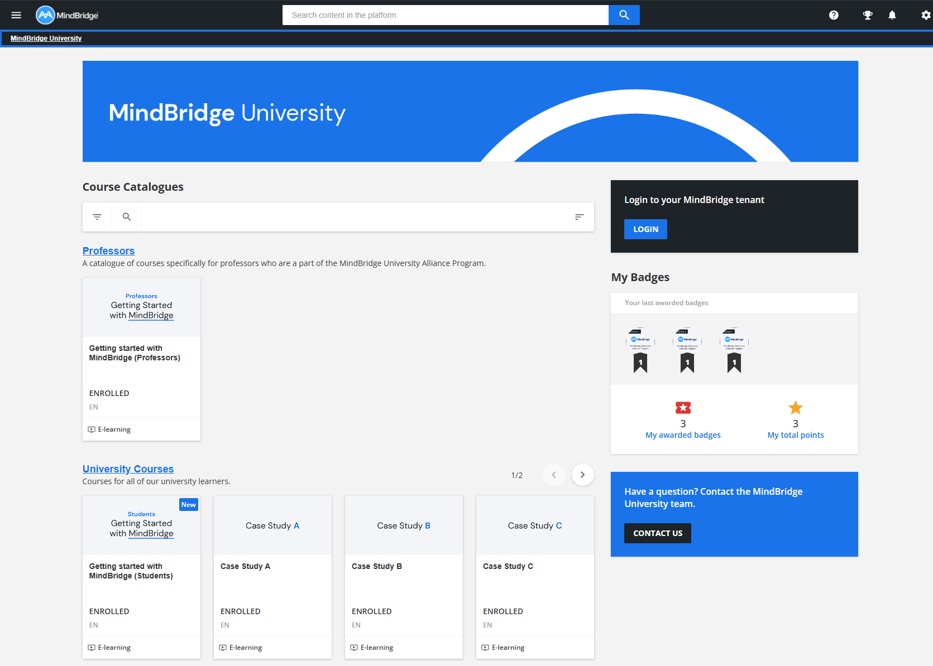
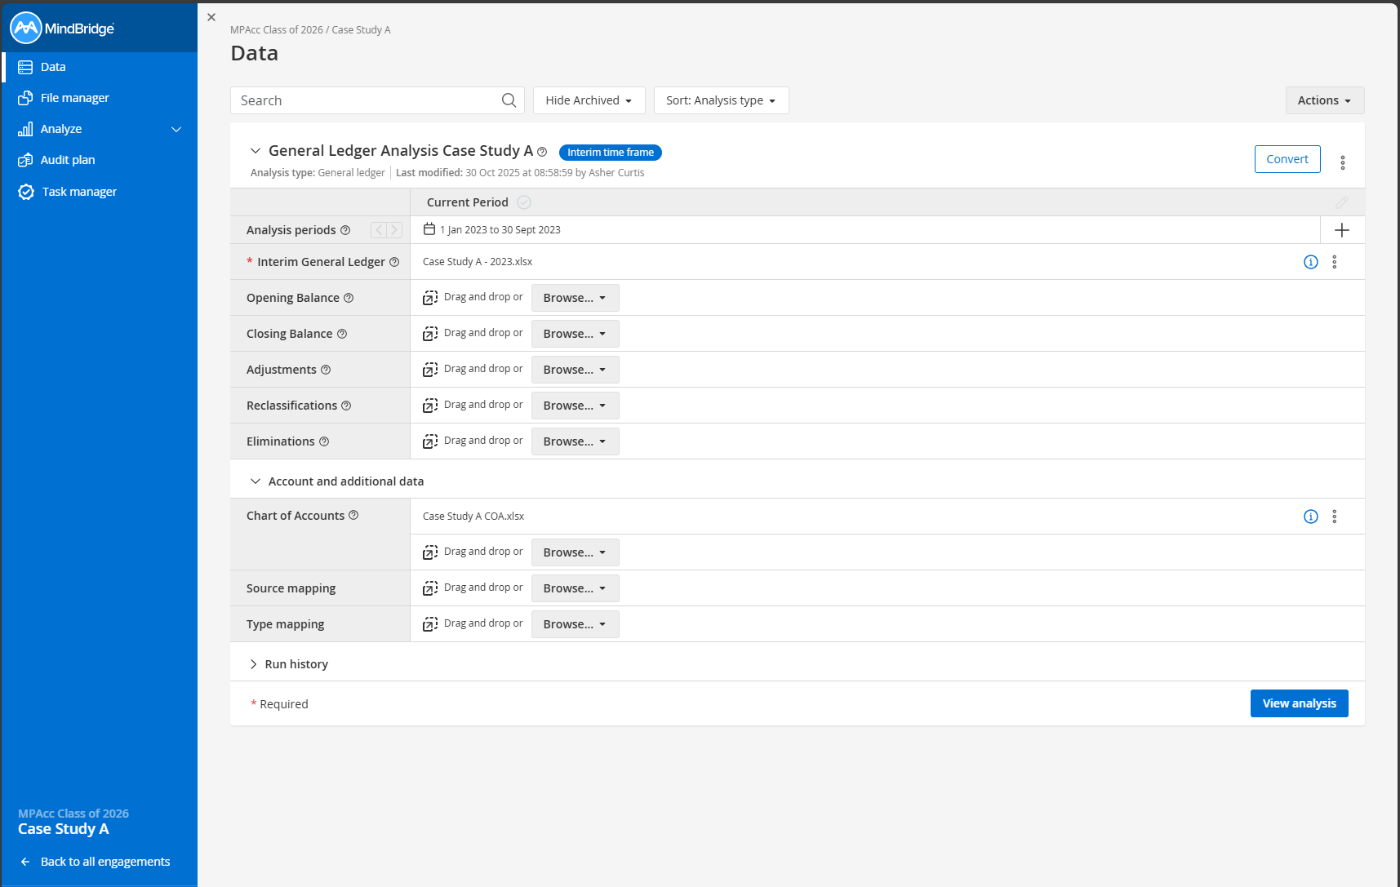
https://uwashington.mindbridge.ai
Mindbridge AI Platform (the software platform where you load the data and perform the audit).
https://university.mindbridge.ai Mindbridge University Platform (where you get the data and case material).

Slide 7
Agenda
Review
Overview: Mindbridge AI
Labs (in discussion teams)
Outline of individual deliverables (Due Nov 6th)
Mindbridge University Cases A, B, and C.
Optional Final Project.

Slide 8
Outline of individual deliverables
Due: Nov 6th
On Mindbridge University: Case Completions (Cases A, B, and C + optional final project).
On Canvas: Short memo outlining potential benefits of this tool.

Slide 9
Labs
Login to Mindbridge University (cloud / not Remote labs)
Note: Access codes in UW email.
Enroll in the short “Getting Started with Mindbridge” course
Work on Case A in discussion teams; Answer questions to complete the case (each case completion is displayed as a badge).
Start Cases B/C if possible depending on time.

Slide 10

Thank you!

