Slide 1
Enron Forensic Email Analysis, Conclusion, and Deliverable
Data Analytics for Professional Accountants (ACCTG 522)
Class 6 | MPAcc Class of 2026

Slide 2
Welcome!
Class Agenda
Case Review: Enron Emails Case
RegEx and DateTime parsing functions
Sentiment Analysis and Phrase Analysis
Case Deliverable Reminder
Case Workflow Overview:
Modifying the Workflow (Capture Individuals of Interest)
Lab Forensic Analysis & Deliverable write-up

Slide 3
Case Review:
Enron Emails Case

Slide 4
Parsing Text using Regex
Our test email:
Message-ID: <25828831.1075855376669.JavaMail.evans@thyme> Date: Mon, 26 Nov 2001 07:25:16 -0800 (PST) From: k..allen@enron.com To: jsmith@austintx.com Subject: RE: Additional properties in San Antonio Jeff, Can you resend the info on the three properties you mailed and the one you faxed on Tuesday. I was out of the office last week. Phillip -----Original Message----- From: "JEFF SMITH" <jsmith@austintx.com>@ENRON Sent: Tuesday, November 20, 2001 3:43 PM To: Allen, Phillip K. Subject: Additional properties in San Antonio Phillip, I am waiting to get info. on two more properties in San Antonio. The broker will be faxing info. on Monday. One is 74 units for $1,900,000, and the other is 24 units for $550,000. Also, I have mailed you info. on three other properties in addition to the 100 unit property that I faxed this AM. Let me know if you have any questions. Jeff Smith The Smith Company 9400 Circle Drive Austin, TX 78736 512-394-0908 office 512-394-0913 fax 512-751-9728 mobile jsmith@austintx.com

Slide 5
Parsing Text using Regex
Unique Key
Our test email:
Message-ID: <25828831.1075855376669.JavaMail.evans@thyme>
Date: Mon, 26 Nov 2001 07:25:16 -0800 (PST)
From: k..allen@enron.com
To: jsmith@austintx.com
Subject: RE: Additional properties in San Antonio Jeff, Can you resend the info on the three properties you mailed and the one you faxed on Tuesday. I was out of the office last week. Phillip -----Original Message----- From: "JEFF SMITH" <jsmith@austintx.com>@ENRON Sent: Tuesday, November 20, 2001 3:43 PM To: Allen, Phillip K. Subject: Additional properties in San Antonio Phillip, I am waiting to get info. on two more properties in San Antonio. The broker will be faxing info. on Monday. One is 74 units for $1,900,000, and the other is 24 units for $550,000. Also, I have mailed you info. on three other properties in addition to the 100 unit property that I faxed this AM. Let me know if you have any questions. Jeff Smith The Smith Company 9400 Circle Drive Austin, TX 78736 512-394-0908 office 512-394-0913 fax 512-751-9728 mobile jsmith@austintx.com
Unstructured data
Key identifier variables

Slide 6
Parsing Text using Regex
Unique Key
Our test email:
Message-ID: <25828831.1075855376669.JavaMail.evans@thyme>
Date: Mon, 26 Nov 2001 07:25:16 -0800 (PST)
From: k..allen@enron.com
To: jsmith@austintx.com
Subject: RE: Additional properties in San Antonio Jeff, Can you resend the info on the three properties you mailed and the one you faxed on Tuesday. I was out of the office last week. Phillip -----Original Message----- From: "JEFF SMITH" <jsmith@austintx.com>@ENRON Sent: Tuesday, November 20, 2001 3:43 PM To: Allen, Phillip K. Subject: Additional properties in San Antonio Phillip, I am waiting to get info. on two more properties in San Antonio. The broker will be faxing info. on Monday. One is 74 units for $1,900,000, and the other is 24 units for $550,000. Also, I have mailed you info. on three other properties in addition to the 100 unit property that I faxed this AM. Let me know if you have any questions. Jeff Smith The Smith Company 9400 Circle Drive Austin, TX 78736 512-394-0908 office 512-394-0913 fax 512-751-9728 mobile jsmith@austintx.com
Unstructured data
What patterns can we use to extract meaning from the Subject/Body of the email (just this email)?
Key identifier variables

Slide 7
What patterns can we use to extract meaning from the Subject/Body of the email (just this email)?
Indicates it is a Reply
Helps us distinguish the reply from the original email
Subject: RE: Additional properties in San Antonio Jeff, Can you resend the info on the three properties you mailed and the one you faxed on Tuesday. I was out of the office last week. Phillip -----Original Message----- From: "JEFF SMITH" <jsmith@austintx.com>@ENRON Sent: Tuesday, November 20, 2001 3:43 PM To: Allen, Phillip K. Subject: Additional properties in San Antonio Phillip, I am waiting to get info. on two more properties in San Antonio. The broker will be faxing info. on Monday. One is 74 units for $1,900,000, and the other is 24 units for $550,000. Also, I have mailed you info. on three other properties in addition to the 100 unit property that I faxed this AM. Let me know if you have any questions. Jeff Smith The Smith Company 9400 Circle Drive Austin, TX 78736 512-394-0908 office 512-394-0913 fax 512-751-9728 mobile jsmith@austintx.com
Various parsable contact details, emails, phone #s
Discussions involving (parsable) cash amounts
And address
As well as specific keywords like “properties” “broker” and phrases like “I was out of the office last week”

Slide 8
RegEx Sensitivities
Sentiment analysis:
We use \<\w+\> (could also use [[:word:]]+) requires correct spelling of each word and a match in the dictionary.
We do match 4,179 words but don’t match 116,959 “words” (with numbers, missing spaces, typos etc)

Slide 9
RegEx Sensitivities
Sentiment analysis:
Alternative is to try and remove all the numbers and other characters and see if there are actual words of interest, e.g.:
010413_Termination

Slide 10
RegEx Sensitivities
Phrases on unstructured text blocks:
We often use .*\s([what we want to capture])\s.*
Which expects zero or more “anything” followed by a space.
My password is:pa55word
versus
My password: pa55word .

Slide 11
Using OR
Another way to make the expressions more robust is to use the or command “|”
(blue|red|yellow)
\.|\s|\(
Password.xyz Password xyz Password(xyz etc

Slide 12
Keyword Sensitivities
When using the join approach (like in our case) Keywords require exact match on wording e.g.,
Keyword = “Fraud” only matches “Fraud” not “Frauds”, “Defraud”, “Fraudulence” or “Fraudulent” or lowercase versions (i.e., it is case sensitive).
Alternative: Use filters and “Contains” formula for fraud or FRAUD and lowercase/uppercase both fields.

Slide 13
Welcome!
Class Agenda
Case Review: Enron Emails Case
RegEx and DateTime parsing functions
Sentiment Analysis and Phrase Analysis
Case Deliverable Reminder
Case Workflow Overview:
Modifying the Workflow (Capture Individuals of Interest)
Lab Forensic Analysis & Deliverable write-up

Slide 14
Welcome!
Class Agenda
Case Review: Enron Emails Case
RegEx and DateTime parsing functions
Sentiment Analysis and Phrase Analysis
Case Deliverable Reminder
Case Workflow Overview:
Modifying the Workflow (Capture Individuals of Interest)
Lab Forensic Analysis & Deliverable write-up

Slide 15
Memo Structure
Interpretation and Recommendations
Explain significance of the findings, widespread evidence? Identifies very targeted group, discuss why the analysis is important.
Conclude with identification of individuals and suggest further investigative steps (e.g., deeper audit of certain users as seen in screenshot /table in the attachments).
Attachments

Slide 16
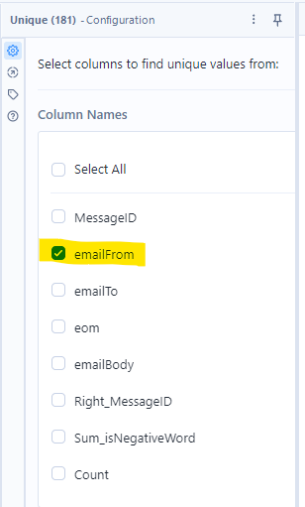
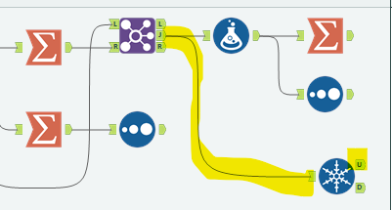
The Unique Tool
Identify the individual email addresses of interest
(“U” node outputs a single Unique value for our list; “D” is the duplicates)

Slide 17
Welcome!
Class Agenda
Case Review: Enron Emails Case
RegEx and DateTime parsing functions
Sentiment Analysis and Phrase Analysis
Case Deliverable Reminder
Case Workflow Overview:
Modifying the Workflow (Capture Individuals of Interest)
Lab Forensic Analysis & Deliverable write-up

Slide 18


Slide 19
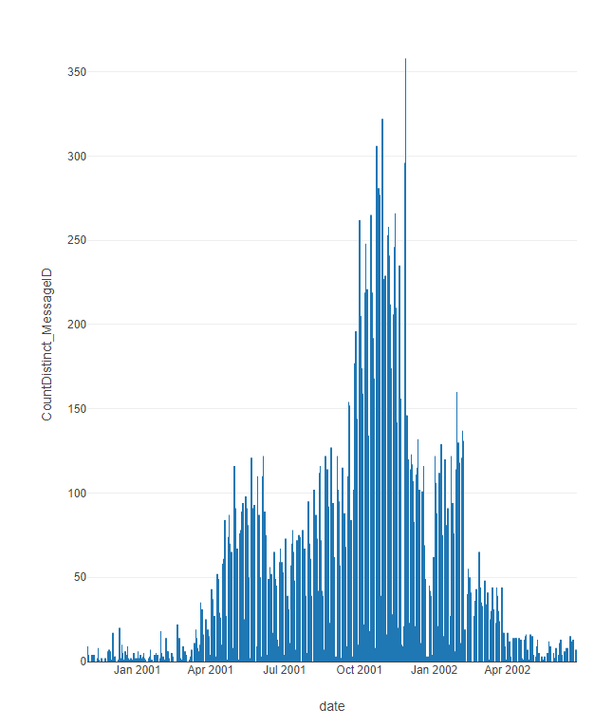
Enron Key Timeline
1999–2000 → Enron at peak: rapid growth, accounting complexity.
Aug 2001 → Skilling resigns, Watkins memo.
Oct 2001 → Massive loss and equity reduction disclosed.
Oct–Nov 2001 → SEC investigation begins.
Nov 2001 → Restatement and Dynegy merger collapse.
Dec 2001 → Bankruptcy (at time biggest ever).
2002 → Andersen indicted and collapses.
2002–2006 → Enron Task Force prosecutes key executives.

Slide 20
Case Deliverable Question
Conduct a forensic review of internal communications from the Enron email corpus. What evidence, if any, points to failures of governance, accountability, or integrity within the organization? Submit a memo and attach supporting exhibits from your analysis.

Slide 21
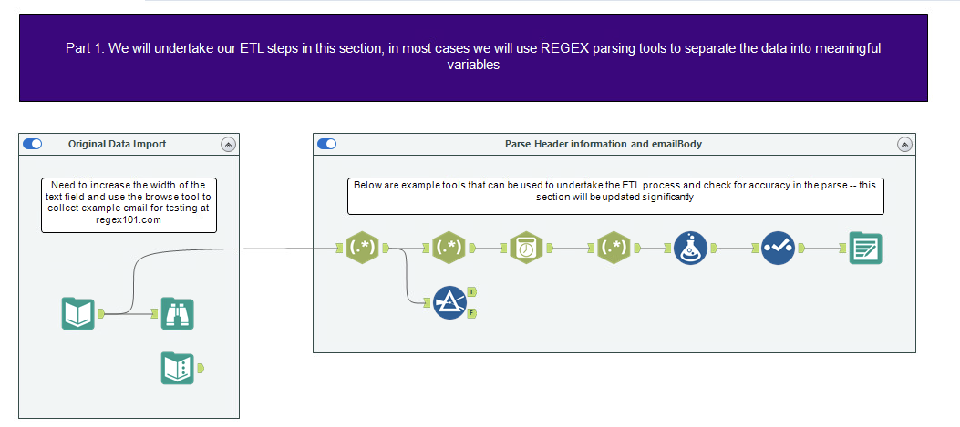
Enron Emails ETL Overview
“Custom” Date-Time Parsing
Additional Formulas
Input data and browse to look at it
Retain and output data we want to keep
Regular Expressions to break apart the text fields
One example email for practice

Slide 22
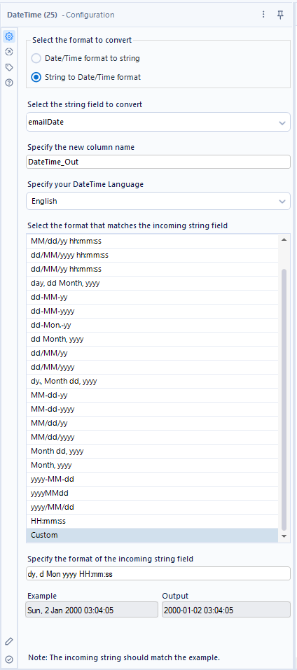

“Custom” Date-Time Parsing
Specifying: dy, d Mon yyyy HH:mm:ss
**Warning: Sometimes this tool will default back to unconfigured, losing the info in Custom. Type in the date format above exactly to have it run correctly.

Slide 23
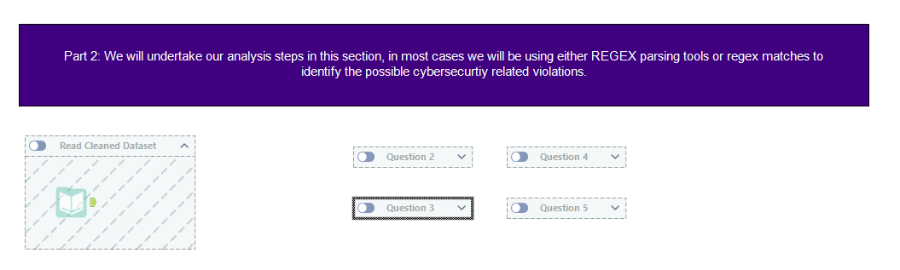

Enron Emails Analysis Overview
Save dataset from part 1 and read it into Alteryx

Slide 24
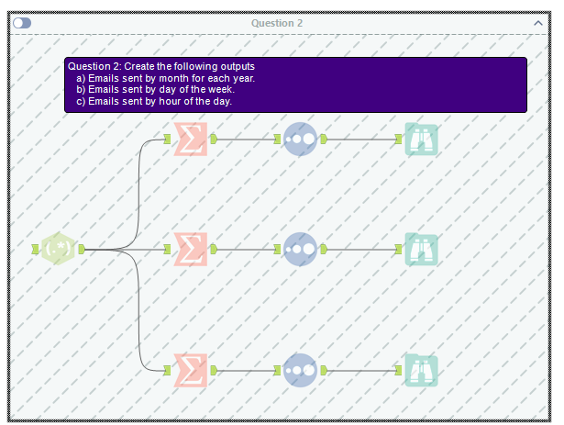
Enron Emails Analysis

Slide 25
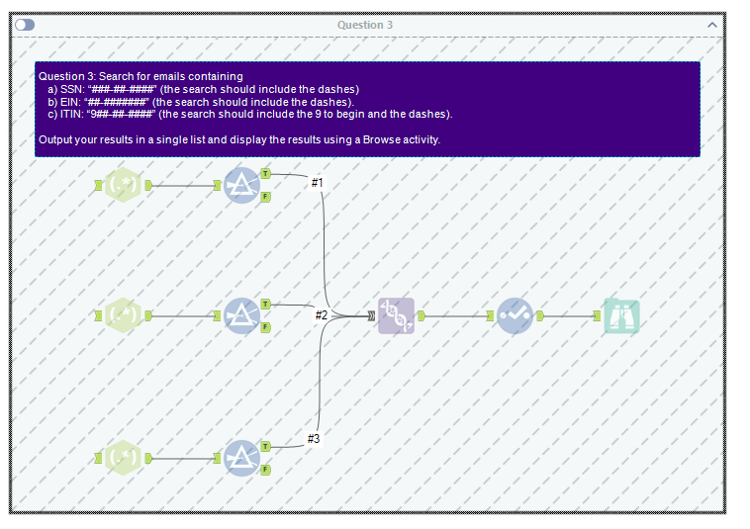
Enron Emails Analysis

Slide 26
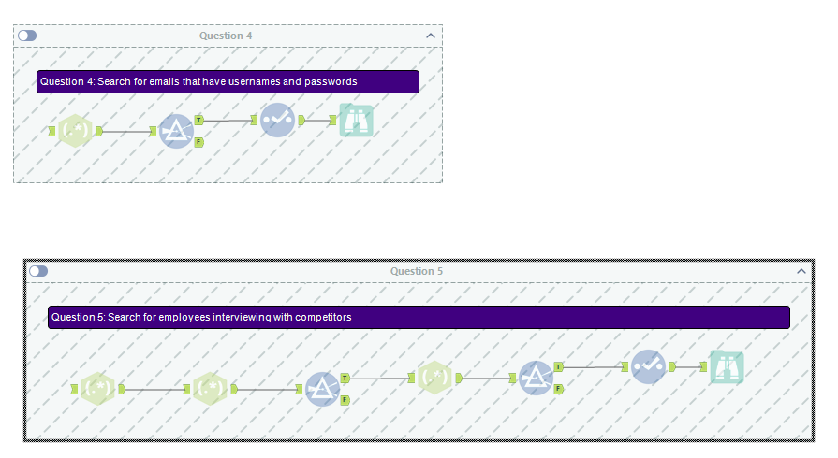
Enron Emails Analysis

Slide 27
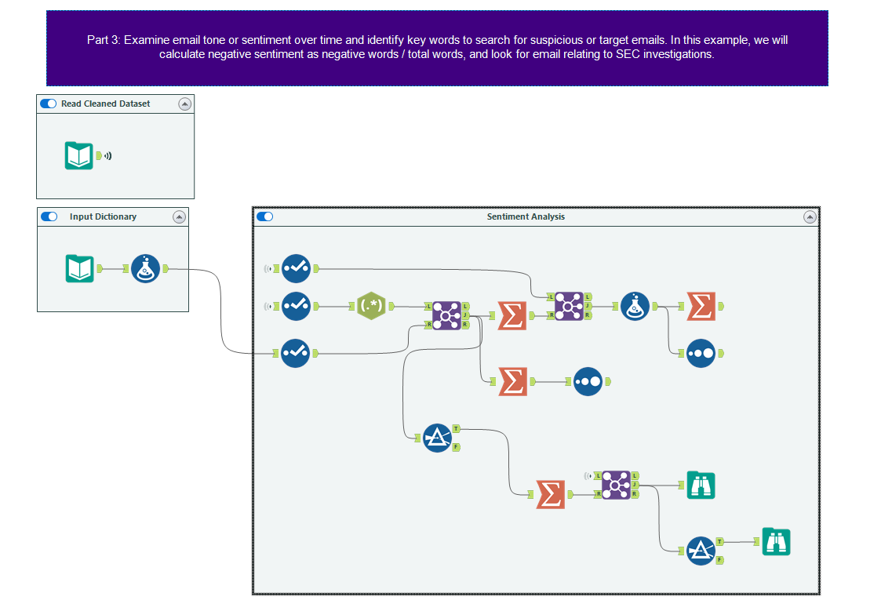
The parsed dataset
Formula tool to transform data for analysis
Extracts individual “words” \<\w+\> with Tokenize
2
Summarize tool used four different ways
1
Dictionary of positive/negative words
Sorting tool
3
Three different joins for different purposes

Slide 28
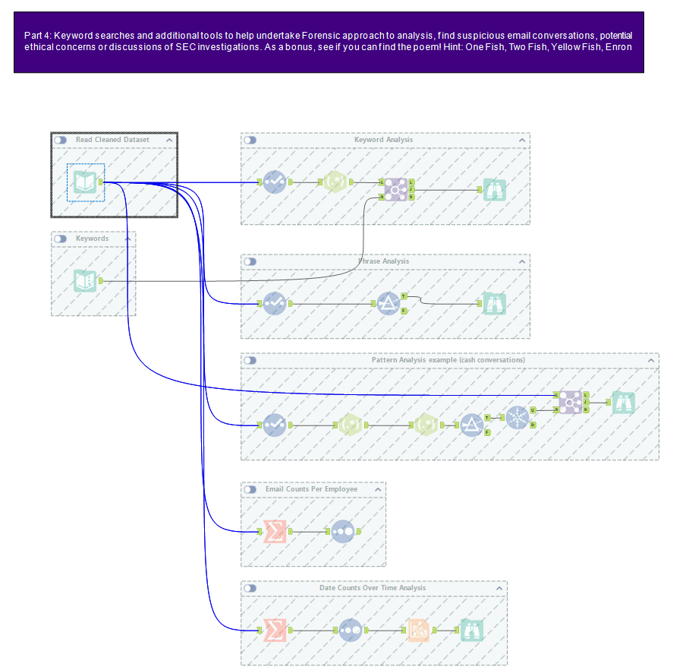
Clean dataset
Keyword Analysis
Editable keywords input
Phrase analysis (i.e., multiple words)
Pattern analysis using RegEx, identify any cash conversations
Base employee analysis (everyone w/ counts)
Base Time Analysis (all dates w/counts)

Slide 29
Conclusion and look-ahead
We have undertaken a sophisticated analysis of unstructured data.
Please submit your case deliverable by Monday.

Slide 30

Thank you!

