Slide 1
Accounting Analytics: Financial Analysis
ACCTG 320
Accounting Systems and Analytics
Class 12 | Autumn | 2026

Slide 2
Agenda
Admin
Review of integrated workflows (SparkEd cases)
Topic and Labs Overview
Conclusion and look ahead

Slide 3
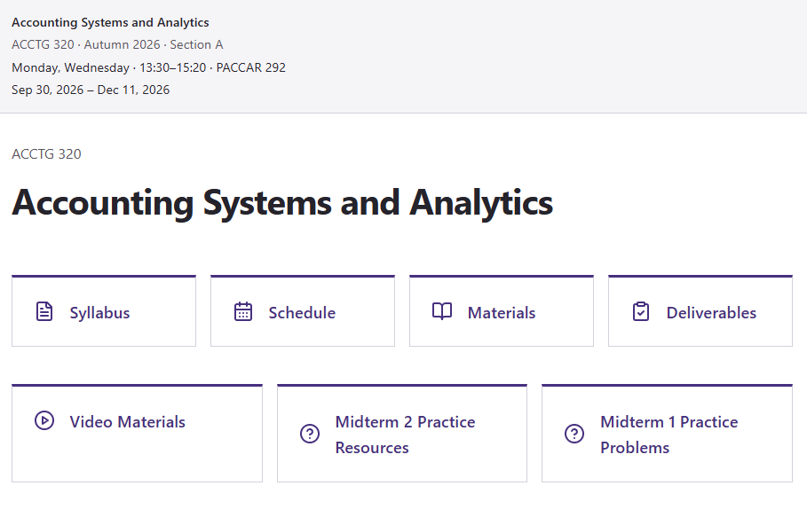
Admin
Coming up:
Midterm 2 (in class, on Foster Remote Labs, 100 Mins)
Individual Case Deliverable 1 (11/17; 11:59pm)
  This class OR an online asynch replacement for Wednesday.

Slide 4


Slide 5

Why Alteryx?
Alteryx brings data preparation and analysis into a visual workflow, allowing us to connect analytical steps in a logical sequence that is easy to follow, check, and repeat.

Slide 6
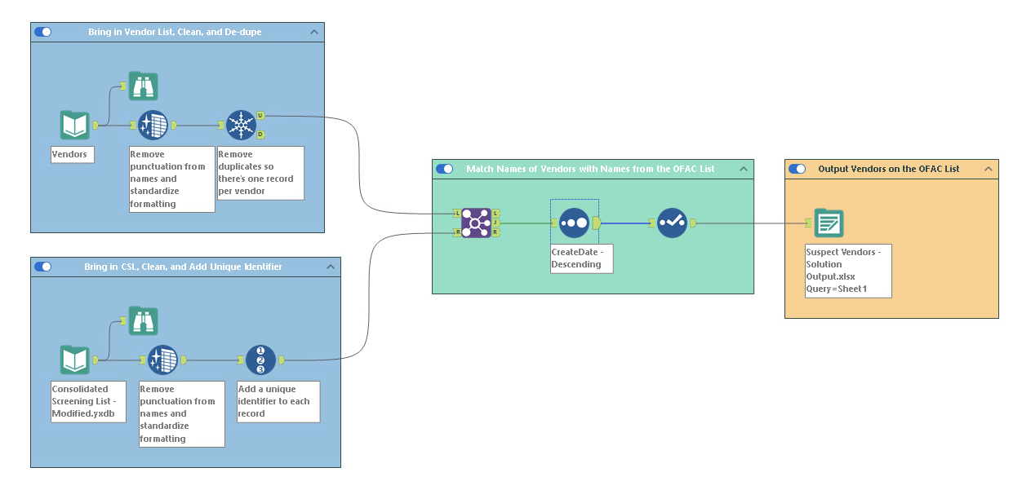
Suspect Vendors
10 Records match

Slide 7
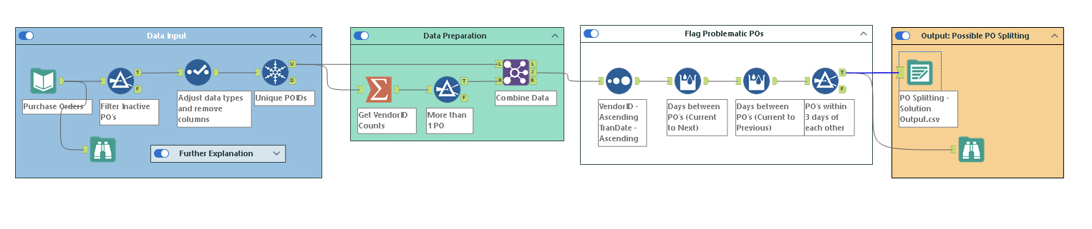
Purchase order splitting
186 records
10 records

Slide 8
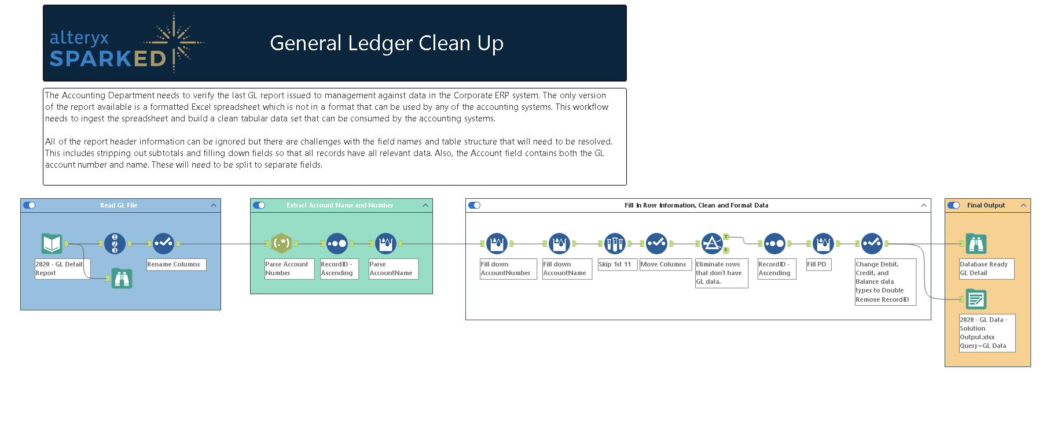
Similar steps with multi-Row Formular Tool
First hurdle, RegEx
Reminder \d is for digits; RegEx wants a pattern for account numbers.
18,806 records

Slide 9
Topic and Labs Overview

Slide 10
Agenda
Admin
Review of integrated workflows (SparkEd cases)
Topic and Labs Overview
Conclusion and look ahead

Slide 11
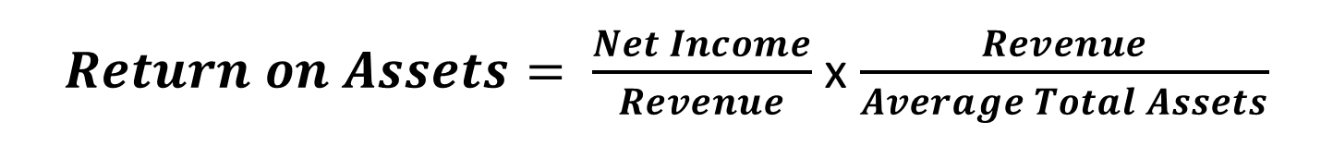
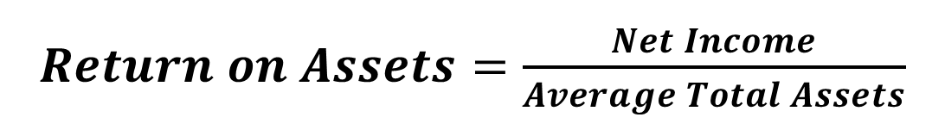
FSA - Ratio Analysis
Ratios: combine accounting information into useful measures
$Return on Assets=\frac{Net Income}{Average Total Assets}$
$Return on Assets= \frac{Net Income}{Revenue}$ x $\frac{Revenue}{Average Total Assets}$
Profit Margin Ratio
Asset Turnover

Slide 12
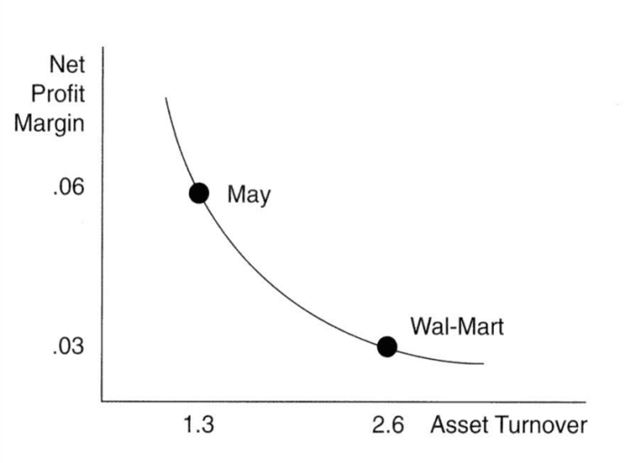
DuPont Analysis
ROA ←→ Firm Strategy
Price differentiator (high margins low turn)
Wholefoods
Grocery
Outlet
Cost leader (low margins high turn)

Slide 13




Example:
ROA: -21%
ROA < 0 → loss making
ROA = 0 → means break-even
ROA > 0 → profitable
ROA: -10%
ROA: +1%
➔Good/Bad?? Depends on your benchmark!
Notes:
“Appropriate” benchmarks are necessary.
Accounting measurement differences.
Accounting classification differences.
One-time events.
Garbage in garbage
Period for ratios is around July 2022
Heuristics
Historical comparisons
Peer / Industry comparisons
Synthetic comparisons

Slide 14
Deliverable 1
Answer the open-ended question: Has Amazon outperformed?
Modify the workflow to examine alternative benchmarks
Visualize the data using Tableau
Record yourself explaining important elements of the workflow and visualization, in 3-5 minutes, the workflow / visuals should be visible on the screen when discussed.
Extension Case: Compare earlier performance with more recent data (available Wednesday)

Slide 15

Lab Overview
What benchmark?
vs.

Slide 16
Lab Overview
Use Alteryx to get our data ready
Use Tableau to perform industry DuPont Analysis

Slide 17
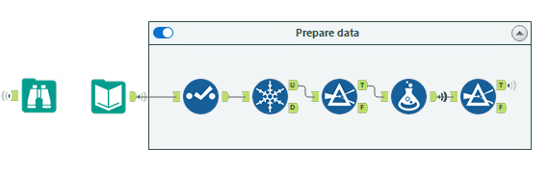
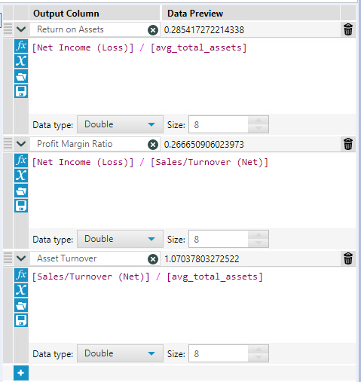
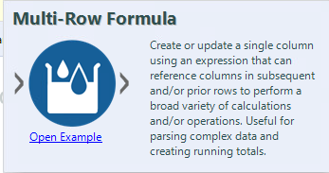
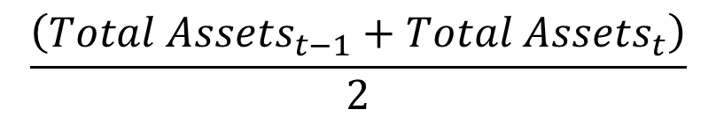
Alteryx ETL:
How can we calculate avg_total_assets??
$$\frac{\left({Total Assets}_{t−1}+{Total Assets}_{t}\right)}{2}$$

Slide 18
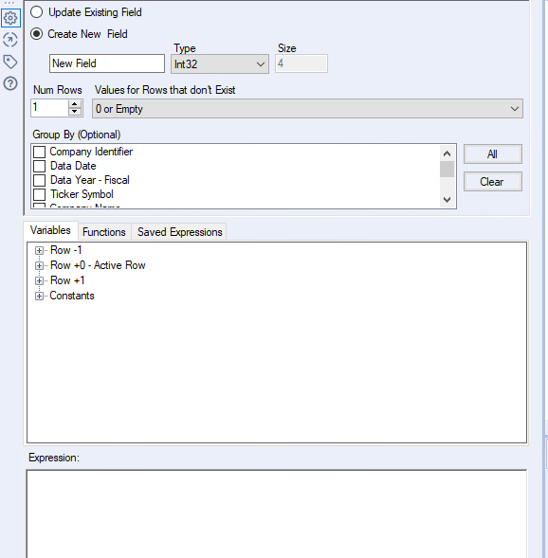
Multi-row formula tool
https://help.alteryx.com/20223/designer/multi-row-formula-tool

Slide 19



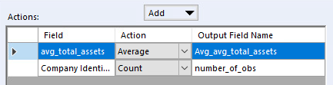
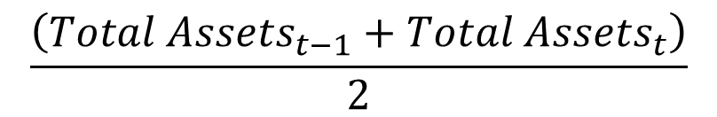
ETL Challenge #1A
Complete these steps:
Calculate the average total assets
Hint:
$$\frac{\left({Total Assets}_{t−1}+{Total Assets}_{t}\right)}{2}$$
Verify:

Slide 20
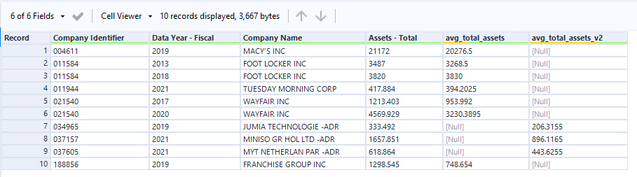
ETL Challenge #1B
There is a problem with our #1a solution….
Check the avg_total_assets calculation for “FOOT LOCKER INC” and identify the error
Figure out an alternative solution to #1A that doesn’t have the problem
Identify the 10 observations with a difference between 1A and 1B:
Verify:

Slide 21
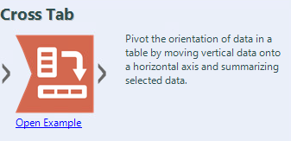
ETL Challenge #2A
Complete these steps:
Use the Cross Tab tool to generate the descriptive table below which shows the sales (turnover) by group and by year:
Objective:

Slide 22
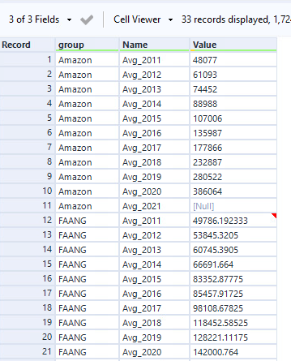
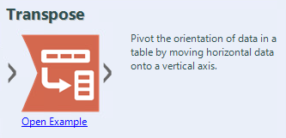
ETL Challenge #2B
Complete these steps:
Use the Transpose tool to convert the Table from 2A into long format
Objective:

Slide 23
Tableau
Notes:
We will establish the importance of the analytical mindset using the model developed for the MPAcc, but can easily be applied to any career path.

Slide 24
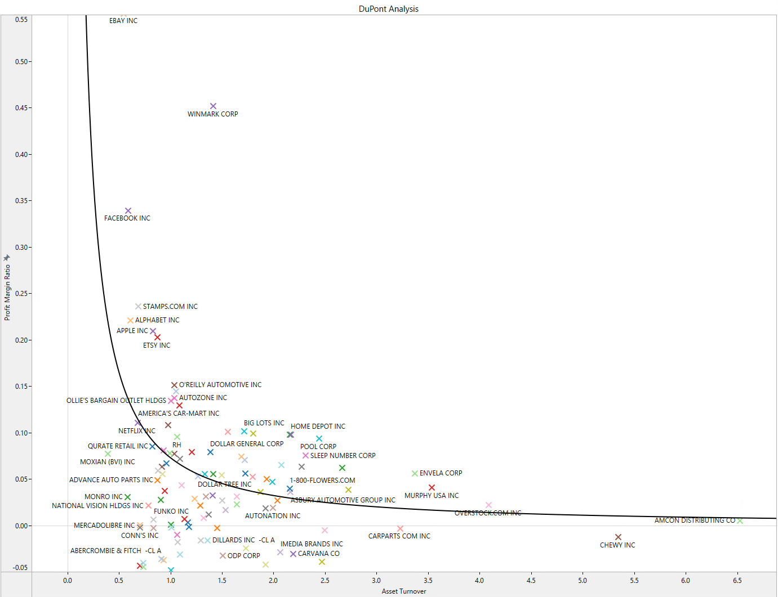
Tableau Challenge #1: Dupont Analysis
Objective:
Notes:
limit to 2020
Constraint Y axis to -0.05 to 0.55

Slide 25
Labs
https://fprod-hcs.foster.uw.edu/

Slide 26
Deliverable 1
Answer the open-ended question: Has Amazon outperformed?
Modify the workflow to examine alternative benchmarks
Visualize the data using Tableau
Record yourself explaining important elements of the workflow and visualization, in 3-5 minutes, the workflow / visuals should be visible on the screen when discussed.
Extension Case: Compare earlier performance with more recent data (available Wednesday)

Slide 27
Next steps
Next topic: Midterm 2 prep and Deliverable 1 conclusion
We will continue to use Alteryx workflows to better understand business problems/decisions
Consider how financial statement analysis can answer specific questions and understand business strategy
Thank you!

