Slide 1
Individual RPA Workshop
Adv. Advisory | ACCTG 528 | Class 09
MPAcc Class of 2026

Slide 2

What will we do today?
Review
Workflows and Logic
Individual RPA Workshop
Add comments
Add activities
Add logging steps

Slide 3
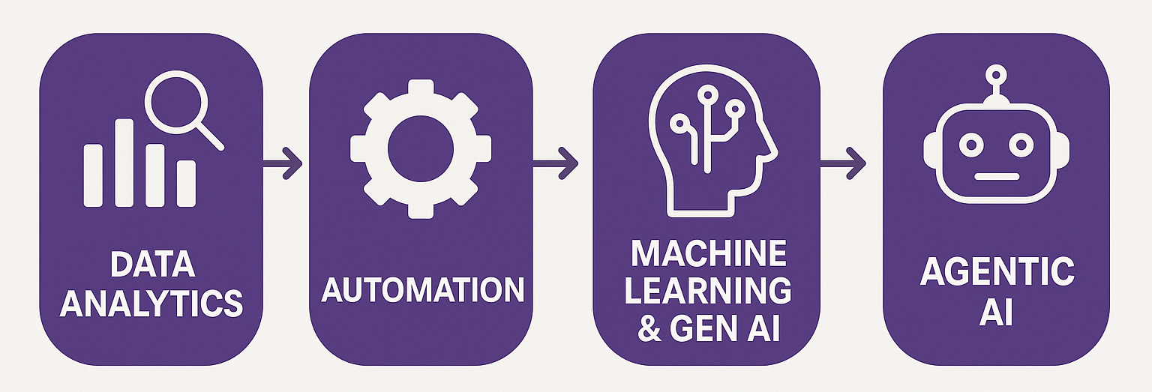
Course Diagram (high-level)

Slide 4











UiPath Agentic Automation
Notes:
Everything happens in one place: the UiPath Platform—where AI Agents aren’t just assistants, they’re true work partners, transforming complexity into a seamless, orchestrated operation.
We break it down into three powerful layers: Activities (the building blocks—reading, processing, integrating), Workflows (connecting the dots with human-in-the-loop and testing), and Processes (the big picture—managing, optimizing, and enhancing enterprise operations).
Agentic Orchestration / Maestro takes automation even further—coordinating UiPath Agents, third-party AI models, people, robots, and tools into a single, intelligent system.
Your existing systems don’t need to be reinvented—our platform integrates seamlessly with your data, applications, and workflows while maintaining enterprise-grade security, governance, and AI trust.
We’re not just compatible with your tech stack—we enhance it. From cloud providers like AWS, Google, and Azure to enterprise apps like Salesforce and SAP, we turn digital chaos into a symphony of efficiency.

Slide 5
Looking ahead
Where do your individual and team projects go next?
Individual:
Appropriate identification rules-based automation
Selection of appropriate automation spectrum model
Team:
Appropriate mix of RPA, Agent, and human in the loop
Selection of best cases for agent decision enhancement

Slide 6
Workflows and Logic
Inputs: Web-scraped data, spreadsheet data
Loops: For each row; CurrentRow(“Header”)
Outputs: Spreadsheet, email
Cleaning steps appear logical
Workflows logical
Need to continue to ID the activities/tools in workflows
Data cleaning in VB (using assign) – Wednesday

Slide 7
What will we do today?
Review
Workflows and Logic
Individual RPA Workshop
Add comments
Add activities
Add logging steps

Slide 8
Individual RPA Workshop
By the end of class, you should be working on your finalized workflow you plan to submit to the Individual RPA Assignment.
Feasibility tested
Logical Workflow
Some to all activities scoped out
Logging started (see example)

Slide 9
Submission checklist
Build your RPA solution in UiPath Cloud Studio Web
Save it as an *.uip or *uis file (the three vertical dot menu next to the solution, choose Download Solution)
Set up Zoom or other video software to record your video. Speak to the bot’s purpose and benefits on camera with you visible, run the bot with screen being captured showing the bot operating.
Discuss any inputs or outputs required for the bot.
Use Efficiency (hours saved) and effectiveness (errors avoided).
Save your video recording locally.
Download copies of anything required to run the bot (inputs etc).
Zip all the files together (UiPath solution file, video, inputs).

Slide 10
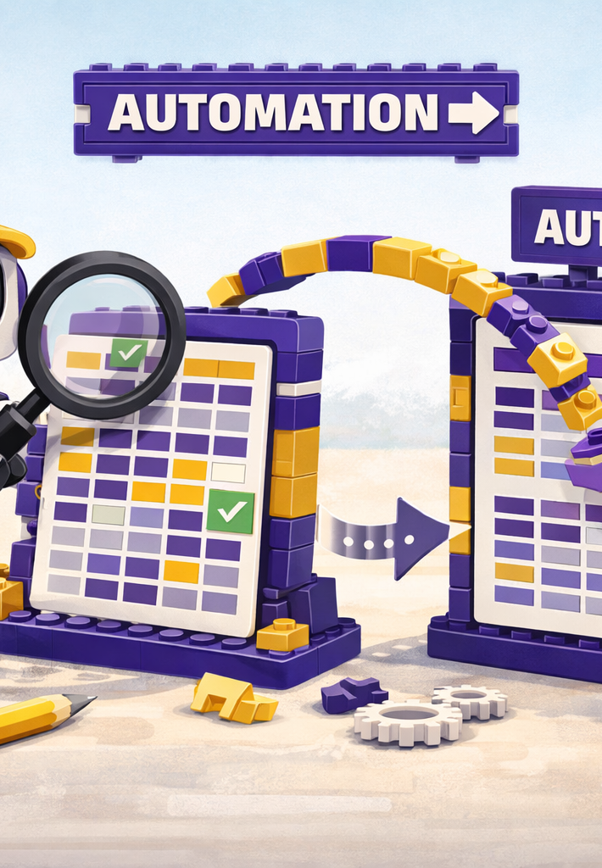
Where we will go next
RPA
Manipulation of files, components
Triggers, Controls, Governance
Costs and benefits of RPA
Agentic
BPMN revision and extension
Tasks for RPA versus Agent
Advanced Prompt Engineering
Scalability

Slide 11
Thank you

