Slide 1
Advanced Analytics and Final Project Workshop
Data Analytics for Professional Accountants (ACCTG 522)
Class 17 | MPAcc Class of 2026

Slide 2
Agenda
Welcome!
Review: Final Project
Goal for today
Final Project Checklist
Final Project Appendices
EDGAR Explorer and Extensions/Helpers
Final Project Workshop:
Teams to work in assessment teams locally/remotely
Finalize any requests

Slide 3
Workshop classes
Goal facilitate completion of the final project.
Class # | ACCTG 522 | ACCTG521
18 | 11/24 Workshop | 11/25 Blockchain (individual)
19 | 11/26 Thanksgiving break | 11/27 Thanksgiving break
20 | 12/2 Workshop | 12/2 Workshop *Audit Plan Deadline
21 | 12/3 Workshop *Final Project Due by 11:59PM | 12/4 Final Presentations
Workshops do not require classroom presence, if teams want to meet remotely or in break out rooms, let me know.

Slide 4
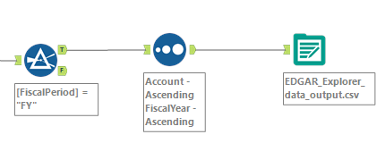
Goals / benchmarking
Today: Goal is to complete ETL for historical data, e.g., in Alteryx:
Before Thanksgiving
Workflow 0. EDGAR Download Workflow
(example in this class)
Workflow 1. An input into a workflow for combining line-items for historical and forecast eVal level of disaggregation
Workflow 2. An input into a workflow for disaggregate forecasting that uses workflow 1 again to combine to eVal level of disaggregation

Slide 5
Checklist
For each item you wish to enhance with data:
Where can I get the data? Is it free? Do I have an API key? Are there restrictions on the data?
Is the ETL easy or difficult to get into eVal? What kind of workflow do I need to use? Will the transpose be easy or difficult?

Slide 6
Checklist
Task | Access to Data? | ETL Comments
Replace eVal historical with EDGAR | EDGAR Explorer / SEC API | Data needs extraction using CFRAME and will need to be transposed to be pasted to eVal Financial Statements Tab
Replace eVal forecasts with Predictive tools based forecasts | Workflow to be developed in Alteryx | Leverages data above, need to better understand predictive tools.

Slide 7
Final Project Templates
Data Source Appendix
Goal: Have a summary Table documenting the sources of data used and where the data was used.

Slide 8
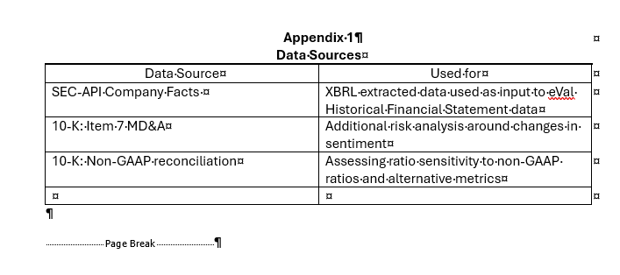

Slide 9
Final Project Templates
Analytics Enhancement Appendix
Goal: Have a summary Table documenting the sources analytical methods used and where in the Financial Statement Analysis they were incorporated.

Slide 10
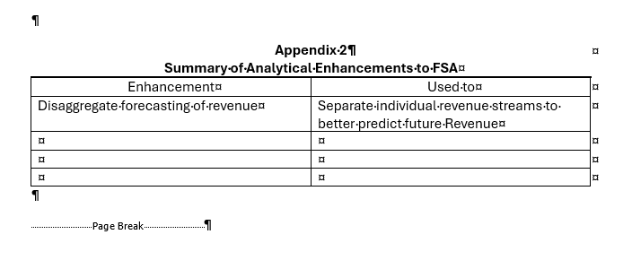

Slide 11
Final Project Templates
XBRL Mapping to eVal
Goal: Have a summary Table documenting the mapping of disaggregated tags to eVal line items.

Slide 12
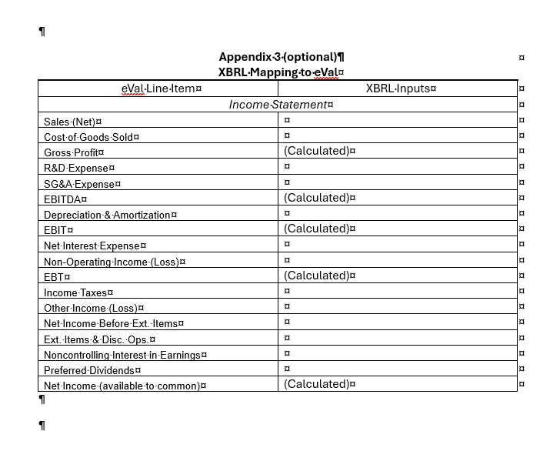

Slide 13
Agenda
Welcome!
Review: Final Project
Goal for today
Final Project Checklist
Final Project Appendices
EDGAR Explorer and Extensions/Helpers
Final Project Workshop:
Teams to work in assessment teams locally/remotely
Finalize any requests

Slide 14
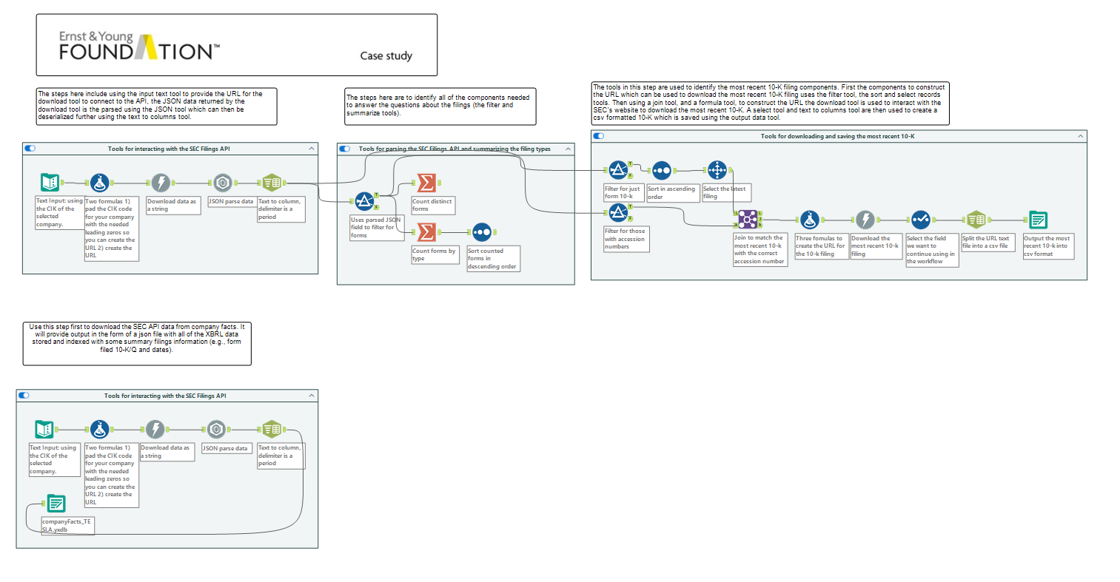
Full text filing (text, tables, XBRL schema and more; includes product/service axis)
JSON file of XBRL (largely numeric)
Usually at the aggregate level (does not include Product/Service Axis)

Slide 15
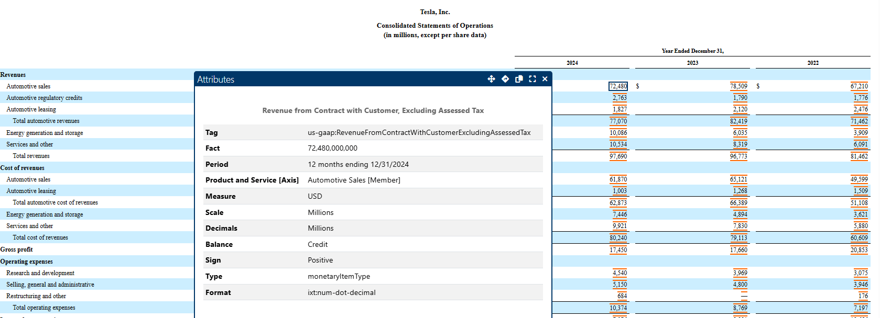
XBRL Tag

Slide 16
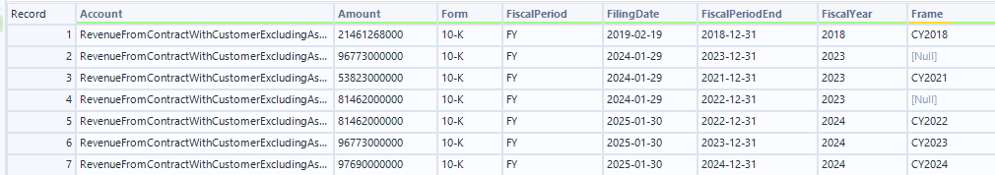
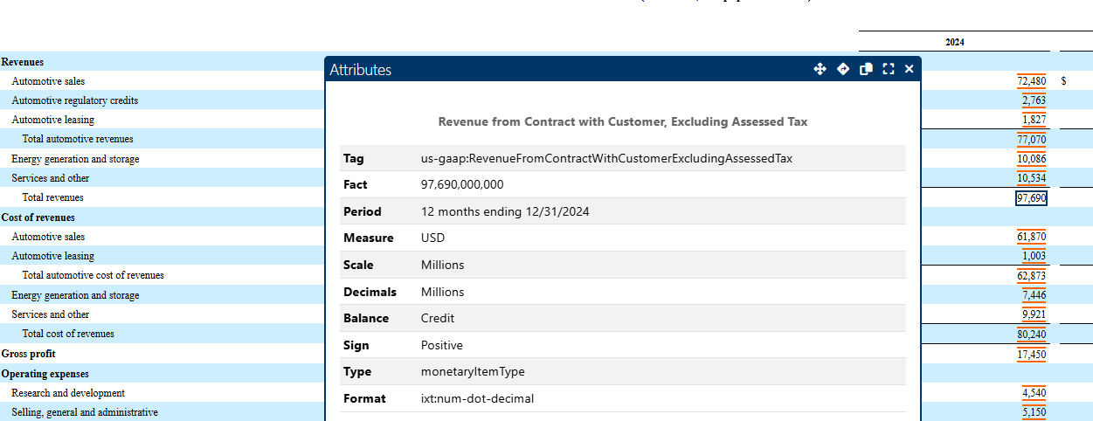
XBRL Tag
Same tag no axis info

Slide 17
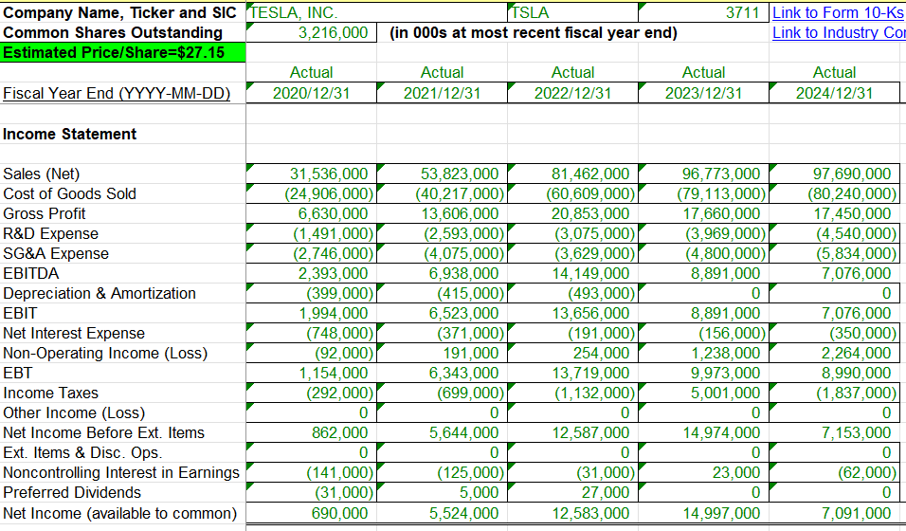
eVal Considerations:
Five years of historical data is the default can ETL more but only paste in 5 years to avoid messing w/ eVal
Look for key missing data or other issues e.g., more important missing data
Less important

Slide 18
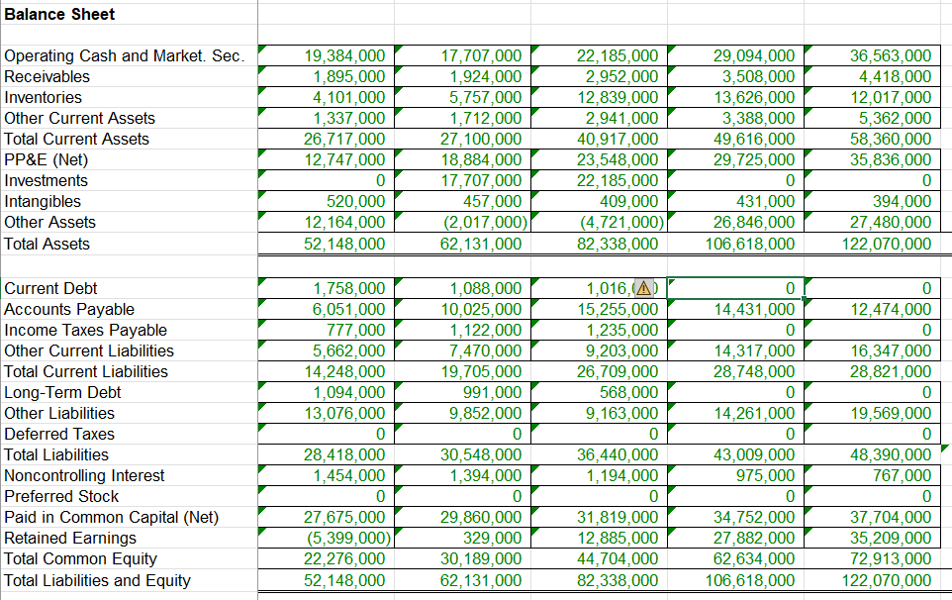
Asset classification and capital structure checks
Other assets is a plug,
e.g., missing investments
Implies Total Debt = 0
Other candidates for missing data (less important)

Slide 19
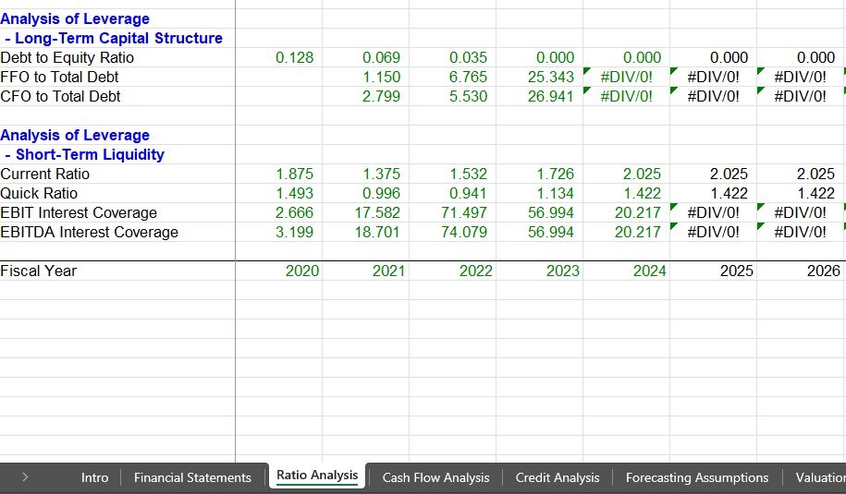
Other red-flags in eVal

Slide 20
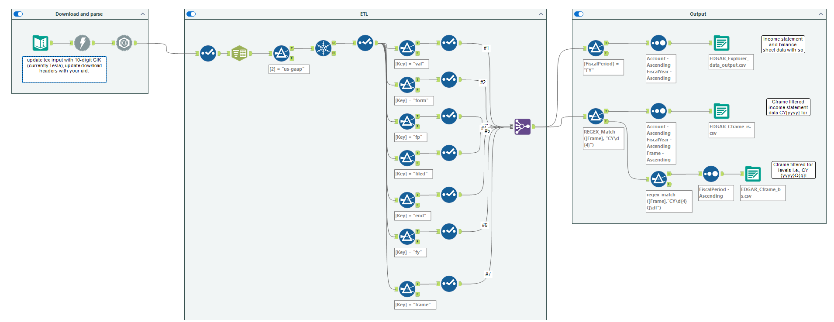
EDGAR Explorer API data Helper

Slide 21
Other helpers/extractions
Hints on extraction from the full filing

Slide 22
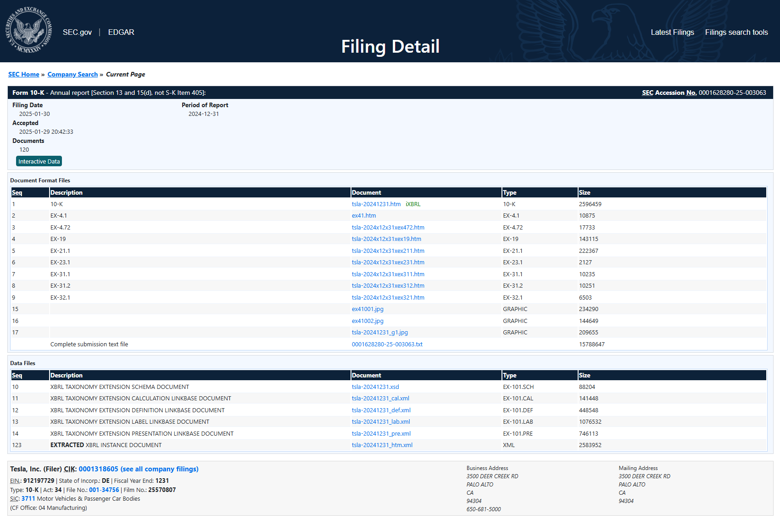
Full text
What we download
Full disaggregate and mappings

Slide 23
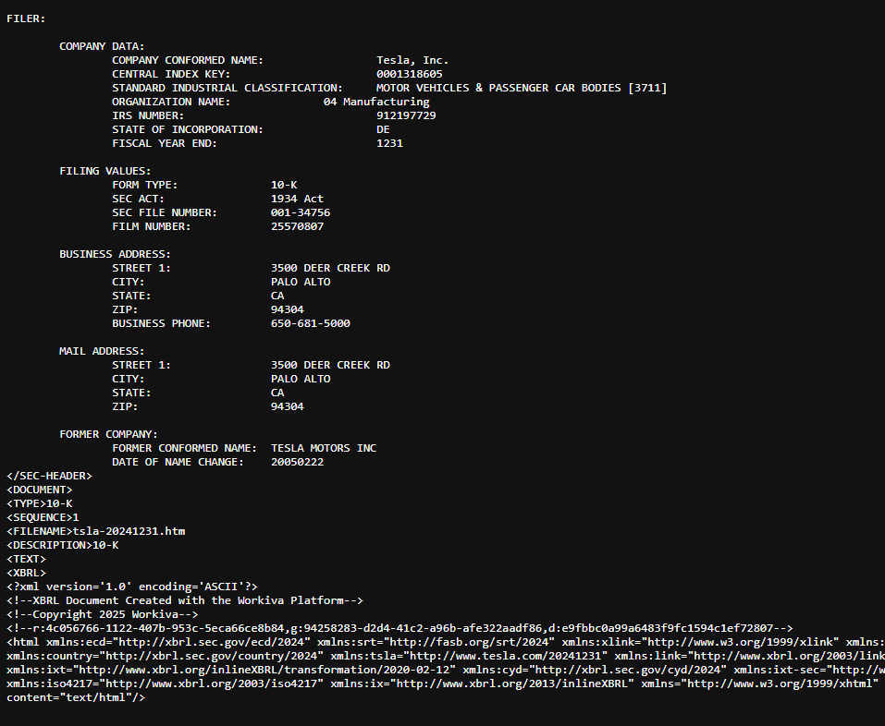
Parse using known tags:
Document, Description, Sequence etc.

Slide 24

Thank you!

